Slide 1
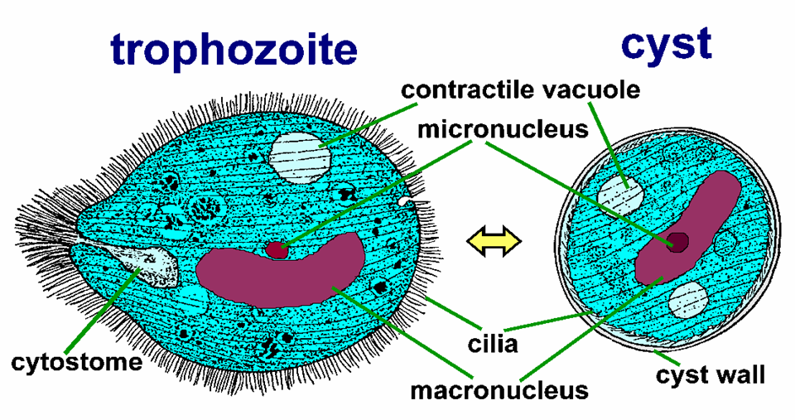
Balantidium coli

Slide 2
A cytosome (cell mouth for phagocytosis) can be seen near the anterior end. Cell also contains food vacuoles which contain debris, bacteria, RBCs, and fragments of host epithelium.

Slide 3
Cysts are spherical.
It contains 1 macro and 1 micronucleus. The cilia disappear after encystment

Slide 4
Life cycle
Definitive hosts are humans including a main reservoir are the pigs and other animals with no intermediate hosts or vectors.
Because pigs are the main animal reservoir (Harmless in pigs), human infections occur more frequently in areas where pigs are raised.
Notes:
Definitive hosts are humans including a main reservoir are the pigs and other animals with no intermediate hosts or vectors. Because pigs are the main animal reservoir (Harmless in pigs), human infections occur more frequently in areas where pigs are raised.

Slide 6
Symptoms
Symptoms include diarrhea, nausea, vomiting and anorexia.
The diarrhea may persist for long periods of time resulting in acute fluid loss and weight loss.

Slide 7
Balantidium coli may penetrate the mucosa.
The incubation period is usually days to weeks after ingestion

Slide 8
Giardia lamblia
Giardia lamblia is a protozoan parasite that colonizes the upper portions of the small intestine.
It is the most common protozoan isolated from human stools.

Slide 9
Morphology
It has two morphological stages:
the trophozoite and
the cyst.

Slide 10
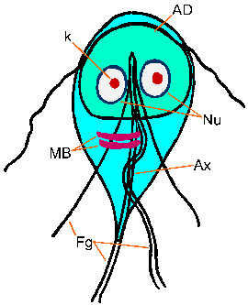
The motile trophozoite
is pear or tear-drop
shaped with
bilateral symmetry.
It is flattened,
with a large sucking disk
on the anterior side.

Slide 11
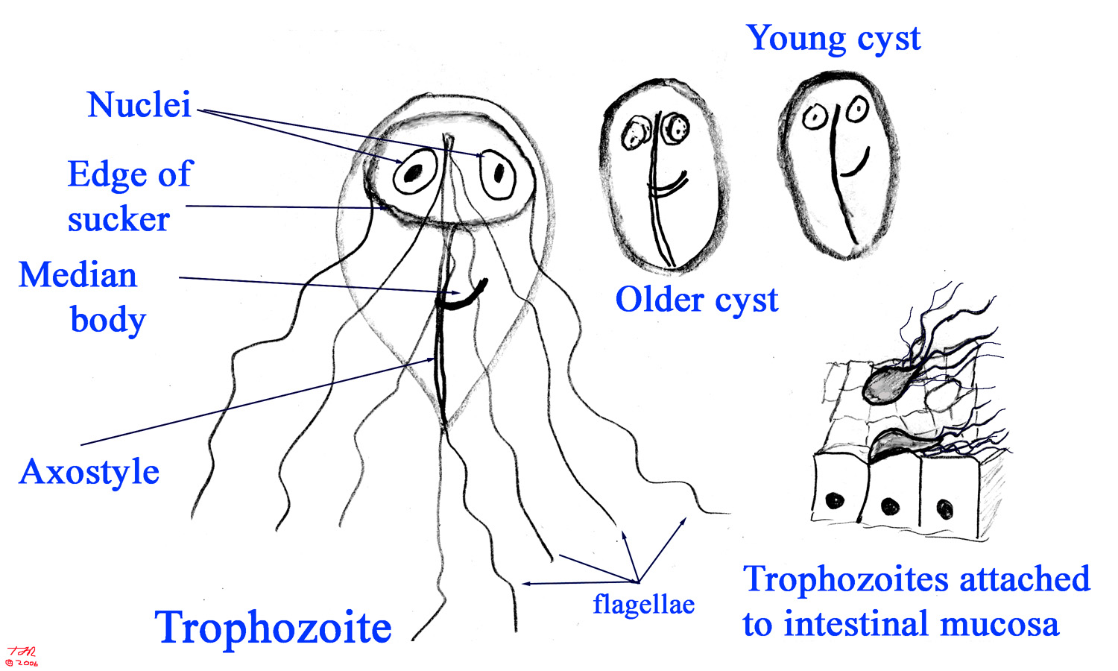
Notes:
It has two morphological stages: the trophozoite and the cyst.
The motile trophozoite is pear or tear-drop shaped with bilateral symmetry.
It is flattened, with a large sucking disk on the anterior side.

Slide 12
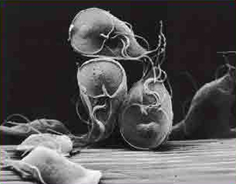
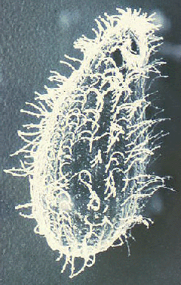
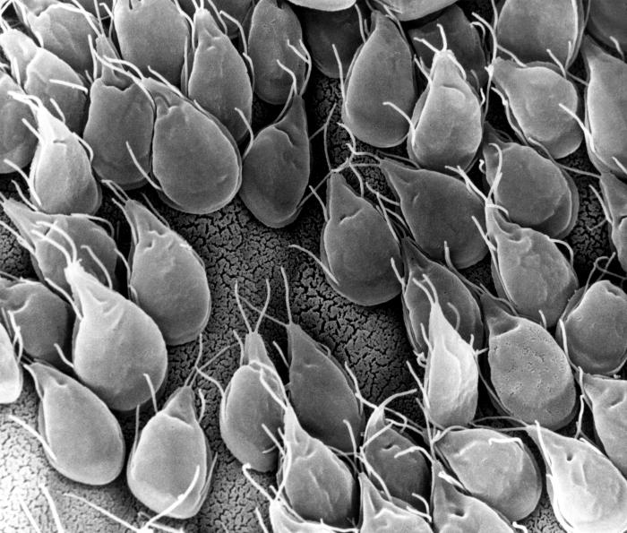

Slide 13
Trophozoite
Sucking disk is the parasite method of attachment to the mucosa of the host.
The trophozoite has two nuclei, two median bodies and four pairs of flagella.

Slide 14
Cyst
Cysts (infectious stage of the parasite) are oval-shaped with a thin wall.

Slide 15
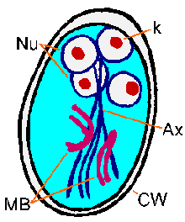
Each cyst contains:
4 nuclei,
4 median bodies,
8 pairs of flagella
produces two
trophozoites upon
excystation.

Slide 16
Cyst
Cysts are resistant to standard concentrations of chlorine used in water treatment
They can persist for several months in cold, moist environment.

Slide 17
Life cycle

Slide 18
Symptoms
Individuals become infected through ingesting from contaminated food, soil, or water.
Acute or chronic diarrhea, dehydration, abdominal pain and weight loss.

Slide 19
Symptoms
The clinical signs of human giardiasis depend on various factors such as:
Duration of infection
The physiological condition of the host
Parasitic factors.
The incubation period is usually 9–15 days.

Slide 20
Trichomonas vaginalis
This protozoan parasitizes in the vagina and urethra, and causes vaginitis, and urethritis. Trichomoniasis vaginalis is prevalent all over the world.

Slide 21
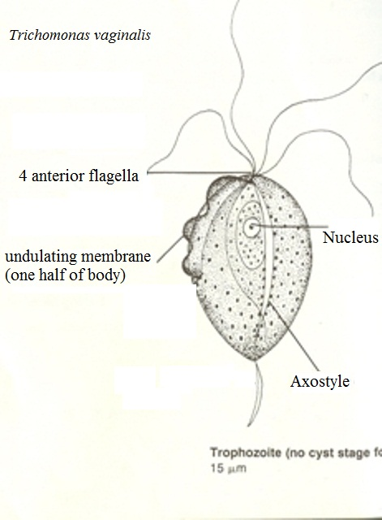
Morphology
Only the trophozoite
stage is found
in its life cycle.
The trophozoite is
ovoid or pear-
shaped.
It has 4 anterior
flagella

Slide 22
and one posterior flagellum which turns back and is attached to the body by an undulating membrane.
The undulating membrane is very short, only one-half of its body length.

Slide 24
Morphology
Internal organelles include a nucleus and a rigid structure, the axostyle that runs through the cell from the anterior end to the posterior end.

Slide 25
Life cycle

Slide 26
Symptoms
In female: itching of the genital area, inflammation, vaginal discharge.
In male: asymptomatic, but in some, urethritis may occur, causing frequency of urination or dysuria (painful urination).
Incubation period is 4 to 28 days

Slide 27
Thank you

