Slide 1
Practical Analytical chemistry
Natural products Practical
1st Stage
Environmental Department
Dr. Hazha Omer Othman
MSc. Suzan Salahaddin Taha

Slide 2
Name of experiment
Prepare of licorice extract by decoction method

Slide 3
Decoction method
In this method we place the plant material in a container then a add the solvent and place the container on a source of heat then agitating until active compound will dissolve in the solvent.
This method is usually used for hard plant material like barks, stems and roots, which contain a lot of fibers .
The solvent used depends on the active compound and source of heats, for example chloroform and ether can not be used because we use a direct source of heat .

Slide 4
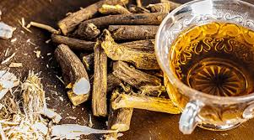
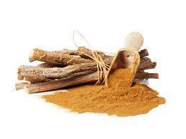
Licorice root

Slide 5
Produce
1- cut the root in a small amount of licorice roots
3- Place the roots in the flask and add 100ml of water and then boil it for 25 min .
4- filtered by using filter paper

