Slide 1
General chemistry
1st Stage
Physical Department
Dr. Suzan Salahaddin Taha

Slide 2
Chemistry sciences are classified into main branches
Analytical Chemistry
Organic Chemistry
Inorganic Chemistry
Physical Chemistry
Biochemistry
Industrial Chemistry

Slide 3
Is the study of the separation, identification, and quantification of the chemical components. It is applied throughout industry, medicine and all the sciences. The separation of components is often performed before to analysis.

Slide 4
Quantitative analysis: amount of each substance in a sample.
Qualitative analysis: identity of the elements and compounds in a sample.

Slide 5
Analytical Methods
Classical Methods: Wet chemical methods such as precipitation, extraction, distillation, boiling or melting points, gravimetric and titrimetric measurements.
Instrumental Methods: Analytical measurements (conductivity, electrode potential, light absorption or emission, mass-to-charge ratio, fluorescence etc.) are made using instrumentation.

Slide 6
Types of Instrumental Methods
1. Spectroscopic methods:
2. Chromatographic methods
3. Electrochemistry

Slide 7
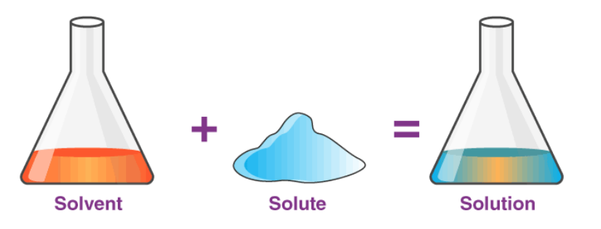
A SOLUTION is a mixture of two or more substances in a single phase.
The substance in the smallest amount and the one that dissolves is called the SOLUTE.
The substance in the larger amount is called the SOLVENT.
solubility refers to the ability of a solute to dissolve in a solvent.

Slide 9
Solutions are classified into the following types based on the amount of solute in the given solvent
Saturated solution: A saturated solution is a solution in which the solvent has dissolved as much solute as it can at a particular temperature and pressure.
Unsaturated solution : is a solution in which the solvent has not dissolved as much solute at a given temperature and pressure.
Supersaturated solution: is a solution that contains more solute than it would typically hold at a given temperature and pressure.

Slide 10
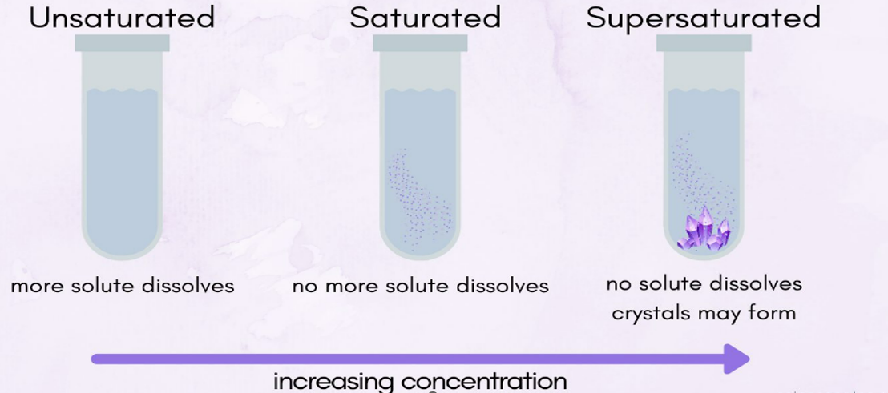

Slide 11
Aqueous Solutions contain water as the solvent, such as salt water, sugar water.
Non-Aqueous Solutions do not contain water as the solvent. The solvent could be other liquids such as ether, benzene . such as naphthalene in benzene.

Slide 12
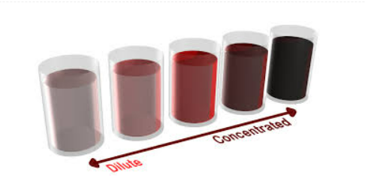
Concentrated Solutions: a large amount of solute in a small amount of solvent
Dilute Solutions: a small amount of solute in a large amount of solvent.

Slide 13
depending on the physical states of solute and solvent, we can classify solutions into different types.

Slide 14
1-Gaseous Solutions:
The solubility of one gas in the other such as He and O₂ forming an uniform gaseous solution.
2-Liquid Solutions:
Prepared from dissolving of Solid, Liquid, and Gaseous martials in a liquid, such as Sugar molecule in H2O.

Slide 15
3-Solid Solutions:
Prepared from random dispersion of solid materials through each other, such as Cu and Zn alloy.

Slide 16
Why Solutions Occurs?
Example1: mixture of H2O and R-OH together forms a solution, why?
Energy accepted from attraction forces of H2O—R-OH
is enough to break the bonds between H2O—H2O and R-OH—R-OH:
E H2O—R-OH ˃˃ E H2O—H2O ˃˃ E R-OH—R-OH
(Note: E = Energy)

Slide 17
Example 2: Mixture of gasoline (C₈H₁₈) and H₂O together does not forms a solution, because the energy need was not enough and the attraction between gasoline and H₂O molecules are very weak.
E H2O—gasoline˃˃ E H2O—H2O ˃˃E gasoline—gasoline

Slide 18
1- Preparation of solutions from Solid substances:
A) Molarity:
Molarity (M): Number of moles in one liter of solution, expressed as M. Unit (mol/L)
M = (no. of mole of solute) / (volume of solution by liter)
M = mole / Vol. (L)
or
M = (no. of mmole solute) / (volume of solution by milliliter)
M = mmole / Vol. (mL)
and:
no. mole = wt. of solute (g) / M.Wt. (g/mol)
Therefore: M = [Wt. (g)] / [M.Wt. (g/mol) × Vol. (L)]
Or: M = [Wt. (g) × 1000] / [M.Wt. (g/mol) × Vol. (mL)]
Wt. = M x V (mL) x M.Wt. (g/mol) / 1000

Slide 19
Example:
Q/ Prepare 2 litre of 0.1M from Na₂CO₃ ?
• Request: How many grams of Na₂CO₃ is needed and dissolving in 2 liter of water to obtaining 0.1M Na₂CO₃?
Molarity = 0.1 M
Number of mole = M * Vol.(L) =0.1 × 2 = 0.2 mole Na₂CO₃ in 2 liter of solution.
no. of mole = Wt. (g) / M.Wt. (g/mol).
Wt. g = no. of mole × M.Wt.
Wt. of Na₂CO₃ (g) = 0.2 × [(2×23) + (1×12) + (3×16)] = 21.2 g which is required to dissolve in 2 litre of water to obtain 0.1M Na₂CO₃ in this volume (2L).
OR
Wt.(gm) = M x V (ml) x M. Wt. (gm/mol) / 1000
Wt. = 0.1 x 2000 ml x 106 / 1000 = 21.2 g which is required to dissolve in 2 litre of water to obtain 0.1M Na₂CO₃ in this volume (2L).

Slide 20
2-Preparation of solutions from Liquids:
Preparation of solutions from concentrated liquids:
This process was done by two steps:
First step: calculation of molar concentration of concentrated solution (bottle).
Second step: dilution process.
(M₁ * V₁) concentrated = (M₂ * V₂) diluted
M₁: From first step
V₁: Unknown
M₂: Needed molarity (concentration)
V₂: Required volume

Slide 21
Ex.1. Prepare 250ml of 2M HNO₃ from the traditional solution. The information on the bottle: 69%(w/w) HNO₃ , specific gravity 1.42 g/ml, formula weight 63 g/mole.
First step:
M = [(69/100) × (1.42) × 1000] / [(1×1)+(1×14)+(3×16)]
M = [(0.69)×(1.42)×1000] / [63]
M = 15.55 mol/L
Second step: dilution
(M₁ V₁) concentrated = (M₂ V₂) diluted
15.55 × V₁ = 2 × 250
V₁ = (2×250) / 15.55
V₁ = 32.15 mL

Slide 22
Ex.2. Describe the preparation of 750 mL of 6.00 M H₃PO₄ from the commercial reagent that is 86% H₃PO₄ (W/W) and has a specific gravity of 1.71.
Ex.3. Describe the preparation of 500 mL of 0.0750 M AgNO₃ from the solid reagent.
Ex.4. Describe the preparation of 1.00 L of 0.285 M HCI, starting with a 6.00 M solution of the reagent.
Ex.5. Describe the preparation of 2.00 L of 0.120 M HCIO₄ from the commercial reagent [71.0% HCIO₄ (w/w), sp gr 1.67].
A.Wt.:
(H=1 , C=12 , N=14 , O=16 , Na=23 , P=31 , S=32 , Cl=35.5 , Ca=40 , Cu=63.5 , Ag=107.9 , Ba=137.3) g/mol

