Slide 1
INTERNATIONAL CLASSIFICATION OF VIRUSES
1)Primary characteristics
Viruses are classified according to the nature of their genome and their structure.
A) Nucleic acid
1- RNA or DNA
2- Single strand or double-stranded
3- Non-Segmented or Segmented
4- Linear or Circular
5- If the genome is ssRNA, can it function as mRNA?
B) Virion structure
1- Symmetry (Icosahedral, Helical, Complex)
2- Enveloped or not enveloped.
2)Secondary characteristics
Replication strategy: Sometimes a group of viruses that seems to be a single group by the above criteria is found to contain a subgroup of viruses which have a fundamentally different replication strategy - in this case the group will be divided based on the mode of replication.

Slide 4
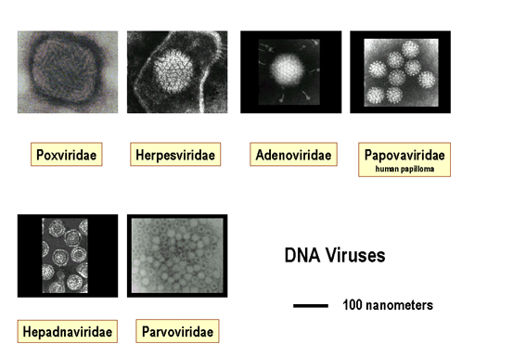

Slide 5
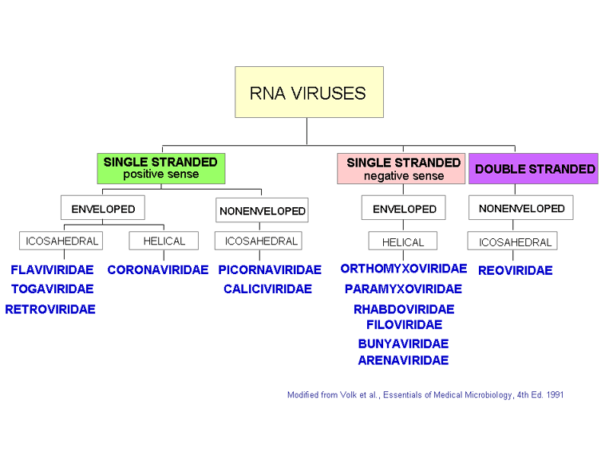

Slide 6
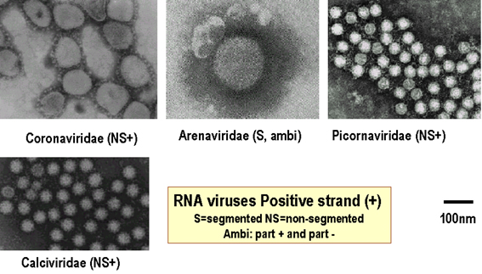

Slide 7
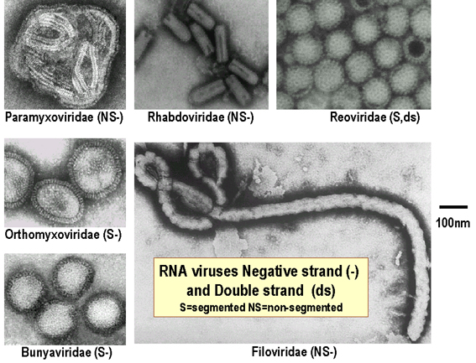

Slide 8
REPLICATION OF THE VIRUSES
Virus multiply only in living cells. The host cell must provide the energy and synthetic machinery and the precursors for the synthesis of viral protein and nucleic acids.
Eclipse period, after interaction with a host cell, the infecting virion is disrupted and its infectivity is lost and its duration varies depending on both the particular virus and the host cell
After the synthesis of the viral nucleic and viral proteins, the components assemble to form new infectious virion. The yield of infectious virus per cell ranges from modest numbers(50000) to more than 100000 particles. The duration of the virus replication cycle varies from 6-8 hours (picorna v.) to more than 40 hours (some herpes v.)

Slide 9
General Step in Viral Replication Cycles:
General out line of the replication cycles is similar although details vary from group to group.
1- Attachment, Penetration, and Uncoating.
The first step in viral infection is attachment, interaction of a virion with a specific receptor site on the surface of the host cell.
Receptor molecules are generally glycoprotein. In some cases viruses bind protein receptors (e.g. picorna virus) and in others oligosaccharides receptor (e.g. Orthomyxo virus and Paramyxo virus). HIV virus binds to the CD4 receptor on cells of immune system and Epstein-Barr virus recognizes the CD21 receptor on B cells. The presence or absent of receptor play important role in viral pathogenesis.

Slide 10
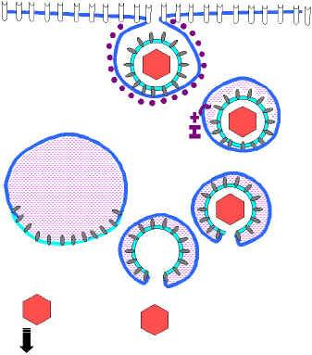
After binding, the virus particle is taken up inside the cell. This step is referred to as penetration or engulfment. In some system, this is accomplished by:
A- Receptor mediated endocytosis, is an efficient and probably the most common mechanism of virus entry in to cell depending on concentrating extracellular macromolecules.

Slide 11
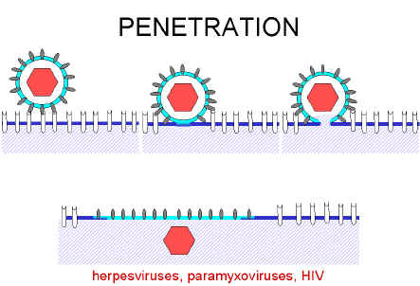
B- Translocation: enteric virus particle across the cytoplasmic membrane of the cell and it must be mediated by protein in virus capsid and specific membrane receptor.
C- Fusion of the virus envelope with cell membrane of the host. Fusion requires fusion protein in the virus envelope e.g. influenza haemagglutinin.This protein promote joining of cellular and virus membranes which results in nucleocapsid being deposited directly in the cytoplasm.

Slide 12
Uncoating: occurs shortly after penetration. Uncoating is the physical separation of the viral nucleic acid from the capsid.The genome may be released as free nucleic acid (picorna virus) or as a nucleocapsid (Reovirus).
2- Expression of viral genomes and synthesis of viral components.
The essential in viral replication is the specific mRNA which must be transcribed from the viral nucleic acid for successful expression and duplication of genetic information. Once this accomplished, viruses use cell components to translate the mRNA.
In the course of viral replication, those involving dsDNA viruses early viral proteins are synthesized soon after infection and late proteins are made only late in infection in contrast RNA viruses is expressed at the same time.
DNA viruses that replicate in the nucleus generally use host cell DNA and RNA polymerase and processing enzymes. The larger viruses (Herpes v., Pox v.) are more independent of cellular function than smaller viruses. This is one of the reason that larger virus more susceptible to antiviral chemotherapy, because more virus specific processes are available as targets for drug action.

Slide 13
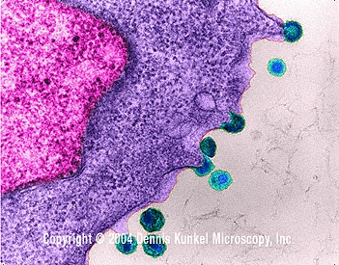
3- Assembly and Release
Newly synthesized viral genomes and capsid polypeptides assemble together to form progeny viruses. There are no special mechanisms for the release of non envelope viruses, the infected cells eventually lyses and release the virus particles. Enveloped viruses mature by a budding process.
HIV budding from human lymph tissue (TEM)

Slide 14
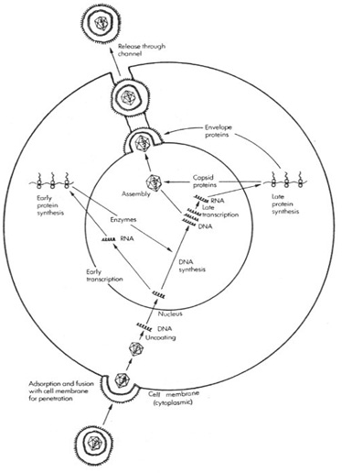

Slide 15
EFFECT OF VIRUSES ON HOST MACROMOLECULAR SYNTHESIS
Cytopathic effect (CPE). The presence of the virus often gives rise to morphological changes in the host cell. Any detectable changes in the host cell due to infection are known as a cytopathic effect.
Cytopathic effects (CPE) may consist of cell rounding, disorientation, swelling or shrinking, death, detachment from the surface, etc.
Many viruses induce apoptosis (programmed cell death) in infected cells. This can be an important part of the host cell defense against a virus - cell death before the completion of the viral replication cycle may limit the number of progeny and the spread of infection. (Some viruses delay or prevent apoptosis - thus giving themselves a chance to replicate more virions.)
Some viruses affect the regulation of expression of the host cell genes which this can have important results both for the virus's ability to grow, and in terms of the effect on the host cell.
The cytopathic effects produced by different viruses depend on the virus and the cells on which it is grown. This can be used in the clinical virology laboratory to aid in identification of a virus isolate.

Slide 16
Assays for plaque-forming units The CPE effect can be used to quantitate infectious virus particles by the plaque-forming unit assay. Cells are grown on a flat surface until they form a monolayer of cells covering a plastic bottle or dish. They are then infected with the virus. The liquid growth medium is replaced with a semi-solid one so that any virus particles produced as the result of an infection cannot move far from the site of their production. A plaque is produced when a virus particle infects a cell, replicates, and then kills that cell. Surrounding cells are infected by the newly replicated virus and they too are killed. This process may repeat several times. The cells are then stained with a dye which stains only living cells. The dead cells in the plaque do not stain and appear as unstained areas on a colored background. Each plaque is the result of infection of one cell by one virus followed by replication and spreading of that virus. However, viruses that do not kill cells may not produce plaques. Assays for viruses Some methods (e.g. electron-microscopy) enable every virion to be counted but are not informative about infectivity. Other methods (e.g. hemagglutination) are a less sensitive measure of how much virus is present, but again are not informative about infectivity. Other methods, e.g. plaque assay, measure the number of infectious virus particles.

Slide 17
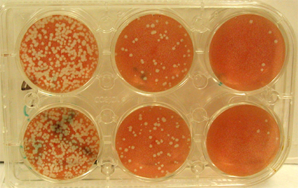
Figure 5. A plaque assay. Serial dilutions of virus have been plated on confluent monolayer cultures of cells. The cells are stained after a period of time in which a single virus infects a cell, produces new virus particles and infects surrounding cells. The white areas show areas of the culture in which the cells have been killed. Each "plaque" is the result of the presence of one original infectious virus particle.

Slide 18
RNA virus that do not have a DNA phase.
1- Positive Strand-RNA viruses: Genomic RNA is the same as mRNA immediately upon infection of the host cell e.g. Polio, Toga, and Flavi.
2- Negative Strand-RNA viruses: Genomic RNA is negative sense (complementary to mRNA) and must therefore be copied into the plus-sense mRNA before protein can be made, thus needed to RNA dependent RNA polymerase e.g. Influenza v., Measles v., and Rabies v.
3- dsRNA: Genomic RNA is double stranded so cannot function as mRNA need for RNA polymerase to make their mRNA e.g. Reo v., and Rotavirus.
4- RNA viruses which copy their RNA in to DNA: These are retroviruses in this case genomic RNA although plus-sense not function as mRNA on infection since its not released from the capsid in to the cytoplasm. instead, it serves as a template for reverse transcriptase and is copied in to DNA. Reverse transcriptase and is not available in the cell, and so these viruses need to code for this enzyme and package it in virion.

