Slide 1
Immunoglobulins classes
Antibodies (also known as immunoglobulins,Ig)
Immunoglobulins are glycoprotein molecules that are produced by plasma cells in response to an immunogen and which function as antibodies.
Antibodies are grouped into different isotypes based on which heavy chain they possess. Five different antibody isotypes are known in mammals IgA, IgM,IgG, IgE, IgD.

Slide 2
They are typically made of basic structural units—each with
*two large heavy chains and
*two small light chains to form monomers with one unit, dimers with two units or pentamers with five units

Slide 3
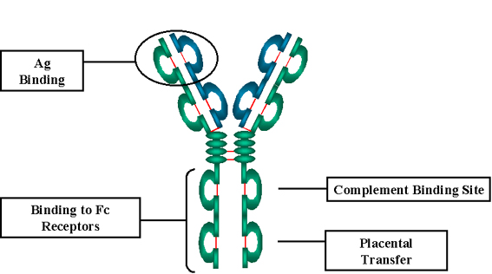
GENERAL FUNCTIONS OF IMMUNOGLOBULINS
-Antigen binding
-Fixation of complement
-Binding to various cell types through Fc receptor- Phagocytic cells, lymphocytes, platelets, mast cells, and basophils.
-Bind to receptors on placental trophoblasts (to transfer across the placenta).

Slide 4
BASIC STRUCTURE OF IMMUNOGLOBULINS
The basic structure of the immunoglobulins is are built from the same basic units.
Heavy and Light Chains: 2 identical light chains (23kD) & 2 identical heavy chains (50-70kD)
B. Disulfide bonds: Inter-chain disulfide bonds & Intra-chain disulfide binds.
C. Variable (V) and Constant (C) Regions
heavy and light chain could be divided into two regions based on variability in the amino acid sequences
1. Light Chain - V_{L} (110 amino acids) and C_{L} (110 amino acids)
2. Heavy Chain - V_{H} (110 amino acids) and C_{H} (330-440 amino acids)

Slide 5
D. Hinge Region
This is the region at which the arms of the antibody molecule forms a Y. It is called the hinge region because there is some flexibility in the molecule at this point.
E. Domains
Three dimensional images of the immunoglobulin molecule show that it is not straight but, it is folded into globular regions each of which contains an intra-chain disulfide bond These regions are called domains.
1. Light Chain Domains - V_{L} and C_{L}
2. Heavy Chain Domains - V_{H}, C_{H1} - C_{H3} (or C_{H4})
F. Oligosaccharides
Carbohydrates are attached to the C_{H2} domain in most immunoglobulins. However, in some cases carbohydrates may also be attached at other locations.

Slide 6
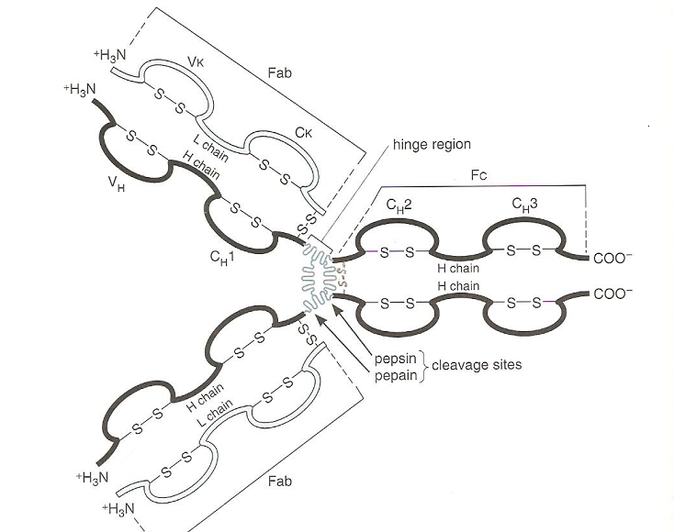
Heavy and Light Chains, Disulfide bonds, Variable (V) and Constant (C) Regions, Hinge Region, Domains, Oligosaccharides

Slide 7
Immunoglobulin classes
The immunoglobulins can be divided into five different classes, based on differences in the amino acid sequences in the constant region of the heavy chains
1. IgG - Gamma heavy chains
2. IgM - Mu heavy chains
3. IgA - Alpha heavy chains
4. IgD - Delta heavy chains
5. IgE - Epsilon heavy chains

Slide 8
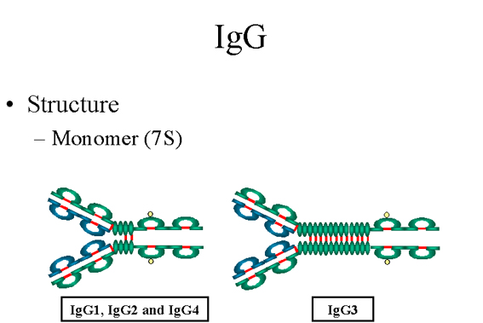
STRUCTURE AND SOME PROPERTIES OF IG CLASSES AND SUBCLASSES A. IgG
Structure
All IgG's (IgG1, IgG2, IgG3, and IgG4) are monomers. The subclasses differ in the number of disulfide bonds and length of the hinge region.

Slide 9
2. Properties
IgG is the most common immunoglobulin because it is capable of carrying out all of the functions of immunoglobulin molecules.
IgG is the major Ig in serum - 75% of serum Ig is IgG
IgG is the major Ig in extra vascular spaces
c) Placental transfer - IgG is the only class of Ig that crosses the placenta. Not all subclasses cross equally well; IgG2 does not cross well.
d) Fixes complement - Not all subclasses fix equally well; IgG4 does not fix complement
e) Binding to cells - Macrophages, monocytes, PMNs and some lymphocytes have Fc receptors for the Fc region of IgG. Not all subclasses bind equally well; IgG2 and IgG4 do not bind to Fc receptors. (internalize the antigen better).

Slide 10
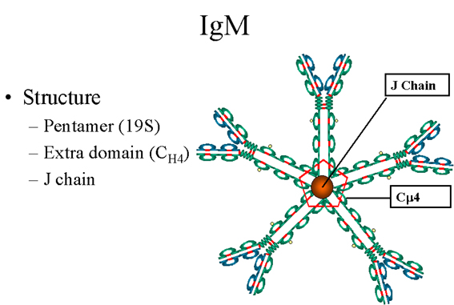
B. IgM
Structure
IgM normally exists as a pentamer but it can also exist as a monomer. IgM has an extra domain on the mu chain (C_{H4}) and it has another protein called the J chain. This chain functions in polymerization of the molecule into a pentamer.

Slide 11
2. Properties
a) IgM is the third most common serum Ig.
b) IgM is the first Ig to be made by the fetus and the first Ig to be made by a virgin B cells when it is stimulated by antigen.
c) As a consequence of its pentameric structure, IgM is a good complement fixing Ig. Thus, IgM antibodies are very efficient in leading to the lysis of microorganisms.
d) As a consequence of its structure, IgM is also a good agglutinating Ig . Thus, IgM antibodies are very good in clumping microorganisms for eventual elimination from the body.
e) IgM binds to some cells via Fc receptors.

Slide 12
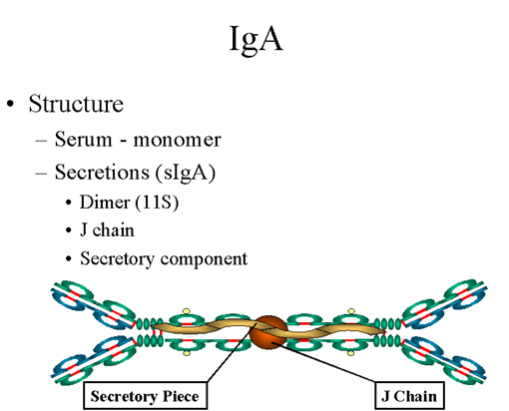
C. IgA
Structure
Serum IgA is a monomer but IgA found in secretions is a dimer as. When IgA exits as a dimer, a J chain is associated with it.

Slide 13
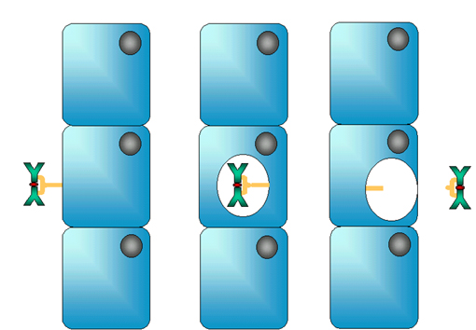
When IgA is found in secretions is also has another protein associated with it called the secretory piece ; Unlike the remainder of the IgA which is made in the plasma cell, the secretory piece is made in epithelial cells and is added to the IgA as it passes into the secretions. The secretory piece helps IgA to be transported across mucosa and also protects it from degradation in the secretions.

Slide 14
Properties
a) IgA is the 2nd most common serum Ig.
b) IgA is the major class of Ig in secretions - tears, saliva, mucus. Since it is found in secretions secretory IgA is important in local (mucosal) immunity.
c) Normally IgA does not fix complement, unless aggregated.
d) IgA can binding to some cells - PMN's and some lymphocytes.

Slide 15
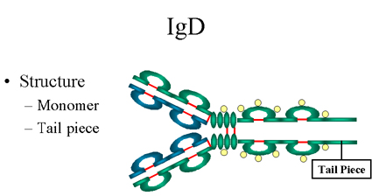
D. IgD
Structure
IgD exists only as a monomer.
Properties
a) IgD is found in low levels in serum; its role in serum uncertain.
b) IgD is primarily found on B cell surfaces where it functions as a receptor for antigen. IgD on the surface of B cells has extra amino acids at C-terminal end for anchoring to the membrane.
c) IgD does not bind complement.

Slide 16
E. IgE
Structure
IgE exists as a monomer and has an extra
domain in the constant region.
Properties
a) IgE is the least common serum Ig since it binds very tightly to Fc receptors on basophils and mast cells even before interacting with antigen.
b) Involved in allergic reactions - As a consequence of its binding to basophils an mast cells, IgE is involved in allergic reactions. Binding of the allergen to the IgE on the cells results in the release of various pharmacological mediators that result in allergic symptoms.
c) IgE also plays a role in parasitic helminth diseases. Since serum IgE levels rise in parasitic diseases, measuring IgE levels is helpful in diagnosing parasitic infections. Eosinophils have Fc receptors for IgE and binding of eosinophils to IgE-coated helminths results in killing of the parasite.
d) IgE does not fix complement.

Slide 17
Immune response
Is a complex and regulated sequence of events involving several cell types. Its triggered when an Ag enter the body and encounters a specialized class of APCs. These cells capture the Ag and processed in a form that can be recognized by helper T lymphocyte, the helper T cells activated and promote the activation of B-cells or cytotoxic T cells. The activated lymphocytes proliferate and carry out their specific function(inactivate or eliminate the Ag).
At each stage in this process, the lymphocytes and APCs communicate with one another through direct or by secreting regulatory cytokines.

Slide 18
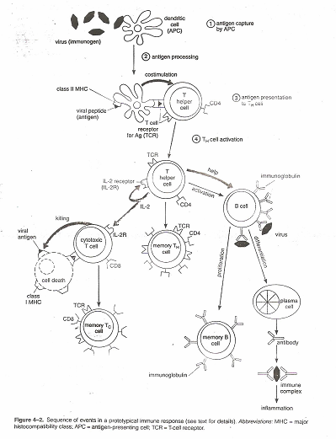

Slide 19
When a person exposed to Ag B-cell response and concentration of serum Ab against that Ag rise this is divided into several phase.
1- Lag phase: time between intial exposure to immunogen and appear of Ab in the circulating which average 1 week in human.
2- Exponential phase: is rapid increase in quality of circulating Ab
3- Steady-State: Ab level remains constant because secretion and degradation is in equal rates.
4- Decling-phase: Ab level decline(no new plasma cell produced and existing plasma cell are dying).
This kind of immune response is weak, short-lived and called primary immune response. subsequent encounters with same immunogen lead to response similar to primary but lag period is short and Ab level rise more rapidly (because of presence of primary memory T and B cells) to much higher level and the steady-state level remaining in the same for much longer periods.

