Slide 1
Starting lessons
Dr. Tahsin H. rassul
2022-2023

Slide 2
Starting Lessons
2

Slide 3
Starting Lessons & Courses
Ice-breaker activities
They are frequently presented in the form of a game to “warm up” a group by helping the members to get to know each other. They often focus on sharing information such as names, personal facts, hobbies, etc.
3

Slide 4
Starting Lessons & Courses
Warmer/ Warm-up Activities
A warm up in teaching (also known as a warmer) is an activity at the beginning of class that's designed to warm up the learners. For example, students may have to talk with a partner about a certain topic, review something from the previous class or watch a short video and talk about it.
Warm-up activities are an excellent way to begin class because they ease students back into using English again.
Principles:
Go at the beginning of the class
Focus students’ attention
Help students begin to work
Should be interesting and an enjoyable activity
Be short
(E.g: Chain Spelling English Warm Up or Picture Prompt)
4

Slide 5
Starting Lessons & Courses
Lead-in activities
A good lead-in is a key factor for successful teaching. It can initiate students’ thinking and arouse their desire for knowledge, serving as a magnet to draw students into the lesson and help students get a clear idea of what they are going to learn.
Principles:
Used to introduce a topic, generate interest
Focus students’ minds on the topic
Can be used to check and pre-teach some necessary language for the following activities
Always connected to main focus of the lesson
Should be relevant, interesting, and brief
multimedia, dialogues, and storytelling techniques
5

Slide 6
Assignment
Task for Sunday:
Groups of 4-5 should design the following:
2 lead-in activities
A warmer activity
An icebreaker
You have to demonstrate them in class if you are asked to
The activities should be creative and engaging
Not extracted from the pamphlet.
After designing them in groups, submit them before next lecture starts.
The activities should be typed and submitted to:
tahsin.rassul@su.edu.krd
6

Slide 7
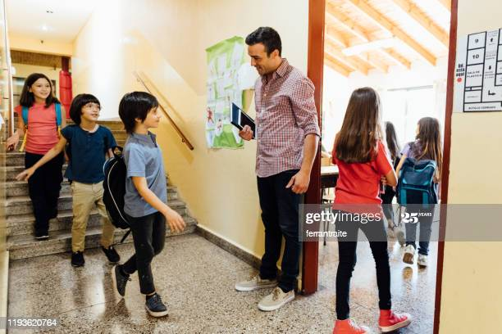
Starting Lessons & Courses
Techniques to start your lessons:
Gatekeeper
Don’t wait for the right time
for the “lesson to start”
7

Slide 8
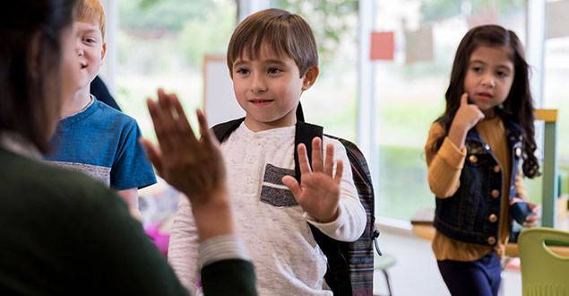
Starting Lessons & Courses
Techniques to start your lessons:
Greet individually
8

Slide 9
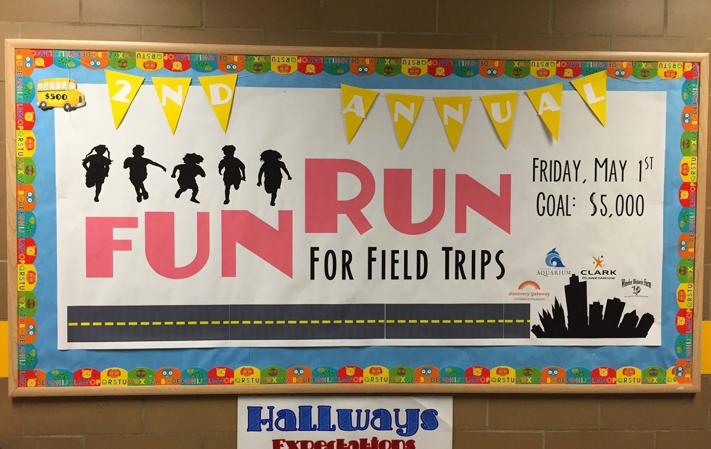
Starting Lessons & Courses
Techniques to start your lessons:
Start at the very beginning
Board welcomes and running themes
9

Slide 10
Starting Lessons & Courses
Techniques to start your lessons:
Gatekeeper
Don’t wait for the right time for the “lesson to start”
Greet individually
Start at the very beginning
Board welcomes and running themes
10

Slide 11
Starting Lessons & Courses
Techniques to start your lessons:
Focussing starts
Hidden → revealed (picture, key words of story, text)
Broken → constructed (text, words, picture)
Mystery → solution (blurred pic, bag/box)
11

