Slide 1
Chapter three Earthmoving equipment selection

Slide 2
Tractors and Dozers
A bulldozer is a tractor unit with a blade attached to its front. The blade is used to push, shear, cut, and roll material ahead of the tractor. It is an ideal surface earthmover that performs best at about 3mph. Each model of bulldozer has an operating range for blade size and adjustment. Both rubber-tired (or wheel) dozers and crawler (or track) dozers are available

Slide 3
TYPE OF DOZERS
1.Crawler (track laying) tractor.
2.Wheel type tractor.

Slide 4
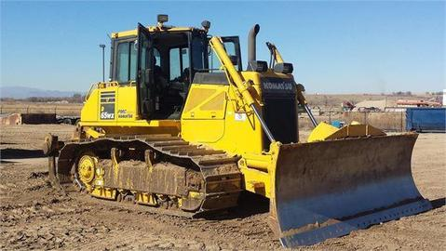

Slide 5
Uses of Bulldozers:
1) Clearing land of timber.
2) Opening up roads through mountains and rocky areas.
3) Moving earth for haul distances up to approximately 100m.
4) Helping load tractor-pulled scrapers.
5) Spreading earth fill.
6) Clearing construction sites.
7) Maintaining haul roads.

Slide 6
Advantages of Crawler-Mounted Bulldozers:
1) Ability to deliver greater tractive effort, especially in operating on soft footing, such as loose or muddy soil.
2) Ability to travel over muddy surfaces.
3) Ability to travel over rough surfaces, which may reduce the cost of maintenance.
4) Ability to operate in rocky formations, where rubber tires might be damaged.
5) Greater use on construction jobs.

Slide 7
Advantages of Wheel-Mounted Bulldozers:
1) Higher travel speed on the job or from one job to another.
2) Elimination of hauling equipment to transport the bulldozer to a job.
3) Greater output.
4) Less operator fatigue.
5) Ability to travel on paved highways without damaging the surface.

Slide 8
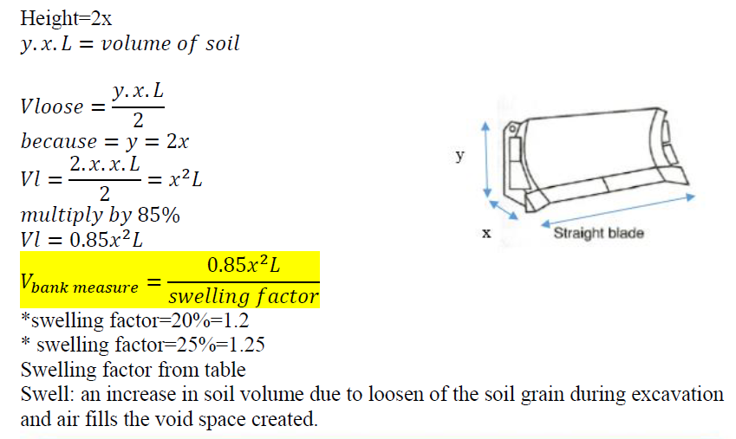
Production of bulldozer
Volume of blade

Slide 9
Soil Volume-Change Characteristics:
Earthmoving material may exist in the following three conditions or states:
1. Bank (or in place ): Material in its natural state before disturbance. It is identified as a bank cubic meter (BCM).
2. Loose: Material that has been excavated. It is identified as a loose cubic meter (LCM).
3. Compacted: Material after compaction. It is identified as a compacted cubic meter (CCM).

Slide 10
(B/L-1)*100=(1780/1370-1)*100=30%

Slide 12
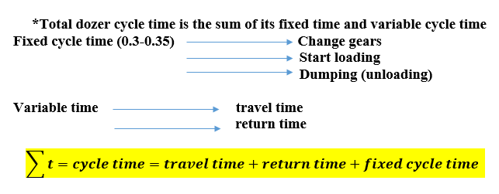
Cycle time

Slide 13
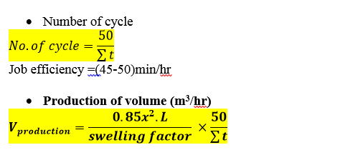

Slide 14
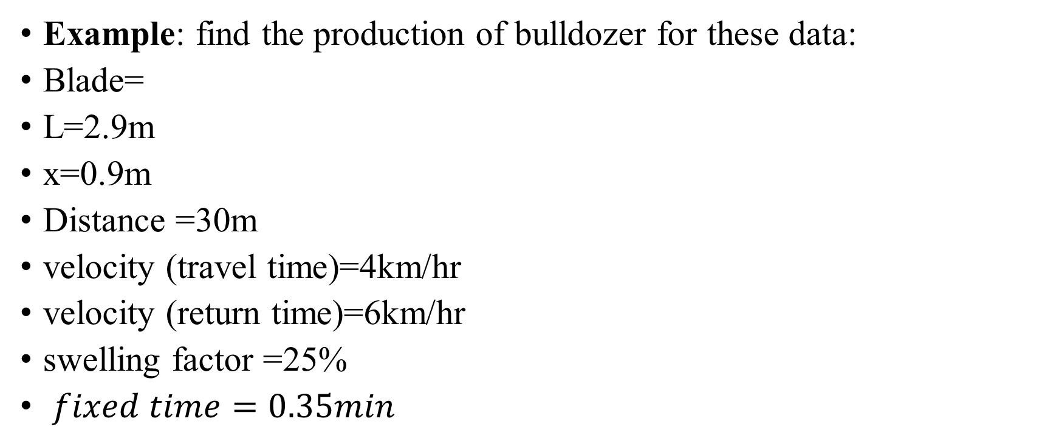
Example: find the production of bulldozer for these data:
Blade=
L=2.9m
x=0.9m
Distance =30m
velocity (travel time)=4km/hr
velocity (return time)=6km/hr
swelling factor =25%
$fixed time=0.35min$

Slide 15

Solution:
$V_{bank measure}=\frac{2.9×{0.9}^{2}}{1.25}×0.85 =1.59m^{3}$
Variable cycle time=travel time+ return time
$t_{travel}=\frac{Distance}{velocity}$

Slide 16
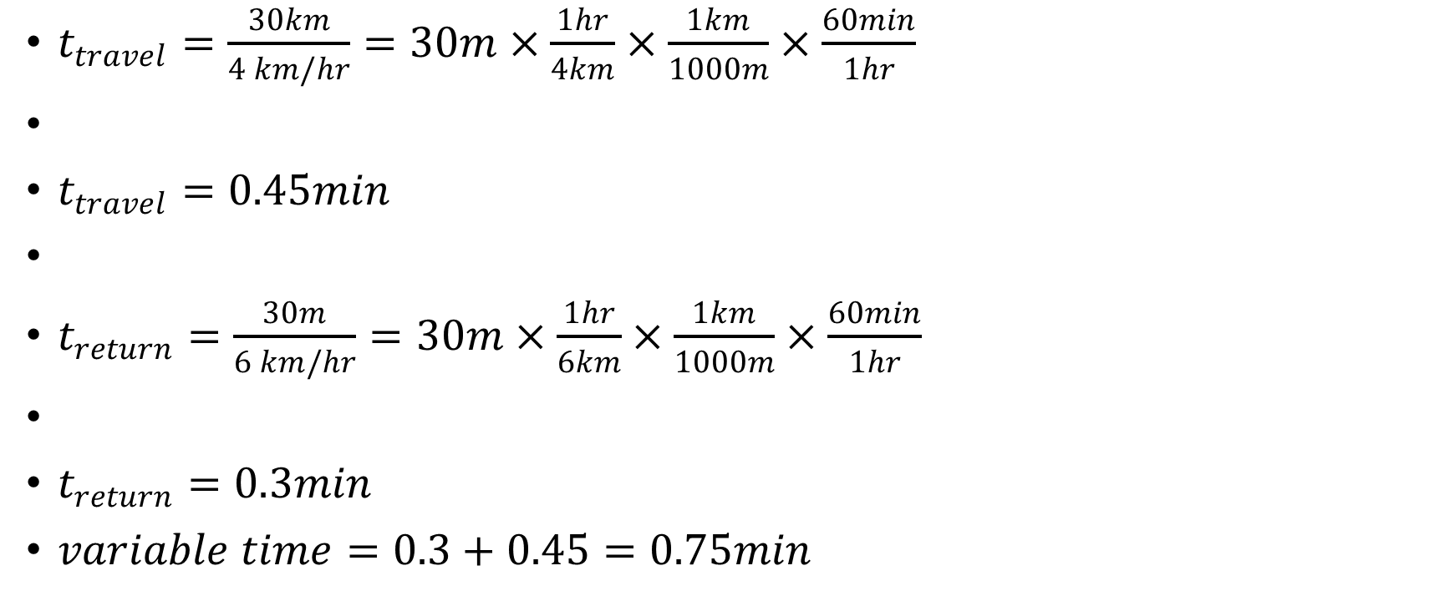
$t_{travel}=\frac{30km}{4 km/hr}=30m×\frac{1hr}{4km}×\frac{1km}{1000m}×\frac{60min}{1hr}$
$t_{travel}=0.45min$
$t_{return}=\frac{30m}{6 km/hr}=30m×\frac{1hr}{6km}×\frac{1km}{1000m}×\frac{60min}{1hr}$
$t_{return}=0.3min$
$variable time=0.3+0.45=0.75min$

Slide 17
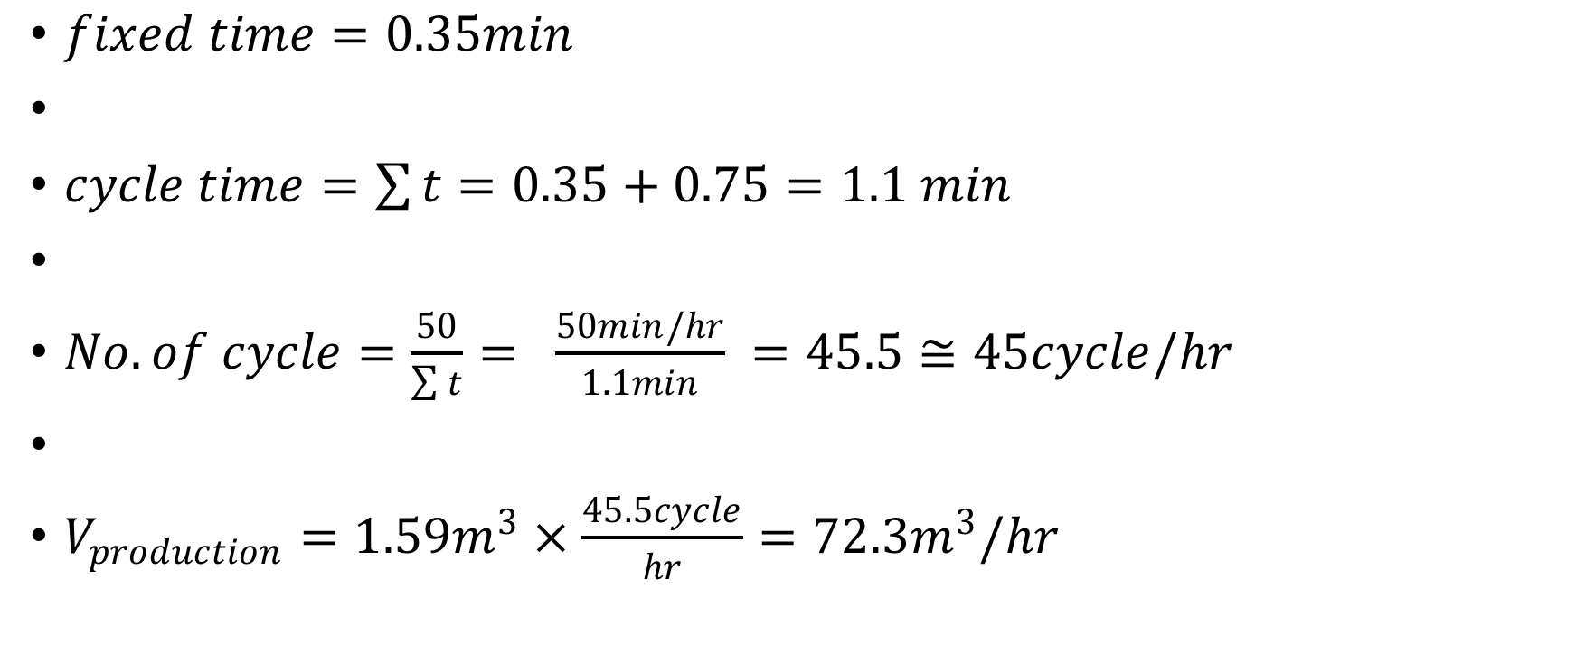
$fixed time=0.35min$
$cycle time=\sum{t}=0.35+0.75=1.1 min$
$No.of cycle=\frac{50}{\sum{t}}= \frac{50min/hr}{1.1min} =45.5≅45cycle/hr$
$V_{production}=1.59m^{3}×\frac{45.5cycle}{hr}=72.3m^{3}/hr$

Slide 18
Example: bulldozer move a distance of 60m with a velocity of 2.4km/hr and return back with 5.6km/hr if its blade was of dimension (x=1 , L=3)and swelling =25%.find the production of bulldozer.

