Slide 1
SPECIFIC GRAVITY OF SOIL GRAINS (GS)
Test no .2
2023-2-22

Slide 2
DEFINITION
The specific gravity (Gs) of a soil is the ratio of the mass of a unit volume of a material at a
stated temperature to the mass of the same volume of distilled water at stated temperature
(4oC). Or the specific gravity of soil grains is unit weight of the solid particles to the unit
weight of distilled water at 4oC.

Slide 4
NTRODUCTION
The choice of using a pycnometer or constant volume method is purely academic. When
the soil particles passing the No. 4 (4.75 mm) sieve.
The volume of a known weight of soil grains can be obtained by using stoppered bottle
of known volume (pycnometer) depending on the Archimedes principle (if a body
submerged in a volume of water will displace a volume of water equal to the volume of
submerged body). Then the pycnometer holds a standard volume of distilled water at 20o
C.
o At temperature above 20 oC, the volume will be slightly more.
o At temperature below 20 oC, the volume will be slightly less.
• The specific gravity of solids for most natural soils falls in the general range of 2.65 –
2.85, the smaller values are for the coarse – grained soils.

Slide 5
PURPOSES
• Gs is useful for determining weight volume relationships.
• It's used in the computation of most of the laboratory tests; such as: hydrometer,
consolidation.
• Specific gravity may be useful in soil mineral classification

Slide 6
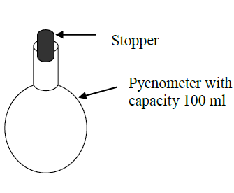
APPARATUS
The equipment for determination specific gravity includes:
1. Pycnometer with capacity 100 ml and stopper.
2. Vacuum pump.
3. Desicator.
4. Wash bottle.
5. Thermometer, ranging from 0 to 50o C.
6. Distilled deaired water.
7. Drying oven.
8. Balance accurate to 0.01 g.

Slide 8
PROCEDURE
Measure weight of empty stoppered bottle with stopper wb, which must be clean and dry.
2. Take about 25 to 30 g of oven dried soil and transfer the soil into the pycnometer then obtain the weight of pycnometer and dry soil wbs. Taking care not to lose any of the soil.
3. Add sufficient distilled water to fill the stoppered bottle half-full to three-fourth full(do not fill it completely).

Slide 9
4. Put the stoppered bottle without stopper inside a desicator and attach the desicator to a vacuum line and for at least 10 min. subject the contents to a vacuum (the reduced air pressure should cause the water to boil).
5. When deairing process is complete, add deaired water to fill the stoppered bottle volume.
6. Obtain the weight of (bottle + stopper + soil+ water) wbws , and take water temperature T1.
7. Empty the stoppered bottle and its contents. Then fill it with distilled deaired water and measure its weight wbw. Take the water temperature T2.

Slide 10
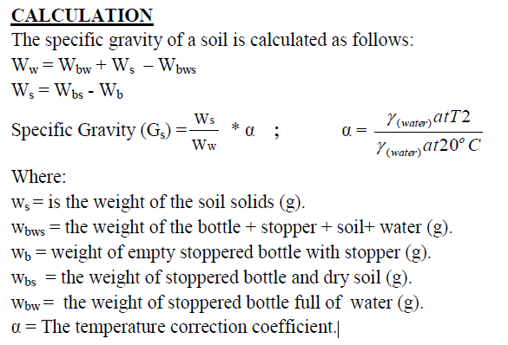

Slide 12
