Slide 1
Plants
Plants are living organisms that cover large amounts of the surface of our planet. They come in many shapes, sizes and colors. Most plants have roots, stems and leaves and they either produce flowers or cones for reproduction. Botanists (scientists who study plants) have identified about 391,000 living species of plants across the world.
Special characteristics of plants:
Plants are multicellular organisms in the kingdom Plantae.
Plant cells are distinguished by their cell walls containing cellulose, chloroplasts and a large central vacuole that holds water and keeps the plant turgid

Slide 2
3. Plants are autotrophs; they produce their own food by photosynthesis, which is the process of making nutrients such as sugars from light energy and carbon dioxide. Photosynthesis occurs in chloroplasts, which contain chlorophyll and carotenoids.
4. Plants develop from embryos which formed by a fusion of egg and sperm cells.
5. Plants have indeterminate growth. While animals reach a certain size and stop growing, plant cells in their meristematic tissues retain the ability to divide and grow throughout the life of the plant.
Plants are sedentary; they have different ways to obtain the materials they need for their metabolism.

Slide 3
The Important of Plants
1- Plants supply food to nearly all terrestrial organisms on the earth, including humans.
2- They produce oxygen and absorb carbon dioxide (CO2) during photosynthesis.
3- Plants provide many products for human use, such as vegetable, timber, medicines, dyes, oils, rubber, clothing, spices).
4- Plants are the earth's main autotrophs and fixers of carbon and nitrogen.
5- Plants provide the habitat and food upon which almost all other living things.

Slide 4
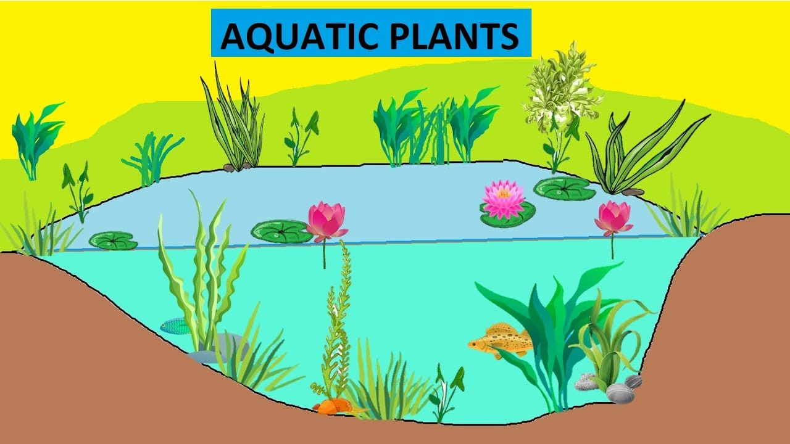
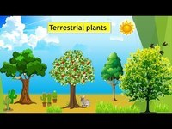
Plant Habitat: Is the place where a plant lives, it may be classified into:
I. Terrestrial Plant: Plants that are growing on land.
II. Aquatic (Hydrophytes) Plants: Plants that are living in water environment.

Slide 5
Plant Habit: Is the general appearance, growth form of plants, it classifies in to:
I. Herbs: are soft stemmed plants with less wood or no wood.
II. Shrubs: A shrub is a perennial, woody plant with several main stems arising from the ground level.
III. Climbers: An elongated weak stem generally supported by means of climbing devices.
IV. Trees: Is a strong, tall, woody plant having one main stem called trunk with many lateral branches.

Slide 6
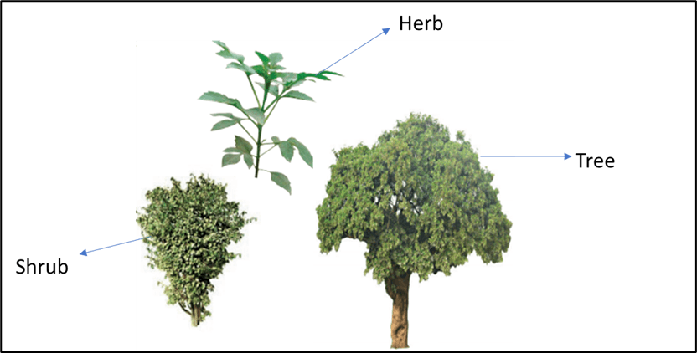

Slide 7
PLANT LIFE CYCLES:
1. Annuals: A plant that completes its life cycle in one growing season or less. Winter and summer annuals. Pea, Wheat, Mize, Barley.
2. Biennials: A plant that lives for two seasons, growing vegetatively during the first season and flowering and fruiting during the second season. Carrots, Papaver.
3. Perennials: A plant that grows for many years that flowers and set fruits for several seasons during life. Apple tree, Morus tree.

Slide 8
