Slide 1
Spermatophyte (Phanerogamae)
In 1883 a German botanist A.W Eichler divided the whole plant kingdom into two subkingdoms Spermatophyte (Phanerogams) and Cryptogams. Phanerogams are the most advanced plants on our planet and their plant body is divided into roots, stems, and leaves. They have special reproductive organs that produce seeds, so they are also known as seed-producing plants.
Cryptogams

Slide 2
Difference between Cryptogams and Phanerogams:
Charecter | Cryptogams | Phanerogams
Definition | They are plants or plants like organisms that produce spores. | They are higher plants that produce seeds.
Classification | They are classified into three parts Thallophyta, Bryophyta and Pteridophytes. | They are classified into two parts: Gymnosperms and Angiosperms.
Vascular System | These plants do not have a well-developed vascular system. | These plants have a well-developed vascular system.
Plant Body | In lower forms, the plant body is not well differentiated. Pteridophyta has well-developed roots, stems and leaves. | The plant body consists of a stem, leaf, and root.
Fertilization | They need external water for fertilization. | They do not need external water for reproduction.
Seeds | They do not have seeds. | They are seed-bearing plants.

Slide 3
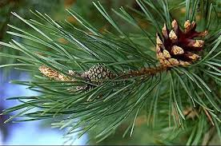
The spermatophyta are classified into two parts such as:
Gymnosperms (naked seed plants)
Angiosperms (covered seed plants)
A-Gymnosperms
Gymnosperms have a well-differentiated plant body and vascular tissues. They bear naked seeds (seeds are not enclosed within a fruit). Common example of gymnosperms is Pinus.
.

Slide 4
B-Angiosperms
Angiosperms are seed-bearing vascular plants with a well-differentiated plant body. The seeds of angiosperms are enclosed within the fruits. These plants are usually terrestrial and they may be annual, biennial or perennial. The vascular system is very well developed with xylem and phloem.

Slide 5
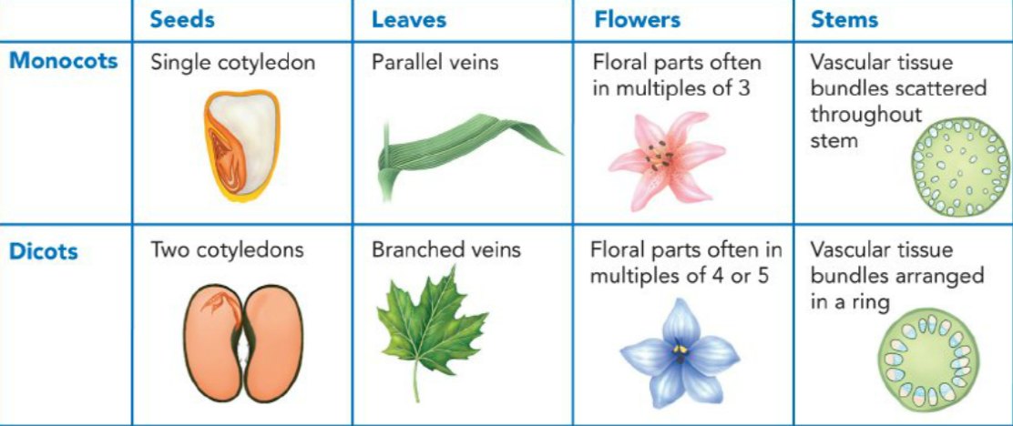
On the basis of the cotyledons (seed leaves) Angiosperms are further divided into:
I- Monocotyledoneae plants: | II -Dicotyledoneaeplants.
1-Embryo with a single cotyledon. 2- Monocots have flower parts in threes or multiples of threes. 3-Major leaf veins parallel. 4-Stem vascular bundles scattered. 5-Roots are adventitious. 6-Secondary growth absent. | 1-Embryo with two cotyledons. 2- Dicots have flower parts in four or five or multiples of four or five. 3-Major leaf veins reticulate. 4-Stem vascular bundles in a ring. 5- Tap root system is present. 6-Secondary growth present.

Slide 6
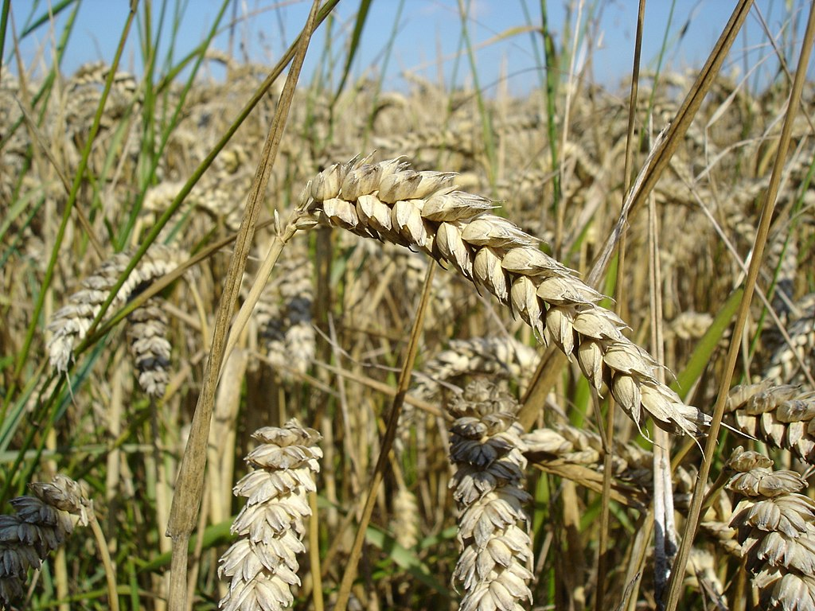
Monocotyledoneae plants
Monotyledoneae plants

