Slide 1
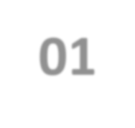
BS111
Probability and Statistics
Lecture 01

Slide 2
Sets and the basics of probability
Sets and Subsets
A fundamental in all branches of mathematics that is for the study of probability and statistics is that of a SET.
SET can be defined as: a collection of objects, each object in SET is called an Element of the SET.
Usually SETs are denoted by capital letters
A, B, X, Y …
While small letters are indicated to the Elements
a, b, x, y, …
40

Slide 3
Sets and the basics of probability
Sets and Subsets
First; if the SET has a finite number of elements, the members should be listed and separated by commas “,” and enclosed in brackets “{ }”
A={2, 4, 6, 9} or B={red, green}
Second; a SET are classified by a statement or rule satisfies a certain property.
C={x : x is satisfies p}
“ : ” called “such that”
40

Slide 4
Sets and the basics of probability
Sets and Subsets
If “S” is a SET and “x” is an Element of “S”, and “y” is not an Element of “S”, than we write
x Є S, and y Є S
SET with a finite number of Elements:
S={x1, x2, x3, …, xn}
Ex: S={1, 2, 3, 4, 5, 6}
SET with an infinite number of Elements
S={x1, x2, x3, …}
Ex: S={2, 4, 6, 8, …} even numbers
40

Slide 5
Sets and the basics of probability
Definitions
Two SETs are equal if they have the same number of Elements.
A={2, 4, 6}; B={4, 6, 2}, C={4, 2, 6, 8}
Then, A=B, A≠C, B ≠C
If all Elements of SET A is also an Elements of SET B, then,
A is subset of B, or B is subset of A
A ⊆ B , B ⊆ A or A = B
40

Slide 6
Sets and the basics of probability
Definitions
Special SET
Its a null SET, that contains NO Elements { }, in which case it called Empty SET, or ϕ
ϕ ⊆ A and A ⊆ ϕ
40

Slide 7
Sets and the basics of probability
Definitions
If SET A is subset of SET B, but SET B is not subset of SET A, A ⊆ B , B ⊆ A
Then, SET A is Proper subset of SET B
A ⊂ B
Ex:
Let SET F={-2, 2, 4, 0} , SET G={-3, -2, 0, 2, 3, 4}
F ⊂ G, since G ⊆ F
Ex:
V= {y Є N : y ≠ y} → is Null SET
Q= {y Є R : x²+2=0 } = ϕ = { }
40

Slide 8
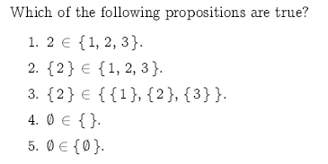
Sets and the basics of probability
Examples
40

