Slide 1
BS111
Probability and Statistics
Lecture 02

Slide 2
Lectures References (1/2)
Probability & Statistics for
Engineers & Scientists
9th Edition

Slide 3
Lectures References (2/2)
Applied Statistics and Probability for Engineers
7th Edition

Slide 4
Course Syllabus
Chapter 1: Probability.
Chapter 2: Random Variables.
Chapter 3: Probability Distributions.
Chapter 4: Descriptive Statistics.
Chapter 5: Estimation (Confidence Interval).
Chapter 6: Hypothesis Tests.

Slide 5
Chapter 1: Probability
Sample Space.
Events.
Counting Techniques.
Probability of an Event.
Additive Rules.
Conditional Probability.
Independence, and the Product Rule.
Bayes’ Rule.

Slide 6
Sample Space (1/9)
Random (Statistical) Experiment:
An experiment <with known outcomes> whose outcome cannot be predicted with certainty, before the experiment is run.

Slide 7
Sample Space (1/9)
Random (Statistical) Experiment:
An experiment <with known outcomes> whose outcome cannot be predicted with certainty, before the experiment is run.
The toss of (flipping) a coin
The roll of a dice

Slide 8
Sample Space (2/9)
Sample Space
Set of ALL possible outcomes of a random experiment.
A sample space is discrete if it consists of a finite or
countable infinite set of outcomes.
A sample space is continuous if it contains an interval (either finite or infinite) of real numbers.

Slide 9
Sample Space (3/9)
Sample Space (S)
Set of ALL possible outcomes of a random experiment.
The roll of a dice
10

Slide 10
Sample Space (3/9)
Sample Space (S):
Set of ALL possible outcomes of a random experiment.
𝑆={1,2,3,4,5,6}
The roll of a dice

Slide 11
Sample Space (3/9)
Sample Space (𝑺):
Discrete
Set of ALL possible outcomes of a random experiment.
𝑆={1,2,3,4,5,6}
Each outcome in a sample space is called an element or a member of the sample space, or simply a sample point.
The roll of a dice

Slide 12
Sample Space (4/9)
Sample Space (𝑺):
Set of ALL possible outcomes of a random experiment.
Flipping a coin

Slide 13
Sample Space (4/9)
Sample Space (𝑺):
Set of ALL possible outcomes of a random experiment.
𝑆={𝐻𝑒𝑎𝑑,𝑇𝑎𝑖𝑙}
𝑆={𝐻,𝑇}
Flipping a coin

Slide 14
Sample Space (5/9)
Example1:
Find the sample space for (flipping) a coin of two times?
the random
experiments

Slide 15
Sample Space (5/9)
Example1:
Find the sample space for (flipping) a coin of two times?
Answer:
𝑆={𝐻𝐻,𝐻𝑇,𝑇𝐻,𝑇𝑇}
the random
experiments

Slide 16
Sample Space (6/9)
Tree Diagrams:
Sample spaces can also be described graphically with tree diagrams.
𝑆={𝐻𝐻,𝐻𝑇,𝑇𝐻,𝑇𝑇}

Slide 17
Sample Space (7/9)
Example2:
An experiment consists of flipping a coin and then flipping it a second time if a head occurs. If a tail occurs on the first flip, then a die is tossed once.

Slide 18
Sample Space (7/9)
Example2:
An experiment consists of flipping a coin and then flipping it a second time if a head occurs. If a tail occurs on the first flip, then a die is tossed once.
Answer:
𝑆={𝐻𝐻,𝐻𝑇,𝑇1,𝑇2,𝑇3,𝑇4,𝑇5,𝑇6}

Slide 19
Sample Space (8/9)
Example2:
𝑆=
{𝐻𝐻,𝐻𝑇,𝑇1,𝑇2,
𝑇3,𝑇4,𝑇5,𝑇6}
20

Slide 20
Sample Space (9/9)
Example3:
Continuous
Consider an experiment that selects a cell phone camera and records, the recycle time of a flash (the time taken to ready the camera for another flash).
If it is known that all recycle times are between 1.5 and 5 seconds, the sample space can be
𝑺 = 𝑥 1.5 < 𝑥 < 5}

Slide 21
Events (1/19)
Event (𝑬):
A result of none , one , or more outcomes in the sample space. An event is a subset of the sample space of a random experiment.

Slide 22
Events (2/19)
Event (𝑬):
A result of none , one , or more outcomes in the sample space. An event is a subset of the sample space of a random experiment.
S = {1,2,3,4,5,6}
𝐸 = {2,4,6}
Even Numbers
The roll of a dice

Slide 23
Events (3/19)
Example1:
A dice is rolled twice. What is the Event that the sum of the faces is greater than 7, given that the first outcome was a 4?

Slide 24
Events (4/19)
Example1:
A dice is rolled twice. What is the Event that the sum of the faces is greater than 7, given that the first outcome was a 4?
Answer:
S = {11, 12, 13, 14, 15, 16, 21, 22, 23, 24, 25, 26,
31, 32, 33, 34, 35, 36, 𝟒𝟏,𝟒𝟐,𝟒𝟑,𝟒𝟒,𝟒𝟓,𝟒𝟔,
51, 52, 53, 54, 55, 56, 61, 62, 63, 64, 65, 66}
𝐸 = {44, 45, 46}

Slide 25
Events (5/19)
Definitions
We can also be interested in describing new events from combinations of existing events. Because events are subsets, we can use basic set operations such as unions, intersections, and complements to form other events of interest. Some of the basic set operations are summarized here in terms of events:

Slide 26
Events (6/19)
Definitions
1. The union of two events is the event that consists of all outcomes that are contained in either of the two events. We denote the union as E₁ ∪ E₂.
The intersection of two events is the event that consists of all outcomes that are contained in both of the two events. We denote the intersection as E₁ ∩ E₂.
The complement of an event in a sample space is the set of outcomes in the sample space that are not in the event. We denote the complement of the event 𝐸 as 𝐸′ or 𝐸^{𝐶} “A^{𝐶}= {x : x ∉ A}”

Slide 27
Events (6/19)
Definitions
The complements between SETs
the given complement of a specific SET “ex: A” to another SET “ex: B”, is defined as all Elements of SET A that not belong to the SET B
A \ B ; read “A given B”
Complement properties
A \ B ≠ B \ A of A ≠ B
A U A^{𝐶} = S or U “universal SET”
A ∩ A^{𝐶} = ϕ
A \ B = A ∩ B^{C}
(A^{C})^{C} = A

Slide 28
Events (7/19)
Ex:
Let Z={a, b, c, d}
S={3, 4, 0, -5, -7}, let G ⊂ S = {0, 3, 4}
X={0, 6, 3, 12, 8}
Then:
X ∩ S ={0, 3}
X U S ={0, 3, 4, -5, -7, 6, 8, 12}
X ∩ Z ={ } = ϕ
G^{𝐶} = {-5, -7} = S \ G
S \ X = { 4, -5, -7} = S – X
X \ S = { 6, 12, 8} = X – S
Difference

Slide 29
Events
• Let A and B be sets. The difference of A and B , denoted by A - B , is the set containing those elements that are in A but not in B .
• The difference of A and B is also called the complement of B with respect to A.
• An element x belongs to the difference of A and B if and only if x ϵ A and x ɇ B . This tells us

Slide 30
Events (6/19)
Definitions
The extension of the all complements is the Symmetric Difference, defined for SETs A and B as:
A Δ B = (A \ B) U (B \ A)
Ex: let; A={8, 9, 10, 11}, B={10, 11, 12, 13}
The symmetric difference is
A Δ B = {10, 11, 12, 13}

Slide 31
Events
• Symmetric difference properties
For any SET A → A Δ ϕ = A
For any SET A → A Δ A = ϕ
For any SETs of A and B → A Δ B = B Δ A

Slide 32
Events (8/19)
Example2:
In the tossing of a die, we might let A be the event that an even number occurs and B the event that a number greater than 3 shows.

Slide 33
Events (9/19)
Example2:
In the tossing of a die, we might let A be the event that an even number occurs and B the event that a number greater than 3 shows.
Then the subsets A = {2, 4, 6} and B = {4, 5, 6} are subsets
of the same sample space S = {1, 2, 3, 4, 5, 6}.
30

Slide 34
Events (10/19)
Example2:
Then the subsets A = {2, 4, 6} and B = {4, 5, 6} are subsets
of the same sample space S = {1, 2, 3, 4, 5, 6}.
A ∩ B =
A ∪ B =
4, 6
2, 4, 5, 6
A′ = 1, 3, 5
B′ = 1, 2, 3

Slide 35
Events (12/19)
Venn Diagrams:
Diagrams are often used to portray relationships between sets, and these diagrams are also used to describe relationships between events. We can use Venn diagrams to represent a sample space and events in a sample space.
S
E

Slide 36
Events (13/19)
Example1:
S= | 1, 2, 3, 4, 5, 6, 7
A = | {1, 2, 4, 7}
B = | 1, 2, 3, 6
C = | 1, 3, 4, 5

Slide 37
Events (13/19)
Example1:
A ∪ C = regions 1, 2, 3, 4, 5, and 7,
B’ ∩ A = regions 4 and 7,
A ∩ B ∩ C = region 1,
(A ∪ B) ∩ C’ = regions 2, 6, and 7,

Slide 38
Events (14/19)
Example2:

Slide 39
Events (15/19)
Example3:

Slide 40
Events (16/19)
Example4:

Slide 41
Events (17/19)
Mutually exclusive events
Mutually exclusive events are those that cannot happen simultaneously, whereas independent events are those whose probabilities do not affect one another.
S

Slide 42
Events (11/19)
Mutually Exclusive, or Disjoint:
Two events A and B are mutually exclusive, or disjoint,
if A ∩ B = ∅, that is, if A and B have no elements in common.
A = 2, 4, 6
A ∩ B =
and B = 1, 3, 5
= ∅

Slide 43
Additive Rules (3/13)

Slide 44
Additive Rules (4/13)
A1
A2
A3
….
An
S

Slide 45
Events (17/19)
Non-mutually exclusive events
Two sets are non-mutually exclusive if they share common elements. ... Non-mutually exclusive events can make calculating probability more complex.
S

Slide 46
Events (18/19)
Example6:
S = | 1, 2, 3, 4, 5, 6, 7
A = | 1, 2, 4, 5, 7
B = | 1, 2
C = | 4, 6
1
4
A ∩ C = φ
A ∪ B = A
2
6
5
7

Slide 47
Additive Rules (1/13)

Slide 48
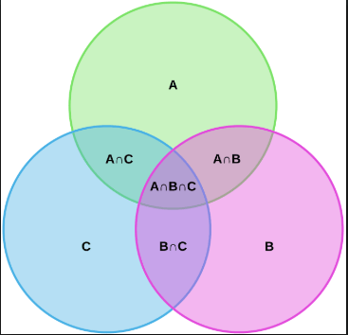
Additive Rules (2/13)

Slide 49
Additive Rules (5/13)
Example4:
If 𝑃 A = 0.3 , 𝑃 B = 0.2 , 𝑃 A ∩ B
the following probabilities:
= 0.1 determine
1)𝑃(𝐴^{c})
2)𝑃(𝐴∪𝐵)
3)𝑃(𝐴^{c}∩𝐵)
4)𝑃[(𝐴∪𝐵)^{c}]

Slide 50
Additive Rules (6/13)
Example4:
If 𝑃(𝐴)=0.3, 𝑃(𝐵)=0.2, 𝑃(𝐴∩𝐵)=0.1 determine the following probabilities:
1)𝑃(𝐴^{c}) = 1−𝑃𝐴 = 1−0.3 = 0.7
2)𝑃(𝐴∪𝐵) = 0.3+0.2−0.1 = 0.4

Slide 51
Additive Rules (7/13)
Example4:
If 𝑃 A = 0.3 , 𝑃 B = 0.2 , 𝑃 A ∩ B
the following probabilities:
= 0.1 determine
3) 𝑃 𝐴^{c}∩𝐵
S
A
B
10

Slide 52
Additive Rules (7/13)
Example4:
If 𝑃 A = 0.3 , 𝑃 B = 0.2 , 𝑃 A ∩ B
the following probabilities:
= 0.1 determine
3) 𝑃 𝐴^{c} ∩ B
S
A
B

Slide 53
Additive Rules (7/13)
Example4:
If 𝑃 A = 0.3 , 𝑃 B = 0.2 , 𝑃 A ∩ B
the following probabilities:
= 0.1 determine
3) 𝑃 𝐴^{c} ∩ B
S
A
B

Slide 54
Additive Rules (7/13)
Example4:
If 𝑃 A = 0.3 , 𝑃 B = 0.2 , 𝑃 A ∩ B
the following probabilities:
= 0.1 determine
S
A
B

Slide 55
Additive Rules (8/13)
Example4:
If 𝑃 A = 0.3 , 𝑃 B = 0.2 , 𝑃 A ∩ B
the following probabilities:
= 0.1 determine
4) 𝑃 A ∪ B
C

Slide 56
Additive Rules (8/13)
Example4:
If 𝑃 A = 0.3 , 𝑃 B = 0.2 , 𝑃 A ∩ B
the following probabilities:
= 0.1 determine
^{c}
4) 𝑃 A ∪ B
= P A ^{c} ∩ B^{c}
S
A
B

Slide 57
Additive Rules (8/13)
Example4:
If 𝑃 A = 0.3 , 𝑃 B = 0.2 , 𝑃 A ∩ B
the following probabilities:
= 0.1 determine
4) 𝑃 A ∪ B
^{c}
= 𝑃 A ^{c} ∩ B ^{c}
S
= 1 - P A ∪ B
= 1 - 0.4 = 0.6
A
B

Slide 58
Example of Venn diagram

Slide 59
Events (19/19)
Several Results:
40

Slide 60
De Morgan’s Laws

Slide 61
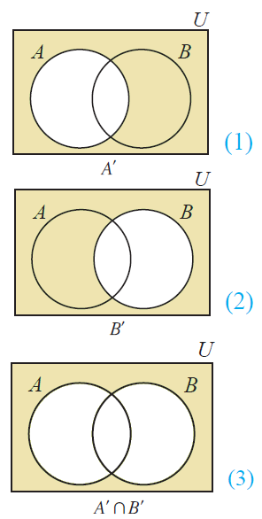
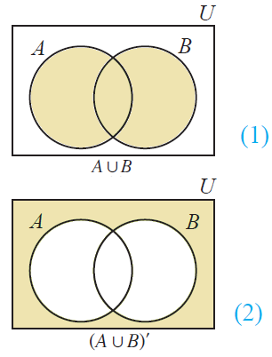
De Morgan’s Laws

Slide 62
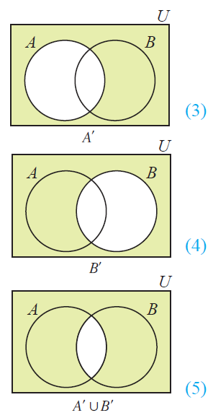
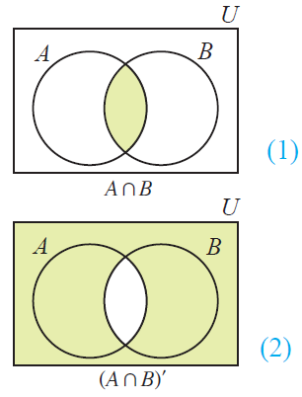
De Morgan’s Laws

Slide 63
De Morgan’s Laws
EX1; suppose you are about to interview for a two jobs,
“A” you get offered job A
“B” you get offered job B
Suppose:
P(A)= 0.2, P(B)= 0.6, P(A ∩ B) = 0.15
What is the probability that you get offered neither job?
Both jobs
You do not get either JOB
You do not get job A AND you do not get job B

Slide 64
De Morgan’s Laws
EX1; suppose you are about to interview for a two jobs,
“A” you get offered job A
“B” you get offered job B
Suppose:
P(A)= 0.2, P(B)= 0.6, P(A ∩ B) = 0.15
Both jobs
Union probability,
P(A U B) = P(A)+ P(B) - P(A ∩ B)
= 0.2 + 0.6 -0.15 = 0.65
$\overline{P(A U B )}$= 1- P(A U B )
= 1 – 0.65 = 0.35

Slide 65
De Morgan’s Laws
EX1; suppose you are about to interview for a two jobs,
“A” you get offered job A
“B” you get offered job B
Suppose:
P(A)= 0.2, P(B)= 0.6, P(A ∩ B) = 0.15
What is the probability that you don’t get two job offers?
Both jobs
You do not get two JOB offers
You do not get job A OR you do not get job B

Slide 66
De Morgan’s Laws
EX1; suppose you are about to interview for a two jobs,
“A” you get offered job A
“B” you get offered job B
Suppose:
P(A)= 0.2, P(B)= 0.6, P(A ∩ B) = 0.15
Both jobs
Union probability,
P(A ∩ B)’ = 1 - P(A ∩ B)
= 1 - 0.15 = 0.85

Slide 67
De Morgan’s Laws
HW1; Suppose:
P(A)= 0.6, P(B)= 0.4, P(A U B) = 0.9
What is
HW2; Suppose:
A={1, 2, 3} , B={2, 4, 6} , C={2, 3, 5}
What is
.
. 4.
.

Slide 68
Tree diagram
Ex:
Suppose all used cars in a large city can be classified as:
low, medium, or high (m1, m2, m3) current mileage
moderate or high (P1 or P2) priced; and
be inexpensive, average, or expensive (C1, C2, and C3) to operate.
Calculate the probability of choosing M2P1C3
In how many ways can a used car be categorized?

Slide 69
Tree diagram
HW:
Given Probability of a used cars in a large city can be classified as:
low, medium, or high (m1, m2, m3) current mileage
moderate or high (P1 or P2) priced; and
be inexpensive, average, or expensive (C1, C2, and C3) to operate. Determine the following
P(M1)
P(P1)
P(C3)
P(M1 ∩ P1)
P(M1 ∩ C3)
P(M1 U C3)
The probability that a used car will not have low mileage.
The probability that a used car will either not have low or not be expensive to operate.

Slide 70
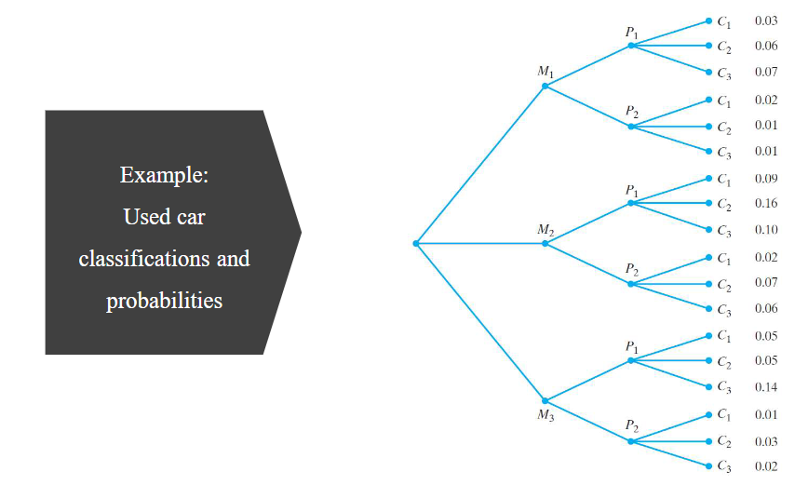
Tree diagram
HW:

