Slide 1
Cycles of Mineral Elements and Gases in Ecosystem
Carbon Cycle
The element carbon is a part of seawater, the atmosphere, rocks such as limestone and coal, soils, as well as all living things. On our dynamic planet, carbon is able to move from one of these realms to another as a part of the carbon cycle.

Slide 2
Carbon moves from the atmosphere to plants. In the atmosphere, carbon is attached to oxygen in a gas called carbon dioxide (CO2). Through the process of photosynthesis, carbon dioxide is pulled from the air to produce food made from carbon for plant growth.

Slide 3
Carbon moves from plants to animals. Through food chains, the carbon that is in plants moves to the animals that eat them. Animals that eat other animals get the carbon from their food too.

Slide 4
Carbon moves from plants and animals to soils. When plants and animals die, their bodies, wood and leaves decays bringing the carbon into the ground. Some is buried and will become fossil fuels in millions and millions of years.

Slide 5
Carbon moves from living things to the atmosphere. Each time you exhale, you are releasing carbon dioxide gas (CO2) into the atmosphere. Animals and plants need to get rid of carbon dioxide gas through a process called respiration.

Slide 6
Carbon moves from fossil fuels to the atmosphere when fuels are burned. When humans burn fossil fuels to power factories, power plants, cars and trucks, most of the carbon quickly enters the atmosphere as carbon dioxide gas. Each year, five and a half billion tons of carbon is released by burning fossil fuels. Of this massive amount, 3.3 billion tons stays in the atmosphere. Most of the remainder becomes dissolved in seawater.

Slide 7
Carbon moves from the atmosphere to the oceans. The oceans, and other bodies of water, absorb some carbon from the atmosphere. The carbon is dissolved into the water.

Slide 8
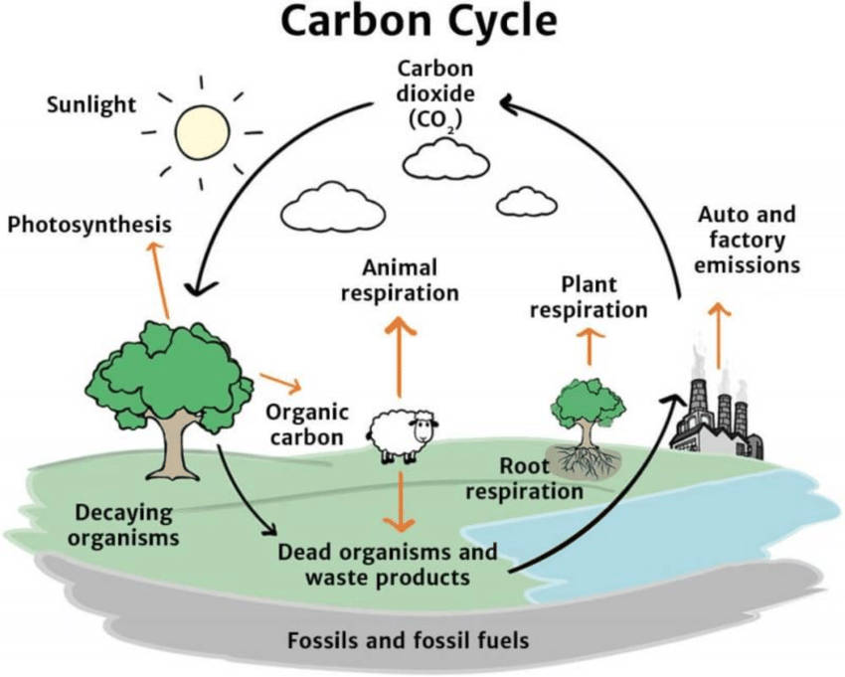

Slide 9
Nitrogen Cycle
Nitrogen is an element that is found in both the all portions of our planet and the inorganic parts of the Earth system. Nitrogen moves slowly through the cycle and is stored in reservoirs such as the atmosphere, living organisms, soils, and oceans along the way. Most of the nitrogen on Earth is in the atmosphere. Approximately 80% of the molecules in Earth's atmosphere are made of two nitrogen atoms bonded together (N2).

Slide 10
All plants and animals need nitrogen to make amino acids, proteins and DNA, but the nitrogen in the atmosphere is not in a form that they can use. The molecules of nitrogen in the atmosphere can become usable for living things when they are broken apart during lightning strikes or fires, by certain types of bacteria, or by bacteria associated with legume plants.

Slide 11
Other plants get the nitrogen they need from the soils or water in which they live mostly in the form of inorganic nitrate (NO3-). Nitrogen is a limiting factor for plant growth. Animals get the nitrogen they need by consuming plants or other animals that contain organic molecules composed partially of nitrogen.

Slide 12
When organisms die, their bodies decompose bringing the nitrogen into soil on land or into the oceans. As dead plants and animals decompose, nitrogen is converted into inorganic forms such as ammonium salts (NH4+ ) by a process called mineralization. The ammonium salts are absorbed onto clay in the soil and then chemically altered by bacteria into nitrite (NO2-) and then nitrate (NO3- ). Nitrate is the form commonly used by plants. It is easily dissolved in water and leached from the soil system. Dissolved nitrate can be returned to the atmosphere by certain bacteria through a process called denitrification.

Slide 13
Certain actions of humans are causing changes to the nitrogen cycle and the amount of nitrogen that is stored in reservoirs. The use of nitrogen-rich fertilizers can cause nutrient loading in nearby waterways as nitrates from the fertilizer wash into streams and ponds. The increased nitrate levels cause plants to grow rapidly until they use up the nitrate supply and die. The number of herbivores will increase when the plant supply increases and then the herbivores are left without a food source when the plants die. In this way, changes in nutrient supply will affect the entire food chain.

Slide 14
Additionally, humans are altering the nitrogen cycle by burning fossil fuels and forests, which releases various solid forms of nitrogen. Farming also affects the nitrogen cycle. The waste associated with livestock farming releases a large amount of nitrogen into soil and water. In the same way, sewage waste adds nitrogen to soils and water.

Slide 15
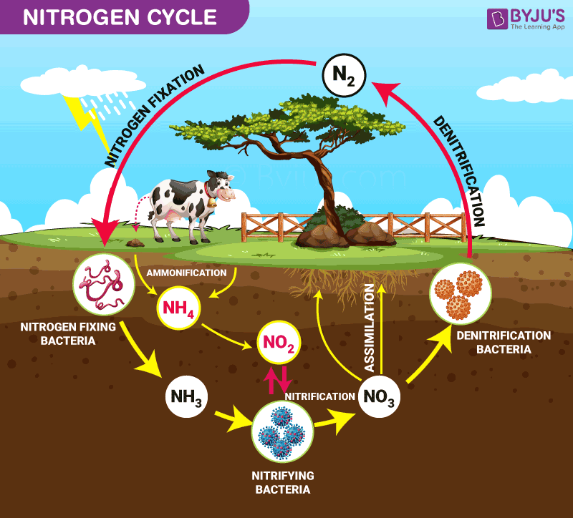

Slide 16
Oxygen Cycle
Oxygen is required by all living organisms for respiration. It occurs in the gaseous form in the atmosphere to extent of 20-21percent. It also occurs as CO2, H2O and in the form of various oxides and salts. The land organisms take it directly from the atmosphere whereas aquatic and marine forms take by the process of diffusion of oxygen from water. It is also utilized in various non-biological processes to produce various oxides, sulphates and nitrates. The major replenishment of oxygen is carried out by the green plants by photosynthesis. Oxygen evolved in the process of photosynthesis comes directly from the splitting of water molecules.

Slide 17
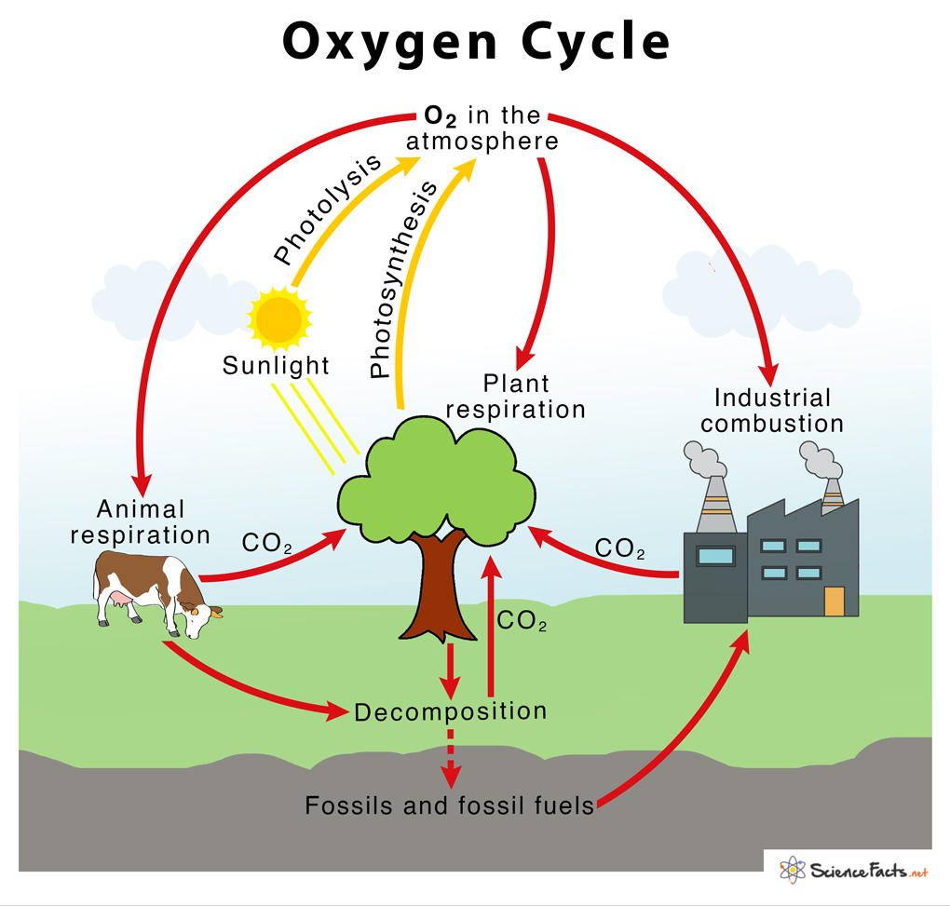

Slide 18
Sulphur cycle
Sulphur is another important constituent of proteins, amino acids and vitamins. It occurs in the rocks and soil as metal sulphides. Plants absorb Sulphur in form of sulphates, which are produced in the soil by breakdown of proteins following death and decay of organism and also due to the microbial oxidation of H2S gas.

Slide 20
Phosphorus cycle
Phosphorus is also an important of nucleic acids, ATP, NADP and phospholipids. The biotic component of ecosystem produces phosphorus from the abiotic component, (atmosphere and soil) and the decomposition of organic matter replenishes this phosphorus of atmosphere. Soil derived from lake or ocean beds are usually rich in phosphates due to the decomposition of marine animals. Inorganic phosphate usually occurs in the insoluble form. It is dissolved by excretions of microorganism and absorbed by plants from soil. Plants later convert it to organic form. Rocks are another source of phosphorus.

Slide 21
