Slide 1
Characteristic of food chain:
The sequential inter-linking of organisms involving transfer of food energy from the producers, through a series of organisms with repeated eating and being eaten is referred as “food chain”.
The biotic components of the ecosystem are linked to each other through food chain. In a typical food chain, producers are at the bottom and their role is to provide food for rest of the community utilizing solar energy. Other organisms belong to the consumers and finally decomper are present at the bottom to recycle the organic content. In this manner, a nutritive interaction relationship exists between the living organisms of an ecosystem.

Slide 2
It is always straight and always follow progressive straight line. The flow of energy is also unidirectional, from sun to producer and then different series of consumers. In a typical food chain, there are always 4 or 5 trophic level in the food chain. The distinct sequential steps in the straight food chains are referred as different trophic levels. For ex. Green plants stand at the first trophic level; the herbivorous are the second trophic level; and flesh eaters represent the third trophic levels. The position of plant is at the bottom but the position of other organism varies to different trophic level in different food chains.

Slide 3
Typical examples of food chains in different ecosystem.
 | Type of Ecosystem | Producers | Herbivores | Primary Carnivores | Secondary Carnivores | Tertiary Carnivores
 | Grassland Ecosystem | Grasses | Insects Rat and mice Grazing Cattle | Frogs Snakes Carnivore mammals | Snakes Predatory birds | Predatory birds
 | Aquatic Ecosystem | Phytoplanktons | Zooplanktons | Small fishes | Large fishes
 | Forest Ecosystem | Trees | Phytophagous insects Herbivora mammals | Lizards, birds Foxes | Predatory birds Wolves | Lions, Tiger
 | Desert Ecosystem | Shrubs, bushes Grasses and some tree | Rats and mice | Snakes | Predatory birds

Slide 4
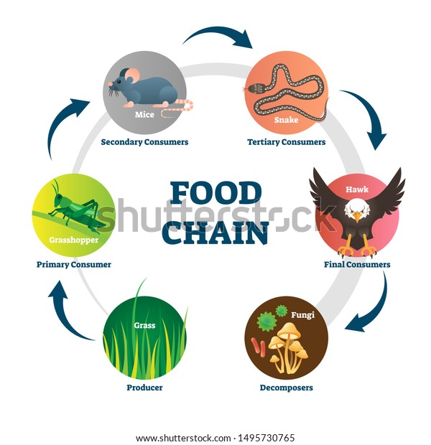

Slide 5
Types of food chains: There are two different types of food chains; grazing food chain and detritus food chain.
Grazing food chain: In the grazing food chain, solar energy is entrapped by the plants and then biomass, in tuen eaten by the herbivorous, and these are subsequently being consumed by a variety of carnivorous. These are longer food and these food chains end at the decomposer level. Here are two typical example of this type of food chain to understand this type of food chain.

Slide 6
1-Food chain in a pond: In a pond, floated or rooted plants and algae are responsible for performing photosynthesis to prepare food for other member of ecosystem. They represent producers in the food chain. Unicellular algae are consumed by protozoan, water flies, snail, mosquito larvae and tadpoles. These small organisms represent primary consumers. These organisms are eaten by hydra, dragonfly larvae, giant insects and small fishes. These are secondary consumers. Large fishes and frog fed on these organisms and represent tertiary consumers. Frog and fishes are eaten by snakes, birds and these are quaternary consumers. Death of all these organisms become the food for bacteria and fungus to produce simple inorganic materials for reuse by the producers.

Slide 7
2-Food chain on land: A typical land food chain is given in Figure 39.3. In land food chain, grass and tree are the producers. Grass is eaten by rabbit and other herbivorous. They represent the primary consumers. Rabbit is eaten by cats (secondary consumers), which in-turn eaten by wolves (tertiary consumers). Both cat and wolves will be consumed by tigers and other big carnivorous (quaternary consumers). Death of all these organisms become the food for bacteria and fungus to produce simple inorganic materials for reuse by the producers.

Slide 8
Detritus food chain: Unlike grazing food chain, detritus food chain starts with the dead organic matter either from fallen leaves or dead animal bodies. This food chain doesn’t depend on solar energy. Common example of detritus food chain is marsh land where mangrove leaves fall into the warm, shallow water. The detritus eating animals ex. Bacteria, fungi and protozoan act upon the dead matter of dead leaves to convert them into simple inorganic substances. The detritivorous are subsequently eaten by insect larvae, grass shrimp, copepods, crabs, nematodes, bivalve mollusks, amphipods, mysids etc. In the last step, the detritus consumers are finally eaten by fishes.

Slide 9
Food Web:
The different food chains are inter connected at various trophic level to develop a food web. For example, in grassland ecosystem, grass is consumed by the rabbit but in their absence, it may be eaten by the grazing cattle. Similarly, rat or mouse is eaten by snake but snake can be eaten by predatory birds. In contrast to food chain, food web has several distinct characteristics.

Slide 10
Food web are never straight.
(2) Food web is formed due to interlinking of food chains.
(3) A food web in the ecosystem brings alternate source of food.
The complex food web gives better stability to the ecosystem. Most of the animals are polyphagous and they feed on more than one kind of organism. If the availability of one particular animal is decreasing in the ecosystem, they start eating alternate animal. As a result, it gives chance to other animal to reproduce and grow in number and in addition, it gives chance to predator to survive.

Slide 11
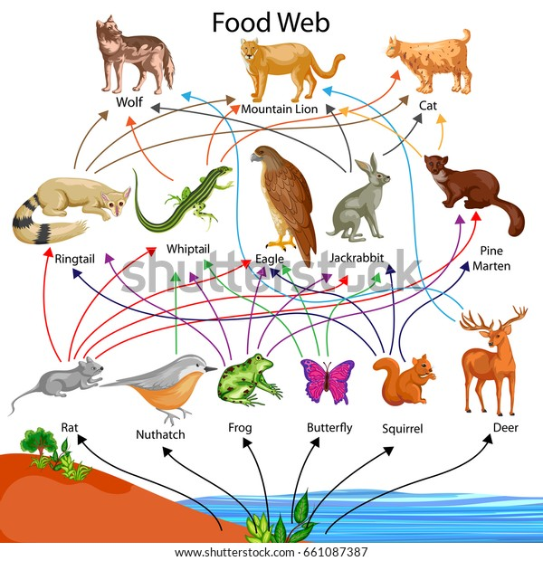

Slide 12
Ecological Pyramids:
In a food chain, producers and consumers at different trophic level are connected in terms of number, biomass and energy. These properties reduce from producers to consumers and representing these parameters for food chain gives a pyramid with a broad base and a tapering apex. Ecological pyramids can be of three types:
(a) Pyramid of Numbers
(b) pyramid of biomass
(c) pyramid of energy

Slide 13
Example of inverted ecological pyramid is provided by parasitic food chains. A single mango tree supports large number of birds, which in turn supports a large number of parasites like lice and bugs. Hyperparasites, such as bacteria and fungus are the greatest in the number and occupy the top of the inverts pyramids.

Slide 16
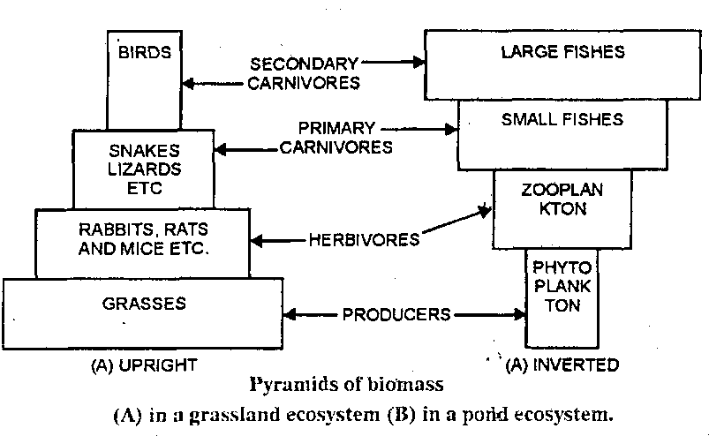

Slide 17
Flow of energy in food chain:
Sun is the ultimate source of energy on earth and plants utilizes it to produce food for rest of the member of the ecosystem. Only the 1% of the total energy fall on green part of leaves is changed into the potential energy of the organic substances, the rest of the energy dissipates as heat. To explain the flow of energy,

Slide 18
lindermann proposed the law of ten per cent law. This law proposed that during transfer of food energy from one trophic level to the other, only 10% is stored at higher trophic and the rest 90% is lost in respiration, decomposition and waste in the form of heat. For example, 5000 jules fall on leaves, it will convert only 50 jules into the chemical form (food). It will be eaten by rabbit, he will get only 5 jules (10% of 50 jules) on next trophic level. Rabbit will be consumed by carnivorous and they can be able store only 0.5 jules (10% of 5 jules).

