Slide 1
Ecological factors
The ecological factors can be classified as follows:
Climatic factors (including light, atmospheric temperature, precipitation, humidity and winds).
Topographic factors (including altitude i.e., height of mountains, direction of mountain, chains and valleys, the steepness and exposure of slop).
Edaphic factors (including soil texture, chemical nature of soil, soil moisture, soil temperature, soil air and soil organisms).
Biotic factors (including plants, animals and symbiotic organisms).

Slide 2
A- Climatic factors
The word of climate is believed to have originated from a Greek word Klima which means inclination or angle of the sun’s rays falling on the earth. There for, the climate of area is influenced mainly by sun. indirectly, climate is influenced by a large number of factors and the study of these factors is known as climatology. These factors vary considerably in different areas of the world and include the following:

Slide 3
Light
Light is the most important factor for many vital functions in plants. practically all the energy required for organisms under natural conditions is derived directly from the sun (solar energy). The total amount of light that reach the earth varies according to season, latitude and certain other conditions. Photoperiod (day length) shows its basic effect on stem elongation, flowering, fruit growth etc.

Slide 4
Effect of light on plant
Light actually affects plants in many ways by its intensity, quality and duration.
In absence of light, chlorophyll synthesis will not take place and there will be no assimilation of carbon dioxide. Thus, carbohydrates will not be synthesized in absence of light.
Intensity of light plays an important role in controlling the rate of transpiration and thus indirectly also influences the rate of water absorption from the soil.

Slide 5
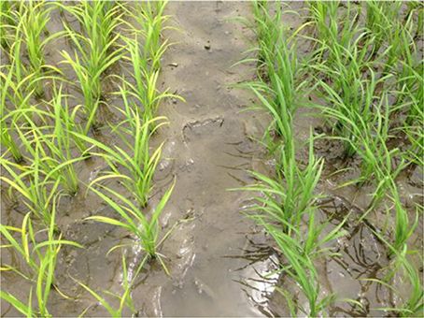

Slide 6
3- Opening and closing of stomata is regulated by light. This in turn is related to transpiration and absorption of water.
4- The light plays an important role in maintaining the temperature of different plant organs and also controls various enzymatic reactions.
5- Seedlings get etiolated in absence of light.

Slide 7
6- Very high light intensities cause solarization in plants in which all the cell contents are oxidized by atmospheric oxygen.
7- All plants in general require light for their growth and development. However, not all plants require same intensity of light. Sometimes, plants are classified ecologically on the basis of their relative light requirements.
8- Light not only affects vegetative growth of plants but also flowering. On the basis of their photoperiod, plants may be short day plants or long day plants.

Slide 8
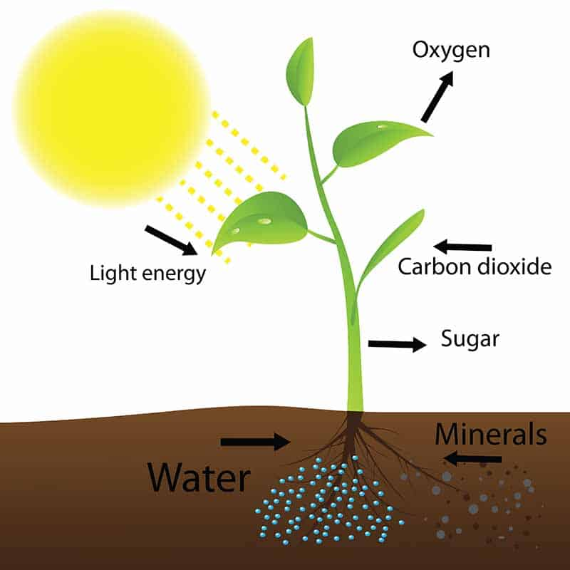

Slide 9
Effect of light on animals
Light also has far reaching effects on animals by affecting their several activities such as reproduction, pigmentation, growth and development. In some animals, development of fur and feathers is known to occur in response to photoperiodism. The pigmentation in animals is also influenced by light. Certain insects, fishes and reptiles change their skin color as a mean of protection and according to environmental conditions. The most important effect of light is on the metabolic processes of animals through the heating effect on tissues. This in turn results into an increase in enzymatic activates, general metabolic rate and the degree of solubility of salts and animals. In certain birds and animals, light also initiates breeding activates.

Slide 10
Temperature
Temperature is the another important factors which regulates many chemical processes. The plants express a wide range of tolerance for temperature. Many plants are capable of surviving only within a certain range of temperature. All physical processes like growth, respiration, photosynthesis and transpiration are influenced by temperature. Variation in temperature of different regions effects the vegetation as well as the morphological characters of the plants. However, extreme temperatures have harmful effect on plants in the form of desiccation, chilling injury and freezing injury.

Slide 11
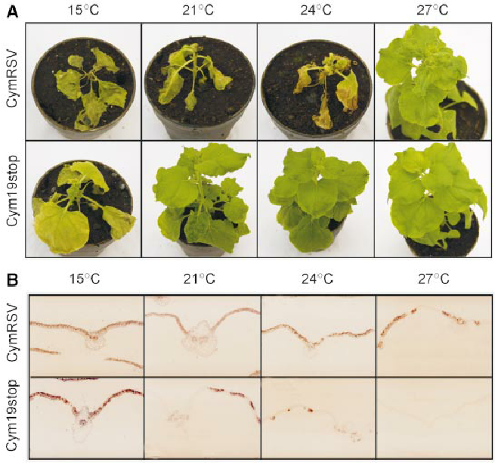

Slide 12
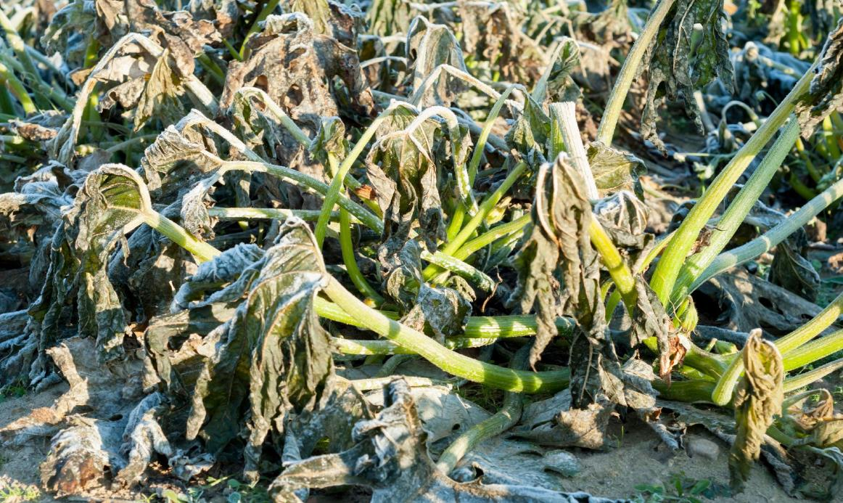

Slide 13
The effect of temperature on the developmental stages has been observed in animals also. Birds and mammals attain greater body size in cold region than warm areas. The tail, snout, ears and legs of mammals are relatively shorter in colder regions than in warmer areas. Temperature also affects the coloration of animals, for example, some insect, birds and mammals in warm humid climates have darker pigment than the races of same species present in cool and dry climates.
The temperature of place is influenced by altitude (height above the sea level), latitude (distance from equator), plant cover, water content of soil, steepness of slop and direction of mountain chains.

Slide 14
Precipitation
Rainfall (precipitation) and humidity are the most important factors in determining the vegetation of any region. Precipitation may occur in the various form (drizzle, rain, dew and frost). Drizzle is a uniform precipitation of minute drops which seem to float in the air. Snow is the precipitation of moisture in the solid state. The rainfall also varies according to altitude. On mountains the rainfall increase with the altitude up to certain height but decreases beyond a certain altitude. The rainfall and its distribution during the various seasons corresponding determine regional distribution of different types of vegetation in the following way:

Slide 15
When heavy rainfall is distributed over the whole year evergreen rain forests occur.
In those regions, where rainfall is very heavy, only for a few months in the year and rest of the year remains dry, forests consisting of tall deciduous trees are developed.
In tropical countries, heavy annual rainfall remains distributed throughout the year and it results into the production of evergreen frosts.
4. In regions, where heavy rainfall occur only in summer and low rainfall in winter appearance of grassland may be noticed.
5.In the regions, where rain is very low, desert or desert vegetation may be noticed.

Slide 16
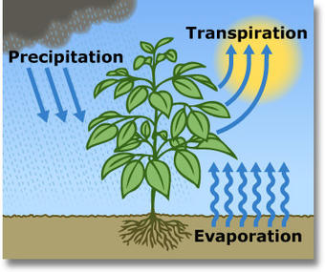

Slide 17
Atmosphere moisture or humidity
The moisture in the air in the form of water vapor is called humidity. Atmospheric humidity is the amount of water vapor present in a unit volume of the air. It is often expressed as relative humidity (RH). Humidity is affect by temperature, wind, altitude and soil moisture. Humidity of air affects the water relations of the plant and directly determines the rate of transpiration. In moist air, the plants become more elongated, thinner and paler, their leaves get smaller and thinner, more transparent and possess less developed palisade tissue. Some plant such as orchids, lichens and mosses make direct use of atmosphere moisture. In fungi and other microbes, it plays an important role in germination of spores and subsequent stages in life cycle.
Temperature variations also influence evaporation. Dry winds decrease the amount of air moisture by removing moist air the plants. Hence, transpiration rate increases.

Slide 18
Winds
Moving air is called wind. Air moves from a region of high pressure to one of low pressure. This different in pressure is mainly due to unequal heating of atmosphere. Wind has both direct as well as indirect effects on plant life, the direct effect is mechanical, such as uprooting of trees, breaking branches and twigs. The indirect effects are on physiological phenomena like evaporation and transpiration which are directly related to wind velocity. When transpiration is more, the plant fail to maintain an internal water balance and suffer from desiccation.

