Slide 1
Plant community
Plant community is a part of the biotic component comprising a plants and animals living in any natural area. A plant community forms an assemblage of plants in particular environment, which is suitable for proving at least the minimum requirements of individual in community.
The social group­ings of plant species are called plant community of which plant is the fundamental basic unit.

Slide 2
Characteristics of a community
All communities have certain general characteristics which are listed below:
Species diversity
In community, there may be different organisms (plants, animals, microbes) which differ taxonomically from each other. The number of these species varies in different communities.

Slide 4
2. Growth form and structure
In a community, there occur major categories of growth forms such as trees, shrubs, herbs and mosses. These different growth forms in space and time determine the stratification or vertical layering of the community.

Slide 5
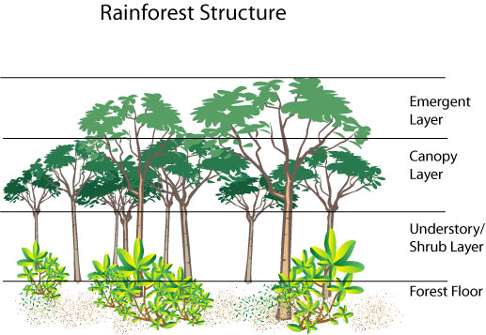

Slide 6
3. Self-sufficiency
Each community is nutritionally well balanced. There may be both autotrophic and heterotrophic individuals in a community.

Slide 7
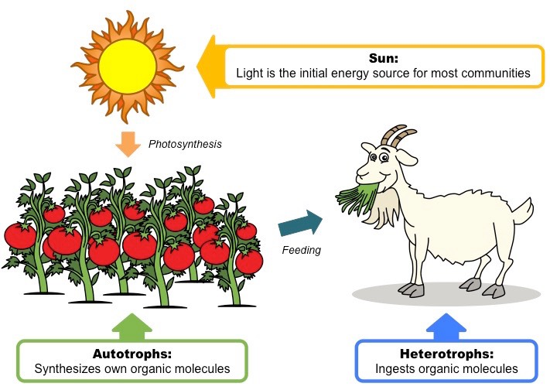

Slide 8
4. Dominance
In a community, all the species may not be equally important. There are always a few species which exert major controlling influence by virtue of their size, number etc., in determining the nature of community. These species are known as dominant species.

Slide 9
5. Succession
In a community develops as a result of directional change in its composition as well as in environmental properties.

Slide 10
Classification of community
According to some ecological communities can be classified to:
Plant formation
A fully developed or climax community within a climatic region is called plant formation. The major plant formations or the world are rain forests, deciduous forests, coniferous forest, grasslands, deserts, mangroves.

Slide 11
2. The associations
A climax community consist of two or more sub-divisions, called associations. The number of associations in any plant formation is determined by a number of sub-climates within the general climates of the formation in that area. Each association is marked by one or more dominant species peculiar to it.

Slide 12
3. The consociation
Due to local varieties in temperature, precipitation and edaphic factors, several plant communities may develop within a plant association. Each community in the association may be dominated by a single species and such communities with a single dominant species are known as a consociation. In one association, there may be many consociations, each with a single dominant species.

Slide 13
4. The society
A society is a community characterized by one or more sub-dominant species. In areas with dominance of consociation, many other species are found growing in abundance. These species influence the communities present un the area and are called sub-dominants. Societies may be:
An aspect society
A layer society

Slide 14
Aspect societies are found in places with marked seasonal variations and are common in deserts and grasslands. Different species may appear which may differ in duration of their vegetative growth and flowering. Thus, each species can form its own society. Layer societies, on the other hands, are common in forest formation which show complex stratification. Under the influence of dominant species, the trees of the forest formation, one or more layers of shrubs may develop followed by layers of herbaceous communities and ground communities of mosses, lichens, algae etc. in the forest.

