Slide 1
Plant cell
Cell wall layers ,structure and its function
The protoplast-Living component and Non- living components
The protoplast-Non -Living component
Vacuole , Ergastic substances ( carbohydrate, Protein and fats )

Slide 2
Plant Cell
The basic units of which organisms are constructed are the cells. The term cellula was first used by Robert Hooke in 1665. Hooke gave this term to the small cavities surrounded by walls that later he observerved cells in other plant tissues and noticed that they contained juice. Still later the protoplasm – the substance within the cell-was discovered. In 1880 Han stein coined the term protoplast to indicate the unit of protoplasm found in a single cell. He also suggested that the term protoplast should be used instead of the term cell but his suggested is not generally accepted and cell is the accepted term. In plant the term cell includes the protoplast together with the wall

Slide 3
The plant cell typically consists of a more or less rigid cell wall and a protoplast. The term protoplast is derived from the word protoplasm, which is used to refer to the contents of cells. A protoplast is the unit of protoplasm inside the cell wall. A protoplast consists of cytoplasm and a nucleus.
Plant cell
Cell wall
Protoplast

Slide 4
Pits
These areas which are of variable shape are called pits, it can develop over the primary pit fields and then one or more pits may develop on those parts of the primary wall devoid of pit fields. On the other hand the primary pit fields can become completely covered by the secondary cell wall, the pits are apparently areas through which substances pass from cell to cell.

Slide 5
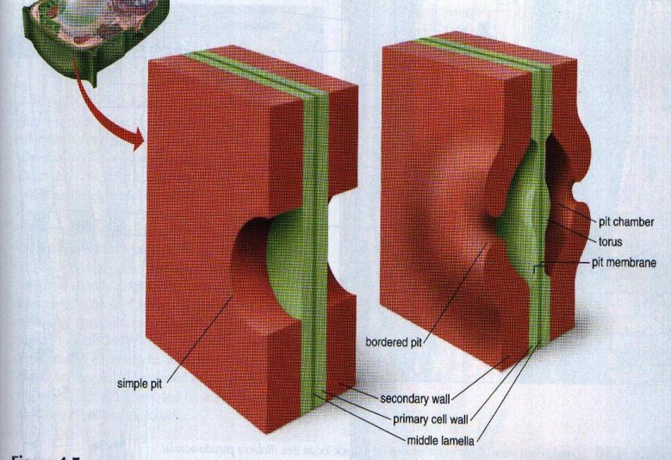
Pits are depressions in cell walls where the secondary wall does not form. There may be from one or two to several thousand in a cell. They often occur in pairs, with one on each side of the middle lamella. Some called bordered pits (right), bulge out from the wall and resemble doughnuts in surface view, while others, called simple pits (left), do not bulge.

Slide 6
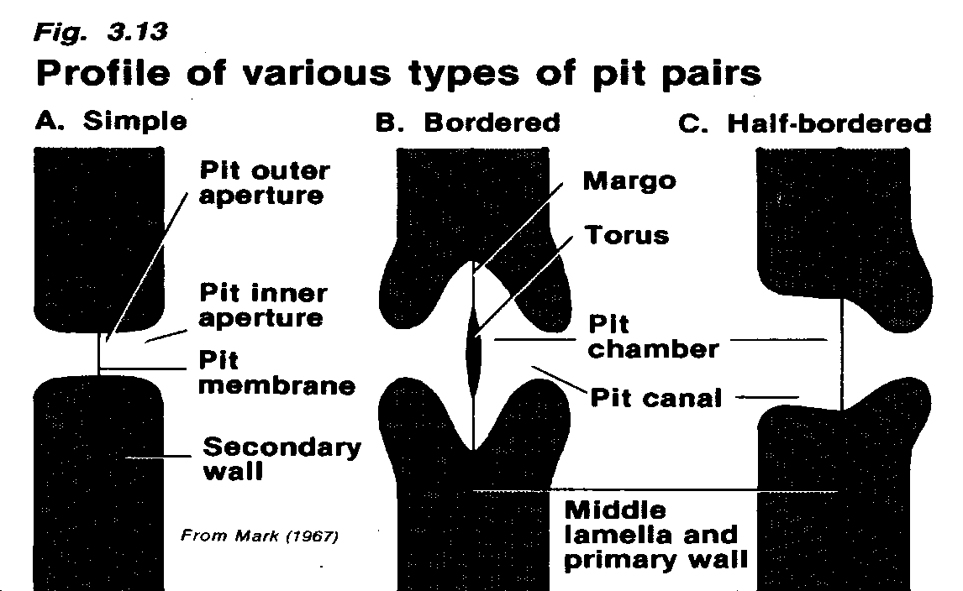
Generally, each pit has a complementary pit exactly opposite it in the wall of the neighboring cell. Such pits form a morphological and functional unit called the pit-pair.
The cavity formed by the break in the secondary wall is called the pit cavity. The membrane, built of the primary cell walls and middle lamella that separates the two pit cavities of the pit pair is called the pit membrane. The opening of the pit on the inner side of the cell wall is called the pit aperture.

Slide 7
Two principal types of pits are recognized simple pits and bordered pits. The main characteristic of bordered pits is that the secondary wall develops over the pit cavity to form an overarching roof with a narrow pore its centre. In a simple pit no such development of the secondary wall is present. If the two pits of a pair are simple a simple pit-pair is formed, if the two pits are bordered a bordered pit-pair

Slide 8
if one of the pits is simple and the other bordered a half-bordered pit-pair. If the pit has no complementary pit in the adjacent cell or if it is opposite an intercellular space it is termed a blind pit. Sometimes two or more pits are found opposite one large pit-such an arrangement is called unilateral compound pitting.
Simple pits are usually found in parenchyma cell with thickened walls, in libriform fibers and in sclereids. Bordered pits are found in the tracheary elements and in fiber- tracheids. In the bordered pit that part of the secondary wall is called the pit chamber and the opening in the secondary wall that faces the cell lumen is called the pit aperture.

Slide 9
In the pit canal two openings are distinguished that facing the cell lumen is termed the inner aperture and that nearest the pit chamber the outer aperture. In some plants there are bordered pit-pairs in which the pit membrane is thickened in its central portion; this thickening which is of a primary nature is disc-shaped and is termed the Torus, the diameter of the torus is wider that of the pit aperture.

Slide 10
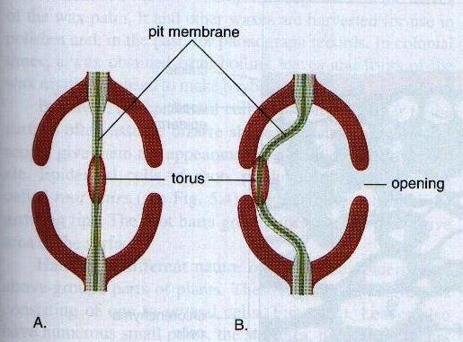
How water flow is controlled in adjacent pairs bordered pits. The pits are separated by a pit membrane consisting of the middle lamella and two thin layers of primary walls:
Water moves relatively freely through the pit membrane when the torus (a thickened region of the pit membrane) is in the center.
If the flexible pit membrane swings to beside so that the torus blocks on opening, water movement through the pit pair is restricted.

Slide 11
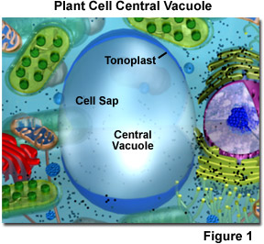
Non- living components 1-Vacuole Occupy more than 90% of the Volume of most mature plant cells. A vacuole is a watery cell compartment surrounded by a membrane, the tonoplast. It contains a variety of organic and inorganic substances, such as sugars, proteins, organic acids, phosphatides, tannins pigments, and calcium oxalate. Some substances in the Vacuole may occur in solid form and may even be crystalline. The Vacuoles function in regulation of the water and solute content of the cell in osmoregulation, storage and in digestion.

Slide 12
2- Ergastic Substances Various nonliving inclusions called ergastic substances are found in the cytoplasm. Some of these are carried in the cytoplasm where as others are localized in the Vacuoles A- Carbohydrates B- Proteins C- Fats And Related Substances D- Tannins E- Crystals

Slide 13
A- Carbohydrates: cellulose and starch are principal ergastic substances of the protoplast. Cellulose is the chief component of plant cell wall. Starch is carbohydrate composed of long chain molecules. It appears in the form of grains, which commonly stain bluish – black with a solution of iodine in potassium iodide. Starch grains are first formed in chloroplasts. Later the Starch is broken down and moves as sugar to storage tissues

Slide 14
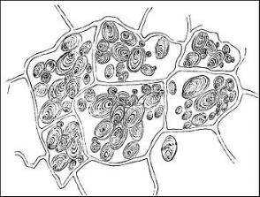
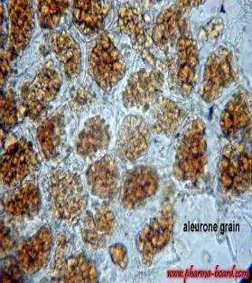
B- Proteins: Are storage materials in many seeds embryo and the endosperm which contain storage protein in the form of aleuronic grains, these grains may be simple
b)contain globoids and crystalloids of protein( this type occur within parenchyma cells in the potato tuber)

Slide 15
C- Fats And Related Substances: Are widely distributed in the plant body, and probably occur in small amounts in plant cells.

Slide 16
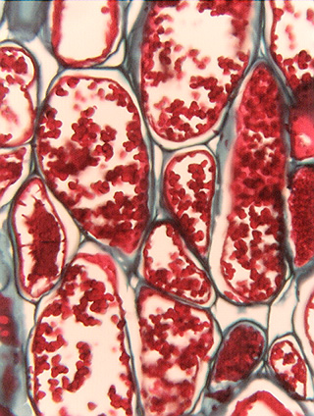
D-Tannins: Are phenol derivatives usually related to glucosides. They are in a high molecular weight. It is abundant in the leaves of many plants. Tannins are substances protecting the protoplast against desiccation, decay or injury by animals.

Slide 17
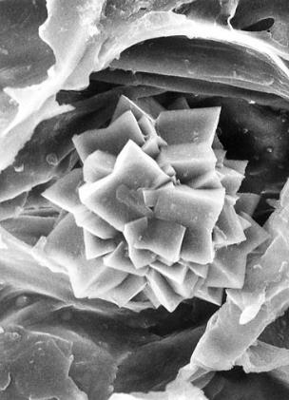
E-Crystals:-The inorganic to precipitate in plants, consist mostly of calcium salts as: 1-Calcium oxalate: crystals may be united into compound structures as druses, raphids and prismatic. (Calcium oxalate crystals may be commonly observed in vacuole). 2-calcium carbonate occur in well-formed crystals e.g cystoliths which are out growth of the cell wall.

Slide 18
The function of these crystals is relatively uncertain. They seem to be more abundant in plants, which grow in arid and xeric environments. They are all composed of Calcium oxalate, which causes epithelial cells to swell. Consequently, they should deter herbivores.

