Slide 1
Plant cell
The protoplast-Living component
Plasma membrane
Nucleus
Ribosome
Plastids
Mitochondria
Peroxisome
Endoplasmic Reticulum
Golgi apparatus

Slide 2
The plant cell typically consists of a more or less rigid cell wall and a protoplast. The term protoplast is derived from the word protoplasm, which is used to refer to the contents of cells. A protoplast is the unit of protoplasm inside the cell wall. A protoplast consists of cytoplasm and a nucleus.

Slide 3
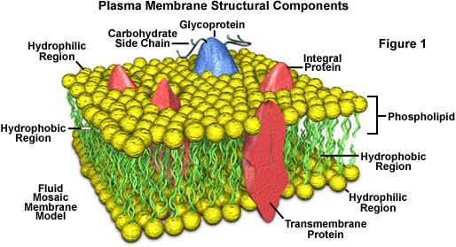
Protoplast
The Function
The components
Control transport of substances and homeostasis. It is permeable to gases and water, but many substances can only pass through it with the help of proteins, such as channels, protein pumps and receptor proteins
1- The plasma membrane
It is a phospholipid bilayer.
It is both elastic and rigid and helps give the cell its shape.
It is selectively permeable

Slide 4
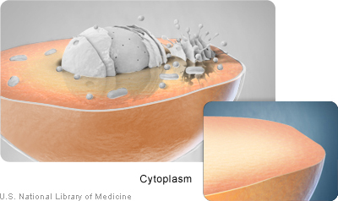
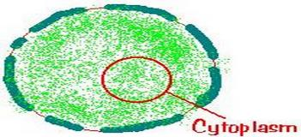
2- The Cytoplasm
The cytoplasm comprises part of the protoplast. Physically it is a viscous substance which is more or less transparent in visible light. Chemically the structure of the cytoplasm is very complex even though the major component (85 – 90 %) is water. The cytoplasm is delimited from the cell wall by a unit membrane termed the plasma lemma and from the vacuole by another unit membrane the tonoplast.
Contains all the components of a living cell and non-living

Slide 5
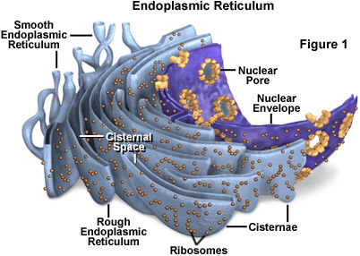
In special form the (ER) occurs in the cytoplasm strands, plasmodesmata traversing the walls of neighboring cells.
-Carrying the ribosome
-has role in cell division
3- Endoplasmic Reticulum
One of the membranous structures occurring in the cytoplasm is the endoplasmic reticulum (ER). This is a complex system which consists of two unit membranes enclosing a narrow space between them.

Slide 6
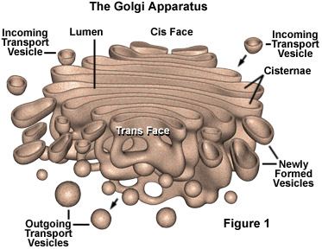
4- Golgi apparatus
The Golgi apparatus consists of a system of stacks of flat circular cisternae, each bound by a smooth unit membrane.
The Golgi bodies are concerned with secretion processes and have a polar structure. In active bodies in addition to the production of many vesicles distal cisternae may break up into vesicles
The Golgi bodies are mainly involved in the secretion of sugar, polysaccharides and polysaccharides protein complexes.

Slide 7
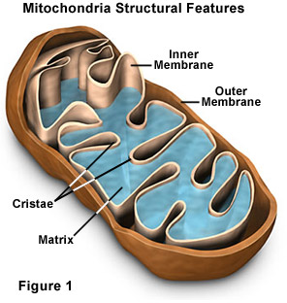
5- Mitochondria
Mitochondria are organelles which can be seen with the light microscope when living cells are stained with Janus Green B.
The mitochondria contain ribosome's which are smaller than those of the cytoplasm and DNA fibrils, but their genetic capability is limited.
The mitochondria are concerned with processes of energy conversion and contain many enzymes

Slide 8
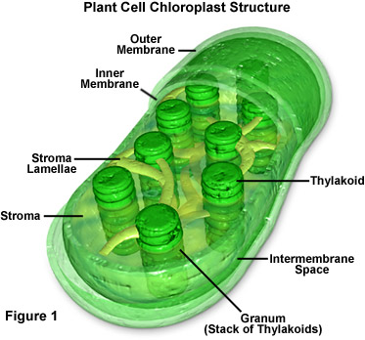
6- Protplastids
Plastids are organelles characteristic of plant cells and have no homologues in the animal cell. The principal types of Plastids are chloroplasts, chromoplasts, and Leucoplasts.
Chloroplasts are green as a result of the pigment chlorophyll which predominates in them.
Chromoplasts are usually yellow, orange or red because of the carotene pigments.
Leucoplasts are non-pigmented Plastids usually located in tissues not exposed to light and they store plant products such as starch, protein and fats.
-Site of photosynthesis
-providing space for the temporary storage of starch
- involved in the synthesis of amino acids and fatty acids

Slide 9
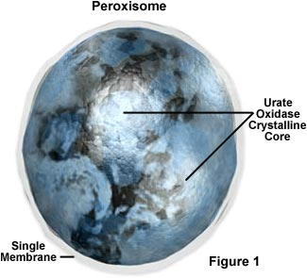
7- Peroxisomes
Micro bodies are small bodies 1.5 nm in diameter which occurs in the cytoplasm of a Varity of tissues. They are bound by a single membrane and their matrix appears granular or fibril.
They contain enzymes that Vary in accordance to the type of cell or tissue in which they are present.
These micro bodies are sites for oxidation of glycolic acids, a product of carbon dioxide fixation.

Slide 10
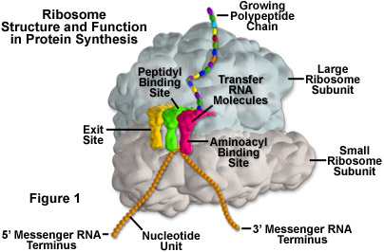
8- Ribosomes
Are small particles (17-20)Um in diameter that occur free in the cytoplasm, on the outside of the membranes of the endoplasmic reticulum, and in the nucleus,
also chloroplasts, and mitochondria
contain smaller ribosomes (similar to those in prokaryotes ) Ribosomes aggregates
Called polysomes or polyribosomes .
They consist of RNA and protein mainly histone

Slide 11
9- Nucleus
The cell usually contains a single nucleus but there are also cells which have numerous nuclei. The nucleus is usually more or less spherical though nuclei with other shapes have also been observed. The nucleus is surrounded by an envelope and contains the nuclear matrix and one or more nucleoli. In the nucleoplasm chromosomes consisting of deoxyribonucleic acid (DNA) and proteins are present. The complex of DNA and protein in the chromosomes which has an affinity to basic dyes is called chromatin
controls and regulates the activities of the cell (e.g., growth and metabolism) and carries the genes, structures that contain the hereditary information

