Slide 1
Cell Division
Cell division in eukaryotes
Chromosomes in eukaryotes and prokaryotes are different
What is a chromosome?
The DNA Structure
DNA Function
Cell cycle
Cell division
Cytokinesis

Slide 2
In one-celled organisms, the cell grows by absorbing substances from the environment and using these ma­terials to synthesize new structural and functional mol­ecules.
When such a cell reaches a certain size, it divides. The two daughter cells, each about half the size of the original mother cell, then begin growing again.

Slide 3
In a one-celled organism (prokaryote e.g. Bacteria), cell division may occur every day or even every few hours, producing a succes­sion of identical organisms.
In many-celled organisms (Eukaryote e.g. fungi and plants), cell division, together with cell enlargement, is the means by which the organism grows. In all of these in­stances, the new cells are genetically and initially struc­turally similar to both the parent cell and one another.
Cell division in eukaryotes consists of two overlap­ping stages: mitosis and cytokinesis.
Mitosis is the process by which a nucleus gives rise to two daughter nuclei, each morphologically and genetically equivalent to the other.
Cytokinesis involves the division of the cytoplasmic portion of a cell and the separation of daughter nuclei into separate cells.
Cell division in eukaryotic cells is much complex than in prokaryotes or organelles.

Slide 4
Chromosomes in eukaryotes and prokaryotes are different
PROKARYOTES | EUKARYOTES
Single chromosome plus plasmids | Many chromosomes
Circular chromosome | Linear chromosomes
Made only of DNA | Made of chromatin, a nucleoprotein (DNA coiled around histone proteins)
Found in cytoplasm | Found in a nucleus
Copies its chromosome and divides immediately afterwards | Copies chromosomes, then the cell grows, then goes through mitosis to organise chromosomes in two equal groups

Slide 5
What is a chromosome?
In the nucleus of each cell, the DNA molecule is packaged into thread-like structures called chromosomes. Each chromosome is made up of DNA tightly coiled many times around proteins called histones that support its structure.
the DNA that makes up chromosomes becomes more tightly packed during cell division and is then visible under a microscope. Each chromosome has a constriction point called the centromere.

Slide 6
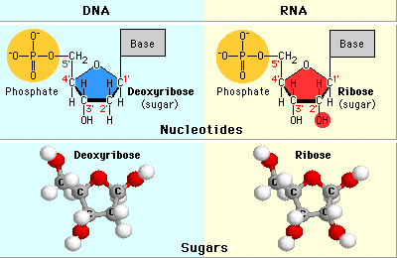
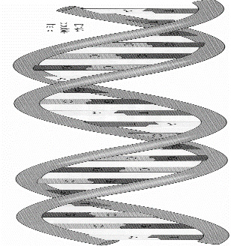
THE STRUCTURE OF DNA
DNA is made of long chains of nucleotides. DNA has a Double-helix structure where 2 strands of nucleotides join and twist around to form a spiral staircase or twisted ladder.

Slide 7
Each nucleotide has 3 parts:
1. a phosphate group - helps form the backbone of the DNA molecule.
2. a sugar (deoxyribose) - acts as a glue, forms the backbone with phosphate.
3. nitrogen bases - 4 types (Guanine, Cytosine, Adenine, Thymine) the base of one nucleotide forms a hydrogen bond with the base of another nucleotide, thus the bases form the steps of the DNA ladder.
The sequence of the bases makes up the genetic code

Slide 8
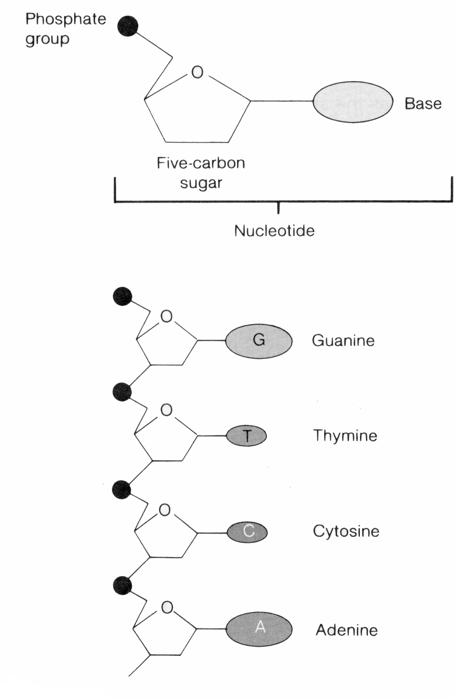

Slide 9
DNA FUNCTION
Control of cell activities
Replication
Undergo mutations: permanent changes passed onto offspring may advance the species via evolution

Slide 10
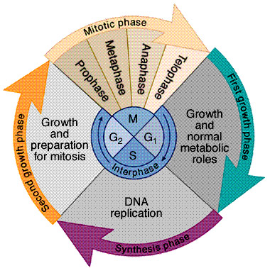
Cell cycle
Actively dividing cells pass through a regular sequence of events known as the cell cycle.
Com­pletion of the cycle requires varying periods of time, depending on both the type of cell and external factors, such as temperature or availability of nutrients. Com­monly, the cycle is divided into interphase and the four phases of mitosis.

Slide 11
Interphase, the phase between successive mitotic divi­sions, was once regarded as the "resting phase" in the cell cycle. Nothing could be further from the truth, however, for interphase is a period of intense cellular activity.
Interphase can be divided into three phases, which are designated G1, S, and G2.
The G1 phase (G stands for gap) occurs after mitosis. It is a pe­riod of intense biochemical activity, during which the cell increases in size, and the various organelles, inter­nal membranes, and other cytoplasmic components in­crease in number. In order for the cycle to continue to the S phase, the G: phase must proceed past a critical point called the restriction point, or Start, at which time the cell undergoes an internal change that commits it to complete the subsequent steps of the cycle.

Slide 12
The S (synthesis) phase—the period of DNA syn­thesis—apparently requires a signal from the cyto­plasm before it can begin. The appearance of this S-phase activator presumably switches on DNA synthe­sis. During the S phase, many of the histones and other DNA-associated proteins are also synthesized. Follow­ing the S phase, the cell enters the G2 phase, which continues until mitosis starts.
During the G2 phase, structures directly involved with mitosis, such as the components of the spindle fibers, are formed

Slide 13
Nuclear and Cell Division
Nuclear division (mitosis) and cytoplasmic division (cytokinesis) occur during the M phase of the cell cycle. By morphological examination, the process of mitosis (animal cell, plant cell) can subdivided into the following sub-phases: 1. prophase, 2. pro-metaphase, 3. metaphase, 4. anaphase and 5. telophase. Based upon the changing behavior and appearance of the chromosomes.

Slide 14
1) Prophase: The chromosomes begin to condense and become visible by light microscopy. The two sister chromatids appear to be attached at the centromere. The two centrosomes (which were duplicated during S-phase) begin to move to opposite ends of the cell. The centrosomes begin assemble of the microtubule-containing structure, the mitotic spindle with dense asters forming at each centrosome. The cytoskeletal microtubules disassociate and the tubulin is added to the mitotic spindle. In animal cells but not plant cells, centrioles are located at the core of the centrosomes.

Slide 15
2) Prometaphase: The nuclear membrane breakdown. Centrosomes stop as locations at opposite poles of the cell. As the nuclear membrane is no longer present, mitotic spindle microtubules make contact with the chromosomes with the CEN DNA sequences of the chromosomes’ centromere to form the kinetochore (a protein-DNA complex). Each chromosome develops two kinetochores, one for each sister chromatid. The kinetochores bind the free ends of the mitotic spindle microtubules to attach the chromosomes to the mitotic spindle. The chromosomes are forced toward the center of the cell. The mitotic spindle microtubules can attach to the kinetochores (kinetochore microtubules), to microtubules from the other pole (polar microtubules) and to the proteins of the inner plasma membrane (aster microtubules).

Slide 16
3) Metaphase: The chromosomes are completely condensed. The chromosomes are paused and aligned at the metaphase plate, a plane half-way between the poles. A mitotic karyotype can be constructed from cells arrested at metaphase.

Slide 17
4) Anaphase: Sister chromatids separate and begin to move to opposite poles. In anaphase A, the chromosomes are pulled by the centromeres towards the poles as the kinetochore microtubules shorten. In anaphase B, the poles push apart as the polar microtubules get longer. Anaphase A and B may occur in this order or at once, depending upon cell type.

Slide 18
5) Telophase: The daughter chromosomes arrive at the pole and begin to revert to chromatin. The nucleoli develop, the spindle disassembles and the nuclear envelope reappears. Cytokinesis occurs.

Slide 19
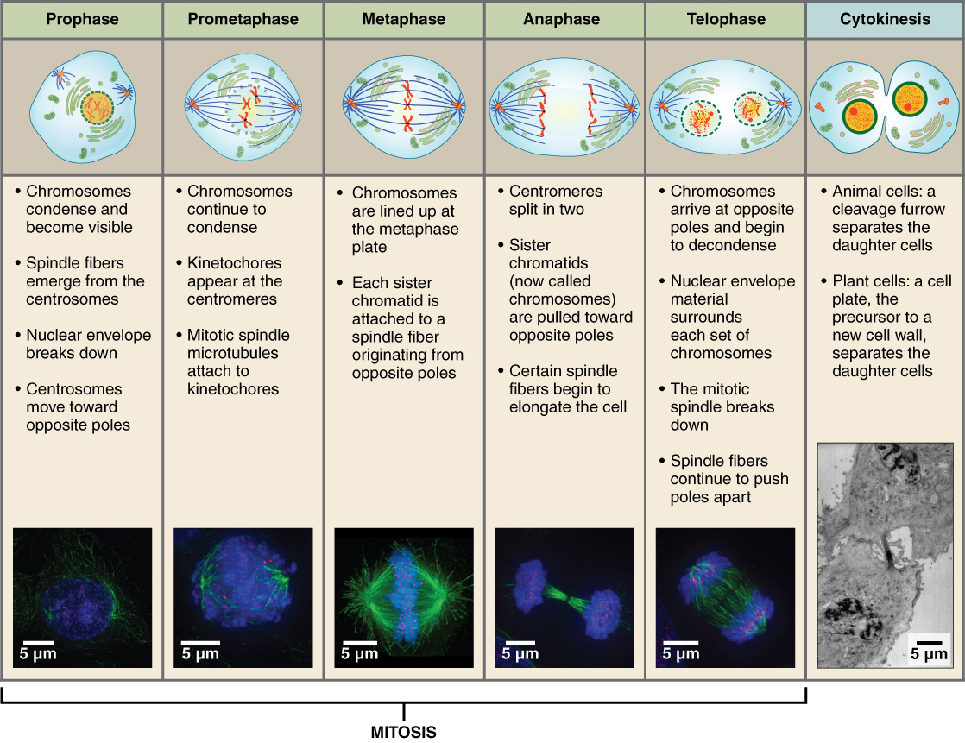

Slide 20
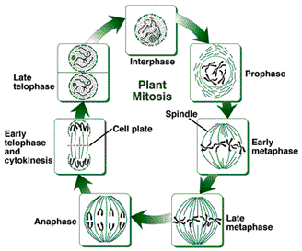

Slide 21
Cytokinesis Cytokinesis is the division of the cytoplasm typically flows mitosis. Cells divide by in growth of the cell wall and plasma membrane, a phragmoplast (microtubules) forms between the two daughter nuclei.

