Slide 1
Plant tissue
Tissues are groups of cells that form a structural and functional unit
Simple tissues have one cell type
Complex tissues have two or more cell types
Plant tissues
Meristematic tissue
Permanent tissue
Simple
complex

Slide 2
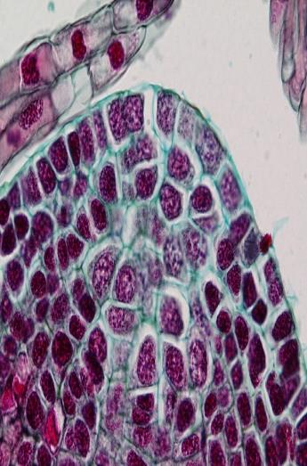
Meristematic tissue
The embryonic tissue consists of actively dividing cells located in specific regions of the plants is called meristem.
Unlike animals, plants have permanent regions of growth called meristems, or meristematic tissues, where cells actively divide. As new cells are produced, they typically are small, six-sided, boxlike structures, each with a proportionately large nucleus, usually near the center, and with tiny vacuoles or no vacuoles at all. As the cells mature, however, they assume many different shapes and sizes, each related to the cell's ultimate function; the vacuoles increase in size, often occupying more than 90% of the volume of the cell.

Slide 3
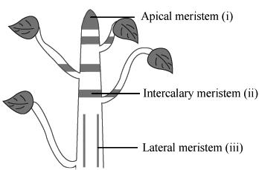
According to the position of meristems in the plant body they are divided into the following types:-
1- Apical meristems: which are found in the apices of the main and lateral shoots and roots.
2- Intercalary meristems: which are found between mature tissues.
3- Lateral meristems: which are situated parallel to the circumference of the organ in which they are found as, for instance the vascular cambium and the phellogen.

Slide 4
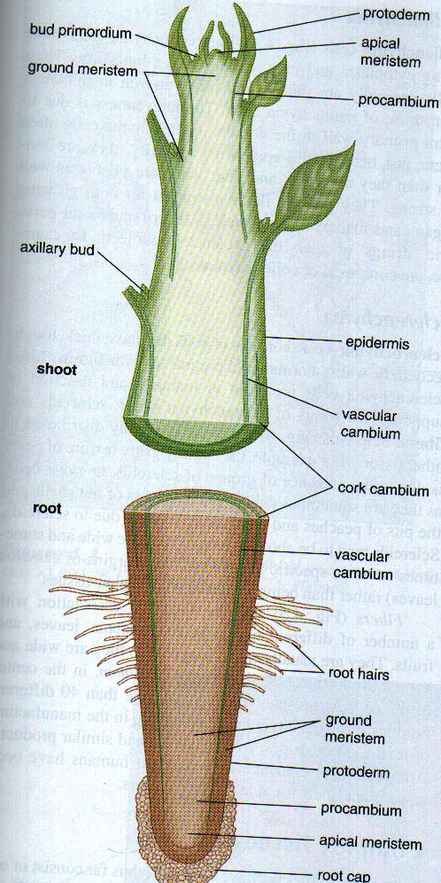
According to the classification of meristems on their origin and the tissues which they produce, their structure which they stage of development and their function of meristems they are divided into the following types:-
1- Primary meristematic tissues: These tissues which are initiated during embryogenesis are extended throughout the plant body by the activity of the apical meristems. These primary meristems are partly differentiated tissues that remain meristematic for some time before they begin to differentiate into specific cell types in the primary tissues in the shoot and root epics, as follows: (Apical meristem in root apices contain calyptrogen which forms the root cap (calyptra)

Slide 5
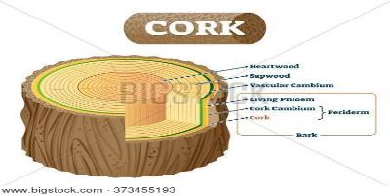
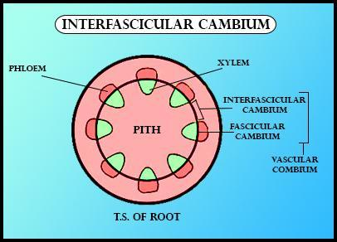
2- Secondary meristematic tissues When the cells first differentiate and function as interfascicular cambium and cock cambium (phellogen), and they are mature tissues system, then again take up meristematic activity, the resulting meristem is called secondary meristem.

Slide 6
Differentiation
the process by which cells that have identical genetic constitutions become different from one another and from the meristematic cells from which they originated often begins while the cell is still enlarging. At maturity, when differentiation is complete, some cells are living and others are dead. These living and dead cells include many different cell types. How cells that have a common origin come to be so different is generally considered one of the crucial questions of modern biology.

Slide 7
Permanent tissue
Simple
Complex

Slide 8
A- Simple permanent tissues like parenchyma tissues, collenchyma tissues and sclerenchyma tissues. Also the permanent tissues are classified on the basis of topographic continuity to tissues system which are:-
1- Dermal tissues system: which consist of epidermis and periderms.
2- Vascular tissue system: consist all xylem and phloem tissues in plant body.
3- Fundamental tissue system: consist cortex, pith ray, ground tissue in monocotyledon and mesophyll in leave

Slide 9
Simple Permanent tissues
sclerenchyma tissue
Parenchyma tissue
Collenchyma tissue

Slide 10
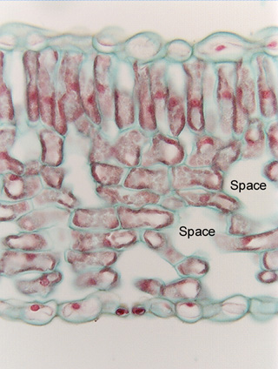
Parenchyma tissue
Types and Positions of Parenchyma: Parenchyma tissue is not confined to the cortex of the stem but occurs in practically all parts of the plant flowers, fruits, seeds, leaves and roots it divided on the basis of function:
1- Ordinary parenchyma.
2- Storage parenchyma.
3- Chlorenchyma. when contains chloroplast
Parenchyma tissue is composed of parenchyma cells, which are the most abundant of the cell types and are found in almost all major parts of higher plants. They are more or less spherical in shape when they are first produced, but when all the parenchyma cells push up against one another, their thin, pliable walls are flattened at the points of contact. As a result, parenchyma cells assume various shapes and sizes, with the majority having 14 sides. They tend to have large vacuoles and may contain starch grains, oils, tannins (tanning or dyeing substances), crystals, and various other secretions.
This tissue is characterized by the presence of intercellular air spaces. The air spaces vary greatly in size; in some parenchyma tissues they are difficult to find while in others they are very apparent. Because parenchyma cell retains active protoplasts, they function in the
1- storage of water and food,
2- photosynthesis and sometimes in secretion. The green color of many stems is due to the presence of chloroplast in the parenchyma cells

Slide 11
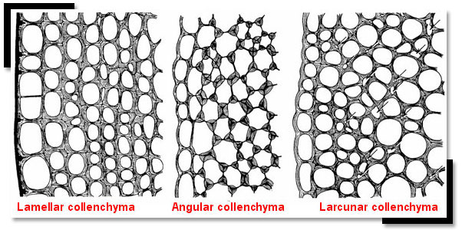
Collenchyma tissue
Collenchyma may occur in other plant parts comprised of primary tissues also. There are three types of collenchyma:
1- Lamellar collenchyma.
2- Lacunar collenchyma.
3- Angular collenchyma
Collenchyma cells, like parenchyma cells;
1- Have living cytoplasm and may remain alive for a long time.
2- Their walls generally are thicker and more uneven in thickness than those of parenchyma cells. The unevenness is due to extra primary wall in the corners.
3- Typically longer than wide
4- Tend to be found under the epidermis
5- Provide flexible support

Slide 12
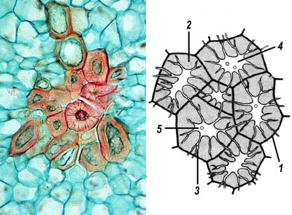
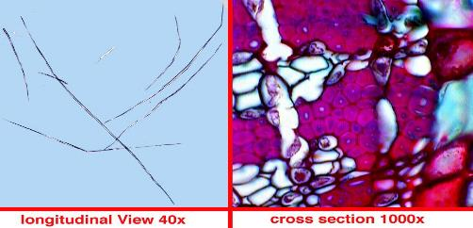
Sclerenchyma tissue
Sclerenchyma tissue consists of cells that have thick, tough, secondary walls, normally impregnated with lignin.
1-Most Sclerenchyma cells are dead at maturity and function in support.
2-Two forms of Sclerenchyma occur: sclereids and fibers.
Sclereids may be randomly distributed in other tissues. For example, the slightly gritty texture of pears is due to the presence of groups of sclereids, are sometimes called stone cells.
Fibers: are elongated think – walled cell usually tapered at the ends. They give strength to the tissue in which they occur. Each fiber is one cell. The walls may or may not be lignified. When lignified the walls may be so thick that the cavity (lumen) of the cell almost disappears. Fibers are usually very elastic and can be stretched to a great degree without losing their ability of returning to their original length. Various types' fibers occur in vascular tissue of stems as well as in the cortex. The protoplasts of fibers often disappear as they attain maturity.

