Slide 1
Permanent complex tissue
Vascular Tissue:
The stems of plants consist of epidermal, cortex and vascular regions. The vascular region consisting of xylem and phloem, extend from the roots through the stem. To the leaves, flowers and fruits. The vascular system of plants contains many specialized cells.

Slide 2
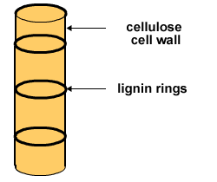
1-Xylem:
Cells of the wood are greatly elongated and have considerable thickening of the walls. The kinds of cells composing the xylem vary in different plants but may consist of
parenchyma, tracheids, vessel elements, and wood fibers.
Xylem parenchyma is much like ordinary parenchyma, though often thicker walled, and is used chiefly for food storage.

Slide 3
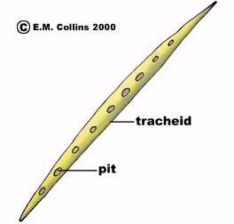
Tracheids: are elongated dead cells with tapering ends and a cavity, or lumen. The walls are somewhat thickened and pitted.

Slide 4
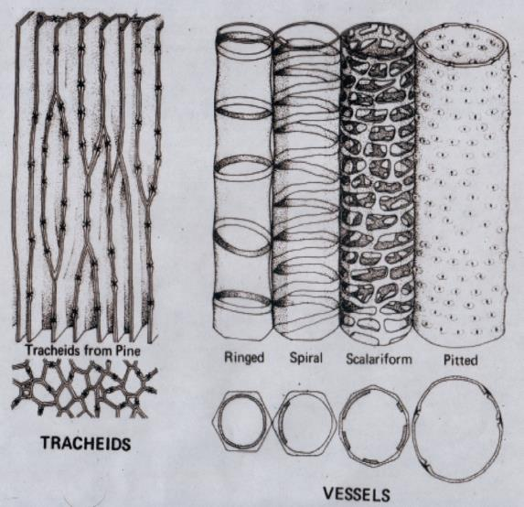
Vessels: The vessels are chains of cylindrical, elongated dead cells attached end to end, with the end walls usually dissolved, forming long tubes or ducts through which water and dissolved, mineral salts are transported. The walls are variously strengthened on the inside by thickened rings:
ringed or annular vessels
spiral vessels
Scalariform vessels,
pitted vessels.
The xylem as a whole is the water conducting and strengthening tissue of the plant.

Slide 5
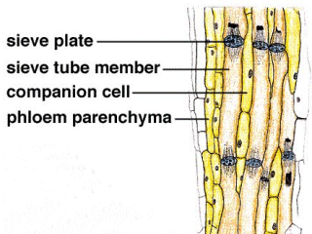
2- Phloem:
The cell composition of the phloem also differs in various plants but it may consist of
phloem parenchyma, phloem fibers, sieve tube elements, and companion cells.
The first two types of cells have already been described.

Slide 6
The sieve tube cell
The most characteristic cell type of the phloem is the sieve tube cell. Sieve tubes consist of longitudinal rows of elongated, thin walled, living cells with rather large cavities. The end walls of the sieve-tube element are perforated forming the so-called sieve plates.
Lying adjacent to the sieve-tube elements and connected with them by pores are usually one or more rows of smaller elongated cells known as companion cells which are a specialized type of parenchyma, filled with dense cytoplasm and a prominent nucleus.

Slide 7
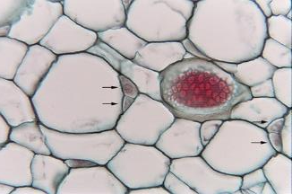
Companion cells are “companions” to sieve tube cells
Because sieve tube cells have no nuclei, the companion cells provide all the nutrients to the sieve tube cell

Slide 8
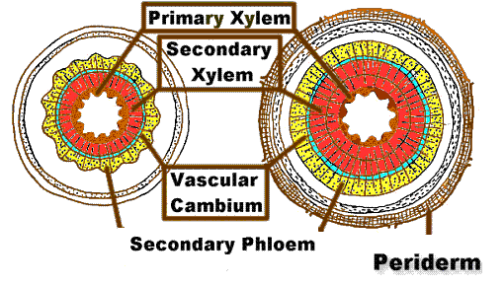
vasclar cambium:
Xylem and phloem elements that have differentiated from procambium cell remain to be meristematic. Certain cells derived from procambium, however do not lose their meristematic character. They from a narrow tissue, between xylem and phloem, known as vascular cambium.

Slide 9
Dermal tissue
Epidermis
Periderm

Slide 10
The dermal tissue system protects the soft tissues of plants and controls interactions with the plants' surroundings.
The dermal tissue system consists of the epidermis and the periderm. The epidermis is generally a single layer (some times more than one layer) of closely packed cells. It both covers and protects the plant. It can be thought of as the plant's "skin." Depending on the part of the plant that it covers, the dermal tissue system can be specialized to a certain extent. For instance, the epidermis of a plant's leaves secretes a coating called the cuticle that helps the plant retain water. The epidermis in plant leaves and stems also contain pores called stomata. Guard cells in the epidermis regulate gas exchange between the plant and the environment by controlling the size of the stomata openings.

Slide 11
Epidermis
The epidermis is a single-layered group of cells that covers plants' leaves, flowers, roots and stems. It forms a boundary between the plant and the external environment. The epidermis serves several functions, it protects against water loss, regulates gas exchange, secretes metabolic compounds, and (especially in roots) absorbs water and mineral nutrients. The epidermis of most leaves shows dorsoventral anatomy: the upper (adaxial) and lower (abaxial) surfaces have somewhat different construction and may serve different functions

Slide 12
a-Epidural cells: most of the epidermal cells are compactly arranged providing mechanical protection to the plant parts. The walls of the epidermal cells of the aerial parts are covered by a cuticle, which minimizes water loss. The cuticle consists mainly of cutin and wax. b-Stomata apparatus: the epidermis contains stomata apparatus which contains Guard cells, and air cavity (sub-stomata chamber) and small pores or stomata (single stoma), they differ in shape from the outer epidermal cells, they control the movement of gases including; water vapor and CO₂ inside air cavity and out of these pores. c-Epidermal trichomes (hairs): these trichomes have a variety in function i- Root hairs facilitate the absorption of water and minerals from the soil ii- In the arial parts these trichomes are increased reflection of solar radiation, lower leaf temperature and lower rates of water loss.

Slide 13
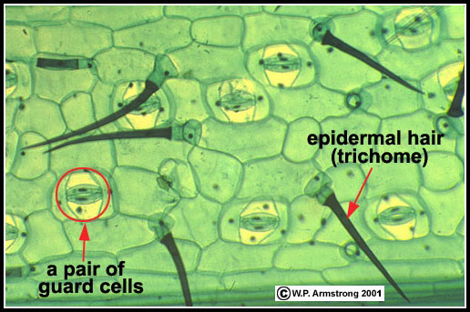
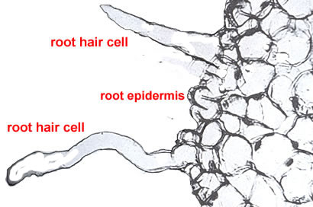
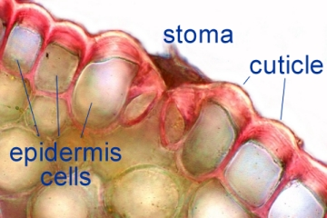

Slide 14
The periderm
The periderm is the secondary protective (dermal) tissue that replaces the epidermis during growth in thickness of stems and roots of gymnosperms and dicotyledons (i.e., secondary growth). Unlike the epidermis, the periderm is a multilayered tissue system, the bulk of which usually constitutes the cork, or phellem.
The cells in periderm are generally arranged compactly, and contain the lenticels which provide for aeration of internal tissues of roots and stems.

Slide 15
The periderm includes:
a-Largely cork(phellem): its nonliving and has walls that are heavily suberized (contain suberin) at maturity.
b-Cork cambium |(phellogen): which forms (1) cork tissue on its outer surface, and (2) forms phelloderm in the inner part.
c-Phelloderm (secondary cortex): it’s a living parenchyma tissue

Slide 16
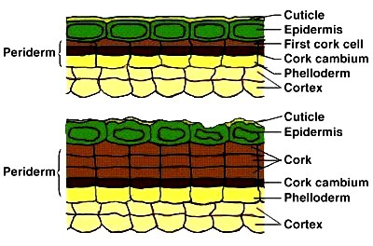

Slide 17
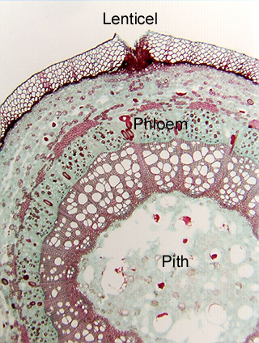
Lenticels
The initial periderm is interrupted at points around the stem by the occurrence of lenticels. These are blister-like, lenticular breaks in the surface. Most often, a lenticel on a stem forms where a stomate once occurred. The lenticel phellogen forms from cells interior to the stomate (lining the substomatal chamber) and is also connected with the adjacent cork cambium. From the lenticel phellogen cells are also produced to the outside and inside, but the outer cells tend to round up and thereby have intercellular air spaces (Phellem usually has no intercellular air spaces.).

Slide 18
so that the tissue inside the lenticel is more loosely packed (filling tissue or complementary tissue). The cells of the lenticel also tend to expand outside the stem, yielding that blistered appearance. Each lenticel therefore becomes a pathway through which gases (especially oxygen) can diffuse to the living cells of the bark. Without sufficient oxygen, cells of bark can die.
Lenticels also can be found on fruits, e.g., the specks on apples and pears and warts on avocado.

Slide 19
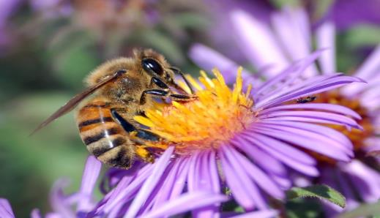
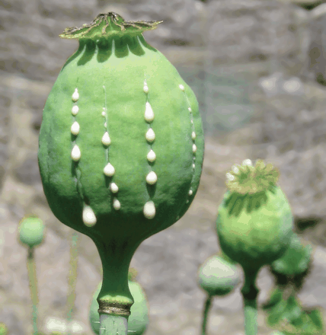
Secretory tissues
*nectar (flowers) from nectaries
*oils (peanuts, oranges, citrus) from accumulation of glands and elaioplasts.
*resins (conifers) from resin canals
*laticifers (e.g., latex - milkweed, rubber plants, opium poppy)
*hydathodes (openings for secretion of water)
*digestive glands of carnivorous plants (enzymes)
*salt glands that shed salt (especial in plants adapted to environments laden with salt).

Slide 20
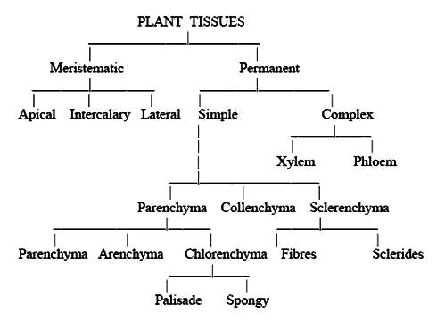

Slide 21
P
r
i
m
a
r
y
M
e
r
i
s
t
e
m
T
i
s
s
u
e
S
y
s
t
e
m
T
i
s
s
u
e
s
C
e
l
l
s
e
p
i
d
e
r
m
i
s
d
e
r
m
a
l
p
a
r
e
n
c
h
y
m
a
p
e
r
i
d
e
r
m
p
r
o
t
o
d
e
r
m
v
e
s
s
e
l
s
t
r
a
c
h
e
i
d
s
x
y
l
e
m
p
a
r
e
n
c
h
y
m
a
f
i
b
e
r
s
A
p
i
c
a
l
M
e
r
i
s
t
e
m
p
r
o
c
a
m
b
i
u
m
v
a
s
c
u
l
a
r
p
h
l
o
e
m
s
i
e
v
e
t
u
b
e
m
e
m
b
e
r
s
c
o
m
p
a
n
i
o
n
c
e
l
l
s
p
a
r
e
n
c
h
y
m
a
f
i
b
e
r
s
g
r
o
u
n
d
m
e
r
i
s
t
e
m
p
a
r
e
n
c
h
y
m
a
p
a
r
e
n
c
h
y
m
a
g
r
o
u
n
d
c
o
l
e
n
c
h
y
m
a
c
o
l
l
e
n
c
h
y
m
a
s
c
l
e
r
e
n
c
h
y
m
a
s
c
l
e
r
e
i
d
s
C
e
l
l
D
i
f
f
e
r
e
n
t
i
a
t
i
o
n
i
n
P
l
a
n
t
s
f
i
b
e
r
s

