Slide 1
The Leaves
The Leaf (Leaves)
Leaf Functions
Leaf structure
Leaf Parts
Internal structure of leaf blade
Phyllotaxis or leaves arrangement
Leaf Venation
Modification of Leaves

Slide 2
The leaf:
Leaf is a lateral appendage of the stem born at the node and bears an axillary bud in its axil. It is usually expanded and concerned with the manufacture of food (photosynthesis).
Leaves:
Leaves are the primary food-producing organs of a plant. They are designed to be efficient in collecting light and using that light energy to produce food. The leaves vary in size. When the leaf attains full size it stops its growth.

Slide 3
Leaf Functions :
leaves able to get every possible ray of the sun. In this way
Photosynthesis is carried in them and are capable of forming food.
2. Loss of water, transpiration is also carried through them by stomata.
3. They also act as ventilators through which gaseous exchange takes
places, they help in respiration.
4. Some leaves get modified to perform certain function.

Slide 4
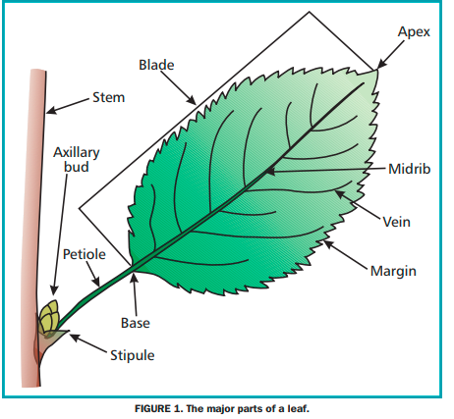
Leaf structure: A leaf is held away from the stem by a petiole and it is attached to the stem at a node. Where they meet is a leaf axil which contains a bud or buds.
Leaf Parts : The leaf consists of three parts :
(1) Leaf base: It is the part of the leaf by means which it attached to the stem or a branch at a node in grass.
(2) Petiole or Leaf stalk: is commonly cylindrical like a stem structure which connects the lamina with the stem
(3) Lamina or Leaf blade : It is thin, green, expanded part of the leaf and is very important for whole of the plant. A leaf is often organized with one main vein running down the middle of the blade. This vein is called the midrib.

Slide 5
Internal structure of leaf blade:
The epidermis is the skin like layer of cells found on both the top and bottom surfaces of the leaf.
The cuticle is part of the epidermis and produces from a waxy layer called cutin which protects the leaf from diseases and dehydration.
Guard cells regulate the passage of CO2, O2 and water through tiny openings called a stoma. The opening and closing of stoma is controlled by a pair of guard cells.
Palisade mesophyll, beneath the upper epidermis are a layer of standing cells called the palisade mesophyll
spongy mesophyll a layer of loosely packed cells called the spongy mesophyll.
Veins: The blade is supported by a system of veins that also contain both xylem and phloem (Vascular bundles).

Slide 6
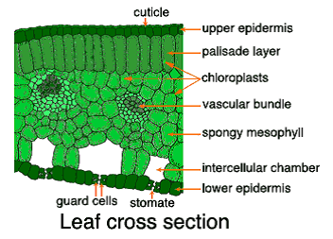
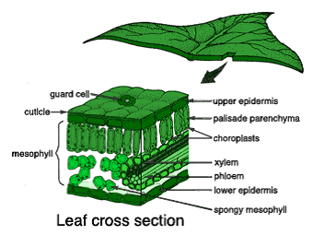

Slide 7
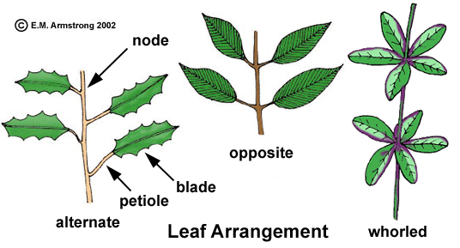
Phyllotaxis or leaves arrangement:
The mode or arrangement in which the leaves are borne on the stems or branches is called Phyllotaxis.
a) Alternate: If only one leaf is attached at a node, the leaves are alternate.
b) Opposite: If two leaves are formed at the same node, on opposite sides of the twig, the leaves are termed opposite.
c) Whorled In a relatively small number of plants more than two leaves arise from the same node in a arrangement. These arrangements are found on herbaceous stems as well as on twigs.

Slide 8
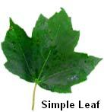
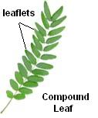
Leaf types:
The leaves have been divided into following two categories:
(a) Simple leaves : When the blade of the leaf is entire , but leaf lamina does not form separate lobes it is called simple leaf as in case of sunflower
(b) Compound leaves : When the blade (lamina) of the leaf is completely divided into separate lobes and each lobe is called leaflet is called compound leaf as in case of Rose,

Slide 9
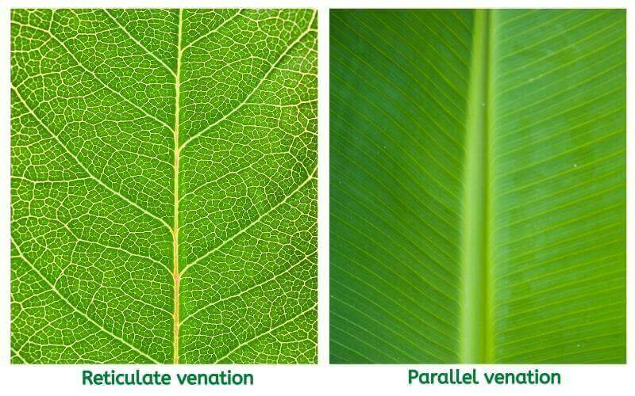
Leaf Venation:
The system in which the veins are present in the lamina of the leaf is called venation.
There are (2) types:
Reticulate Venation: In this case the veins branch and re ­branch thus for reticulum or network on the lamina. This is generally found in dicot leaves but some monocot leaves also show reticulate venation as in Smilax,Arum
2. Parallel Venation: Here the veins arising from the base of lamina and run parallel to one.

Slide 10
Modification of Leaves:
Generally the function of the leaves is to carry on Photosynthesis i.e., making of food. But under special circumstances the leaves are to perform specialized functions accordingly, they get modified into distinct forms. The leaves show the following modifications:
Tendrils leaves
Spiny leaves
Storage leaves

