Slide 1
Tribology Friction, Wear and Lubrication Module Code 3151
Third Year Class
Spring Semester
Tutor: Dr. Wael Ali Khudhair
Wael.Khudhair@su.edu.krd

Slide 2
Chapter 1: Introduction
Definition
Tribology, is defined as ‘the branch of science and technology concerned with interacting surfaces in relative motion and with associated matters’, and includes the study of friction, wear, lubrication and the design of bearings.
The word ‘tribology’ (from the Greek: τριβος = rubbing or attrition)
Mechanical systems in which surfaces do not slide or roll against each other are rare, and tribology is therefore a key enabling technology with very wide application.
Advances in tribology have underpinned much of the world’s engineering progress. Its reach extends to all aspects of modern technology, from transport and power generation to medical engineering, food science and cosmetics.

Slide 3
Friction
Friction may be defined as the resistance force encountered by on body in moving over another.
Friction does play a central role in the performance of many mechanical systems.
In some cases, low friction is desirable and even essential. The satisfactory operation of joints, for example, whether hinges on doors, human hip joints or bridge supports, demands a low friction force.
Work done in overcoming friction in bearings and gears in machines is dissipated as heat, and by reducing friction we can achieve an increase in overall efficiency.
But low friction is not necessarily beneficial in all cases. In brakes and clutches, adequate and controlled friction is essential to dissipate kinetic energy and transfer torque.
High friction is similarly desirable between a vehicle tire and the road surface, just as it is between the human foot and the ground for walking.

Slide 4
Wear
Wear will occur ,whenever surfaces move over each other, causing damage to one or both surfaces, generally involving progressive loss of material. Sometimes the wear is imperceptibly slight, but it can also be extremely rapid.
In most cases, wear is detrimental perhaps causing: -
increased clearances between the moving components.
unwanted freedom of movement.
loss of precision.
It often leads to vibration, to increased mechanical loading and yet more rapid wear, and sometimes to fatigue failure.
The loss by wear of relatively small amounts of material can be enough to cause complete failure of large and complex machines, and there are unfortunately cases where the root causes of major engineering disasters can be traced back to wear.

Slide 5
Wear
High wear rate , however, are sometimes desirable. Grinding
and polishing, for example, are widely used manufacturing processes that employ wear to remove material in a controlled manner.
An initial small amount of wear is often anticipated and even welcomed during the ‘running-in’ process in some kinds of machinery.

Slide 6
Lubrication
Lubrication is considered as a key method of reducing friction, and often also wear, and the study of lubrication is very closely related to that of friction and wear.
Even when an artificial lubricant is not added to a system, components of the surrounding atmosphere (especially the oxygen and water vapor in the air) often play a similar role and must be considered in any study of the interaction of the surfaces.

Slide 7
Junction Growth Theory
Determining coefficient of friction using Solid Mechanics (Junction Growth)
$σ_{1,2}= \frac{σ_{x}+ σ_{y}}{2} ±\sqrt{{(\frac{σ_{x}+ σ_{y}}{2} )}^{2}+τ_{xy}^{2} }$
When $σ_{x}=0$ , $σ_{y}=δW/δA$ and $τ_{xy}=δF/δA$
$δAσ_{1}= \frac{δW}{2}+\sqrt{{(\frac{δW}{2} )}^{2}+{δF}^{2} }$ - - - - - (1)
Where $σ_{1}$ is the first principal stress and $δA$ is element area
$δAσ_{2}= \frac{δW}{2}−\sqrt{{(\frac{δW}{2} )}^{2}+{δF}^{2} }$ - - - - - (2)
Where $σ_{2}$ is the second principal stress

Slide 8
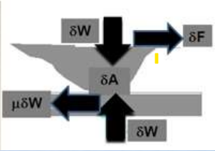

Slide 9
Junction Growth Theory
$δA\left(σ_{1 }−σ_{2}\right)= 2 \sqrt{{\left(\frac{δW}{2} \right)}^{2}+{δF}^{2} }$
If yield strength of the material is$σ_{y}= σ_{1}− σ_{2}$
and shear strength $τ_{y}= 0.5 σ_{y}$
then $δA.τ_{y} = \sqrt{{(\frac{δW}{2} )}^{2} + {δF}^{2} }$
since $τ_{y}$ and 2 are constants then
F = f (A) ????
that means Friction increase area of contact
Area of contact will increase with increasing friction force, till the force reaches its limiting value.

Slide 10
Limiting Junction Growth
Assume $τ_{i}$ is shear stress of fractured interface
$F_{limiting}= τ_{i}$ A max
$μ= \frac{F limiting}{W}$
since$δA.τ_{y} = \sqrt{{(\frac{δW}{2} )}^{2}+{δF}^{2} }$
Then ${ (A max . τ_{y )}}^{2}= {( \frac{W}{2} )}^{2}+ {( A max . τ_{i } )}^{2}$
$$μ= \frac{τ_{i }. Amax }{2 \sqrt{\left(τ_{y}^{2} − τ_{i}^{2} \right)A^{2} .max}}$$
$$μ= \frac{τ_{i } }{2 \sqrt{\left(τ_{y}^{2} − τ_{i}^{2} \right)}}= \frac{0.5}{\sqrt{( {(\frac{τ_{y}}{τ_{i}} )}^{2}−1}}$$

Slide 11
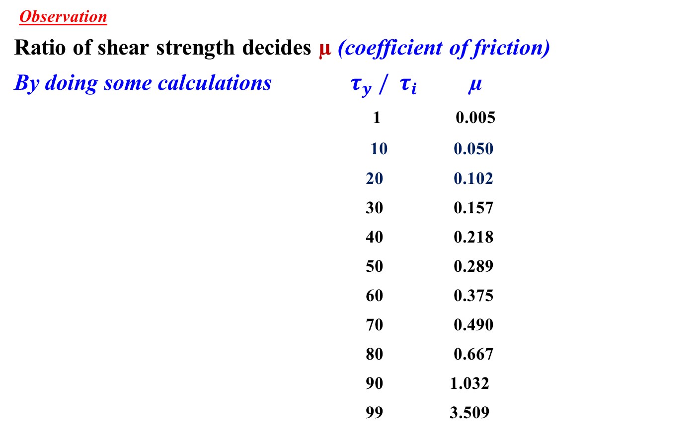
Limiting Junction Growth
Observation
Ratio of shear strength decides µ (coefficient of friction)
By doing some calculations $τ_{y} / τ_{i}$ µ
1 0.005
10 0.050
20 0.102
30 0.157
40 0.218
50 0.289
60 0.375
70 0.490
80 0.667
90 1.032
99 3.509

Slide 12
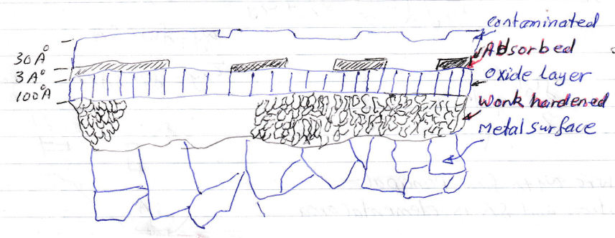
How to reduce Junction Growth
Contamination : -
A few molecules thick oxide layer (encountered with metals in air) on the surface can reduce the friction (i.e., µ = 0.1 to 0.3 ) .

Slide 13
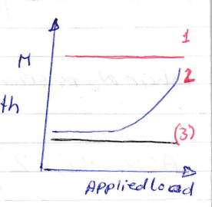
How to reduce Junction Growth
Observation: -
Rough surface ( Rq ˃ 0.2 µm ) may damage protective layers.
Weak (ductile) metal, Weak Oxide (1)
- Film easily broken, rapid junction growth
and high µ . Example: Indium , Gold.
Weak Metal, Strong Oxide (2)
- Transition from low to high µ as load increase
Example: Copper , Iron.
Strong Metal, Strong Oxide (3)
- Low µ at all loads.
Example: Strong steel , Chromium.

Slide 14
How to reduce Junction Growth
Note: - Both Junction growth and ploughing (two / three) effects play role, and either of them may dominated friction behavior.
Lubricant :
Presence of lubricant reduces chances of Junction.
Use of Suitable Contacting Materials
- Using Soft (lesser shear strength, but high hardness) materials result in low shear strength of interface.
- Never use same metal or closely metals in tribo-pair.
µ copper on copper = 1.0
µ Aluminum – low carbon steel = 0.8
µ Silver – low carbon steel = 0.3

Slide 15
How to reduce Junction Growth
Ductility : Use materials of limited ductility.
These materials after a small amount of junction growth will fracture rather than flow further.

Slide 16
Wear
Defining Wear : Undesirable removal of material from operating solid surfaces by:-
Solid
the working parameters are Load , Velocity , Environment and Materials
Fluid ( liquid / gas )
parameters are Velocity, Pressure, Environment and Materials
Wear Increases
Power losses
Oil consumption
Rate of component replacement

Slide 17
Wear
Wear Mechanisms
There are more than 35 Mechanisms
Abrasive Wear
- Polishing, Scouring , Scratching, Grinding, Gouging , - - -
Adhesive Wear
- galling , scuffing, scoring
Cavitation ( localized impact of fluid against a surface during the collapse of bubbles
Corrosive Wear ( chemical nature)
Erosive Wear (impact of particles against a solid surface)
Fatigue (Delamination)
Fretting Wear (between bolt and nut)

Slide 18
Abrasive Wear
Abrasive wear caused by the passage of relatively hard particles / asperities over a surface.
Micro cutting: -
Sharp particle or hard asperity cuts the softer.
Cut material is removed as wear debris.
Micro fracture: -
Abraded material is brittle, e.g., ceramic. Fracture of the worn surface occurs due to merging of a number of smaller cracks.
Micro fatigue: -
When a ductile material is abraded by a blunt particle/asperity then cutting is unlikely and worn surface is repeatedly loaded and unloaded

Slide 19
Abrasive Wear
Removal of material grains: -
Happens in materials (i.e. ceramics) having relatively weak grain boundaries.
Two basic modes of abrasive wear are: -
Two body abrasion
Three body abrasion

Slide 20
2-Body Abrasion
Two interacting asperities in physical contact, and one of them is harder than other.
Example polishing by emery paper.
Normal load causes penetration of harder asperities into softer surface thus producing plastic deformation.
To slide, the material is displaced/removed from the softer surface by combined action of micro ploughing and micro cutting.

