Slide 1
By: Yousef Alkhan Abdulhakeem Supervisor: Miss. Waran N. Abdullah 2022_2023
Salahaddin University-Erbil
College of Agricultural engineering sciences
Department of plant protection
Effect of entomopathogenic fungi verticillium lecanii on lesser grain borer Rhyzopertha dominica (Coleoptera: Bostrichidae) in the stored-wheat

Slide 2
Outline
Introduction
Objectives
Economic importance
Biology and description
Materials and methods
Insect rearing
Entomopathogen
Powder
Results and Discussion
Conclusion
References

Slide 3
Introduction
Wheat is naturally a good source of proteins (8-12%), vitamins such as Vitamin E, minerals such as Iron, Zinc, and dietary fibers,so, Wheat flour is used as the major ingredient in most of the breads (Anjum et al., 2006).
Rhyzopertha dominica is the most economically important primary pest of stored grain in the United States and is a strong flier that can tolerate high temperatures and dry grain (moisture content less than 12%) (David K. et al, 2004).

Slide 4
Chemical insecticides have been widely employed for the control of storage grain pests. This has caused such problems as insecticide resistance along with contamination of foodstuffs with chemical residues. Thus, there is a growing interest in using pathogenic control agents as alternative (Khashaveh, et al).
Entomopathogenic fungi have low environmental impact and are generally considered environmentally safe agents with low mamma- lian toxicity (Rumbos and Athanassiou 2017).

Slide 5
Aim of study (Objectives)
Using alternative methods (safe method) to chemical control
Determine the economic losses caused by Rhyzopertha dominica

Slide 6
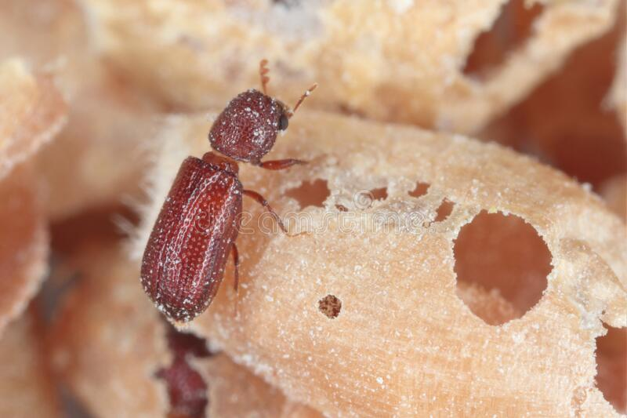
Economic importance
Both grubs and adults cause damage but the adult is more harmful than the grub. They feed within the interiors of the grains and the kernels are reduced to mere shell. The young grub eats out the starchy content by
boring the grain as it is straight but in the later
stage the grub is curved and hence is unable to
penetrate the grain and thus feeds on the waste
Flour left by the adults.

Slide 7
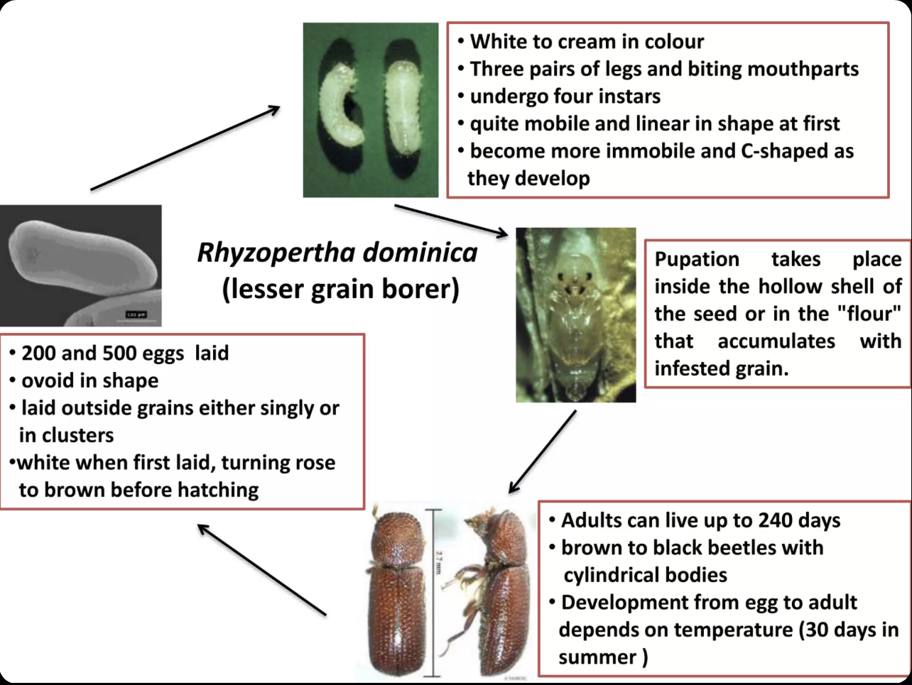
Biology and description

Slide 8
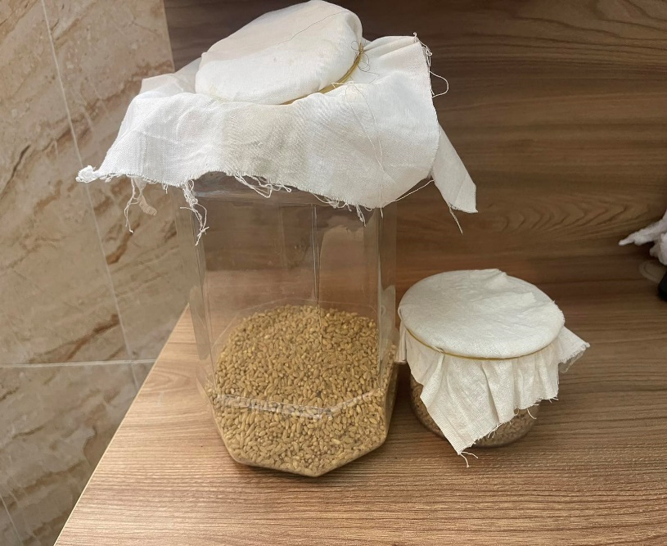
Materials and methods
Insect rearing
Insect rearing Adults of R. dominica collected from infested stored wheat grain were reared on healthy wheat grains
The mouth of each glass jar was covered with muslin cloth and
tied with the help of rubber bands. The glass jars were kept in an
incubator at a constant temperature of 30 ± 20C
and 75 ± 5% relative humidity.

Slide 9
Entomopathogenic fungi verticillium lecanii
Commercially produce formulated conidia of Verticillium lecanii (Zimmerman), containing 1.87×108 conidia per gram of powder was used and kept at 4°C in refrigerator.
Each run of the experiment consisted of an untreated control and two different treatments powder of verticillium lecanii with wheat. Petri dishes containing treated and control insects were sealed with elastic bands. Mortality was recorded after 3, 7, 14, 21, 28 and 35 days.

Slide 10
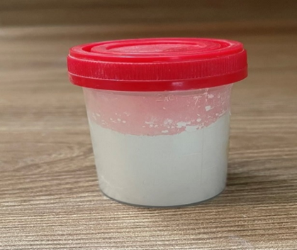
Powder
Verticillium lecanii was applied as powder at three concentration (0.2, 0.4 and 0.6 g) in (1.87×10⁸ spore/ ml). Petri dishes contain filter paper with (5gram wheat and 10 adults).
10 adults of R. dominica were transformed into petri dishes containing steril filter paper (9 cm diameter) then Verticillium lecanii was applied (1.87×10⁸ spore/ ml) at three concentration were sprayed (0.2, 0.4 and 0.6 ml/g) powder after sealed with acloth mesh to prevent them from escaping.

Slide 11
Result and Discussion
Based on the data given in Tab. 1, our analyses show that the data regarding the mortality was recorded after 3 to 35 days exposure intervals. All the treatments gave the significant mortality of R. dominica and V. lecanii of 0.6 g was found to be the most effective after a 35 days exposure intervall.
Table 1: Mortality percentages of R. dominica indicated days treated with Verticillium lecanii at different concentrations:
powder V.lecanii | Mortality percentages of R. dominica indicated days
 | 3 | 7 | 14 | 21 | 28 | 35
0.2 | 6 | 10 | 23 | 30 | 36 | 41
0.4 | 6 | 23 | 30 | 31 | 36 | 48
0.6 | 6 | 46 | 56 | 66 | 73 | 83
Control | 0 | 0 | 0 | 1 | 1 | 2

Slide 12
Result and Discussion
These results show that the effectiveness of entomopathogenic fungi depends on both the fungal concentration and the time elapsed after the treatment. EPFs can be effective when applied directly on the insect or when the insect contacts the applied surface (Castrillo et al. 2013).
Mortality after treatment varied from 6% at low concentration (0.2) to 83% at the highest concentration (0.6 g). Percent mortality of R. domonica was significantly increased after 3 days exposure interval and exceeded 50% in all concentration, the highest mortality was reached to more than 80% at (0.6g) 35 days after treatment. Mortality reached more than 50% after 14 days with the highest concentration. These results are in agreement with those of Mahdneshin et al. (2009) who reported that isolates of B. bassiana and M. anisopliae were more effective against adult R. dominica with higher conidial concentrations and LC50 values of 9.6x105 to 1.9x107 conidia·mL.

Slide 13
Conclusion
Our study once again confirmed that the efficacy of a given fungal species is always strain-specific and virulence may vary depending on the host.
Using of entomopathogenic fungi Verticillium lecanii has potential for effective and economically feasible control of stored product insects because chemical control has many side effects, increasing environmental toxicity and resistance to pest.
In addition, chemicals cause damage to beneficial organisms, causing a loss of natural balance.
Verticillium lecanii was more efficient against adults of Rhyzopertha dominica, based on the result of our study it is one of the best methods we can use as biological control agents to control of this pest and storage pests.

Slide 14
Selected References
Anjum, F. M. Rauf, M. Issa Khan, M. Shahzad, H. (2006). Preparation of low calorific fiber rich cakes by wheat bran supplementation. Nutrition and Food Science 36:438-444.
Khashaveh, A. Ghosta, Y. Safaralizadeh, M. H. Ziaee, M. (2011). The use of entomopathogenic fungus, Beauveria bassiana (Bals.) Vuill. in assays with storage grain beetles. J Agric Sci Technol. 13:35– 43.
Rumbos CI, Athanassiou CG (2017) Use of entomopathogenic fungi for the control of stored-productinsects: can fungi protect durable commodities? J Pest Sci 90:839 –854.

Slide 15
Weaver, D. K. and Petroff, A. (2004). Stored Grain Lesser Grain Borer. High Plains IPM Guide, a cooperative effort of the University of Wyoming, University of Nebraska, Colorado State University and Montana State University. P: 1-4.
Vasal, S. K. (2002). The role of high lysine cereals in animal and human nutrition in Asia. In protein soures for the animal industry. Food and Agriculture Organization in United Nation. Italy, Rome. P.97-108.
Ak. K. (2019). Efficacy of entomopathogenic fungi against the stored-grain pests, Sitophilus granarius L. and S. oryzae L. (Coleoptera: Curculionidae). Egyptian Journal of Biological Pest Control. 29 (12). Pp. 1-7.

Slide 16
Thank you

