Slide 1
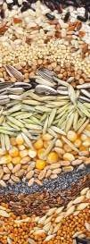
Stored product pests
Practical
Miss. WARAN N. ABDULLAH AGHA
Waran.agha@su.edu.krd
second exam
17/4/2023
Monday

Slide 2
Q1: write 5 difference between Sitophilus oryzae and Sitophilus granaries ?

Slide 3
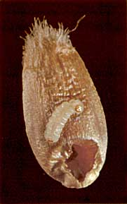
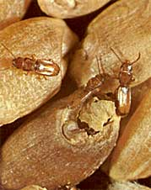
Q2: write natural damage of this species?

Slide 4
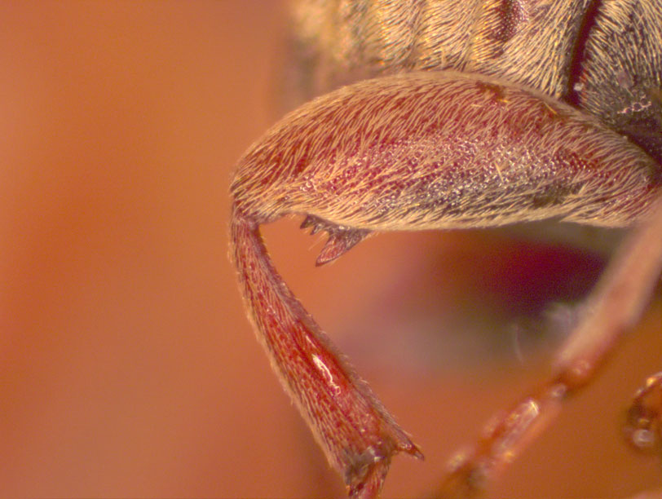
Q3: A: what is this (how can we identify)?
B: write the common name ?

Slide 5
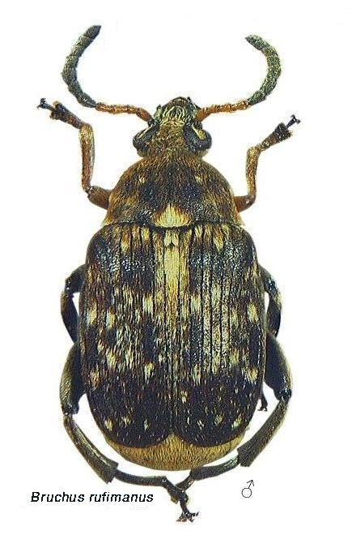
Q4: Identify this insect?
(scientific name and family)

Slide 6
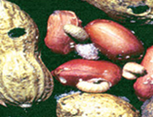
Q5: What is the photo in front of you & what insect is making this?

Slide 7
Q6: Compare between adults of Drugstore beetle & Cigarette beetle?

Slide 8
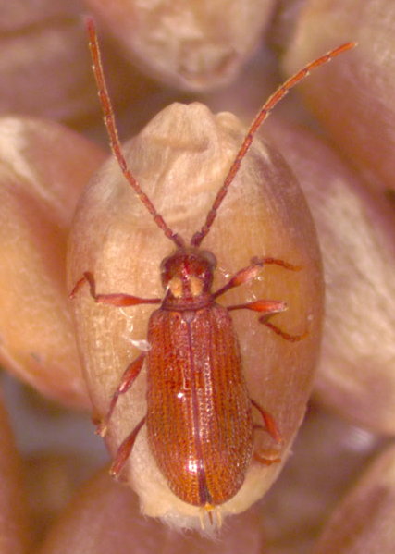
Q7:
A:Identify this insect?
(common name and family)
B: ……………………………… giving a spider-like appearance?

Slide 9
Q8:
1- order……………….. Damage stage is larva.
2- The maize weevil has the characteristic ……………………
3- Callosobruchus maculatus has two……………..
4- Contamination the foods by ………………… & …………….

Slide 10
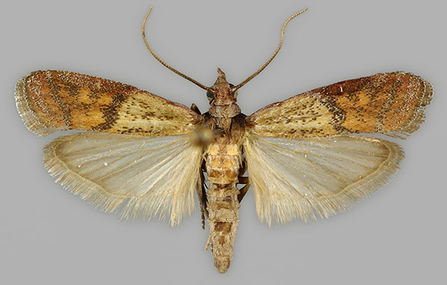
Q9: Identify this insect?
(scientific name and family)

Slide 11
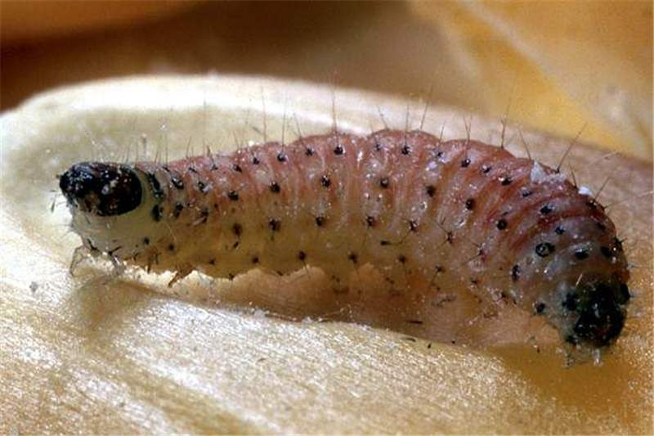
Q10:
A:describe this larvae?
B: write (common name and family)

