Slide 1
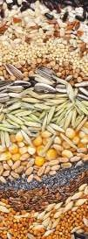
Stored product pests
Practical
Miss. WARAN N. ABDULLAH AGHA
Waran.agha@su.edu.krd
First exam
20/2/2023
Monday

Slide 3
5_6 days (summer
15_ 20 days (winter)
Grub 5
Females lay 300_ 500 eggs
5_ 7 Generations/ Year
Life cycle completed in 56_ 69 days in summer and 66_ 84 days in winter
40_50 days
5_6 adults
4_ 8 days
pupa

