Slide 1
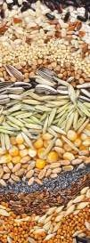
Stored product pests
Practical/ Exam
Miss. WARAN N. ABDULLAH AGHA
Waran.agha@su.edu.krd
Third exam
2/5/2023

Slide 2
Q1:
A: write the main character of order Coleoptera in stored product insects?
B: ……… and ………….are the most common stored-product insect pests.

Slide 3
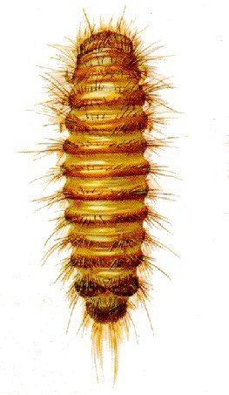
Q2:
A: describe this specimen?
B: write common name and family?

Slide 4
Q3: write 5 differentiate between Tribolium castaneum and confusum ?

Slide 5
Q4:
A: write natural damage of Merchant grain beetle?
B: O. mercator can be separated from O. surinamensis by its ……………….. and by the …………………….. .

Slide 6
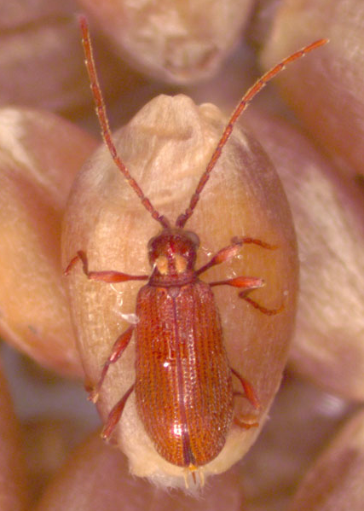
Q5:
A:Identify this insect?
(order and family)
B: ……………………………… giving a spider-like appearance?

Slide 7
Q6: Compare between adults of Drugstore beetle & Cigarette beetle?

Slide 8
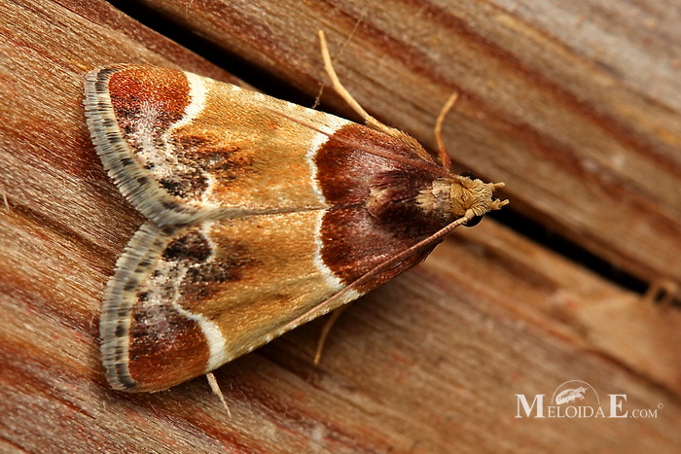
Q7:
A:Identify this insect?
(common name and family)
B: Damage is causes by ………….. Stage feeding and is not distinctive.
?

Slide 9
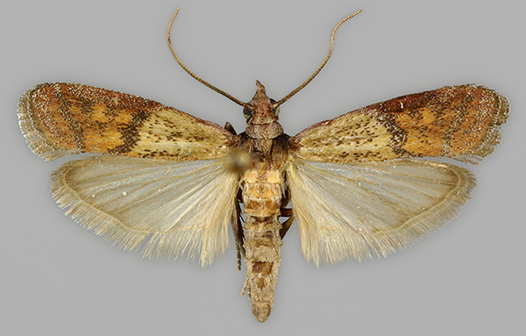
Q8: Identify this insect?
(scientific name and family)

Slide 10
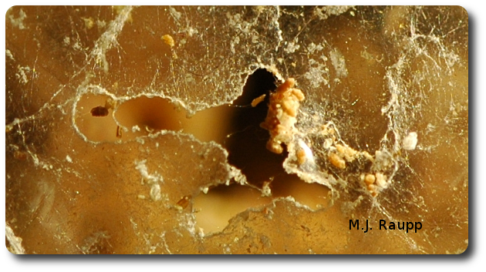
Q9: What is the photo in front of you & what insect is making this?

Slide 11
Q10:
Contamination of stored product insects are by. …………….., …………………, …………………
Mouthparts of lepidoptera in adults are ……………………..,
larval mouthparts are …………………………..

