Slide 1
Spectrophotometric Determination Of Iron(II) In Soil
Experiment no. (2)

Slide 2
Introduction
Any solution which is colored or can be made to be colored by adding a complexing agent can be analyzed using a spectrophotometer. Solutions containing iron ions( Fe³⁺ , Fe²⁺ ) are colorless. Iron can be analyzed spectrophotometrically by forming the reddish-orange tris-complex of iron (II) and 1,10-phenanthroline. This complex absorbs light in the visible region strongly with a maximum absorbance occurring around 510 nm.

Slide 3
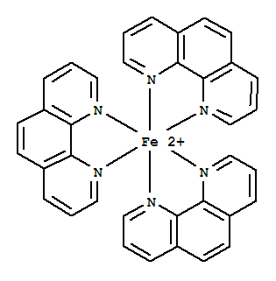
(Structure of Tris(1,10-phenanthroline)iron(II) ion complex)
To form a complex, the ferric ion(Fe³⁺) must be first reduced to its ferrous ion(Fe²⁺). This is done by reacting the iron with (hydroxylamine, NH2OH) by the following reaction:
2 Fe³⁺ + 2 NH2OH + 2 OH⁻ 2 Fe²⁺ + N2 + 4 H2O

Slide 4
Procedure
Dissolve (0.7022) grams of ferrous ammonium sulfate, hexahydrate [Fe(NH4)2(SO4)2.6H2O] in (5mL) (6M) H2SO4 and complete the solution to (1 L) with distilled water. This solution is 100 mg/L Fe⁺² (equal to 100 ppm).
Prepare standard solutions of 0, 5, 10, 15, and 20ppm respectively by diluting stock solution into five separate 100 mL volumetric flasks. To each flask add 5mL of a 0.1% 1,10-phenanthroline solution. Dilute each solution with deionized water to 100 mL.

Slide 5
Preparation of the unknown Weigh accurately about 0.2 gm of the unknown into a 100mL volumetric flask. Add about (5mL) (6M) H2SO4 to dissolve the sample, Add 10mL of freshly prepared 10% w/v hydroxylamine hydrochloride (NH2OH.HCl) and wait 5 to 10 minutes for the reduction of any Fe(III) to Fe(II). Add 8 mL of the sodium acetate buffer, Add 10 mL of 0.25% 1,10-phenanthroline solution, complete to the mark with water and mix thoroughly. Allow 10 minutes for the reddish-orange color to develop completely.

Slide 6
Calibrate the spectrophotometer by the blank as a reference ( which consist of all chemicals except analytes ) and measure the absorbance for each diluted standard solution and unknown solution with a maximum absorbance occurring around 510 nm.
Draw the calibration curve and find the concentration of unknown.

