Slide 1
Archegoniate plants
Archegoniate plants are the plants bearing an archegonium which includes bryophytes, pteridophytes and gymnosperms. The name of this group is derived from the name of female reproductive organ known as archegonium (singular) archegonia (plural). The archegoniate plants comprises the following groups
* Non vascular plants (Bryophytes)
* Seedless vascular plants (Pteridophytes)
* Seed vascular plants (Gymnosperm)

Slide 2
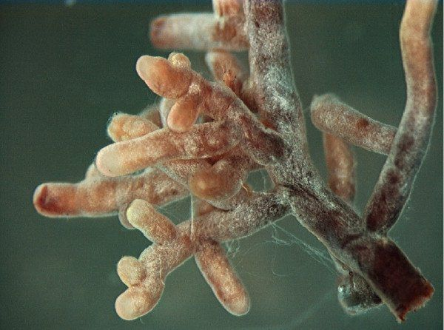
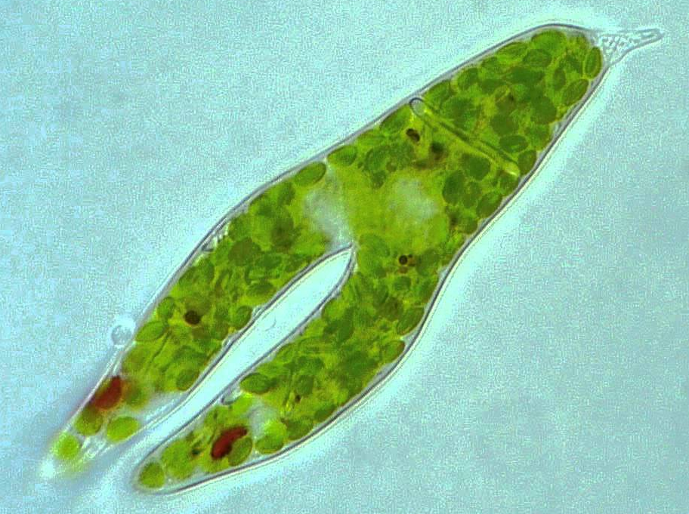
One of the Classification systems, classify Kingdom Plantae to:
Subkingdom Thallophyta: Comprises bacteria, actinomycetes, myxomycetes, fungi, algae, and lichens. The body of Thallophytes, the thallus, is not divided into a root, stem, and leaf; multicellular reproductive organs are absent.

Slide 3
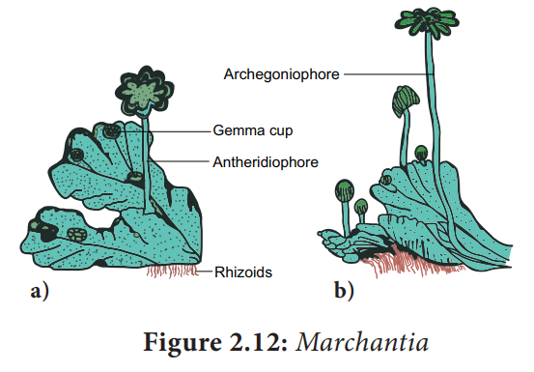
Subkingdom Embryophyta: Comprises hornworts, liverworts, mosses, ferns and their allies, gymnosperms and flowering plants. Embryophyta are the plants where the zygote forms an embryo.

Slide 4
Bryophytes
Bryophytes are the simplest and primitive plants among the embryophytes. This is the first group to invade the land, though they require water for their fertilization therefore they are regarded as plant amphibians.

Slide 5
Life cycle of Bryophyta
The life cycle of a bryophyte consist of a regular alternation of a gamete producing generation and a spore-producing generation. The alternation of generation is obligatory when a gametic union forms a zygote that grows into a sporophyte and when spores produced by a sporophyte always germinate to form gametophyte.

Slide 6
Life cycle of Bryophyta
However the alternation of generation is not obligatory when the gametophyte and sporophyte do not alternate with each other but instead during the life cycle a vegetative propagation of the gametophyte results in a succession of gametophytic generation before there is formation of sporophyte.

Slide 7
It should also be noted that vegetative propagation does not always result in a similar generation. Thus, vegetative budding of sporophytic tissue may result in the formation of a gametophyte. This production of a gametophyte from a sporophyte without the formation of spores is apospory.
Conversely, a gametophyte may bud off a mass of cells which develops into a sporophyte. Production of a sporophyte from a gametophyte without any union of gametes is apogamy.

Slide 8
Apospory and apogamy are of rare occurrence among bryophytes as compared with pteridophytes and most of the recorded cases among bryophytes are among mosses where a wounding of sporophytes induces an aposporous production of gametophytes. The Anthocerotae are also known to be aposporous.

Slide 9
Origin of the Bryophyta
In contrast with pteridophytes, there are no known fossil bryophytes more primitive than present-day forms. The nature of the primitive bryophyte and the manner in which it originated must, therefore, be based upon
1-The comparative morphology
2-Ontogeny of living plants.
There is an almost universal belief that bryophytes arose from algae.

Slide 10
The belief is quite general that these algae were Chlorophyceae, and confirmation of this is seen in the fact that they have been found to be the only algae in which the chlorophylls and xanthophylls are identical with those of bryophytes.

Slide 11
General Characteristics
The Bryophyta have a sharply defined heteromorphic alternation of generations in which sporophyte although morphologically distinct from the gametophyte, is attached to it and never becomes an independent free living plant.
The gametophytic phase is predominant and ecologically persistent, i.e., green, independent and long-lived.
The sporophytic phase is very short-lived, and completely dependent upon the gametophyte.

Slide 12
General Characteristics
Unlike most of the higher plants, bryophytes are not found as single individuals but in groups of individuals which have characteristic features depending on their family, genus or species.
The gametophytic plant body is either thaIloid or differentiated into the erect axis (stem) and lateral appendages (leaves).

Slide 13
General Characteristics
Roots are absent in bryophytes. The rhizoids perform the function of roots. They are either unicellular and unbranched or multicellular and branched.
They never form xylem and phloem tissues.
Vegetative propagation takes place by some special structures, like gemmae, tubers, protonema etc.

Slide 14
General Characteristics
Sexual reproduction is only of oogamous type. They produce large, multicellular sex organs for reproduction.
The male sex organs, called antheridia, are stalked, globose or ovoid with one celled thick jacket surrounding androgonial mother cells.
The female sex organs, called archegonia, are flask-shaped structure having the basal swollen venter containing a ventral canal cell and an egg, and the upper elongated neck containing neck canal cells. Both the venter and neck are surrounded by the sterile jacket.

Slide 15
General Characteristics
The sperms are motile and biflagellate having two whiplash flagellae.
Bryophytes require water for sperm dispersal and subsequent fertilization.
The sperms move short distances in the water film and ultimately reach the open necks of the archegonia. The slimy mucilage secretions in the archegonial neck help to pull the sperm downward to the egg.

Slide 16
General Characteristics
The zygote does not pass any resting phase. Embryonic growth of the sporophyte begins within the venter of the archegonium soon after fertilization.
The sporophyte consists of only bulbous foot, with or without an un-branched seta and a single terminal sporangium. Sometimes the sporophyte is represented only by a capsule (Riccia). The capsule has a protective covering called calyptra which is a part of gametophyte. As the sporophyte of bryophytes is monosporangiate (containing a single sporangium), they are called sporogonium.
.

Slide 17
General Characteristics
Bryophytes are homosporous- isospores (spores are identical morphologically and physiologically) are produced from the sporogenous cells of the capsule.
The spore after germination either produces a filamentous germ tube that gives rise to a young gametophyte (Riccia, Marchantia) or produces a protonema which bears leafy buds that will ultimately form the adult gametophytic shoot.

Slide 18
Classification of Bryophytes
Class 1: Marchantiophyta (Liverworts)
Class 2: Anthocerotophyta (Hornworts)
Class 3: Bryophyta (Mosses)

