Slide 1
Division: Bryophyta - (Mosses)
Mosses are differs from other bryophyte (liverworts and hornworts) in:
Vegetative features of gametophyte.
Early ontogeny and mature structure of sex organs.
Early ontogeny and mature structure of sporophytes.

Slide 2
The General characters of mosses
While liverworts and hornworts totally lack a vascular system, mosses have simple soft strands of conducting cells.
The mature gametophyte is differentiated into an upright branched axis and spirally arranged leaves.

Slide 3
The General characters of mosses
The leaves of mosses are always sessile they lack a petiol and the lamina is thus inserted directly on the stem at it is apex. Leaves are normally only one layer thick except at the midrib (which is lacking in some genera).

Slide 4
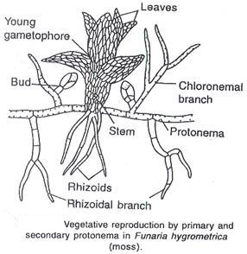
The General characters of mosses
The rhizoids borne by both: protonema and gametophore, are multicellular and with diagonal cross wall branched and reddish-brown in colour. Rhizoid are absent in Takaya and restricted to the protonemal stage in Sphagnum.

Slide 5
The General characters of mosses
The sporophyte is differentiated into foot, seta and capsule. Capsules with a greater proportion of sterile tissue and frequently have the sterile portion differentiated in to a variety of tissues.

Slide 6
The General characters of Bryopsida
Sporogenous tissue of a capsule may arise in the endothecium or amphithecium of an embryo.
Unlike other bryophytes, Mosses do not have a differentiation of elaters or nurse cells by the sporogenous tissue.

Slide 7
The General characters of mosses
The spores can travel long distance on wind.
The spore germinates to form protonema.
Sex organ are born terminally on gametophyte either at the tip of the main axis or at the end of the lateral branch

Slide 8
The General characters of mosses
Unlike liverworts and hornworts, a mature antheridium has a multicellular long stalk and a club shaped body.
Unlike those of liverworts and hornworts, a mature archegonium consists of a long stalk, a basal swollen venter and an elongated neck.

Slide 9
Division Bryophyta (Mosses) includes approximately 660 genera and 14500 species, and it’s classified into 3 classes: Sphagnidae, Andreaeidae and Bryidae.
Class Bryidae (True Mosses)
The true mosses (Bryidae) differ from other two classes in the following features:

Slide 10
Mature capsules are generally internally differentiated into several tissues.
There is no uniformity in mode of opening of capsules but the great majority of genera have the spore cavity covered by a peristome.

