Slide 1
Non-renewable energy
Exists freely in nature. Some of them exist infinitely (never run out, called RENEWABLE), and the rest have finite amounts (they took millions of years to form, and will run out one day, called NON-RENEWABLE).
Non-renewable energy is energy from fossil fuels (coal, crude oil, natural gas) and uranium. Fossil fuels are mainly made up of Carbon. It is believed that fossil fuels were formed over 300 million years ago when the earth was a lot different in its landscape. It had swampy forests and very shallow seas. This time is referred to as 'Carboniferous Period'.

Slide 2
Fossil fuels are usually found in one location as their formation is from a similar process. Let us take a look at the diagram below to see how fossil fuels are formed:
1. Millions of years ago, dead sea organisms, plants and animals settled on the ocean floor and in the porous rocks. This organic matter had stored energy in them as it used the sun's energy to prepare foods (proteins) for itself (photosynthesis). 2. With time, sand, sediments and impermeable rock settled on the organic matter, trapping its' energy within the porous rocks. That formed pockets of coal, oil and natural gas. 3. Earth movements and rock shifts create spaces that force the collection of these energy types into well-defined areas. With the help of technology, engineers are able to drill down into the seabed to tap the stored energy, which we commonly know as crude oil.

Slide 3
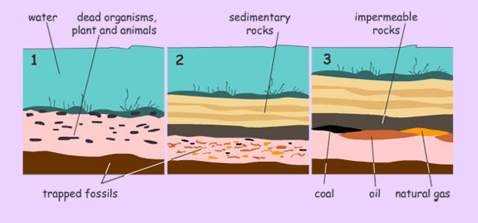

Slide 6
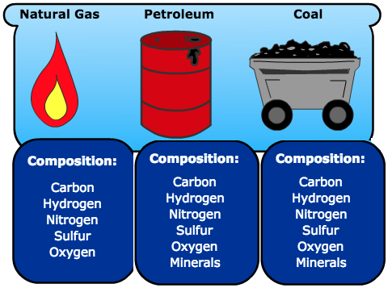

Slide 7
Coal:
Coal is one of the oldest and most abundant non-renewable energy sources used by humans. It is a combustible black or brownish-black sedimentary rock composed primarily of carbon, along with assorted other elements, including sulfur, hydrogen, oxygen, and nitrogen. Coal's formation is the result of the decomposition of plant matter over millions of years under high pressure and temperature, a process known as coalification. Due to its abundance and high energy content, coal has been a key driver of the industrial revolution and remains a major source of energy for electricity generation and other industrial processes worldwide. However, its use comes with significant environmental and health implications.

Slide 8
Uses of Coal
Electricity Generation: The most common use of coal is for generating electricity in thermal power plants. Coal is burned to produce steam, which then drives turbines to generate electricity.
Industrial Processes: Coal is also used as a raw material in the steel and cement industries. For example, it is used in blast furnaces to make steel and as a fuel in the production of cement.
Heating: In some countries, coal is still used for residential and commercial heating due to its high heat output.

Slide 9
Environmental Impact
The combustion of coal is one of the largest sources of carbon dioxide (CO₂) emissions, contributing significantly to global warming and climate change. Additionally, coal-fired power plants release pollutants such as sulfur dioxide (SO₂), nitrogen oxides (NOx), particulate matter (PM), and mercury into the atmosphere. These pollutants can cause respiratory illnesses, heart disease, and neurological damage in humans, and they can acidify water bodies, leading to the degradation of ecosystems.
Coal mining also has substantial environmental impacts, including habitat destruction, soil erosion, and water pollution. Surface mining techniques, such as strip mining and mountaintop removal, can have particularly severe effects on landscapes and ecosystems.

Slide 10
Economic and Social Considerations
Coal is a relatively inexpensive and widely available source of energy, making it a crucial component of the energy mix in many countries, especially those with abundant coal reserves. However, the health impacts of air pollution from coal combustion, as well as the long-term environmental damage, impose significant economic costs in terms of healthcare expenses and lost productivity.
The coal industry is also a significant source of employment in some regions, but the sector is facing challenges due to the global shift towards cleaner energy sources. This transition poses socioeconomic challenges, requiring strategies for economic diversification and support for affected workers and communities.

Slide 11
How is coal converted into electricity?
Let us take a look at the diagram below:
1. Coal is milled to a fine powder, allowing it to burn more quickly. It is blown into the combustion chamber of a boiler where it is burnt at high temperatures.
2. The hot gases and heat energy produced converts water in tubes lining the boiler into steam. 3. The high-pressure steam is passed into a turbine containing thousands of propeller-like blades. The steam pushes these blades causing the turbine shaft to rotate at high speed. The steam is condensed and returned to the boiling chamber where it is heated again.

Slide 12
How is coal converted into electricity?
4. The shaft rotation engages the wire coils and magnets in a generator connected to it. This charged magnetic field produces electricity 5. Electricity is sent to the switchboard (transformer) where it is regulated and sent via on-land cables to homes.

Slide 13
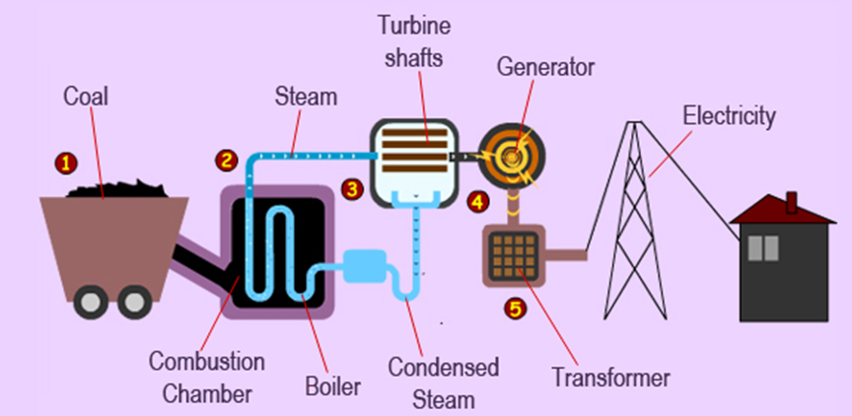

Slide 14
Crude Oil:
Oil, also known as petroleum, is a complex mixture of hydrocarbons and other organic compounds found beneath the Earth's surface. It is a liquid fossil fuel that forms from the remains of ancient marine organisms such as plankton and algae, which were buried under sedimentary rock and subjected to intense heat and pressure over millions of years. Oil is a non-renewable energy source, meaning it cannot be replenished within a human timescale once extracted and used. It plays a critical role in the modern global economy, serving as a key energy source for transportation, heating, and electricity generation, as well as a raw material for various chemical products.

Slide 15
Uses of Oil
Transportation: Oil is refined into various fuels, including gasoline, diesel, and jet fuel, which power cars, trucks, airplanes, and ships.
Electricity generation: Although less common than coal or natural gas, oil can be used to generate electricity in power plants.
Heating: Oil is used for heating in residential and commercial buildings, particularly in the form of heating oil.
Industrial and chemical products: Beyond energy, crude oil is a feedstock for a wide range of chemical products, including plastics, pharmaceuticals, fertilizers, and synthetic fibers.

Slide 16
Environmental Impact
The extraction, refining, and combustion of oil have significant environmental and health impacts. These include:
Greenhouse Gas Emissions: Burning oil releases carbon dioxide (CO₂), a major greenhouse gas contributing to global warming and climate change.
Air Pollution: Combustion of oil products emits pollutants such as sulfur dioxide (SO₂), nitrogen oxides (NOx), particulate matter, and volatile organic compounds (VOCs), which can lead to respiratory problems, heart disease, and other health issues.
Oil Spills: Accidental releases of oil during drilling, transportation, or storage can have devastating effects on marine and coastal ecosystems, killing wildlife, damaging habitats, and impacting local economies dependent on tourism and fishing.
Water Pollution: The oil extraction process can lead to water contamination through the discharge of produced water, which contains various hydrocarbons and heavy metals.

Slide 17
Economic and Social Considerations
Oil is a major driver of the global economy, influencing everything from the cost of transportation and goods to national security policies. Countries with significant oil reserves often rely on oil revenue as a major source of income, which can have both positive and negative effects on their economies and societies. On the one hand, oil wealth can fund public services and infrastructure development; on the other hand, it can lead to economic volatility, corruption, and conflict, a phenomenon known as the "resource curse."

Slide 18
Natural Gas:
Natural gas is a fossil fuel formed from the decay of organic matter over millions of years under high pressure and temperature in the Earth's crust. It is primarily composed of methane (CH₄) along with smaller amounts of other hydrocarbon gases, carbon dioxide, nitrogen, hydrogen sulfide, and in some cases, helium. Natural gas is considered a non-renewable energy resource because its formation takes millions of years, and once extracted and consumed, it cannot be replenished within a human timeframe.

Slide 19
Uses of Natural Gas
Natural gas is versatile and has several applications across various sectors:
Electricity Generation: Natural gas is used as a fuel in power plants to generate electricity. It is favored for its efficiency and relatively lower carbon dioxide emissions compared to coal and oil when combusted.
Heating: It is extensively used for heating homes and water, especially in residential and commercial buildings.
Industrial Use: Natural gas serves as a raw material in the production of chemicals, fertilizers, and hydrogen. It is also used in various industrial processes as a heat source.
Transportation: Though less common, natural gas can be used as a fuel for vehicles in the form of compressed natural gas (CNG) or liquefied natural gas (LNG), offering a cleaner alternative to gasoline and diesel.

Slide 20
Environmental Impact
Although natural gas is the cleanest burning fossil fuel, its extraction, transportation, and combustion have environmental consequences:
Greenhouse Gas Emissions: Burning natural gas produces carbon dioxide, a greenhouse gas. However, its emissions are about half that of coal for the same amount of energy produced, making it a more climate-friendly option among fossil fuels.
Methane Leakage: Methane, the primary component of natural gas, is a potent greenhouse gas with a much higher global warming potential than CO₂ in the short term. Leakages during the extraction, processing, and transportation of natural gas contribute significantly to its greenhouse gas footprint.
Water Pollution: Hydraulic fracturing ("fracking"), a method used to extract natural gas from shale formations, can contaminate groundwater with chemicals used in the fracking fluid.
Habitat Disruption: The extraction process, especially fracking, can lead to land degradation and habitat loss for wildlife.

Slide 21
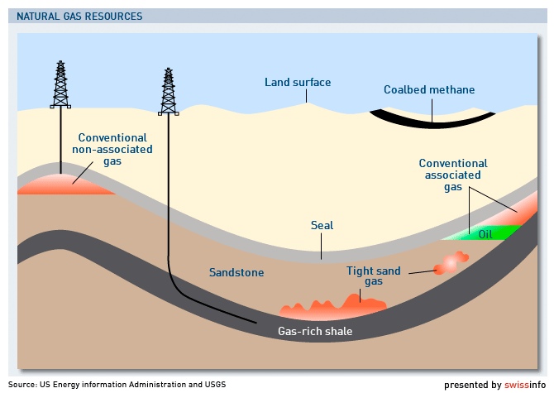

Slide 22
Economic and Social Considerations
Natural gas plays a crucial role in the energy mix of many countries due to its abundance, cost-effectiveness, and lower emissions profile compared to other fossil fuels. It has been pivotal in reducing coal usage in electricity generation, thereby reducing air pollution and greenhouse gas emissions.
However, the reliance on natural gas also presents challenges, including price volatility and geopolitical tensions over control of gas reserves and supply routes. Additionally, the infrastructure required for natural gas extraction and transportation can be capital-intensive and may lock in dependency on fossil fuels, potentially delaying the transition to renewable energy sources.

