Slide 1
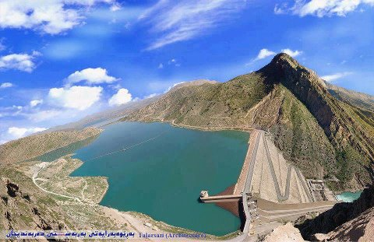
ADVANCED DAM ENGINEERING

Slide 2
Yaseen W. Aziz
BSc. 2012 Dams & Water Recourses
MSc. 2016 W.R. & Dam Engineering (Hydraulics)
yaseen90aziz@gmail.com (Contact email)
Area of interest:
Open channel Hydraulics, CFD, SVF, Well Hydraulics, Rainfall-Runoff modeling.

