Slide 1
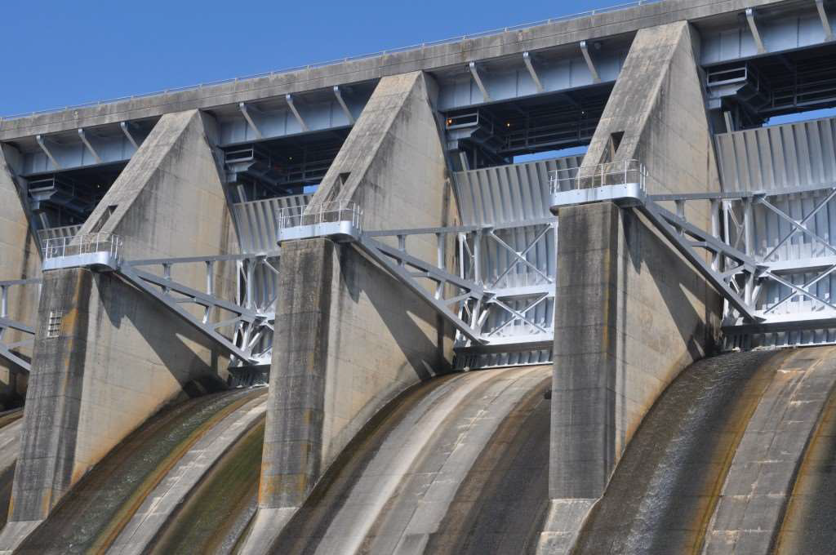
DESIGN OF Spillways AND ENERGY
Dissipators

Slide 2
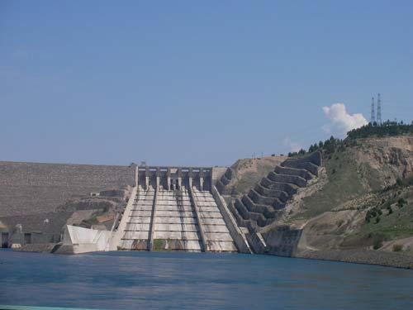
Spillway
Is a hydraulic structure provided at the dam to release flood discharge.
Spillway is the most important component of the dam which serves to release excess flood from a reservoir efficiently and safely.
Its capacity is determined from the hydrological studies over the drainage area.

