Slide 1
Cross drainage and Drop Structures
Yaseen Wsu Aziz
MSc. Hydraulics

Slide 2
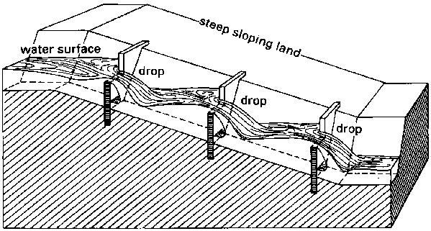
Drop Structures

