Slide 1
Lecture Notes
- Optics-
Prepared by Dr. Y.M. Hassan
Department of Physics/college of science
Note
Use one of the following copies with lecture notes
1-F. L. Pedrotti, L. M. Pedrotti, Introduction to Optics, 2nd ed., prentice- Hall intrnational,Inc.1993.
2-F. L. Pedrotti, L. M. Pedrotti, and L. S. Pedrotti,
Introduction to Optics 3th , ed., Pearson International edition,Pearson, Addison, Wesley, 2007.

Slide 2
Lecture notes covering the following subjects :
Brief history of Optics
Nature of Light;
Production of light and measurements,
Matrix method in paraxial optics
Geometrical Optics;
Aberrations
Some optical Instruments
Wave Equations;
Superposition of Waves;
Interference of Light;
Optical Interferometry;
Fraunhofer Diffraction;
Fresnel Diffraction;
Production of Polarized Light.
Matrix treatment of polarization

Slide 3
Chapter one :Introductory concepts
1.1 Brief history of Optics ：
• Middle Ages
– Alkindi, Alhazen defeat emission hypothesis (~9‐10 century AD) 965-1020
– Lens is invented by accident (northern Italy, ~12th century AD)
– Della Porta, da Vinci, Descartes, Gallileo, Kepler ,formulate geometrical optics, explained lens behaviour, construct optical instruments (~15th century AD)
bn-al-Haitham ( also known as Alhazen) In his investigations, he used spherical and parabolic mirrors and was aware of spherical aberration. He also investigated the magnification produced by lenses and atmospheric refraction. His work was translated into latin and became accessible to later european scholars
• Beyond the middle ages:
– Newton (1642‐1726) and Huygens (1629‐1695) fight over nature of light
1672 | Isaac Newton (England). Newton's earlier observations on the dispersion of sunlight as it passed through a prism were reported to the Royal Society. Newton concluded that sunlight is composed of light of different colors which are refracted by glass to different extents

Slide 4
18th–19th centuries :
-Fresnel, Young experimentally observed diffraction,
defeat Newton’s particle theory
– Maxwell formulates electro‐magnetic equations,
- Hertz verifies antenna emission principle (1899)
1801
Thomas Young (Scotland). Provided support for the wave theory by demonstrating the interference of light
1808
E.L. Malus (France). As a result of observing light reflected from the windows of the Palais Luxembourg in Paris through a calcite crystal as it is rotated, Malus discovered an effect that later led to the conclusion that light can be polarized by reflection
20th century
– Quantum theory explains wave‐particle duality
– Invention of holography (1948)
– Invention of laser (1956)
– Optical applications in communications, fundamental science,
medicine, manufacturing….etc

Slide 5
• Light has the wave‐particle duality. Light behaves like waves in its propagation and in the phenomena of interference and diffraction; however, it exhibits particle‐like behaviour when exchanging energy with matter, as in the Compton
and photoelectric effects.
• Electrons have similar properties.
Bohr’s principle of complementarity: photons and electrons were neither waves nor particles, but something more complex than either.
• Electrons: obey Fermi‐Dirac statistics
(No 2 electrons in the same interesting system can
be in the same state)
• Photons: obey Bose‐Einstein statistics
(identical photons can have the same energy,
momentum, polarization)
• An electrons is capable of both absorbing and emitting a photon.
• The wave description of light will be adequate to describe most of the optical phenomena treated in this course.

Slide 6
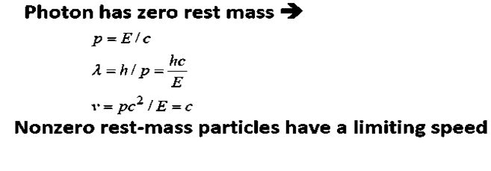
--------------------------( 1.3)
----------------- ( 1.4)
-----------------( 1.5)
Acruial difference between particles like electrons and neutrons and particles like photons that the later have zero rest mass
-------------------------------------( 1.6)
---------------------( 1.7)
-----------------------( 1.8)

Slide 7
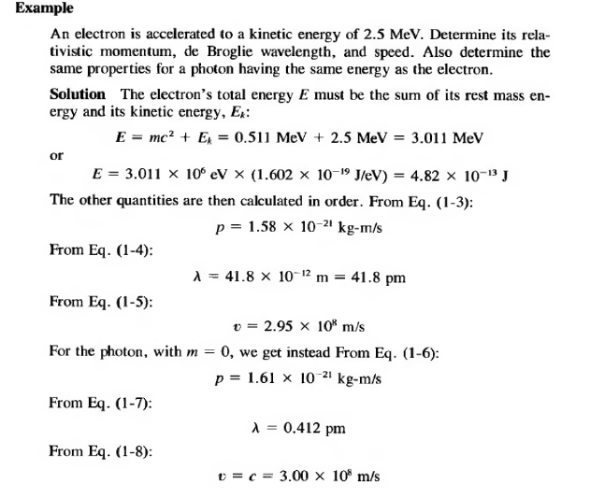

Slide 8
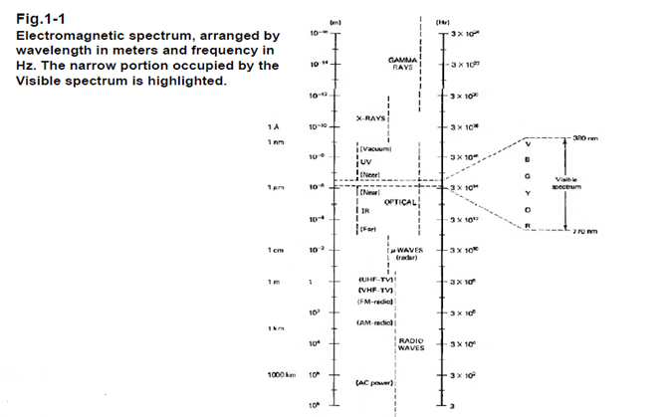
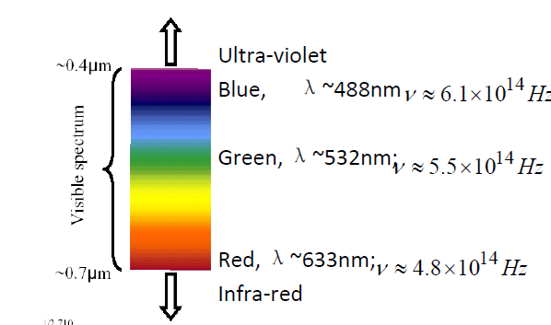
1.2 Electromagnetic Spectrum
Use the relation c=λ$ν$
• The visible light is shown in an enlarged band.

Slide 9
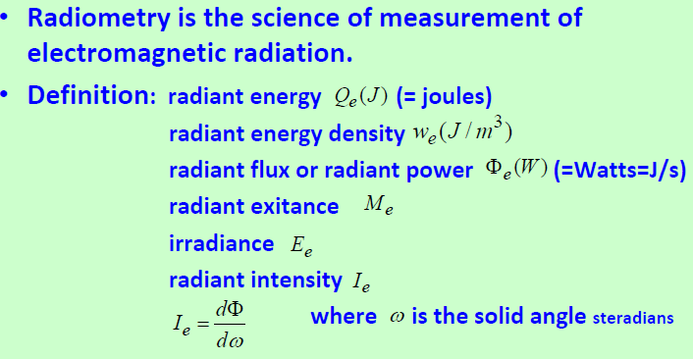
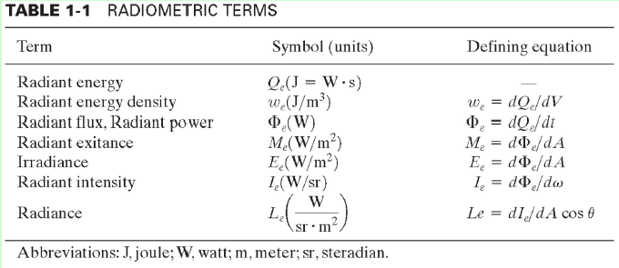
1.3 Radiometry
ω = A / r²

Slide 10
$$φ$$
$$=$$
The inverse squire law of radiation from a point source is
$E_{e}$= $\frac{φ}{A}$= $\frac{4πI_{e}}{4πr^{2}}$= $\frac{I_{e}}{r^{2}}$

Slide 11
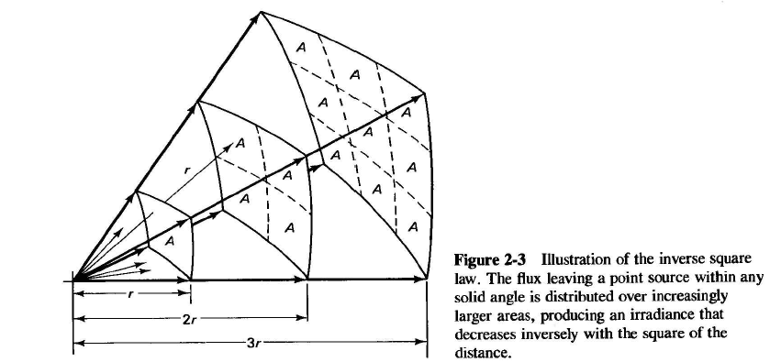
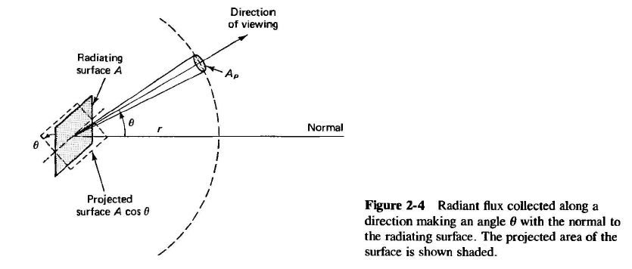

Slide 12
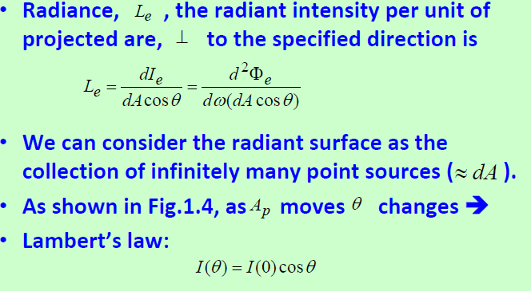
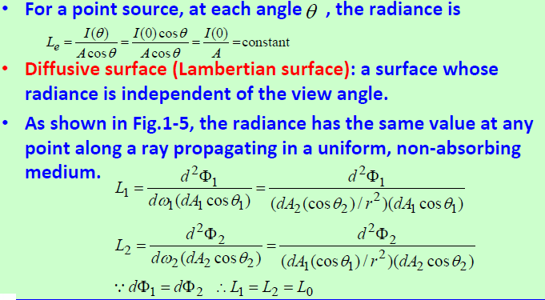

Slide 14
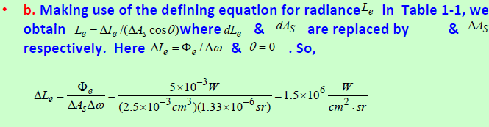
H.W : 1.1, 1.2,1.10

