Slide 1
Photodynamic Therapy (PDT)
some dyes have been known to induce photosensitizing effects as reported by von Tappeiner (1900). The first intended therapeutic application of dyes in combination with light was proposed by von Tappeiner and Jesionek (1903). Later, it was observed by Auler and (1942) that certain porphyrins have a long clearance period in tumor cells.
If these dyes could somehow be transferred to a toxic state, e.g. by laser light, tumor cells could be preferentially treated.
Kelly and Snell (1976) have reported on the first endoscopic application of a photosensitizer in the case of human bladder carcinoma.
Today, the idea of photodynamic therapy has become one of the major pillars in the modern treatment of cancer.
Photodynamic therapy is performed as follows:
first, a photosensitizer,e.g. hematoporphyrin derivative (HpD), is injected into a vein of the patient.In the case of HpD, 2.5–5mg per kg body weight are applied. Within the next few hours, HpD is distributed among all soft tissues except the brain. The basic characteristic of a photosensitizer is that it remains inactive until irradiated. After 48–72 hours, most of it is cleared from healthy tissue.

Slide 2
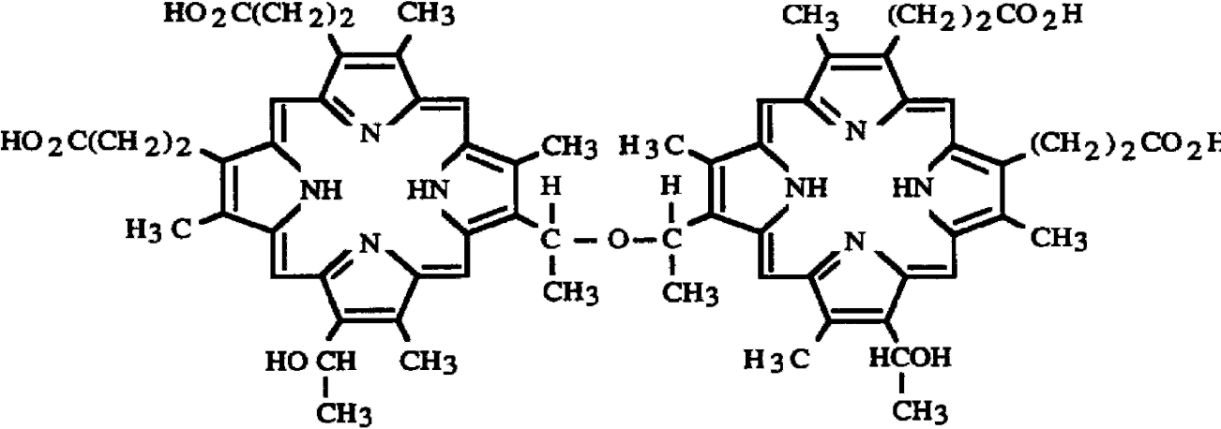
One of the most commonly used photosensitizers in photodynamic therapy is a hematoporphyrin derivative called HpD. It is derived from calf blood and is a complex collection of different porphyrins, mainly:
– dihematoporphyrin,
– hydroxyethylvinyl-deuteroporphyrin,
– protoporphyrin.
Fig. 3.4. Chemical structure of the active substance dihematoporphyrin which consists of two symmetric porphyrin rings

Slide 3
3- Light-Tissue Interaction at the Molecular Level
In order to r understand the different mechanisms and how they arise, we must first revise the basics on what happens when light and matter interact at the level of the photon molecule interaction: molecular absorption and de-excitation.
• First, remember that tissue consists of molecules. It is constructed out of and contains hundreds of different types of molecules (protein, DNA, water, fats, . . . ). When we talk about light interacting with ‘tissue’ we mean light interacting with (some of) the molecules
within the tissue.
• Second, not all of the molecules in the body absorb the same wavelengths of light (e.g blood is red, hair blond and eyes dark) so by choosing the laser wavelength we may be able to target specific molecules. This notion is used to remove tattoos without damaging the surrounding tissue, as they are different colors.

Slide 4
• Third, different molecules behave differently once they have absorbed a photon. Several things could happen, and which does will depend on the particular molecule in question and the energy in the absorbed photon. Fig. 3 shows where the energy - gained from absorbing a photon - ends up, as the molecule returns to its lowest energy level, its ground state, from the excited state reached by absorbing the photon.
3.1 Molecular Absorption of a Photon
An unexcited molecule is said to be in its ground state, its lowest energy level. This is usually a singlet state, so-called because the electrons orbiting the nucleus (for an atom) or nuclei (for
a molecule) are (quantum mechanically) spin-paired ↑↓ and there is only a single orientation in space for such a pair of spins.

Slide 5
When a photon is absorbed, a bound electron interacts with the electric field of the photon ,and the energy in the photon is converted into kinetic energy of the electron. The electron moves to a higher energy level. The energy levels are quantized - an electron bound to a nucleus cannot have any amount of energy it pleases - so the energy conversion, the absorption, will only take place if there is an energy level to which the electron can move with that amount of extra energy. (For atoms, the absorption spectrum contains quite distinct, discrete lines. For large molecules, though, such as those found in tissue, there are so many energy levels that the absorption spectrum becomes virtually continuous. However, the spectrum is not flat, as there will still be frequencies at which the absorption is greater, maybe substantially greater, than others.)
3.2 De-excitation Pathways
Having absorbed the photon, the molecule is now in an excited singlet state. Several things could now happen

Slide 6
1. Photochemical reactions. Because the electron now has more energy, it is moving faster and has more angular momentum and orbits the nuclei at a greater distance. As the attractive nuclear force falls off rapidly with distance, the electron will be less tightly bound, and will form a chemical bond with another molecule more readily. This is the basis of photochemistry.
2. Vibrational relaxation → heating. The electronic energy is converted into vibrational or rotational energy of the molecule. Then through collisions, this vibrational energy is transferred to kinetic energy of nearby molecules. An increase in molecular kinetic energy is just what is called a temperature rise, when observed at the macroscale. This process is called vibrational relaxation and leads to photothermal effects. It occurs rapidly, on a time scale of picoseconds, 10−12 s.
3. Fluorescence. After losing some of the energy through vibrational relaxation, an excited molecule may then jump abruptly to a lower energy state by emitting a photon. As the molecule has already lost some energy this photon is necessarily of a lower energy, and therefore longer wavelength, than the absorbed photon. The lower energy photon is emitted typically 1-100 ns following absorption.

Slide 7
4. Intersystem crossing → triplet state → phosphorescence. Some molecules happen to have singlet and triplet states with the same or very similar energy. (A triplet state is one in which two electrons in different orbitals have parallel spins ↑↑ so they can adopt only three different orientations in space.) When this is the case, the molecule
may undergo an intersystem crossing from the singlet to the triplet state. This unpairing of spins is more likely if the molecule contains a heavy atom such as sulphur. In this triplet state, the molecule may undergo reactions with other molecules, notably oxygen in photodynamic therapy, or the excess electronic energy may be released as a low energy photon in a process called phosphorescence, returning the molecule to its singlet ground state. Because this triplet-to-singlet transition is a ‘forbidden’ transition it is unlikely to occur, so the low energy photon is emitted typically ms to seconds following absorption.
Fluorescence and phosphorescence are together called radiative processes as they radiate photons. All other mechanisms are by default non-radiative. A schematic diagram showing some of the connections between the laser-tissue interaction mechanisms and the different routes for electronic de-excitation is shown in Fig. 2.

Slide 8
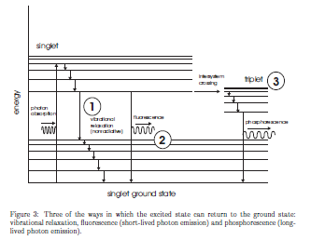
Figure 3: Three of the ways in which the excited state can return to the ground state: vibrational relaxation, fluorescence (short-lived photon emission) and phosphorescence (longlived photon emission).
3.3 Plasma Formation . When the laser beam is sufficiently intense (sufficiently tightly focussed) its electric field can accelerate a free electron (ie. one not bound to a molecule) to such a speed, ie. kinetic

Slide 9
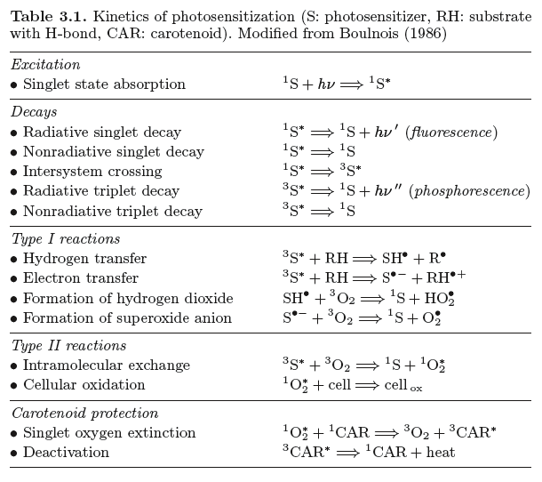

Slide 10
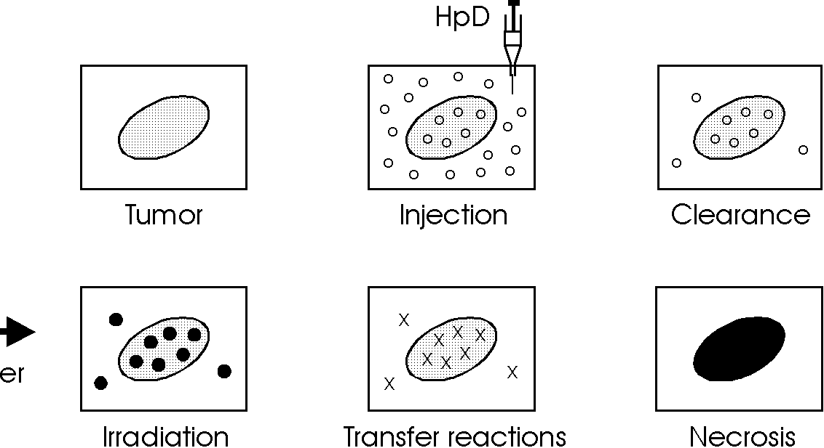
Laser irradiation usually takes place after the third day and up to the
seventh day after injection if several treatments are necessary. Within this
period, tumor cells are still very sensitive and selective necrosis of tumor cells
is enabled. However, many healthy tissues may retain certain constituents
of HpD and are thus photosensitized, as well. Cellular effects of HpD were
studied in detail by Moan and Christensen (1981) and Berns et al. (1982).
The general procedure of photodynamic therapy is illustrated in Fig. 3.2.

Slide 11
5- Photothermal Effects
Thermal effects are perhaps the most widely encountered form of tissue-laser interaction in clinical practice.
They do not require the very short pulses (ps, fs) which are now available.. There is no specific pathway, and the photons may be absorbed by any biomolecule and still lead to a thermal effect. Heat energy is deposited in the tissue by the absorption of light and its subsequent conversion to heat via vibrational relaxation.
-This causes a rise in temperature of the tissue. Also the heat will diffuse through the tissue causing a rise in temperature in the surrounding tissue. The damage done to the tissue depends on the temperature that is reached, and the duration at which it is held at that temperature.
we look at how we can calculate the temperature rise in the tissue and how the heat diffuses to the surrounding tissue. Then we look at the effect of the raised temperature on different types of tissue - the damage done by the heating.
There are many different and varied medical applications that use a thermal interaction, from vaporization of tumours, to welding gastrointestinal ulcers, and the removal of skin marks such as port wine stain birthmarks or tattoos.

Slide 12
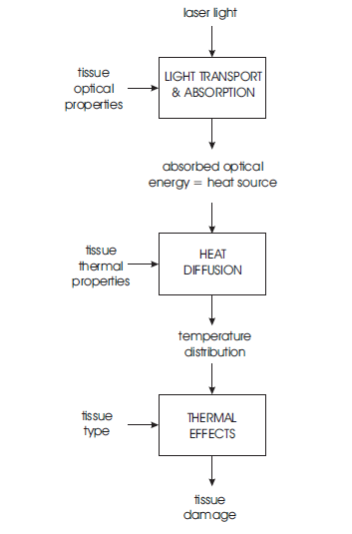
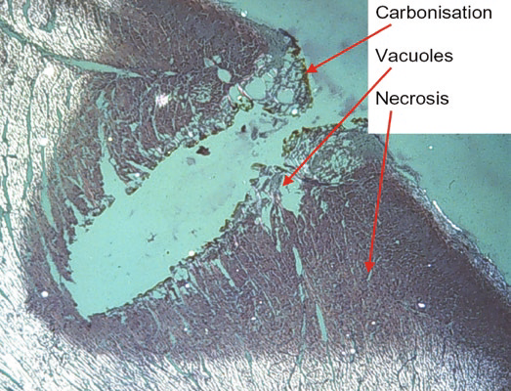
Figure 6: The various aspects involved in thermal interactions of light with tissue.

Slide 13
dependthe duration and peak value of the tissue temperature achieved, different effects like coagulation, vaporization,carbonization, and melting may be distinguished.
5.1 Tissue Heatg
5.1.1 Heat deposition
Consider a continuous wave laser beam incident on tissue. When a steady state has been reached, the incident light can be described by the irradiance which depends on the position in the tissue I = (x, y, z). The units of (x) are Wm−2, so it is a measure of the energy crossing a unit area in a unit time. Now, for the energy in the photons to end up as heat, two things must happen:
1-absorption. The photon must be absorbed by a molecule, putting that molecule into an excited state. When we are looking at soft tissue and the absorption of infrared light, as we will be in this section, the main chromophores (light absorbers) of interest will be water molecules.
2- vibrational relaxation. Collisions with other molecules leads to a gradual deactivation of the original molecule and an increase in the kinetic energy of those it collides with. An increase in the kinetic energies of the molecules is, of course, an increase in the temperature,T.

Slide 14
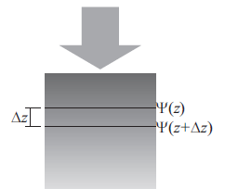
The amount of optical energy absorbed per unit volume
per unit time is called the absorbed power density, Q(x)
in Wm−3, and is related to the irradiance by
(8)
where μa is the absorption coefficient, units m−1. To see where this expression comes from think of the following one-dimensional example: a pure absorber with light incident on it. If the irradiance at a depth z is written z, then the difference between the irradiance at depths
of z and z + dz isΨ (z) −Ψ (z + dz). If this difference is
non-zero, then some power must have been absorbed. The
absorbed power density is the difference in the irradiance
per unit depth, i.e.

Slide 15
Q the optical energy that is being deposited in the tissue as heat (per unit time), now becomes a heat source term in the equation describing heat transport.

Slide 16
Q the optical energy that is being deposited in the tissue as heat (per unit time), now becomes a heat source term in the equation describing heat transport.

Slide 17
Q the optical energy that is being deposited in the tissue as heat (per unit time), now becomes a heat source term in the equation describing heat transport.

Slide 18
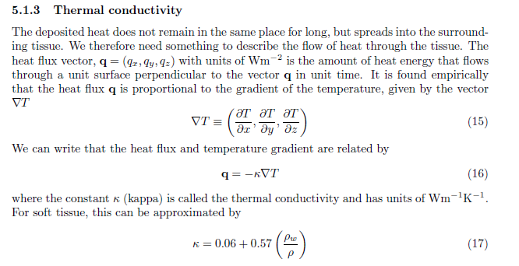

Slide 19
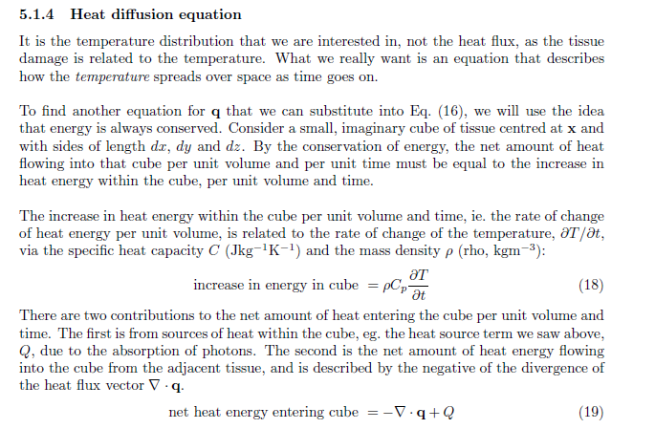

Slide 20
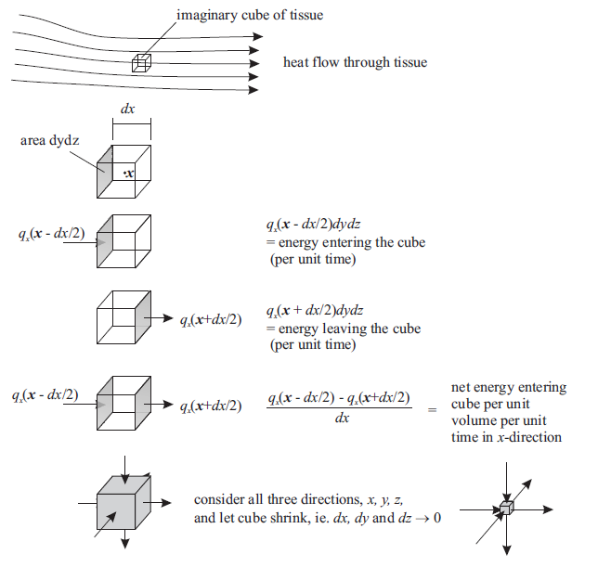

Slide 21
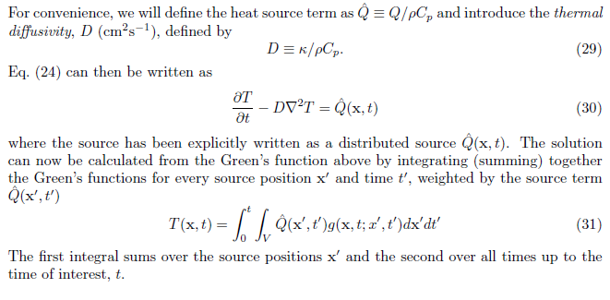

Slide 22
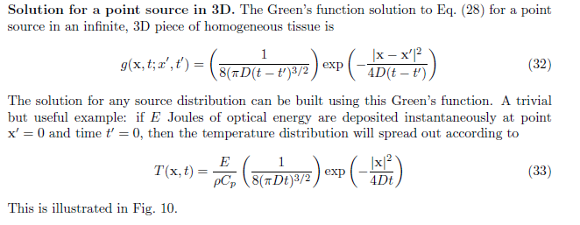

Slide 23
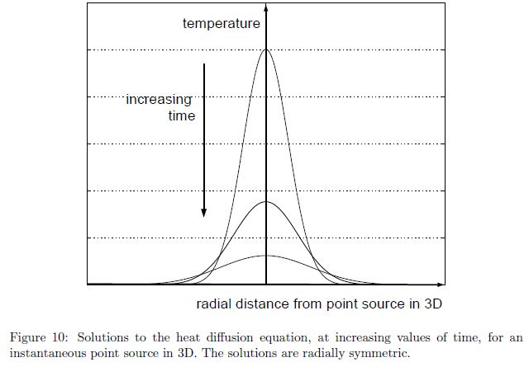

Slide 24
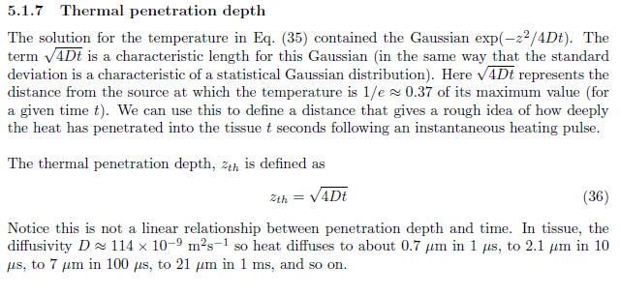

Slide 25
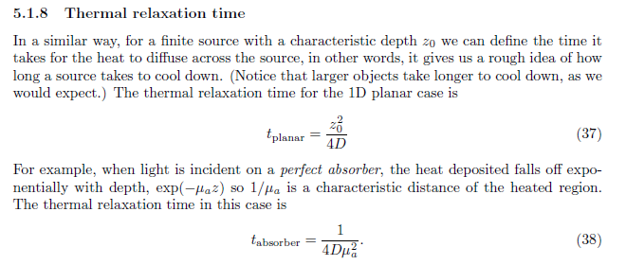

Slide 26
• Main idea: achieving a certain temperature which leads to the desired thermal effect
• Observations: either coagulation, vaporization, carbonization or melting
• Typical lasers: CO2, Nd:YAG, Er:YAG, Ho:YAG, argon ion and diode lasers
• Typical pulse durations: 1 μs . . . 1min
• Typical power densities: 10 . . . 106 W/cm2
• Special applications: coagulation, vaporization, melting,
thermal decomposition,
treatment of retinal detachment,
laser-induced interstitial thermotherapy

Slide 27
One of the most commonly used photosensitizers in photodynamic therapy is a hematoporphyrin derivative called HpD. It is derived from calf blood and is a complex collection of different porphyrins, mainly – dihematoporphyrin, – hydroxyethylvinyl-deuteroporphyrin, – protoporphyrin
Q1. Which light–tissue interaction can only be realized by the use of lasers?
For which interaction mechanisms can conventional (thermal) light sources be used alternatively?
Q2. What are the primary reasons for laser usage in medical therapy?
Solution:
1. Light–tissue interactions such as plasma-induced ablation and photodisruption, which require very high light intensities and short exposure times, can only be realized in the focal region of short-pulse lasers. Other light–tissue interactions like the photothermal interaction and photochemical interaction can also be achieved by using conventional (thermal) light sources due to the requirement of low intensities and relatively long exposure times (Figure 9.4).
2. Due to high spatial and temporal coherence, they are extensively used in medical therapy. These properties make lasers precise and easy to manipulate according to the underlying medical condition. High spatial coherence ensures maximum transfer of energy to the interacting tissues and high temporal coherence which makes the laser source monochromatic or leads to a small bandwidth. Therefore, wavelength-specific tissue response can be achieved, since tissue properties determined by absorption and scattering coefficients depend on the wavelength of light

Slide 28
Laser-Induced Interstitial Thermotherapy (LITT)

