Slide 1
University of Salahaddin – Erbil
College of Engineering
GROUND IMPROVEMENT
TECHNIQUES
(Code:1144)
Ground Improvement -
Compaction
Bologna System
Prepared by:
Prof. Dr. Yousif Ismael Mawlood.
Civil Engineering Department
2022- 2023

Slide 2
5.1 Introduction
5.2 General Principles of Compaction
5.3 Empirical Relationships for Compaction
5.4 Field Compaction
5.5 Compaction Control for Clay Hydraulic Barriers
5.6 Vibroflotation
5.7 Blasting
5.8 Precompression
5.9 Sand Drains
5.10 Prefabricated Vertical Drains
5.11 Lime Stabilization
5.12 Fly-Ash Stabilization
5.13 Cement Stabilization
5.14 Stone Columns
5.15 Sand Compaction Piles
5.16 Dynamic Compaction
5.17 Jet Grouting
5.18 Deep Mixing

Slide 3
1. Introduction
The natural ground conditions at the site may not always be totally suitable for
supporting the proposed structures, such as
- buildings,
- bridges,
- highways, and
- dams.
One or more of the subsoil layers can be problematic and require some
improvement.
o Near the surface, it is possible to replace problematic soil with better-
performing ones.
o An alternative is to modify this soil through a ground improvement
technique, such as compaction.
When these soils are present at large depths, soil replacement or compaction may
not be possible. Other techniques, such as
o vibroflotation,
o vertical drains,
o stabilization using additives,
o deep mixing, and
o stone columns,
can be used for such situations.
The common problems that are associated with poor ground conditions and that
necessitate some form of soil improvement are as follows:
1. Low shear strength
2. Low stiffness
3. High permeability
4. High swell–shrink potential

Slide 4
o Loose granular soil or soft clays have low shear strength and low stiffness.
o Low shear strength can lead to shear failure in the surrounding soil, and
o low stiffness can result in large deformations or settlements.
While there are several ground improvement techniques, they have their limitations.
Not all techniques will work well in all soil conditions.
5.2 General Principles of Compaction
- Compaction is the oldest and simplest ground improvement technique.
- The soil is densified by applying external pressure using rollers.
- Water is added to act as a lubricant between the soil grains and enhance
the compaction process. The moisture content at which the maximum dry
unit weight [□□_{□□(□□□□□□)}] is achieved is referred to as the optimum moisture
content (□□□□□□□□).
- Good geotechnical properties are achieved when the soil is compacted near
□□□□□□□□.
- The standard Proctor (ASTM D-698) and modified Proctor (ASTM D-
1557) are two common test procedures that apply different levels of
compaction energy.
- The specifications for the two tests are given in Tables 5.1 and 5.2,

Slide 5
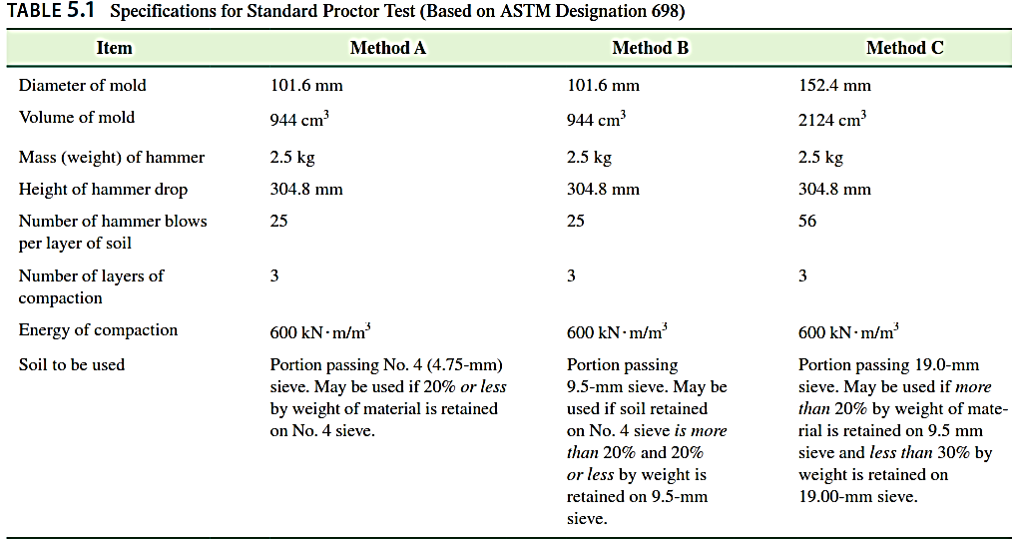
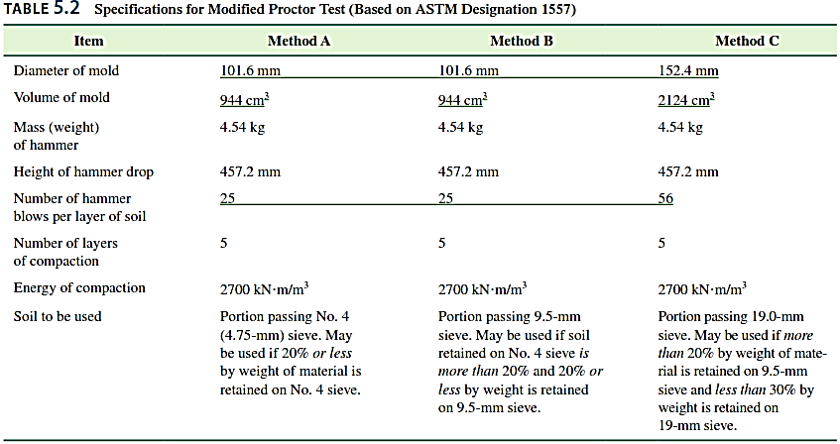
Figure 5.1 shows a plot of □□□□ against □□ (%) for a clayey silt obtained from
standard and modified Proctor tests (method A).

Slide 6
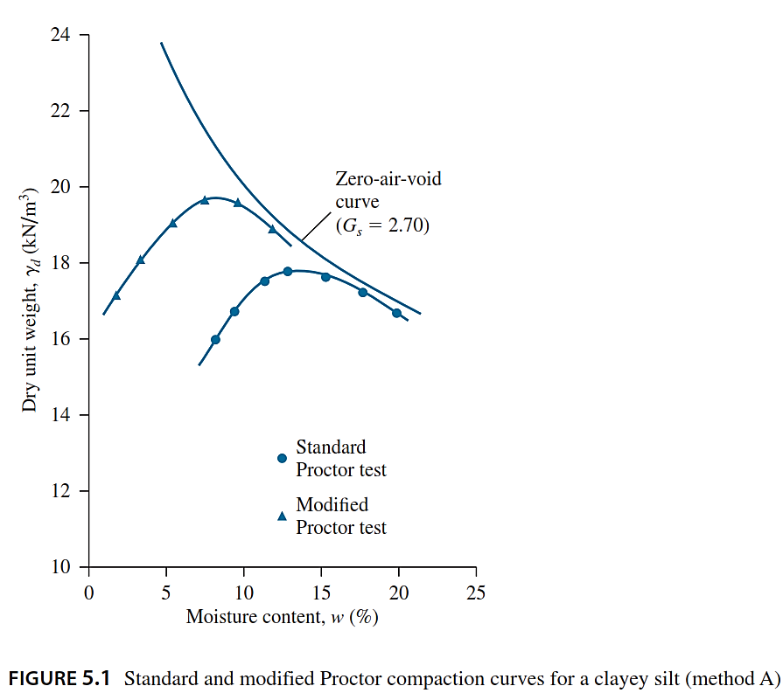
The following conclusions may be drawn:
1. The □□_{□□(□□□□□□)} and the □□□□□□□□ depend on the degree of compaction.

Slide 7
2. The higher the energy of compaction, the higher the □□_{□□(□□□□□□)}.
3. The higher the energy of compaction, the lower the □□□□□□□□.
4. No portion of the compaction curve can lie to the right of the zero-air-void line. The
zero-air-void dry unit weight, □□□□□□□□, at a given moisture content is the theoretical
maximum value of □□□□, which means that all the void spaces of the compacted soil are
filled with water, or
□□□□□□□□= □□□□
1
(5.1)
□□□□^{+□□}
Where:
□□□□= unit weight of water
□□□□= specific gravity of the soil solids
□□= moisture content of the soil
5. The □□_{□□(□□□□□□)} of compaction and the □□□□□□□□ content will vary from soil to soil.
- In most cases, the contractor is required to achieve a relative compaction of 90% or
more on the basis of a specific laboratory test (either the standard or the modified
Proctor compaction test).
- These days, the modified Proctor compactive effort is specified more commonly
- Some typical requirements, as suggested by the U.S. Navy (1982) and Hausmann
(1990), are summarized in Table 5.3

Slide 8
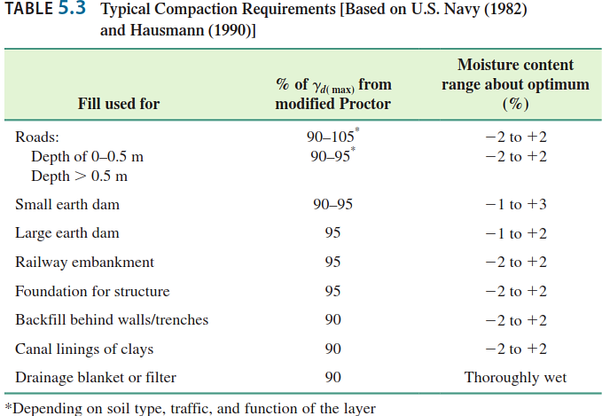
- The relative compaction is defined as
□□□□=
□□_{□□(□□□□□□□□□□)}
□□_{□□(□□□□□□)} ^{(5.2)}
Relative density (for the compaction of granular soil), defined as
□□□□=[
□□□□−□□_{□□(□□□□□□)}
□□_{□□(□□□□□□)}−□□_{□□(□□□□□□)}]
□□_{□□(□□□□□□)}
□□□□
Where:
□□□□= dry unit weight of compaction in the field
□□_{□□(□□□□□□)}= maximum dry unit weight of compaction as determined in the laboratory
□□_{□□(□□□□□□)}= minimum dry unit weight of compaction as determined in the laboratory

Slide 9
- For granular soil in the field, the degree of compaction obtained is often measured
in terms of relative density. Comparing the expressions for relative density and
relative compaction reveals that
□□□□= □□
1−□□□□(1−□□) ^{(5.3)}
Where □□=^{□□□□(□□□□□□)}
□□_{□□(□□□□□□)}
Here it is assumed that □□_{□□(□□□□□□)} determined from the compaction test (ASTM D-698 or
D-1557) is the same as that determined in defining the densest state corresponding to
□□□□□□□□ (ASTM D-4253). Because the procedures are different, the two values for □□_{□□(□□□□□□)}
can be slightly different.

