Slide 1
Salahaddin University_Erbil
College of Engineering
Department of Civil Engineering
Flow through porus media
Geotextile encased columns
Prepared by:
Nazik Falah Muhammedfakhri
Supervised By:
Dr. yousif Mawlood
January, 2024

Slide 2
Outlines
Introduction
Principles and Working Mechanism
Types of Geotextiles
Advantage and limitation
Conclusion
References

Slide 3
Introduction
GEC (geotextile encased columns) are granular piles, most of the time consisting of sand, encased with a high strength geotextile. The purpose of this geotextile is to ensure the piles integrity and provide confinement in very weak soils. They involve the insertion of columns (commonly stone columns or concrete piles) into soft or loose ground and encasing them with a high-strength geotextile fabric.

Slide 4
Why we use it
The system is used on location where very soft soil exist and a solution with surcharge is not capable to provide the required stability or residual settlement within the given construction period. Applying GEC will result in the following effects:
Reduction of residual settlement by 50 – 75% and can be mitigated by temporary surcharge
Up to 90% of the consolidation takes place during construction
Able to be used in extremely soft soil (e.g., undrained shear strength < 15 kPa)
Loadable immediately after installations

Slide 5
Principles and Working Mechanism
The construction of geotextile encased columns (GECs) involves several steps that aim to improve the ground conditions and provide stability to the soil. the typical construction process for GECs:
1. Site Investigation and Design
Site Survey: Initial site investigation to understand soil properties, composition, and engineering characteristics.
Geotechnical Analysis: Conducting tests to determine soil parameters, bearing capacity, and other relevant geotechnical properties.
Design Stage: Based on the site investigation and analysis, engineers develop a design for the GECs, considering load requirements and soil conditions.

Slide 6
2) Installation Preparation
Preparation of the Work Area: Clearing the site and preparing the ground for construction equipment and machinery.
Layout and Marking: Establishing the grid layout and marking the locations where the columns will be installed.

Slide 7
3. Installation of Geotextile Columns
Drilling or Vibro-Replacement: Using drilling rigs or vibro-replacement equipment to create boreholes or cavities in the soil where the columns will be placed.
Insertion of Geotextile Tubes: Placing or inserting geotextile tubes or columns into the boreholes. These tubes are filled with granular materials like stone, gravel, or sand.
Compaction and Installation Depth: Ensuring proper compaction of the granular fill material within the geotextile tubes and reaching the desired depth to reinforce the soil.

Slide 8
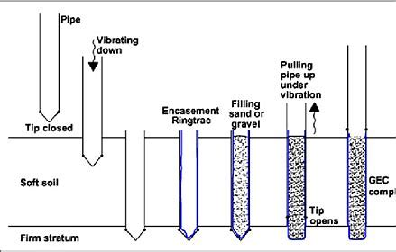

Slide 9
4. Compaction and Testing
Compaction Verification: Verifying and ensuring the proper compaction of the fill material within the geotextile tubes to achieve the desired strength and stability.
Load Testing: Conducting load tests to evaluate the performance and bearing capacity of the installed columns.
5. Quality Control and Assurance
Monitoring and Inspection: Regular monitoring and inspection during the construction process to verify compliance with design specifications and quality standards.

Slide 10
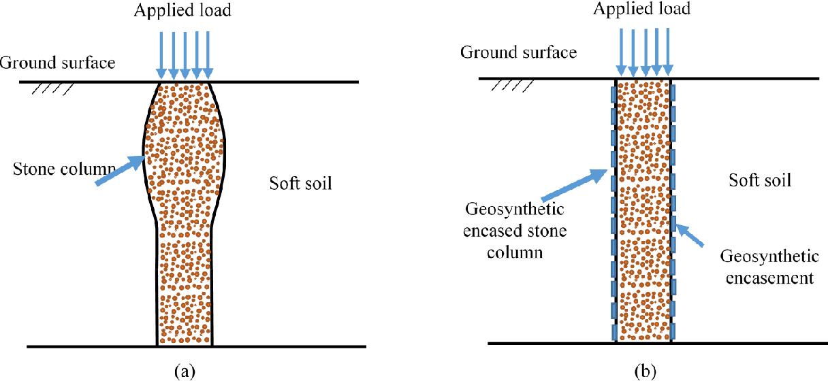
Types of geotextiles
Geotextile encased stone columns (GEC)
Method: stone or aggregate is inserted and compacted within a geotextile sleeve or casing.
Function: these columns enhance soil stability by improving load-bearing capacity and reducing settlement through the vertical columns' reinforcement effect.

Slide 11
Geotextile Encased Cementitious Columns (GCC or Geopiers)
Method: Cementitious material or grout is injected into the ground through a casing formed by geotextile sleeves.These columns create stiff columns or pillars within the soil, reinforcing it and providing additional load-bearing capacity, and provide confinement in very weak soils up to an undrained shear strength of 15kPa.

Slide 12
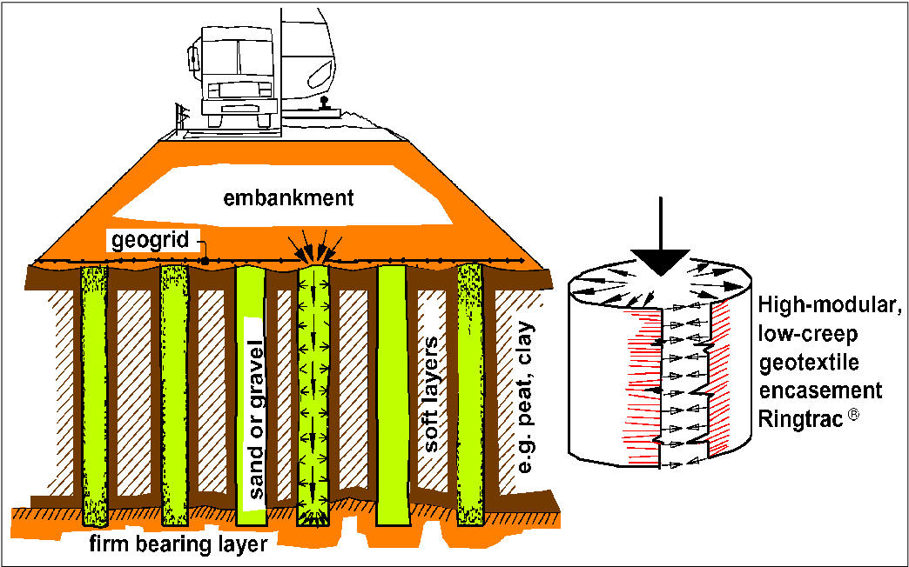
Geotextile encased sand columns
Method: granular sand or other fine aggregates are placed within geotextile sleeves.
Function: similar to stone columns, these enhance soil stability and load-bearing capacity, particularly in loose or soft soils.

Slide 13
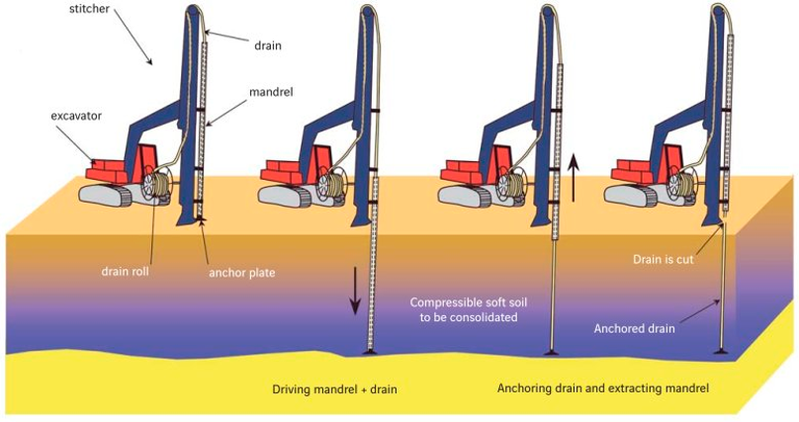
Geotextile-encased prefabricated vertical drains (PVD)
Prefabricated vertical drains (pvds) or ‘wick drains' are composed of a plastic core encased by a geotextile for the purpose of expediting consolidation of slow draining soils. They are typically coupled with surcharging to expedite preconstruction soil consolidation.

Slide 14
Advantage and limitation
Advantages:
Improved Soil Stability: Reinforces weak soils, enhancing their load-bearing capacity, and reduces settlement.
Versatility: Adaptable for various soil conditions, including loose or soft soils, providing stability in a wide range of situations.
Cost-Efficiency: Often more cost-effective compared to traditional deep foundation systems, reducing construction time and materials required.
Environmentally Friendly: Generally, installation produces minimal environmental impact compared to other methods.
Construction Flexibility: Can be used in restricted access sites or areas with height limitations where other foundation methods might be impractical.
Uniform Settlement Control: Assists in reducing differential settlement, ensuring more uniform settlement across the structure.

Slide 15
limitation
Limited Bearing Capacity: May have limitations in terms of load-bearing capacity, especially in certain soil conditions or when faced with heavy loads.
Long-Term Performance: Long-term performance may vary based on the consolidation and behavior of the surrounding soil over time.
Design Complexity: Requires a detailed analysis and design process, potentially complicating the construction process.
Site-Specific Nature: The effectiveness of geotextile encased columns can be site-specific, requiring careful consideration and analysis before implementation.
Quality Control Challenges: Ensuring consistent installation and quality control during construction can be challenging.
Maintenance Requirements: Over time, there might be a need for maintenance or monitoring to ensure continued effectiveness.

Slide 16
Conclusion
The choice of geotextile depends on the specific requirements of the project, including soil conditions, expected loads, drainage requirements, and environmental factors. Each type of geotextile offers different strengths and characteristics suitable for distinct applications in geotechnical engineering.
The Common Applications of geotextile encased columns is to Providing filtration and separation in drainage systems, and to Preventing soil erosion on slopes, embankments, or construction sites Used in geotextile encased columns, roadways, and retaining walls for soil stabilization, and to Preventing mixing of dissimilar soil layers in construction projects

Slide 17
References:
Alexiew, D., & Raithel, M. (2015). Geotextile-Encased Columns. B. INDRARATNA, C. JIAN, & R. CHOLACHAT, EMBANKMENTS WITH SPECIAL REFERENCE TO CONSOLIDATION AND OTHER PHYSICAL METHODS, 451-477.‏
Almeida, M. S., Hosseinpour, I., Riccio, M., & Alexiew, D. (2015). Behavior of geotextile-encased granular columns supporting test embankment on soft deposit. Journal of Geotechnical and Geoenvironmental Engineering, 141(3), 04014116.‏
Hosseinpour, I., Almeida, M. S., & Riccio, M. (2016). Ground improvement of soft soil by geotextile-encased columns. Proceedings of the Institution of Civil Engineers-Ground Improvement, 169(4), 297-305.‏
Akosah, S., Chen, J., & Bao, N. (2022). Reinforcement of problematic soils using geotextile encased stone/sand columns. Arabian Journal of Geosciences, 15(16), 1371.‏

Slide 18
Thank you

