Slide 1
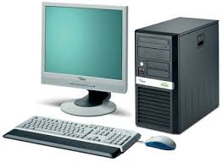
What is a computer?
-An electronic device designed to accept data, perform prescribed mathematical and logical operation at high speed, and display the results of these operations.
- A computer is an electronic device that can perform activities that involve mathematical, logical, and graphical manipulations.

Slide 2
Computer performs the following three operations in sequence:
It receives data and instructions from the input device.
Processes the data as per instructions.
Provides the result (output) in a desired form.

Slide 3
The history of computers:
A person named Charles Babbage (1791 – 1871) invented a mechanical Computer which later developed to more good designs. Charles Babbage is called as the “FATHER OF COMPUTER”. He was an English mathematician, philosopher, inventor and Engineer. The mechanical Computer was Built in early 1800’s. Its special purpose is calculator.

Slide 4
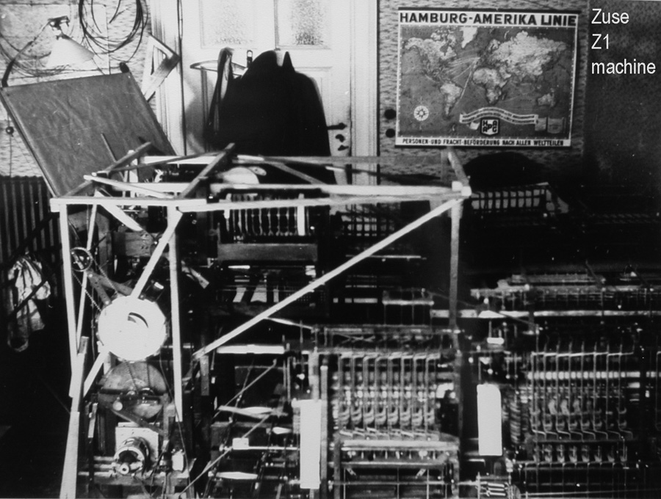
Konrad Zuse in (1936) invented a computer was called the Z1 Computer. The Z1 was the worlds first freely programmable computer.

Slide 5
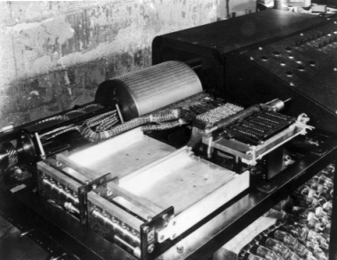
The next computer was invented in 1942 by John Atanasoff & Clifford Berry which called the ABC computer. This computer was mostly used for business purposes.

Slide 6
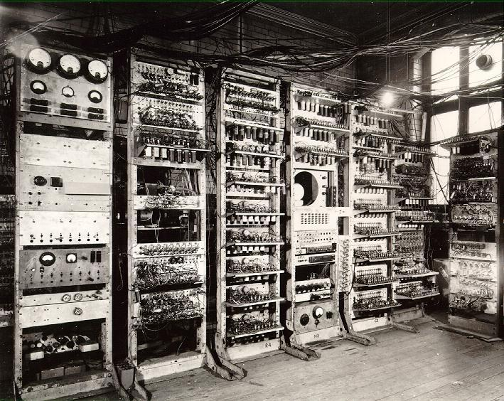
-In 1953 the very first IBM computer came out for businesses to use. It was called the IBM 701 EDPM Computer.
-In 1954 FORTRAN is developed. FORTRAN is the first successful high level programming language. It allowed programmers to make more complex applications for computers.

Slide 7
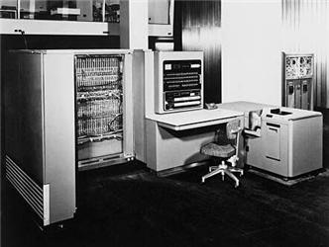
-In 1970 the first dynamic RAM chip became available.
-In 1971 the very first microprocessor was invented. This allowed designers to be able to make computers smaller than they ever could.

Slide 8
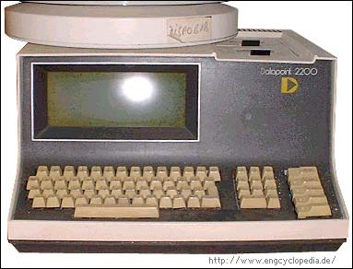
Home Computers
Finally, in 1974 and 1975, the very first consumer computers came out called IBM Computer. And In 1981 MS-DOS came out. DOS was a new operating system for computers.

Slide 9
In 1985 Microsoft begins to compete with Apple. Eventually their competition led to better and better computers, all the way up to the current computers we use now.

Slide 10
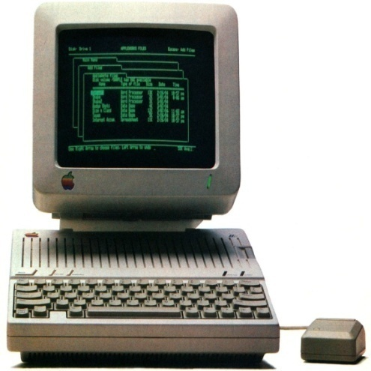
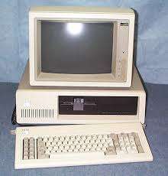
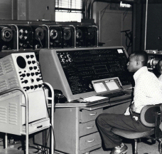
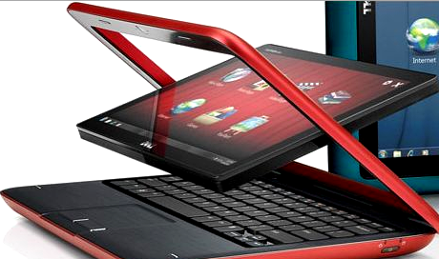
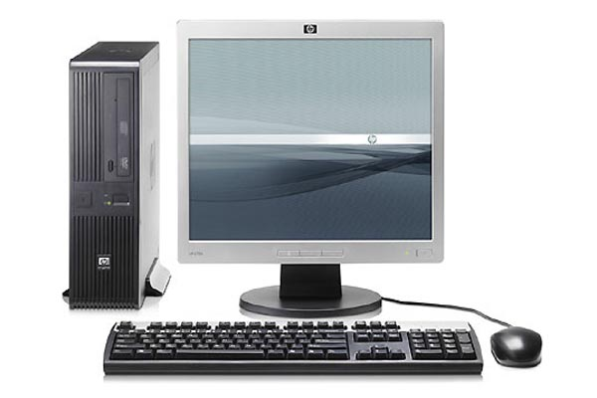
Generation of Computer

Slide 11
Generation of Computer
personal computer (PC) has been developed many times since it was invented . So the computer scientists divided the developing of computer on five generations. Each of the five generations of computers is characterized by a major technological development that fundamentally changed the way computers operate, resulting in increasingly smaller, cheaper, more powerful and more efficient and reliable computing devices.

Slide 12
There are 5 generations of a computer :
First Generation (1940-1956) Vacuum Tubes
Second Generation (1956-1963) Transistors
Third Generation (1964-1971) Integrated Circuits
Fourth Generation (1971-Present year) Microprocessors
Fifth Generation (Present and Beyond) Artificial Intelligence

Slide 13
The first generation:
Taking up entire rooms.
Very expensive.
Using a great deal of electricity.
Generated a lot of heat, which was often the cause of malfunctions.
The lowest-level programming language understood by computers.
They could only solve one problem at a time.
Input was based on punched cards and paper tape.
The first computers used vacuum tubes for circuitry and magnetic drums for memory.

Slide 14
Second Generation (1956-1963) Transistors
Transistors replaced vacuum tubes in the second generation of computers. The transistor was invented in 1947 but did not see widespread use in computers until the late 1950s.
The transistor was far superior to the vacuum tube
Allowing computers to become smaller, faster, cheaper, more energy-efficient and more reliable than their first-generation predecessors.

Slide 15
High-level programming languages were also being developed at this time, such as early versions of COBOL and FORTRAN.
These were also the first computers that stored their instructions in their memory, which moved from a magnetic drum to magnetic core technology.

Slide 16
Third Generation (1964-1971) Integrated Circuits:
The development of the integrated circuit was the hallmark of the third generation of computers. Transistors were placed on silicon chips, called semiconductors, which drastically increased the speed and efficiency of computers.

Slide 17
Instead of punched cards and printouts, users interacted with third generation computers through keyboards and monitors and interfaced with an operating system, which allowed the device to run many different applications at one time.
Computers for the first time became accessible to a mass audience because they were smaller and cheaper than their predecessors.

Slide 18
Fourth Generation (1971-Present) Microprocessors
The microprocessor brought the fourth generation of computers, as thousands of integrated circuits were built onto a single silicon chip. What in the first generation filled an entire room could now fit in the palm of the hand.

Slide 19
In 1981 IBM introduced its first computer for the home user, and in 1984 Apple introduced the Macintosh.
Microprocessors also moved out of the realm of desktop computers and into many areas of life as more and more everyday products began to use microprocessors.
As these small computers became more powerful, they could be linked together to form networks, which eventually led to the development of the Internet.

Slide 20
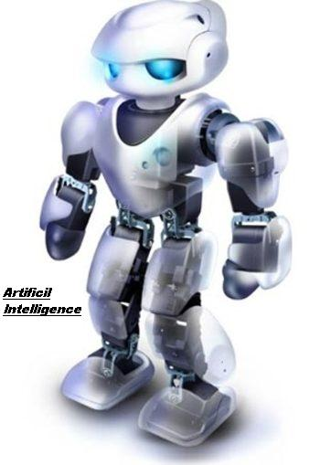
Fifth Generation (Present and Beyond) Artificial Intelligence
Fifth generation computing devices, based on artificial intelligence, are still in development, though there are some applications, such as voice recognition, that are being used today.

Slide 21
The goal of fifth-generation computing is to develop devices that respond to natural language input and are capable of learning and self-organization.

Slide 22
Thank you for your attention

