Slide 1
Expectation Value of Hamiltonian for LMG model
M. Zahraa A.Mala issa
Fall 2021

Slide 3
We consider LMG model of quantum many-body systems. After rewriting Lipkin-Meshkov-Glick with pseudo spin operators Expectation value of Hamiltonian obtained.

Slide 4
Expectation Value
That is the probabilistic expected value of the result(measurement) of an experiment. It can be thought of as an average of all the possible outcomes of a measurement.

Slide 5
For studying Quantum many body systems scientist use two level systems. These models can be numerically diagonalized for every dimensions. An example is Lipkin- meshkow- Glick model(LMG). The LMG model, describes two shells for nucleons and interaction between them in different shells.

Slide 6
Pairing
Nuclear pairing plays an important role in different single-particle and collective aspects of nuclear structures. Several models are proposed for pairing, such as Richardson model, double beta decay and LMG.

Slide 7
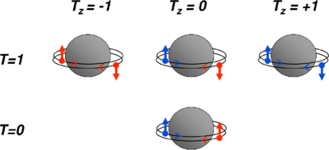
Schematic illustration of the different types of nucleon pairs with orbital angular momentum L=0. The valence neutrons (blue) or protons (red) that form the pair occupy time-reversed orbits (circling the nucleus in opposite direction). If the nucleons are identical they must have anti-parallel spins—a configuration which is also allowed for a neutron–proton pair (top) The configuration with parallel spins is only allowed for a neutron–proton pair (bottom).

Slide 8
LMG MODEL
This model is offered in 1965 for explaining phase transformation in nucleus. Then is used for quantum information and quantum phase transformation. In this model, N particles can distribute themselves on two N-fold degenerate levels

Slide 10
H= T+V

Slide 11
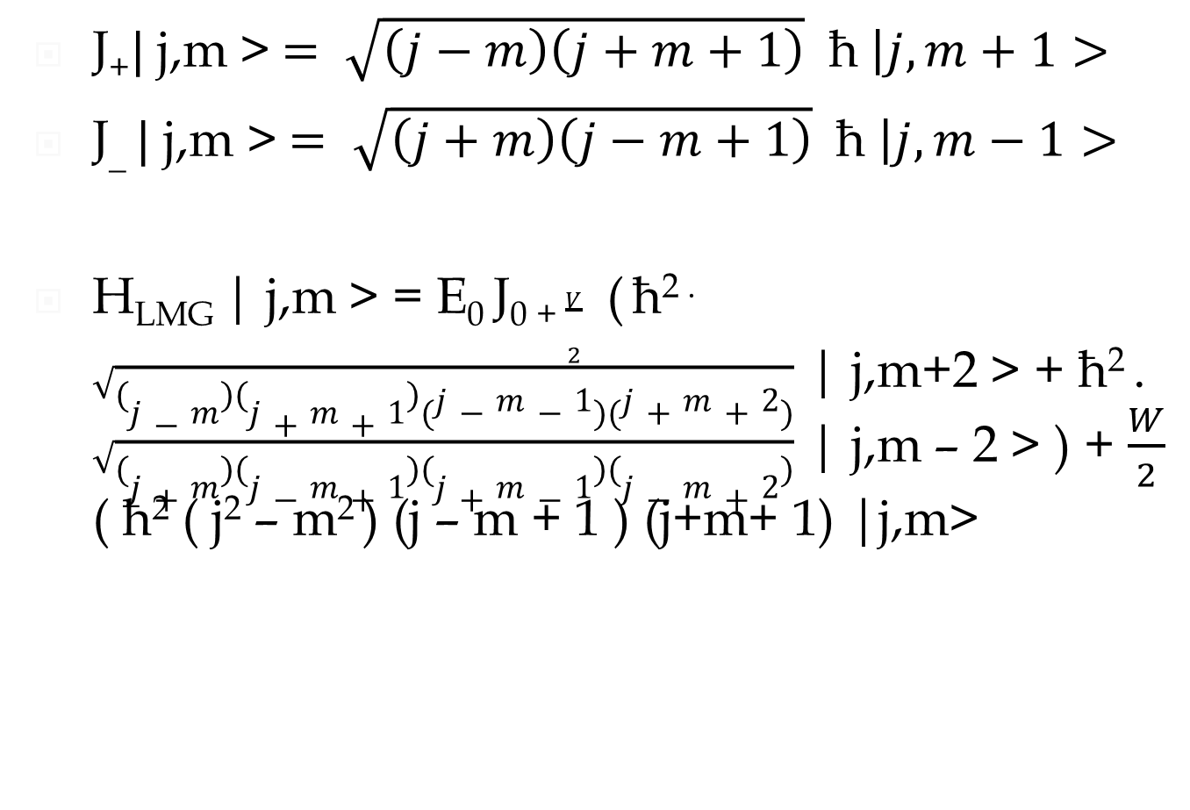
Expectation value of Hamiltonian
< $j^{′}$ $m^{′}$| H | j,m > = E_{n} $δ_{m^{′},m}δ_{j^{′},j}$
J₊$|$j,m >$= \sqrt{\left(j−m\right)\left(j+m+1\right)}$ħ$\left|j,m+1>\right.$
J_ $|$ j,m >$= \sqrt{\left(j+m\right)\left(j−m+1\right)}$ħ $\left|j,m−1>\right.$
H_{LMG} | j,m > = E₀ J₀ ₊$\frac{V}{2}$ ( ħ^{2 .} $\sqrt{\left(j−m\right)\left(j+m+1\right)(j−m−1)(j+m+2)}$ | j,m+2 > + ħ² . $\sqrt{\left(j+m\right)\left(j−m+1\right)\left(j+m−1\right)\left(j−m+2\right)}$ | j,m – 2 > ) + $\frac{W}{2}$ ( ħ² ( j² – m² ) (j – m + 1 ) (j+m+ 1) |j,m>

Slide 12
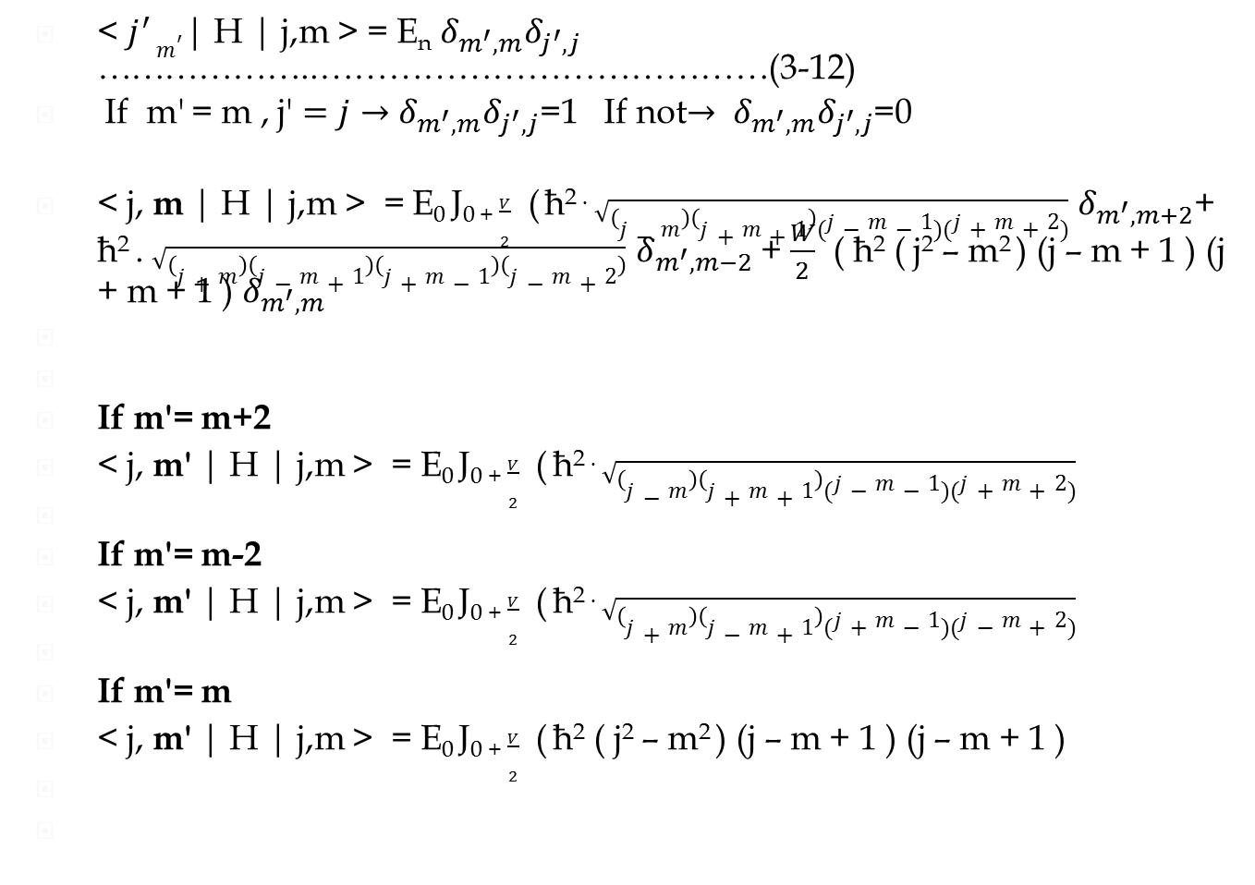
< $j^{′}$ $m^{′}$| H | j,m > = E_{n} $δ_{m^{′},m}δ_{j^{′},j}$ ………………..…………………………………(3-12)
If m' = m , j' $=j→$ $δ_{m^{′},m}δ_{j^{′},j}$=1 If not$→$ $δ_{m^{′},m}δ_{j^{′},j}$=0
< j, m | H | j,m > = E₀ J₀ ₊$\frac{V}{2}$ ( ħ^{2 .} $\sqrt{\left(j−m\right)\left(j+m+1\right)(j−m−1)(j+m+2)}$ $δ_{m^{′},m+2}$+ ħ² . $\sqrt{\left(j+m\right)\left(j−m+1\right)\left(j+m−1\right)\left(j−m+2\right)}$ $δ_{m^{′},m−2}$ + $\frac{W}{2}$ ( ħ² ( j² – m² ) (j – m + 1 ) (j + m + 1 ) $δ_{m^{′},m}$
If m'= m+2
< j, m' | H | j,m > = E₀ J₀ ₊$\frac{V}{2}$ ( ħ^{2 .} $\sqrt{\left(j−m\right)\left(j+m+1\right)(j−m−1)(j+m+2)}$
If m'= m-2
< j, m' | H | j,m > = E₀ J₀ ₊$\frac{V}{2}$ ( ħ^{2 .} $\sqrt{\left(j+m\right)\left(j−m+1\right)(j+m−1)(j−m+2)}$
If m'= m
< j, m' | H | j,m > = E₀ J₀ ₊$\frac{V}{2}$ ( ħ² ( j² – m² ) (j – m + 1 ) (j – m + 1 )

Slide 13
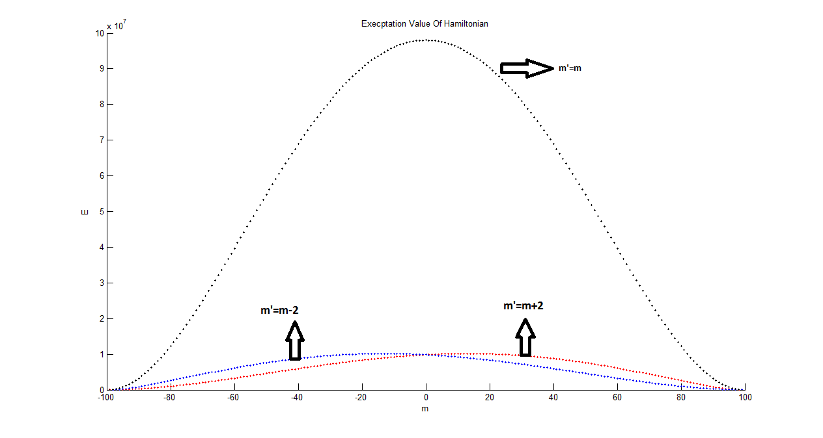

Slide 14
j=input('j')
hold on;
for m=-j:1:j
E1= sqrt(j-m).*(j+m+1).*(j-m-1).*(j+m+2)
E2= sqrt(j+m).*(j-m+1).*(j+m-1).*(j-m+2)
E3= (j.^2-m.^2).*(j-m+1).*(j+m+1)
m
plot(m,E1,'r--')
plot(m,E2,'b')
plot(m,E3,'k')
hold on;
end;
hold off;
xlabel('m')
ylabel('E')
title('Execptation Value Of Hamiltonian')

Slide 15
Discussion and Conclusions
In these notes after briefly review the Pseud-Spin operators we have tried to provide an introduction to the Lipkin Hamiltonian and some of its elementary physics. We have seen how to write the model down and understand its behavior .We have simply pointed to more sophisticated numerical methods and not mentioned
We get a first insight into the Lipkin Hamiltonian by considering its site. We solved this Hamiltonian by extracting the Expectation function. These expectation value integral are important in quantum mechanics. They provide us with the average values of physical properties e.g. like energy, momentum, or position) because in many cases precise values cannot, even in principle, be determined. If we know the average of some quantity, it also is important to know whether the distribution is narrow, i.e. all values are close to the average, or broad, i.e. many values differ considerably from the average. The width of a distribution is characterized by its variance.
Finally we plot their figures with Matlab software too. As we know this software helps us to get our purposes more easily. Their figures go up and go down. We consider j=99, it is optional. When m'= m expectation value is higher than when m'= m+2 or m'= m-2. And the high point of m'= m is the point that the figures of m'= m+2 and m'= m-2 cut together. It is at m=0.

Slide 16
REFERENCES
[1] Introductory Nuclear Physics ,Kenneth S.Krane, (Springer-Verlag, New York,
1987).
[2] R.W. Richardson, Phys. Rev. 159 (1967) .
[3]. R. W. Richardson, Phys. Rev. 144 (1966) .
[4] R.W. Richardson, Phys. Rev. 141 (1966) .
[5]. H. J. Lipkin, N. Meshkov and A. J. Glick, Nucl. Phys. 62 () 188.
[6]. N. Meshkov, A. J. Glick and H. J. Lipkin, Nucl. Phys. 62 (1965) 199.
[7] A. J. F. Glick, H. J. Lipkin and N. Meshkov, Nucl. Phys. 62 (1965) 211.
[8] Ring and P. Schuck, The Nuclear Many-Body Problem (Springer-Verlag, New York,
1980).
[9] Co’, G., & De Leo, S. (2018). Analytical and numerical analysis of the complete Lipkin–Meshkov–Glick hamiltonian. International Journal of Modern Physics E, 27(05), 1850039.
[10] Dukelsky, J. (2013). The Lipkin–Meshkov–Glick model as a particular limit of the SU (1, 1) Richardson–Gaudin integrable models. Nuclear Physics B, 870(2), 421-443.
[11] Morita, H., Ohnishi, H., da Providência, J., & Nishiyama, S. (2006). Exact solutions for the LMG model Hamiltonian based on the Bethe ansatz. Nuclear Physics B, 737(3), 337-350.
[12] Pomorski, K., & Dudek, J. (2003). Nuclear liquid-drop model and surface-curvature effects. Physical Review C, 67(4), 044316.
[13] Somà, V. (2018). From the liquid drop model to lattice QCD. The European Physical Journal Plus, 133(10), 1-22.
[14] Morita, H., Ohnishi, H., da Providência, J., & Nishiyama, S. (2006). Exact solutions for the LMG model Hamiltonian based on the Bethe ansatz. Nuclear Physics B, 737(3), 337-350.
[15] Claeys, P. W., Caux, J. S., Van Neck, D., & De Baerdemacker, S. (2017). Variational method for integrability-breaking Richardson-Gaudin models. Physical Review B, 96(15), 155149.
[16] Claeys, P. W., Van Neck, D., & De Baerdemacker, S. (2017). Inner products in integrable Richardson-Gaudin models. SciPost Phys, 3, 028.
[17] Dukelsky, J., Pittel, S., & Sierra, G. (2004). Colloquium: Exactly solvable Richardson-Gaudin models for many-body quantum systems. Reviews of modern physics, 76(3), 643.
[18] Frank, A., Isacker, P., Jolie, J., Jolie, J., & Van Isacker, P. (2009). Symmetries in atomic nuclei. Springer New York.

Slide 17
?

Slide 18
Thanks for your attentions

