Slide 1
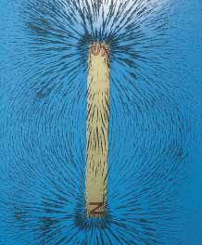
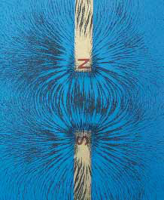
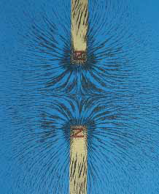
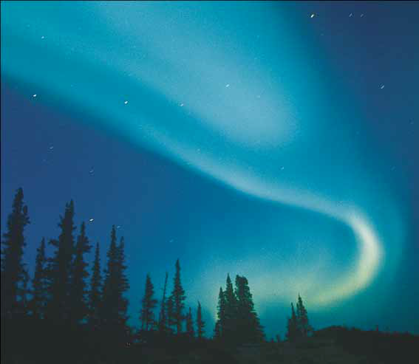
Magnetic Fields

Slide 2
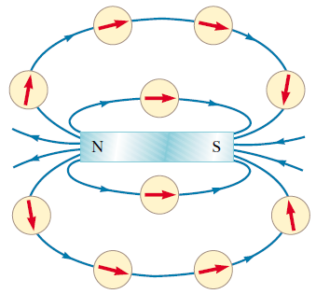
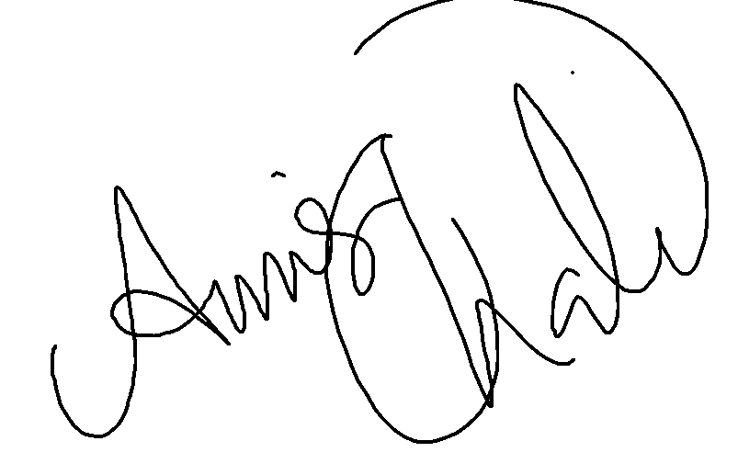
Magnetic Field
A magnetic field exists;
In the region of space surrounding any moving electric charge.
Surrounds any magnetic substance.
Historically, the symbol B has been used to represent a magnetic field.
We can define a magnetic field B at some point in space in terms of the magnetic force FB that the field exerts on a test object, for which we use a charged particle moving with a velocity v.
Note that the magnetic field lines outside the magnet point away from north poles and toward south poles.

Slide 3
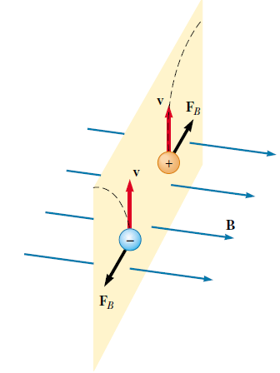
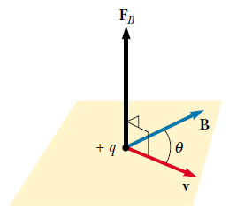
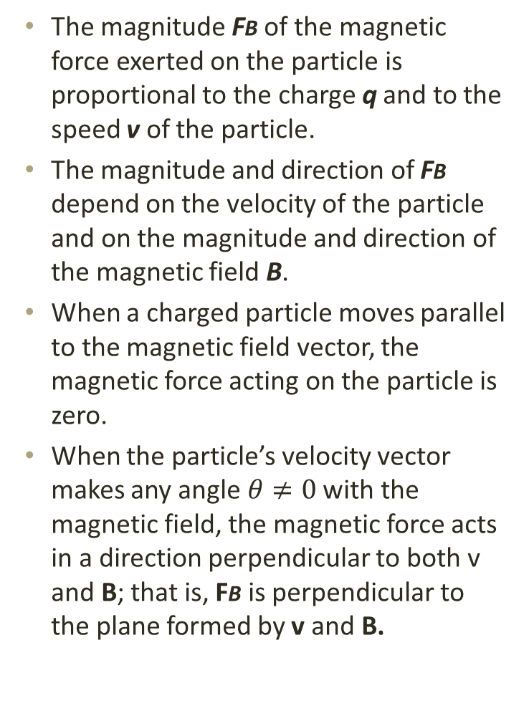
Experiments on various charged particles moving in a magnetic field give the following results:
The magnitude FB of the magnetic force exerted on the particle is proportional to the charge q and to the speed v of the particle.
The magnitude and direction of FB depend on the velocity of the particle and on the magnitude and direction of the magnetic field B.
When a charged particle moves parallel to the magnetic field vector, the magnetic force acting on the particle is zero.
When the particle’s velocity vector makes any angle $θ≠0$ with the magnetic field, the magnetic force acts in a direction perpendicular to both v and B; that is, FB is perpendicular to the plane formed by v and B.

Slide 4
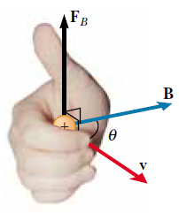
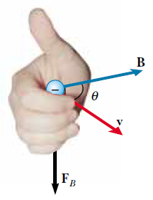
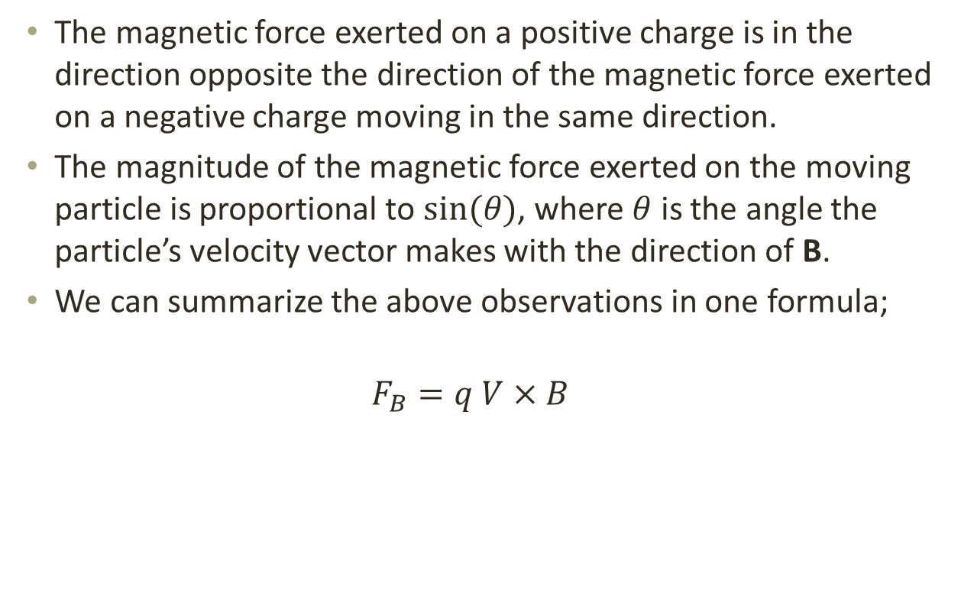
The magnetic force exerted on a positive charge is in the direction opposite the direction of the magnetic force exerted on a negative charge moving in the same direction.
The magnitude of the magnetic force exerted on the moving particle is proportional to $sin⁡(θ)$, where $θ$ is the angle the particle’s velocity vector makes with the direction of B.
We can summarize the above observations in one formula;
$$F_{B}=q V×B$$
The right-hand rule for determining the direction of the magnetic force

Slide 5


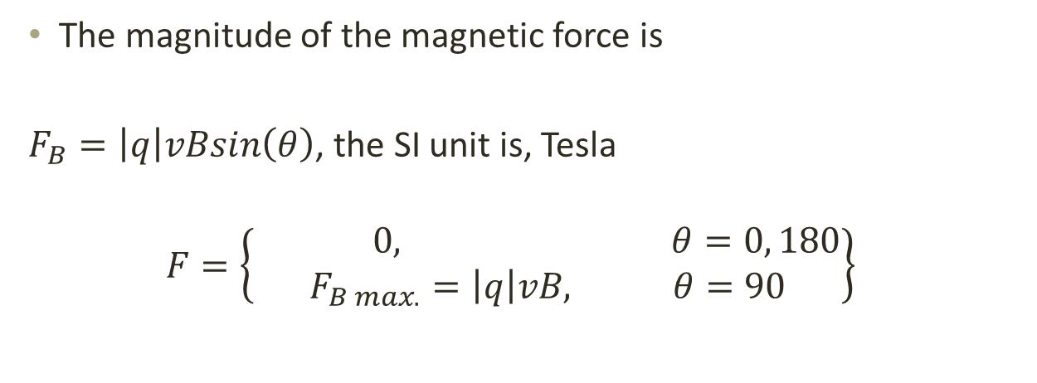
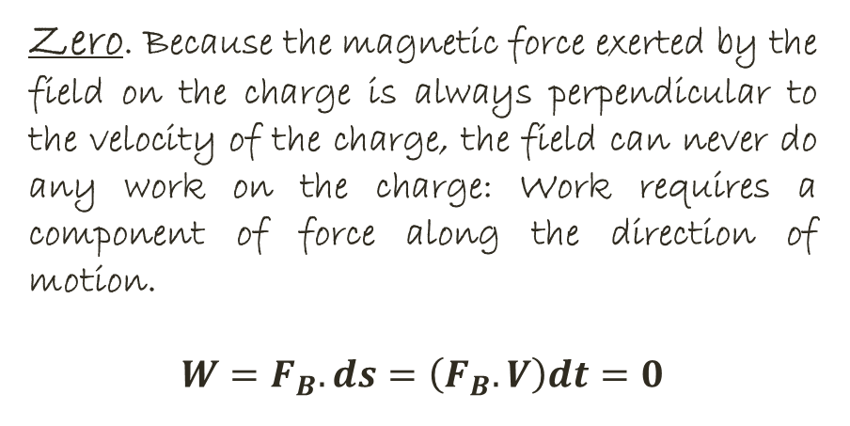
The magnitude of the magnetic force is
$F_{B}=\left|q\right|vBsin\left(θ\right)$, the SI unit is, Tesla
$$F=\left\{\begin{aligned} 0, θ=0, 180 \\ F_{B max.}=\left|q\right|vB, θ=90\end{aligned}\right\}$$
Gauss
QUIZ: What is the maximum work that a constant magnetic field B can perform on a charge q moving through the field with velocity v?
Zero. Because the magnetic force exerted by the field on the charge is always perpendicular to the velocity of the charge, the field can never do any work on the charge: Work requires a component of force along the direction of motion.
$$W=F_{B}.ds=\left(F_{B}.V\right)dt=0$$

Slide 6
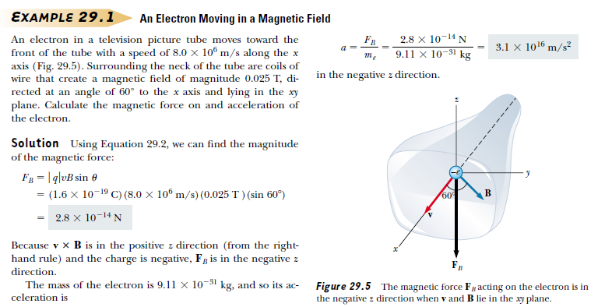

Slide 7
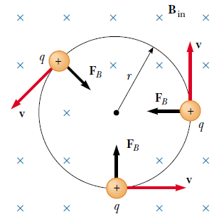
Motion of a Charged Particle in a Uniform Magnetic Field
F_{B} never has a component parallel to v and can’t change the particle’s kinetic energy. The force can change only the direction of v.
Charged particle moves in a circle in a plane perpendicular to the magnetic field.
Start with
Then, we have
The radius of the circular path:
The angular speed:
The period of the motion:
T and ω do not depend on v of the particle. Fast particles move in large circles and slow ones in small circles, but all particles with the same charge-to-mass ratio take the same time T to complete one round trip.
The direction of rotation for a positive particle is always counterclockwise, and the direction for a negative particle is always clockwise.

Slide 8
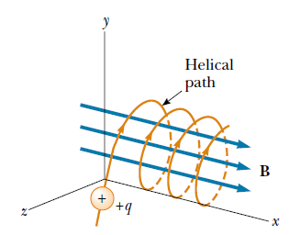
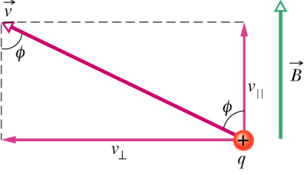
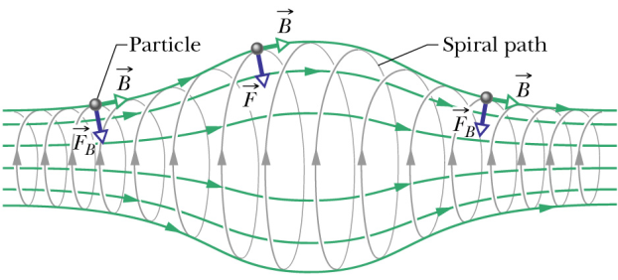
Circle Paths: v is perpendicular to B (uniform);
Helical Paths: v has a component parallel to B.
Motion in a nonuniform magnetic field: strong at the ends and weak in the middle;
  Magnetic bottle
  Aurora
  Magnetic bottle
  Aurora

Slide 9
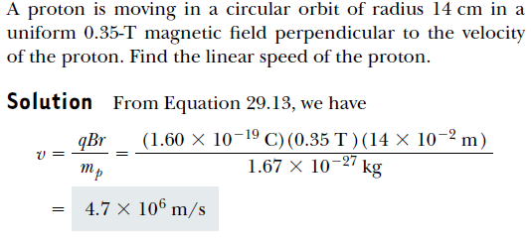
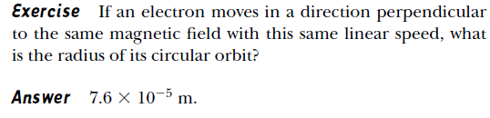
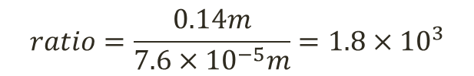
$$ratio=\frac{0.14m}{7.6×{10}^{−5}m}=1.8×{10}^{3}$$

Slide 10
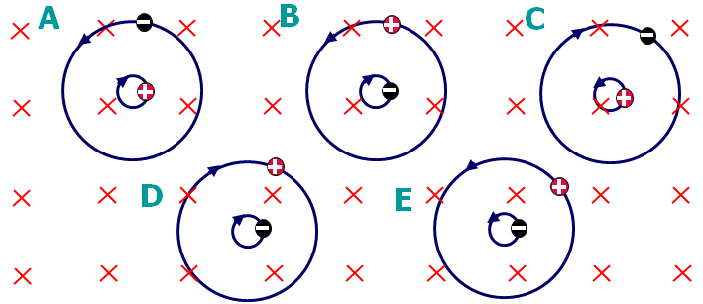
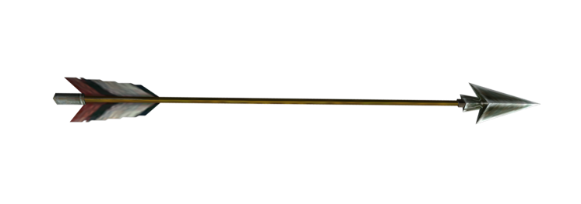
Circulating Charged Particle
The figures shows the circular paths of two particles that travel at the same speed in a uniform magnetic field B, which is directed into the page. One particle is proton; the other is an electron (which is less massive). Which figure is physically reasonable?
Arrow
Into the page
Out of the page

Slide 11

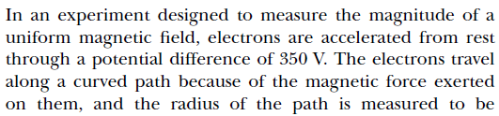
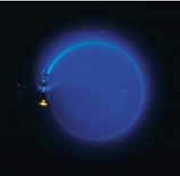
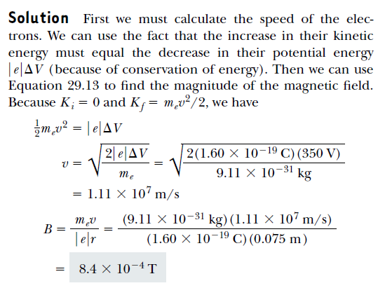

Slide 12
