Slide 1
Reliability
Lec. Zainab A. M.
Second Semester
Dep. Statistics & information
Stage Three
2022 - 2023

Slide 2
Reliability:
Qualitative & Quantitative Definition.
Qualitative Definition:
A reliability may be defined as the probability of a device to operate for a given period of time, without failure under a given operating conditions; for a given interval [0,t] .

Slide 3
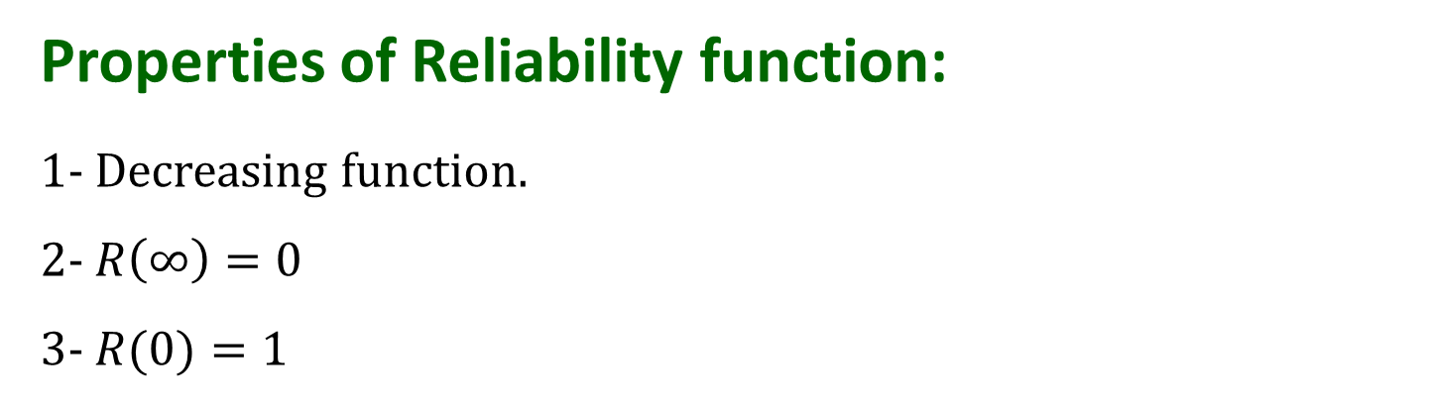
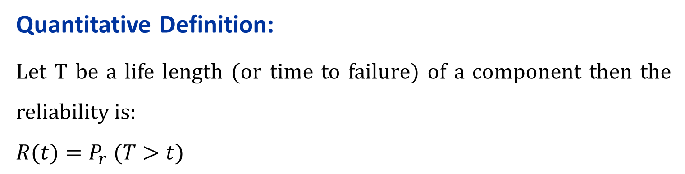
Quantitative Definition:
Let T be a life length (or time to failure) of a component then the reliability is:
$$R(t)=P_{r} (T>t)$$
Properties of Reliability function:
1- Decreasing function.
2- $R\left(∞\right)=0$
3- $R(0)=1$

Slide 4
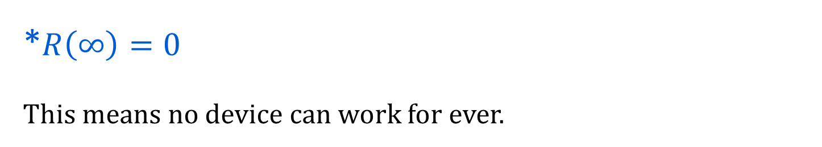
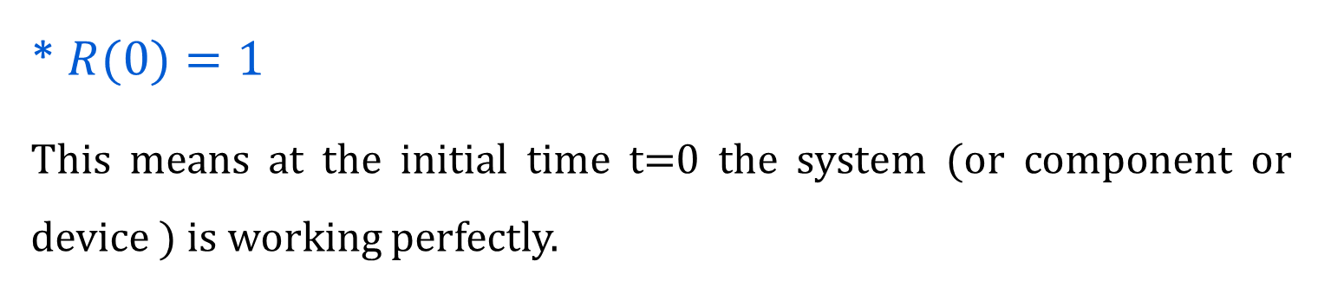
* $R(0)=1$
This means at the initial time t=0 the system (or component or device ) is working perfectly.
*$R\left(∞\right)=0$
This means no device can work for ever.

Slide 5

$R\left(t\right)$in terms of p.d.f f(t) may be written as
$$R\left(t\right)=\int_{t}^{∞}{f\left(u\right)du}$$
$R\left(t\right)$in terms of c.d.f F(t) may be expressed as
$$R\left(t\right)=1−F\left(t\right)$$
Unreliability function Q(t)
$$Q\left(t\right)=P_{r}\left(T≤t\right)$$
$$R\left(t\right)+Q\left(t\right)=1$$

Slide 6
Q/What it means to say R(t)=0.90 ?
It means that 10 percent will fail of the identical items under the same working condition in the interval [0,t].

Slide 7
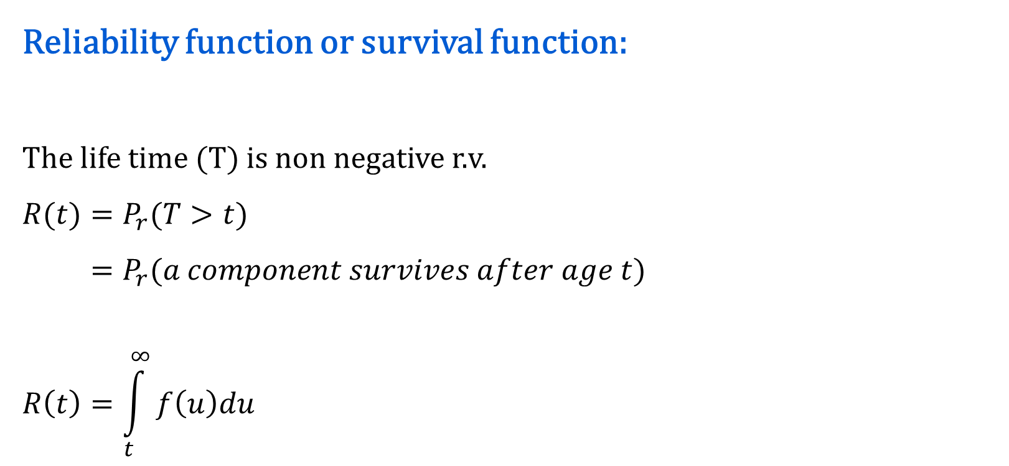
Reliability function or survival function:
The life time (T) is non negative r.v.
$$R(t)=P_{r}(T>t)$$
$$=P_{r}(a component survives after age t)$$
$$R\left(t\right)=\int_{t}^{∞}{f\left(u\right)du}$$

Slide 8

Distribution Function:
$$F\left(t\right)=P_{r}\left(T≤t\right)$$
$=P_{r}\left(failure of a compenent time≤t\right)$
$$F\left(t\right)=\int_{0}^{t}{f\left(u\right)du}$$
$$F\left(t\right)=Q\left(t\right)=1−R(t)$$

Slide 9
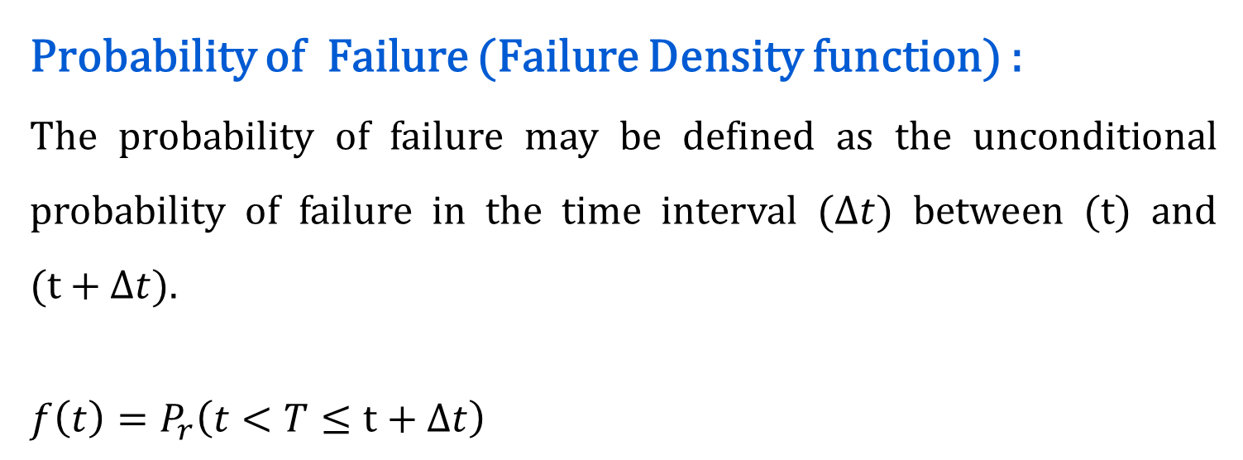
Probability of Failure (Failure Density function) :
The probability of failure may be defined as the unconditional probability of failure in the time interval ($∆t)$ between (t) and ($t+∆t$).
$$f\left(t\right)=P_{r}\left(t<T≤t+∆t\right)$$

Slide 10
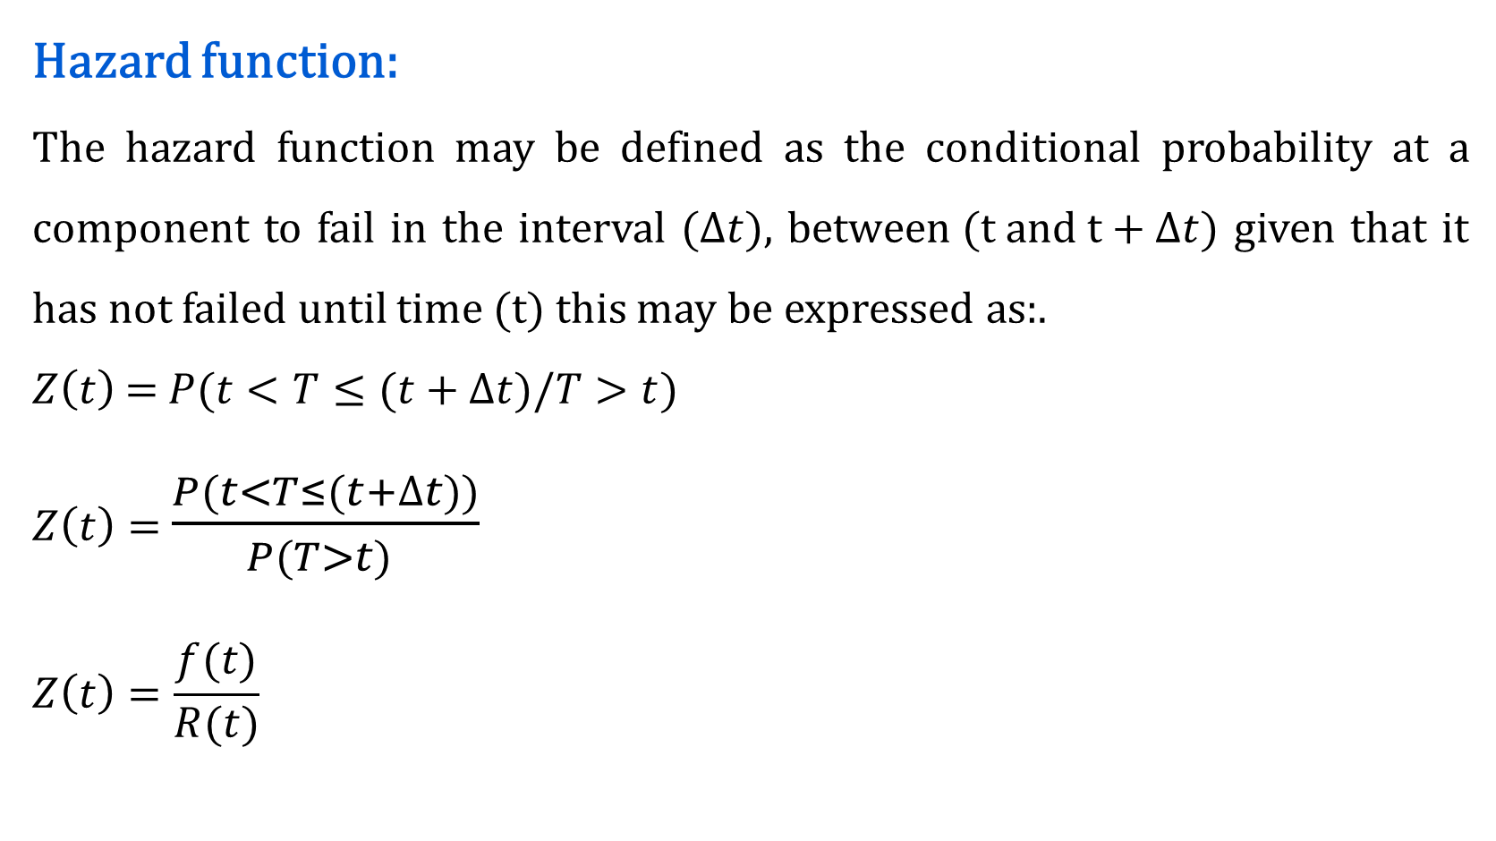
Hazard function:
The hazard function may be defined as the conditional probability at a component to fail in the interval ($∆t),$ b$etween (t and t+∆t$) given that it has not failed until time (t) this may be expressed as:.
$Z\left(t\right)$ =$P(t<T≤(t+∆t)/T>t$)
$Z\left(t\right)=$ $\frac{P(t<T≤(t+∆t))}{P(T>t) }$
$$Z\left(t\right)=\frac{f(t)}{R(t)}$$

Slide 11
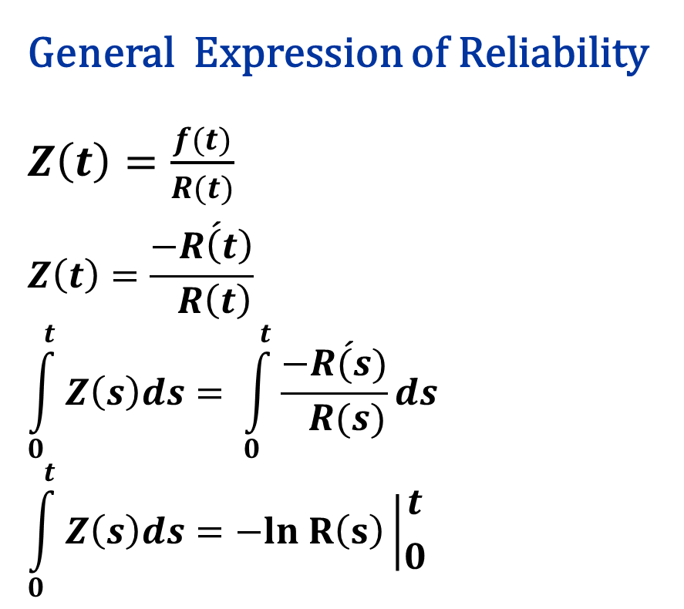
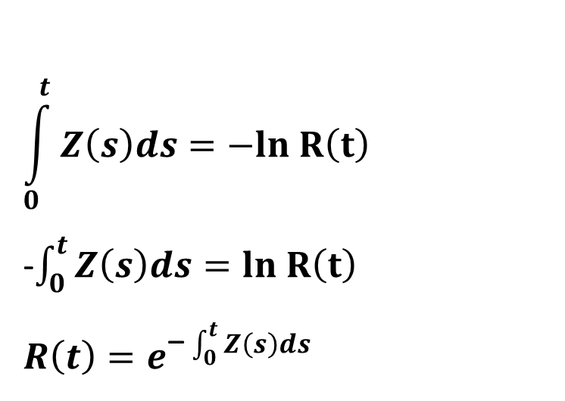
General Expression of Reliability $Z\left(t\right)=\frac{f(t)}{R(t)}$
$$Z\left(t\right)=\frac{−\acute{R\left(t\right)}}{ R\left(t\right)}$$
$$\int_{0}^{t}{Z\left(s\right)ds}= \int_{0}^{t}{\frac{−\acute{R(s)}}{ R(s)}ds}$$
$$\int_{0}^{t}{Z\left(s\right)ds}=−ln R\left(s\right)\left|{t \atop 0}\right.$$
$$\int_{0}^{t}{Z\left(s\right)ds}=−ln R\left(t\right)$$
-$\int_{0}^{t}{Z\left(s\right)ds}=ln R\left(t\right)$
$$R\left(t\right)=e^{\text{−}\int_{0}^{t}{Z\left(s\right)ds}}$$

Slide 12
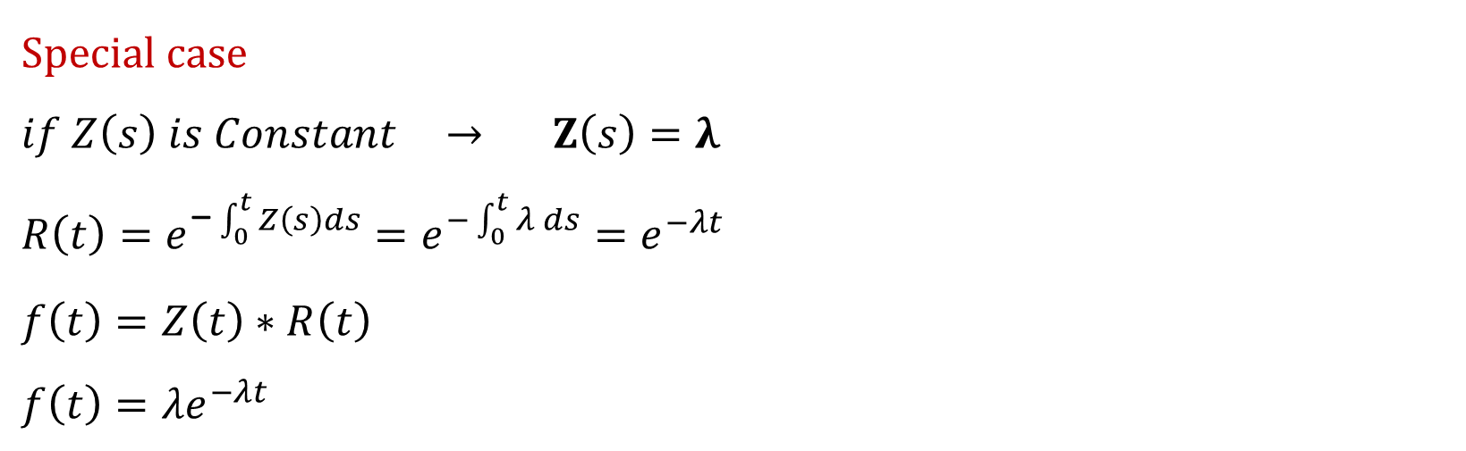
$$Special case$$
$if Z\left(s\right) is Constant$ $→$ $Z\left(s\right)=λ$
$$R\left(t\right)=e^{\text{−}\int_{0}^{t}{Z\left(s\right)ds}}=e^{−\int_{0}^{t}{λ }ds}=e^{−λt}$$
$$f\left(t\right)=Z\left(t\right)∗R\left(t\right)$$
$$f\left(t\right)={λe}^{−λt}$$

Slide 13
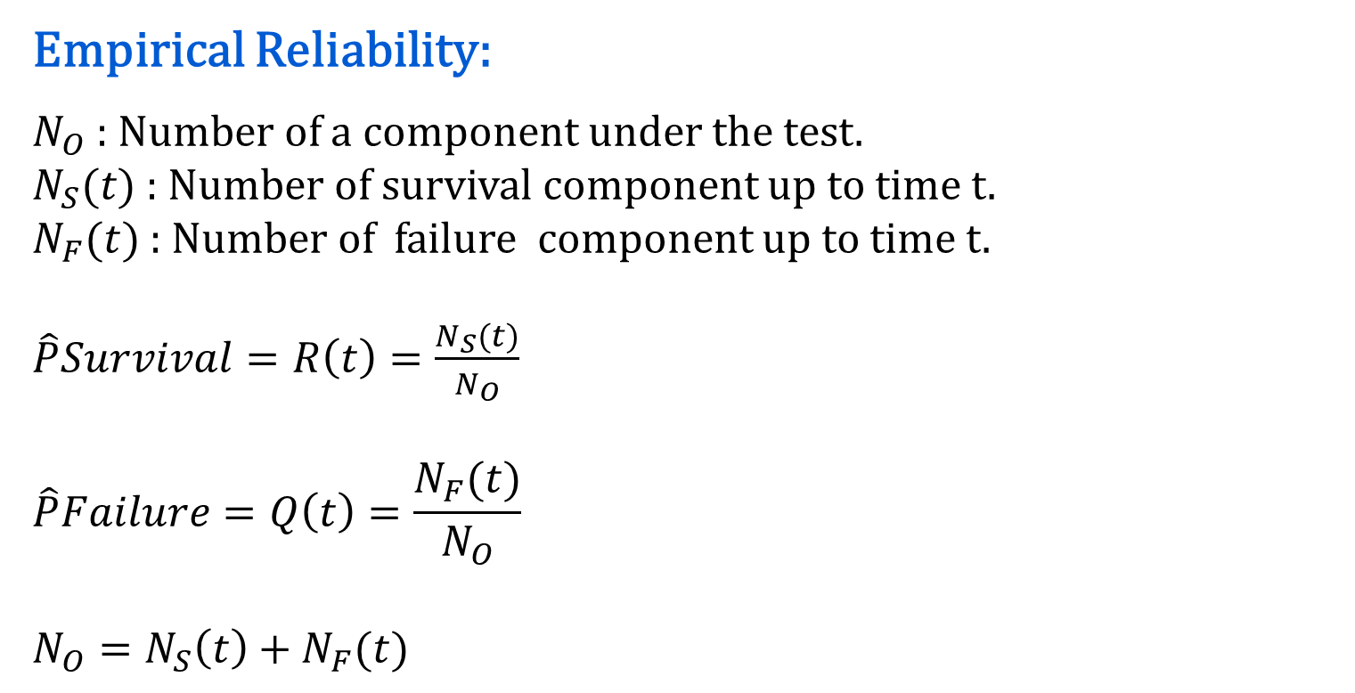
Empirical Reliability:
$N_{O}$ : Number of a component under the test.
$N_{S}(t)$: Number of survival component up to time t.
$N_{F}(t)$: Number of failure component up to time t.
$\hat{P}Survival=R\left(t\right)=\frac{N_{S}(t)}{N_{O}}$
$$\hat{P}Failure=Q\left(t\right)=\frac{N_{F}(t)}{N_{O}}$$
$$N_{O}=N_{S}\left(t\right)+N_{F}(t)$$

Slide 14
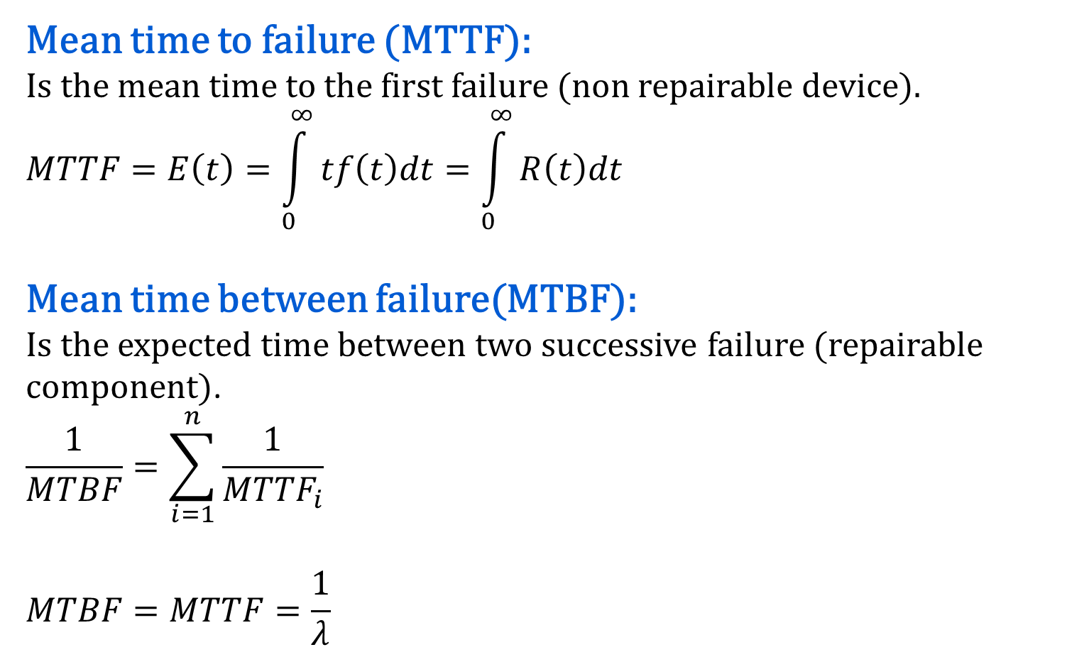
Mean time to failure (MTTF):
Is the mean time to the first failure (non repairable device).
$$MTTF=E\left(t\right)=\int_{0}^{∞}{tf\left(t\right)dt}=\int_{0}^{∞}{R\left(t\right)dt}$$
Mean time between failure(MTBF):
Is the expected time between two successive failure (repairable component).
$$\frac{1}{MTBF}=\sum_{i=1}^{n}{\frac{1}{{MTTF}_{i}}}$$
$$MTBF=MTTF=\frac{1}{λ}$$
اكثر من فشل واحد
إذا كانت فشل واحد

Slide 15
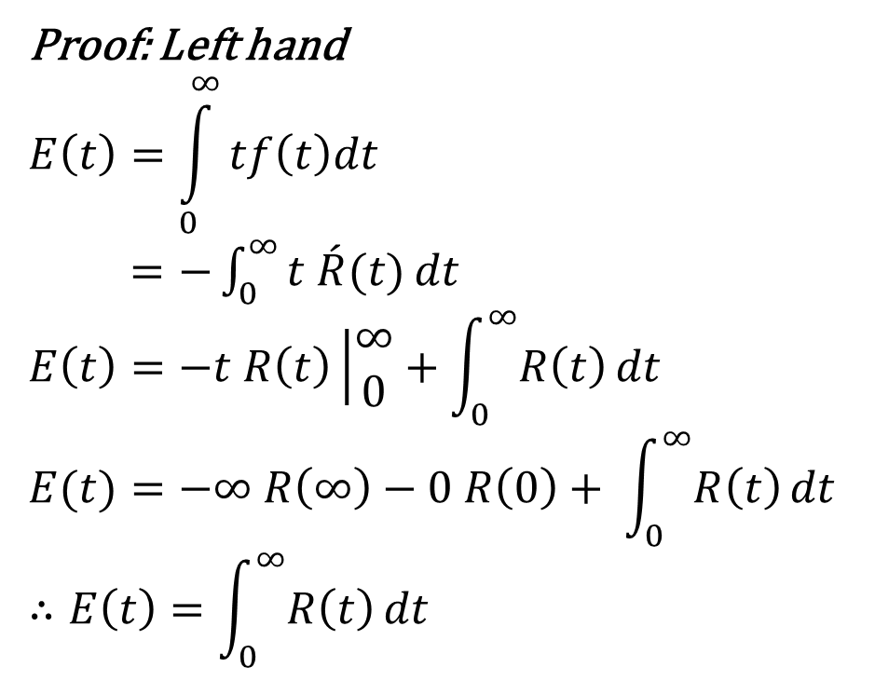
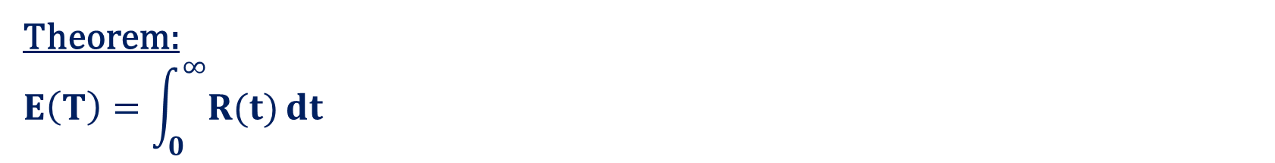
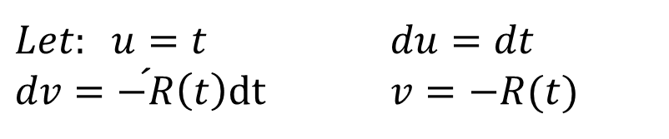
Theorem:
$$E\left(T\right)=\int_{0}^{∞}{R(t)}dt$$
Proof: Left hand
$$E\left(t\right)=\int_{0}^{∞}{tf\left(t\right)dt}$$
$=−\int_{0}^{∞}{t \acute{R}(t)}dt$
$$E\left(t\right)=−t R\left(t\right)\left|\begin{matrix}∞ \\ 0\end{matrix}\right.+\int_{0}^{∞}{R\left(t\right)}dt$$
$$E(t)=−∞ R\left(∞\right)−0 R\left(0\right)+ \int_{0}^{∞}{R\left(t\right)}dt$$
$$∴E\left(t\right)=\int_{0}^{∞}{R\left(t\right)}dt$$
$Let: u=t$ $du=dt$
$dv=\acute{−R}\left(t\right)dt$ $v=−R(t)$

Slide 16
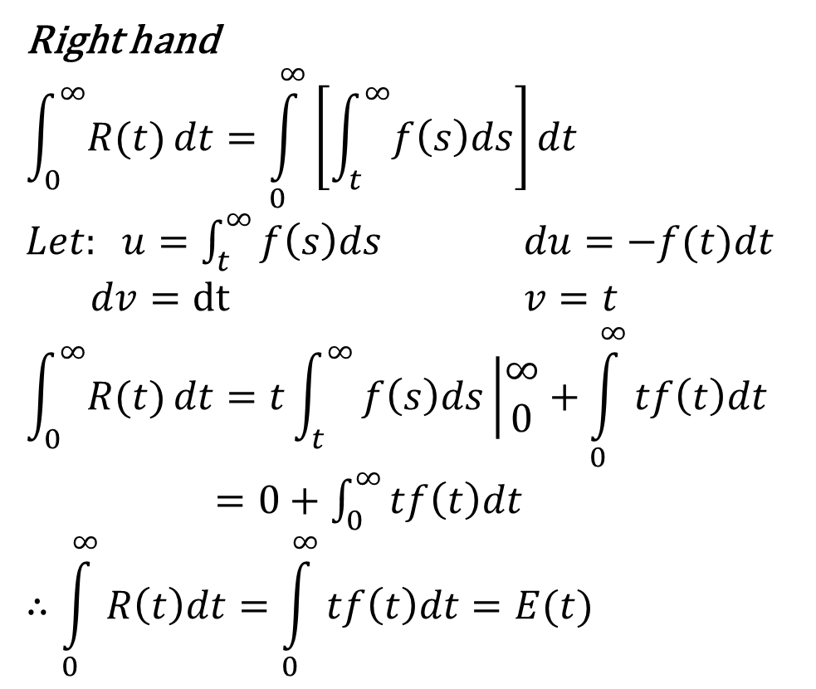
Right hand
$$\int_{0}^{∞}{R(t)}dt=\int_{0}^{∞}{\left[\int_{t}^{∞}{f\left(s\right)ds}\right]dt}$$
$Let: u=\int_{t}^{∞}{f\left(s\right)ds}$ $du=−f(t)dt$
$dv=dt$ $v=t$
$$\int_{0}^{∞}{R(t)}dt=t\int_{t}^{∞}{f\left(s\right)ds\left|\begin{matrix}∞ \\ 0\end{matrix}\right.}+\int_{0}^{∞}{tf\left(t\right)dt}$$
$=0+\int_{0}^{∞}{tf\left(t\right)dt}$
$$∴\int_{0}^{∞}{R\left(t\right)dt}=\int_{0}^{∞}{tf\left(t\right)dt}=E(t)$$

Slide 17

In special case
If $Z\left(t\right)=λ$
$$R\left(t\right)=e^{−λt}$$
$$f\left(t\right)={λe}^{−λt}$$
$$E\left(t\right)=\int_{0}^{∞}{R\left(t\right)}dt$$
$$E\left(t\right)=\int_{0}^{∞}{e^{−λt} }dt=\frac{−1}{λ}e^{−λt}\left|\begin{matrix}∞ \\ 0\end{matrix}\right.$$
$=\frac{−1}{λ}e^{−λ(∞)}+\frac{1}{λ}e^{−λ(0)}=\frac{1}{λ}$
$$E\left(t\right)=\frac{1}{λ}=MTTF$$

Slide 18
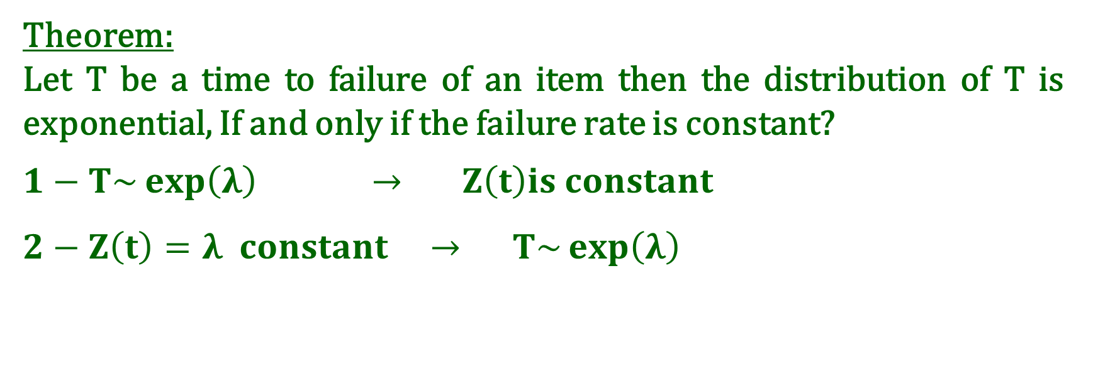
Theorem:
Let T be a time to failure of an item then the distribution of T is exponential, If and only if the failure rate is constant?
$$1−T\sim \exp\left(λ\right) → Z\left(t\right)is constant$$
$$2−Z\left(t\right)=λ constant → T\sim \exp\left(λ\right)$$

Slide 19

$$1−T\sim \exp\left(λ\right) → Z\left(t\right)is constant$$
$$Z\left(t\right)=\frac{f\left(t\right)}{R\left(t\right)}$$
$$f\left(t\right)={λe}^{−λt}$$
$$R\left(t\right)=P\left(T≥t\right)=\int_{t}^{∞}{f\left(s\right)ds}$$
$=\int_{t}^{∞}{{λe}^{−λs}ds}$
$=\left.−e^{−λs}\right|\begin{matrix}∞ \\ t\end{matrix}$
$=e^{−λt}$
$Z\left(t\right)=\frac{{λe}^{−λt}}{e^{−λt}}=λ$ constant Z(t)

Slide 20
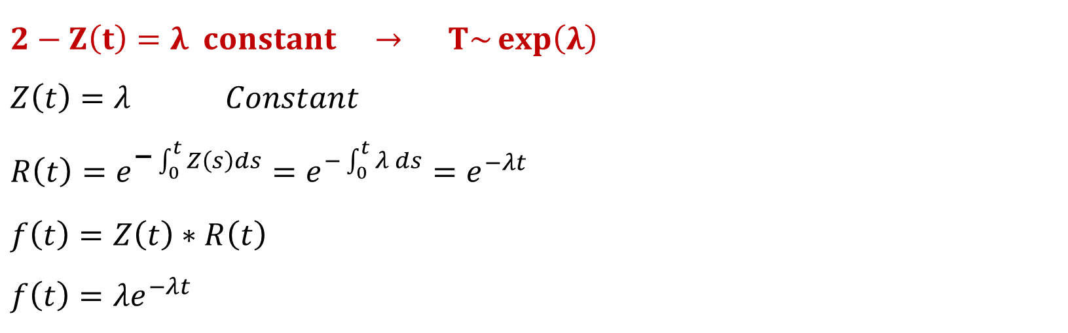
$$2−Z\left(t\right)=λ constant → T\sim \exp\left(λ\right)$$
$$Z\left(t\right)=λ Constant$$
$$R\left(t\right)=e^{\text{−}\int_{0}^{t}{Z\left(s\right)ds}}=e^{−\int_{0}^{t}{λ }ds}=e^{−λt}$$
$$f\left(t\right)=Z\left(t\right)∗R\left(t\right)$$
$$f\left(t\right)={λe}^{−λt}$$

Slide 21
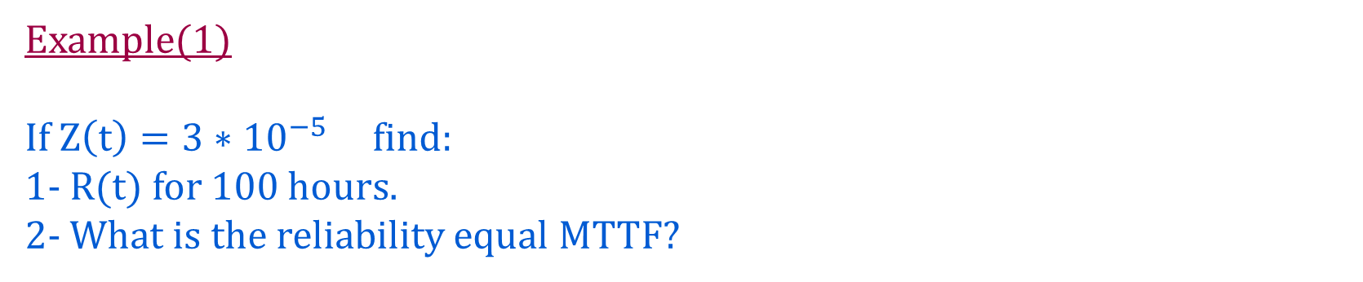

Example(1)
If $Z\left(t\right)=3∗{10}^{−5}$ find:
1- R(t) for 100 hours.
2- What is the reliability equal MTTF?
Solution
$Z\left(t\right)=λ=3∗{10}^{−5}$ constant
$$1−R\left(t\right)=e^{−λt}$$
$$R\left(t=100\right)=e^{−3∗{10}^{−5}∗100}=e^{−3∗{10}^{−3}}=0.99$$

Slide 22
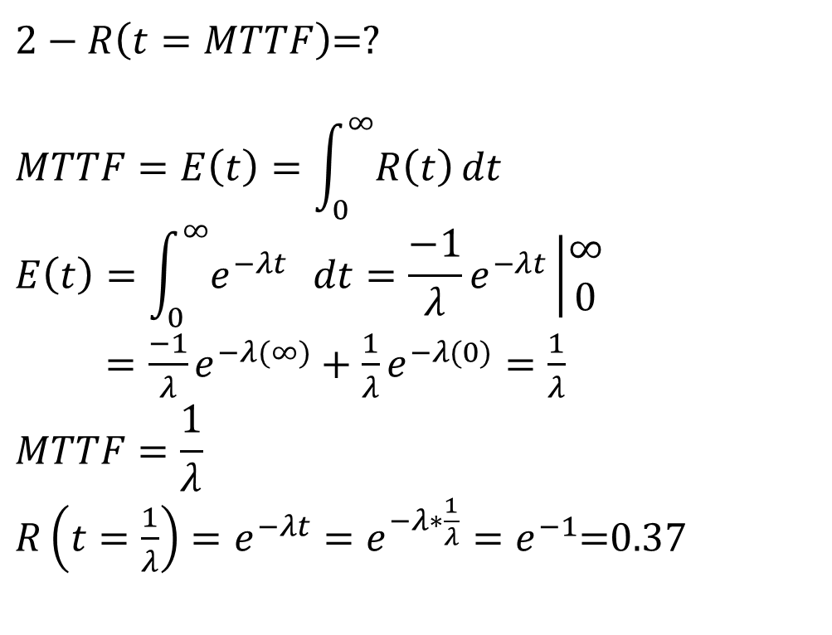
$2−R\left(t=MTTF\right)$=?
$$MTTF=E\left(t\right)=\int_{0}^{∞}{R\left(t\right)}dt$$
$$E\left(t\right)=\int_{0}^{∞}{e^{−λt} }dt=\frac{−1}{λ}e^{−λt}\left|\begin{matrix}∞ \\ 0\end{matrix}\right.$$
$=\frac{−1}{λ}e^{−λ(∞)}+\frac{1}{λ}e^{−λ(0)}=\frac{1}{λ}$
$$MTTF=\frac{1}{λ}$$
$R\left(t=\frac{1}{λ}\right)=e^{−λt}=e^{−λ∗\frac{1}{λ}}=e^{−1}$=0.37

Slide 23
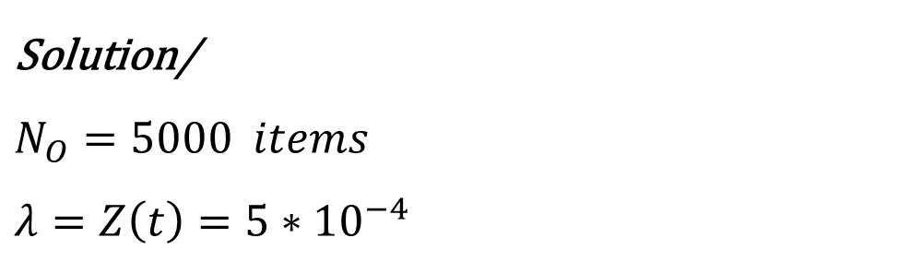
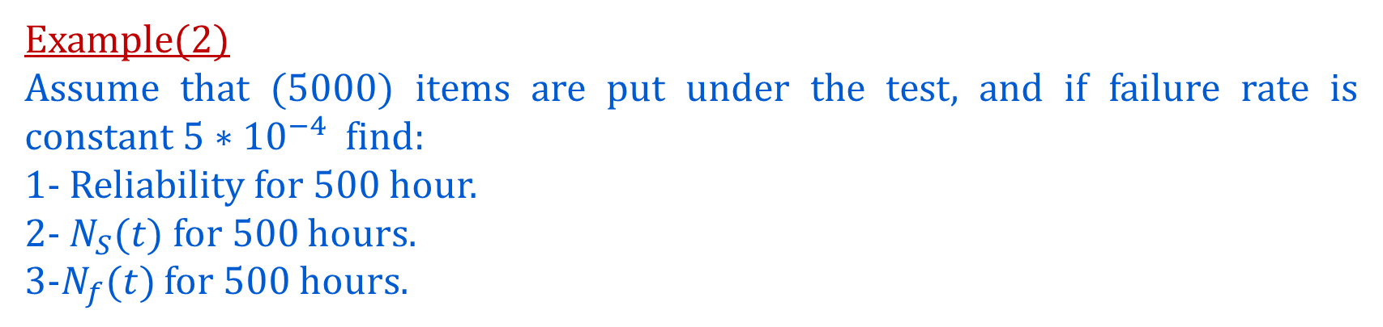
Example(2)
Assume that (5000) items are put under the test, and if failure rate is constant $5∗{10}^{−4}$ find:
1- Reliability for 500 hour.
2- $N_{S}(t)$ for 500 hours.
3-$N_{f}(t)$ for 500 hours.
$$\text{Solution}\text{/}$$
$$N_{O}=5000 items$$
$$λ=Z\left(t\right)=5∗{10}^{−4}$$

Slide 24
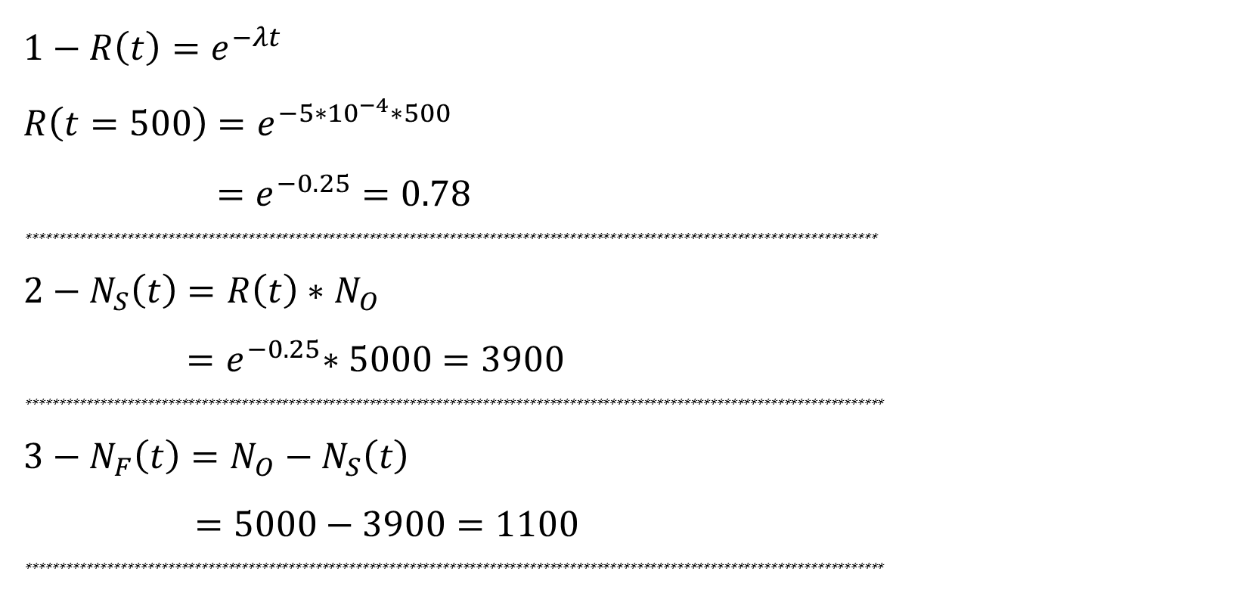
$$1−R\left(t\right)=e^{−λt}$$
$$R\left(t=500\right)=e^{−5∗{10}^{−4}∗500}$$
$=e^{−0.25}=0.78$
*******************************************************************************************************************************
$$2−N_{S}\left(t\right)=R\left(t\right)∗N_{O}$$
${=e}^{−0.25}∗5000=3900$
********************************************************************************************************************************
$$3−N_{F}\left(t\right)=N_{O}−N_{S}\left(t\right)$$
$=5000−3900=1100$
********************************************************************************************************************************

Slide 25
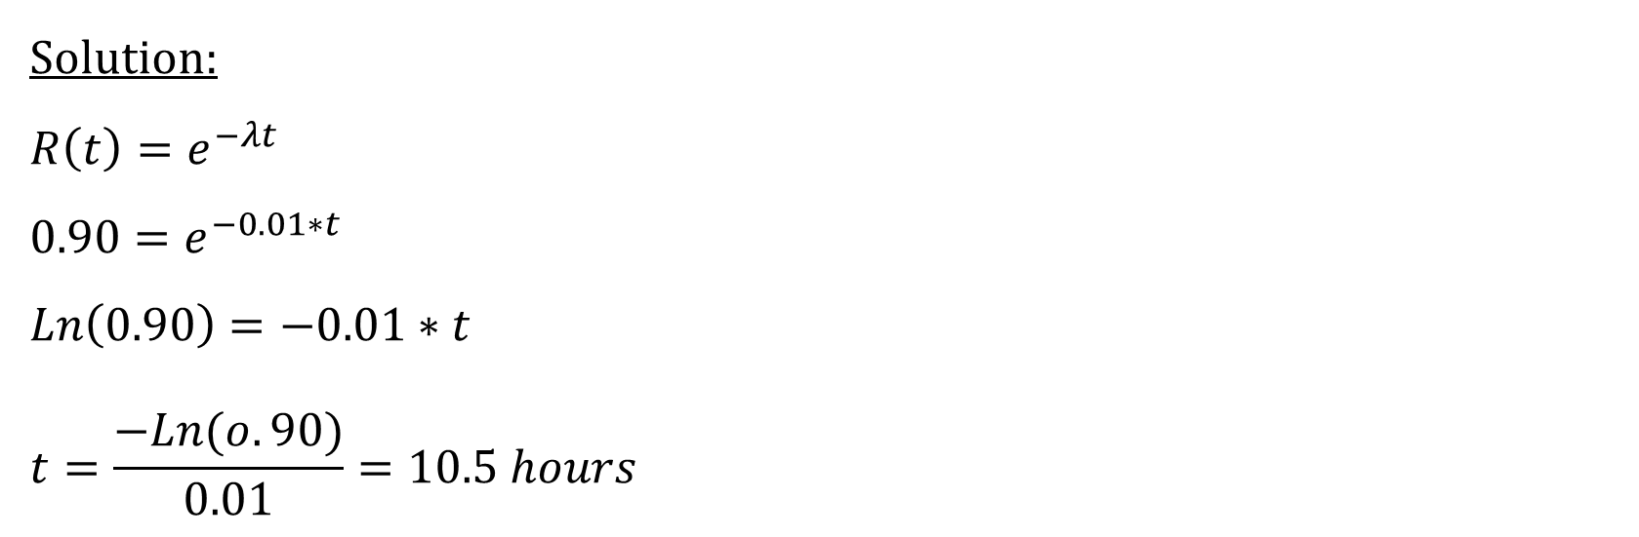
Example(3):
If 𝜆=0.01 parameter of exponential distribution and R(t)=0.90,
Find: t [the number of hours as a system operated]
Solution:
$$R\left(t\right)=e^{−λt}$$
$$0.90=e^{−0.01∗t}$$
$$Ln\left(0.90\right)=−0.01∗t$$
$$t=\frac{−Ln(o.90)}{0.01}=10.5 hours$$

Slide 26
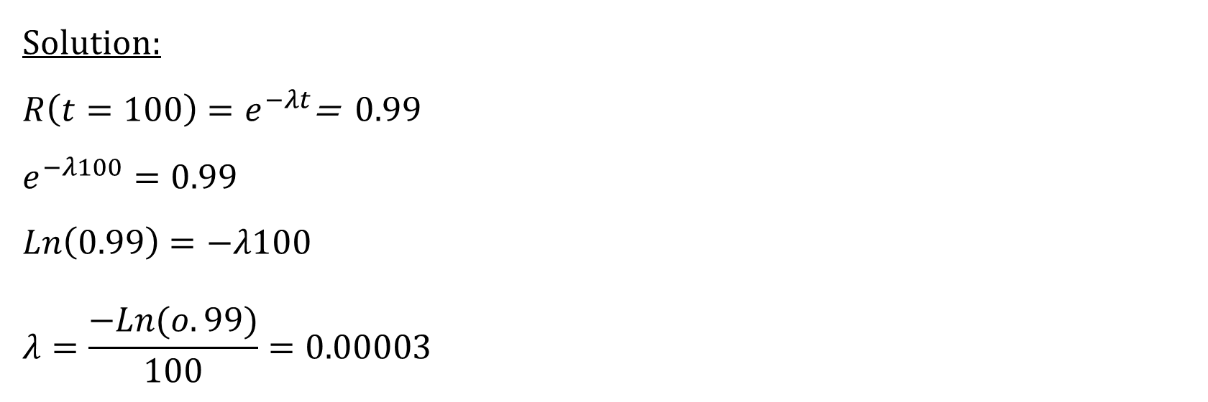
Example(3):
If the Reliability for 100h equal to 0.99 find the failure rate:
Solution:
$R\left(t=100\right)=e^{−λt}$= 0.99
$$e^{−λ100}=0.99$$
$$Ln\left(0.99\right)=−λ100$$
$$λ=\frac{−Ln(o.99)}{100}=0.00003$$

