Slide 1
University of Salahaddin-Erbil College of Education-Shaqlawa Department of Physical Education Third Stage
Principles of Statistics
Presented by
Lecturer’s Zanyar M. Mohammad
Academic Year: 2022-2023

Slide 2
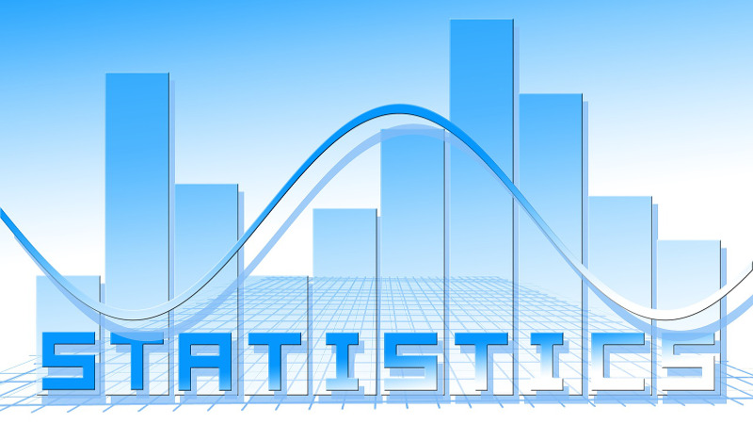
Chapter One

Slide 3
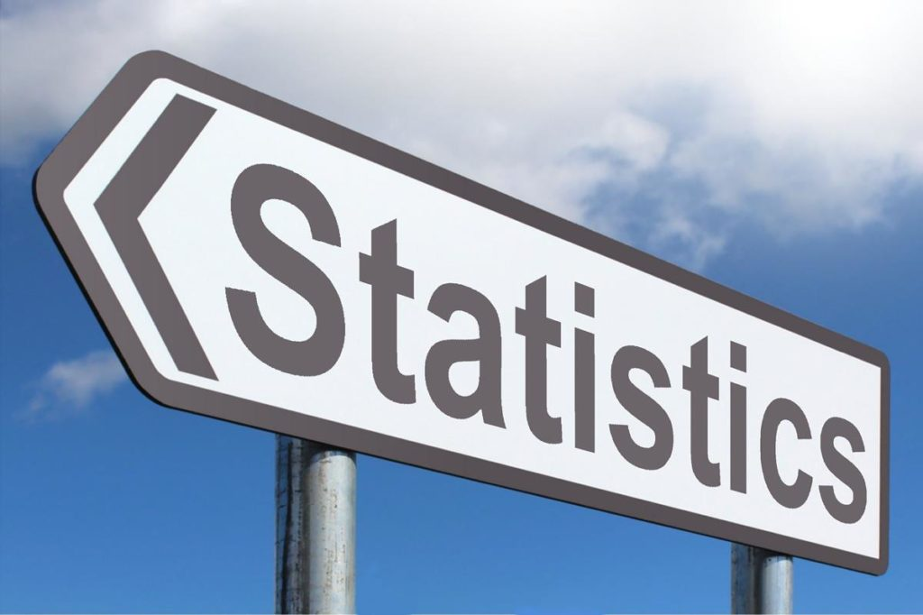
Statistics

Slide 4
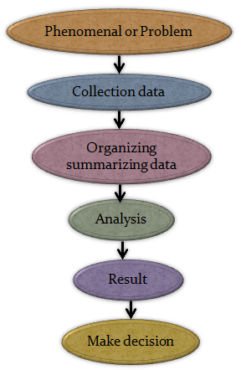
Definition
Statistics is the scientific method concerned with collecting, organizing, and analyzing data for a particular phenomenon. As well as making the reasonable decisions.
Biostatistics can be defined as the application of the statistical tools in the fields of biological sciences and medicine.

Slide 5
Statistics in Sports
Statistics is a scientific discipline that involves the collection, classification, analysis, and presentation of data.
There are many uses of statistics in sports. In fact, without it, the whole industry would not make any sense.
Almost every activity that takes place in the world of sports depends on the stats.
All games, regardless of virtual or real, rely solely on this scientific discipline
In a field where performance determines your worth or success, stats are vital. Sports have involved so much in such a way that the machines calculate 90% of the statistics.
A good example is in the boxing category, where blocks and hits are considered as points.

Slide 6
The steps of scientific research

Slide 7
Types of Statistics
Statistics
Descriptive statistics
ئامارى جؤرى
Inferential statistics
ئامارى دةرئةنجامى
Estimation
خةملاَندن
Testing Hypothesis
تاقيكردنةوةى طريمانة
Point Estimation
خةملاَندنى خالَى
Interval Estimation
خةملاَندنى ماوةيى

Slide 8
Types of statistics
Statistics divided into two parts
Descriptive statistics consists of methods for obtaining data, reviewing, organizing, summarizing and presenting data.
Inferential statistics Consists hypothesis testing, and estimations for generalizing sample results on population. It is divided into two parts also:
Estimation.
Testing Hypothesis.
پێکدێت لە شێوازەکان بۆ بەدەست هێنانی داتا، پێداچوونەوە، ڕێکخستن، پوختەکردن و پێشکەشکردنی داتا.
بریتییە لە تاقیکردنەوەی گریمانە، و خەمڵاندنەکان بۆ گشتاندنی ئەنجامەکانی نموونە لەسەر دانیشتوان. بە دوو بەشەوە دابەش دەکرێت

Slide 9
Data & Variable
Data: Are a set of numbers. Those values represent by the thing called a variable.
Variable: A Characteristic that takes different values.
داتا: کۆمەڵێک ژمارەن. ئەو بەهایانە نوێنەرایەتی دەکەن لەلایەن ئەو شتەی پێی دەوترێت گۆڕاو.
گۆڕاو: خەسڵەتێک کە بەها جیاوازەکان وەردەگرێت.

Slide 10
Classification of Variables
Variables
Qualitative Variables
Quantitative Variables
Nominal Variables
Ordinal Variables
Discrete Variables
Continuous Variables

Slide 11
Types of Variables
First: Qualitative Variables: are variables which assume non-numerical values
For Example:
Gender (male or female).
Blood group (A , B , AB , O)
Economic state (v. good , good , bad)
Level of education (primary , secondary , high school)
Religious (Muslim , Christian , Jewish , etc.)
گۆڕاوەکانی کوالیتی: ئەو گۆڕاوانەن کە بەهای نا ژمارەیی هەڵئەگرێت

Slide 12
Types of Qualitative Variables
1) Nominal Variable: There is no order among characteristics of variable.
For example:
Gender (male , female).
Blood group (A , B , AB , O)
2) Ordinal Variable: There is order among characteristics of variable.
For Example:
Level of education (primary, secondary, high school)
Economic state (v. good, good, bad)
گۆڕینی ناو: هیچ ڕیزێک نیە لە نێوان تایبەتمەندیەکانی گۆڕاو.
گۆڕەری بەندی: ڕیزێک هەیە لە نێوان تایبەتمەندیەکانی گۆڕاو.

Slide 13
Types of Variables
Second: Quantitative Variables: are variables which assume numerical values.
For example:
The number of students (19 , 32 , 14, …)
Age of students (22 , 25.6 , 21 , . )
Grades of students (78 , 89 , 54 , … )
گۆڕینی چەندێتی: ئەو گۆڕاوانەن کە بەهای ژمارەیی دادەنێن

Slide 14
Types of Quantitative Variables
1) Discrete Variables: Usually obtained by counting.
For example:
The number of students
The number of bacteria on a plate,
The number of children in a family
2) Continuous Variables: Usually obtained by measurement.
For example:
Blood pressure (14 , 17 , 12 , ….)
- Age (54 , 65.6 , 43 , …….).
- Height (154 , 165.6 , 143 , …….).
عادەتەن بە ژماردن بەدەست دەهێنرێت.
عادەتەن بە پێوانە بەدەست دەهێنرێت

Slide 15
Data
Data: are a set of numbers. Those values represent by the thing called a variable.
or
Data: are the values (Measurements or observations) that the variables can assume.
Sources of data:
Historical sources: Data and information stored and collected by the organs and institutions of the State or organizations.
Field sources: Data and information can be obtained from their original sources by correspondence, confrontation or any other way of communication.
بەهاکانن (پێوانەکان یان تێبینیەکان) کە گۆڕاوەکان دەتوانن وا دابنێن.
داتا و زانیاری پاشەکەوتکراو و کۆکراوە لەلایەن ئۆرگانەکان و دامەزراوەکانی دەوڵەت یان ڕێکخراوەکان.
داتا و زانیاری دەتوانرێت لە سەرچاوە ڕەسەنەکانیانەوە بە گونجان و ڕووبەڕووبوونەوە یان هەر ڕێگایەکی تری پەیوەندی بەدەست بهێنرێت

Slide 16
Data
Raw data (Ungrouped data): are collected data that have not been organized numerically. An example is the set of trees of 200 families.
Grouped data: is summarizing the data by constructing a frequency table.
We will speak about frequency table in next lectures.
داتا کۆکراونەتەوە کە بە شێوەی ژمارەیی ڕێک نەخراون. نموونەکە بریتییە لە کۆمەڵەی دارەکانی 200 خێزان.
خەریکی کورتکردنەوەی داتایە بە دروستکردنی خشتەی فرێکانس.

