Slide 1

University of Salahaddin-Erbil
College of Education-Shaqlawa
Department of Physical Education
Third Stage
Principles of Statistics
Presented by
Lecturer’s Zanyar M. Mohammad
Academic Year: 2022-2023

Slide 2
Chapter Three

Slide 3
Presentation of the data
After collection data the next step should be express it in some form such as:
Frequency distribution (Tabular presentation)
Graphical presentation.

Slide 4
Frequency Table
Frequency table: is a simple table has two columns first column called classes and the second column called frequency.
Example1:
Example2:
Classes | Frequency
Male | 12
Female | 9
 | Frequency | Classes
 | 110 | Erbil
 | 134 | Sulaimany
 | 69 | Dhock

Slide 5
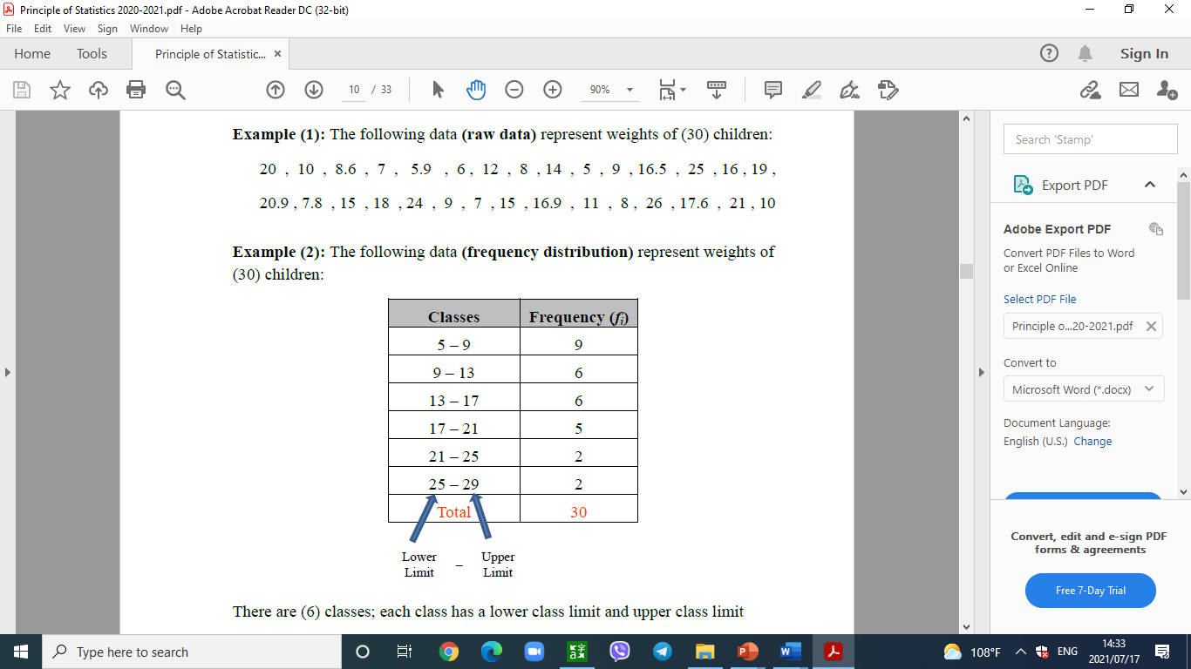
Frequency distribution
Frequency distribution is the organizing of raw data in table form, used classes and frequencies.

Slide 6
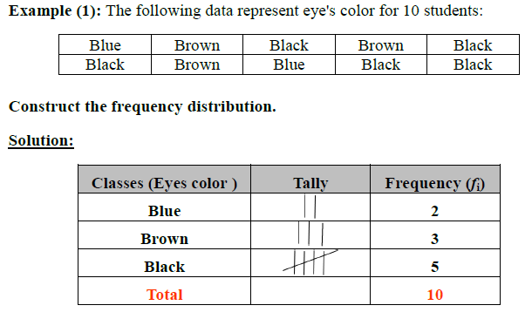
1-Frequency distribution for qualitative data
Frequency distribution for qualitative data lists all classes and the number of elements that belong to each of the classes

Slide 7
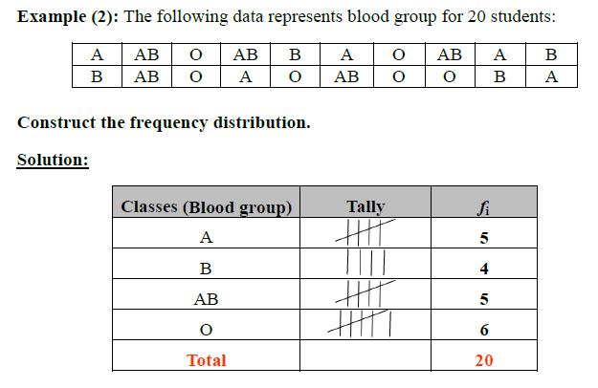
Frequency distribution for qualitative data

Slide 8
Home Work
The following data represent eyes color for 13 students.
Blue, Brown, Green, Black, Brown, Green, Black, brown, Black, Blue, Black, Green, Black.
Solution:
Classes | Frequency
Blue | 2
Brown | 3
Green | 3
Black | 5
Total | 13

Slide 9
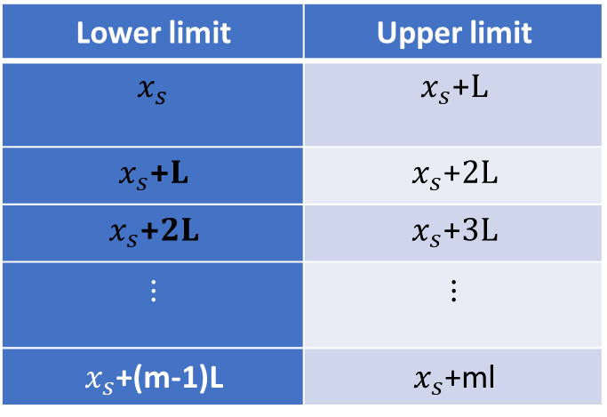

2- Frequency table for quantitative data
Find the range: R = $x_{l}−x_{s}+1$
Find the number of classes: m = 2.5 *$\sqrt[4]{n}$
Find the length of classes: L = $\frac{R}{m}$
Writing class limits:
For continuous variable
Lower limit | Upper limit
$$x_{s}$$ | $x_{s}$+L
$x_{s}$+L | $x_{s}$+2L
$x_{s}$+2L | $x_{s}$+3L
$$⋮$$ | $$⋮$$
$x_{s}$+(m-1)L | $x_{s}$+ml

Slide 10
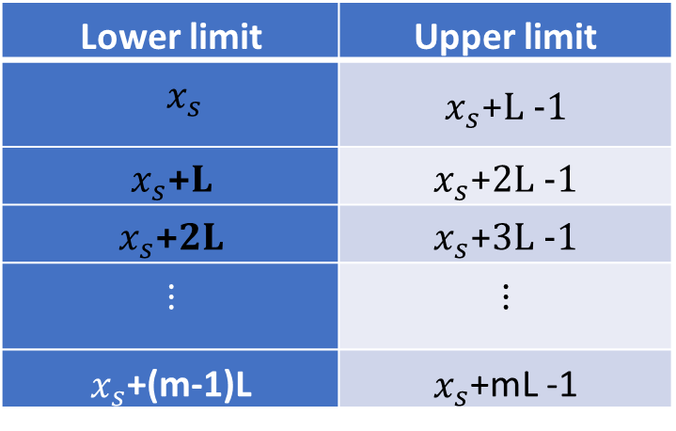
2- Frequency table for quantitative data
b-For discrete variable:
Lower limit | Upper limit
$$x_{s}$$ | $x_{s}$+L -1
$x_{s}$+L | $x_{s}$+2L -1
$x_{s}$+2L | $x_{s}$+3L -1
$$⋮$$ | $$⋮$$
$x_{s}$+(m-1)L | $x_{s}$+mL -1

Slide 11
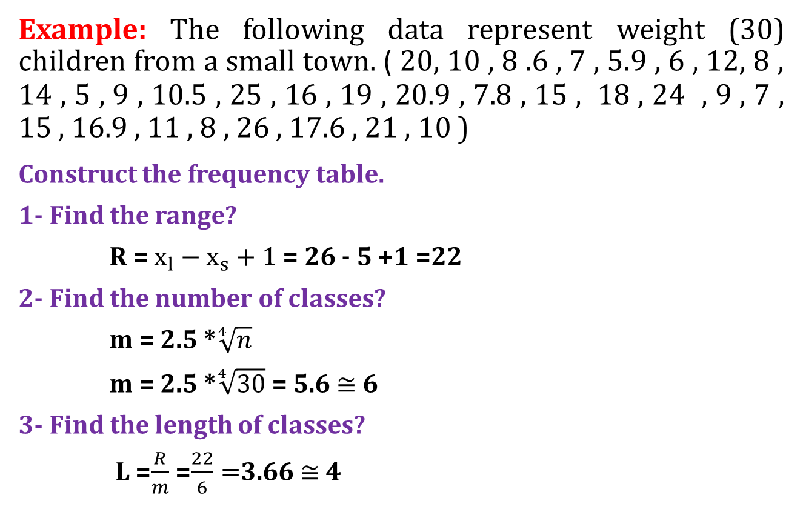
2- Frequency table for quantitative data
Example: The following data represent weight (30) children from a small town. ( 20, 10 , 8 .6 , 7 , 5.9 , 6 , 12, 8 , 14 , 5 , 9 , 10.5 , 25 , 16 , 19 , 20.9 , 7.8 , 15 , 18 , 24 , 9 , 7 , 15 , 16.9 , 11 , 8 , 26 , 17.6 , 21 , 10 )
Construct the frequency table.
1- Find the range?
R = $x_{l}−x_{s}+1$ = 26 - 5 +1 =22
2- Find the number of classes?
m = 2.5 *$\sqrt[4]{n}$
m = 2.5 *$\sqrt[4]{30}$ = 5.6 $≅$ 6
3- Find the length of classes?
L =$\frac{R}{m}$ =$\frac{22}{6}=$3.66$≅$ 4

Slide 12
4- Writing class limit.
5- Find frequencies of any classes?
Classes | Frequency
5_8 | 9
9_12 | 6
13_16 | 6
17_20 | 5
21_24 | 2
25 _28 | 2

Slide 13
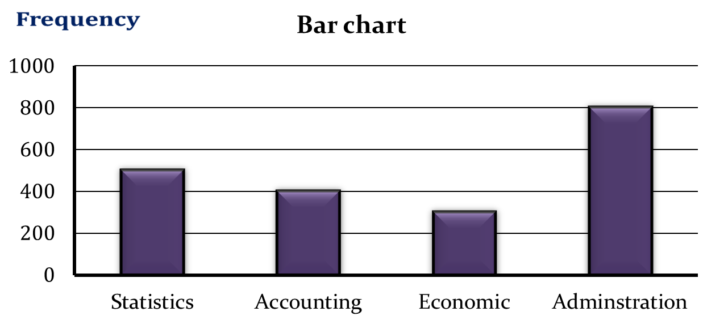
Graph
Example: The following data shows the number of student of each department of Administration and economic College.
Department | Statistics | Accounting | Economic | Administration
No. of student | 500 | 400 | 300 | 800
Classes

Slide 14
2- Pie chart: ويَنةي بازنةيى
Is a circle divided into number of sectors the angle of pie chart for each sectors are calculated as follows:
Example: The following data shows the number of student of each department of Administration College.
Department | Statistics | Accounting | Economic | Administration
No. of student | 500 | 400 | 300 | 800

Slide 15
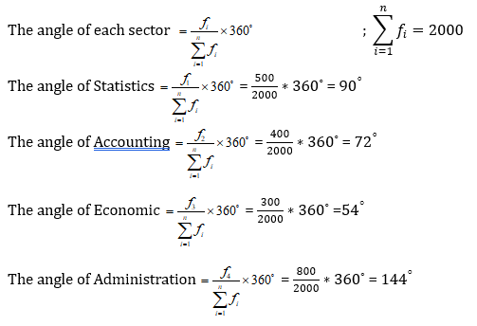
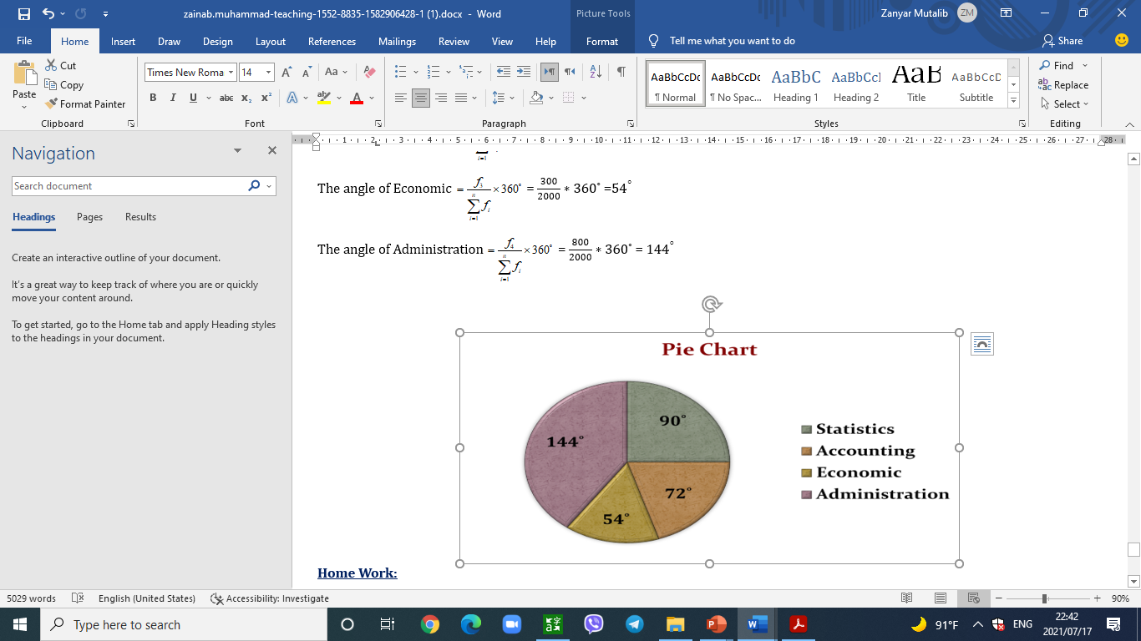
2- Pie chart: ويَنةي بازنةيى

Slide 16
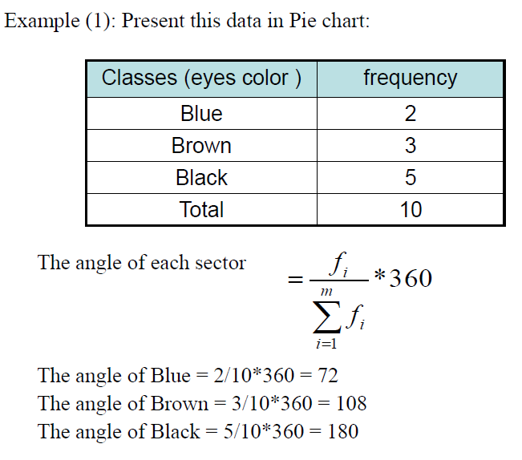
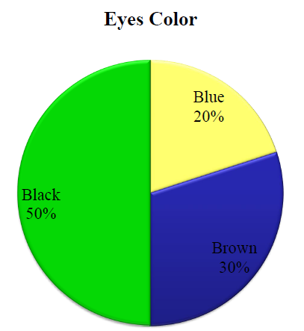

Slide 17
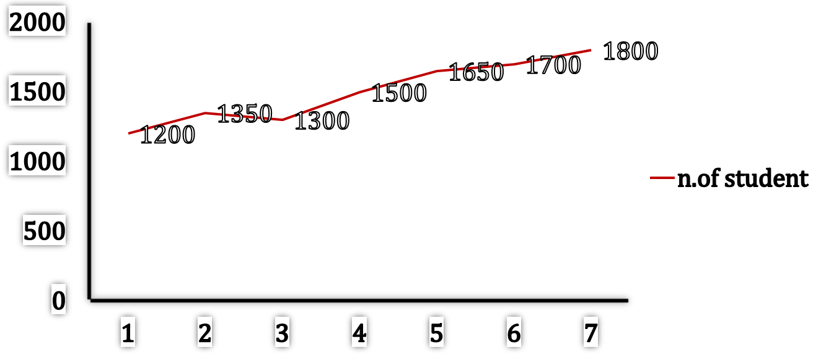
Example: The following data represent number of students in education of shaqlawa College.
Solution:- Present these data by line chart:
1996 | 1995 | 1994 | 1993 | 1992 | 1991 | 1990 | Year
1800 | 1700 | 1650 | 1500 | 1300 | 1350 | 1200 | Number of student
1990 1991 1992 1993 1994 1995 1996
Year

