Slide 1
University of Salahaddin-Erbil College of Education-Shaqlawa Department of Physical Education Third Stage
Principles of Statistics
Presented by
Lecturer’s Zanyar M. Mohammad
Academic Year: 2022-2023

Slide 2
Chapter Four Skewness & Kurtosis

Slide 3
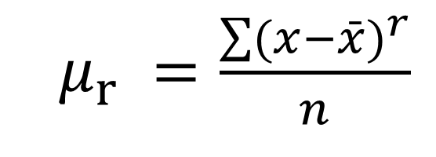
Skewness (التواء)جةماندن
Skewness is a measure of symmetry(هاوتايي).
$μ_{r} =\frac{\sum{(x−\bar{x})^{r}}}{n}$
(Not Skewed)

Slide 4
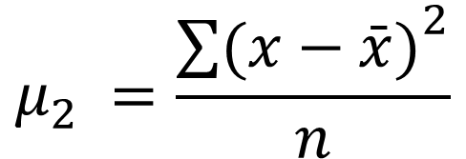
Central Moments
First Moment
Second Moment
Third Moment
Fourth Moment
$$μ_{2} =\frac{{\sum{(x−\bar{x})}}^{2}}{n}$$

Slide 5
Skewness
Mean
Mode
Mean
Median
Mode
Mean
Mode
Median
Median
Negatively
Skewed
Symmetric
(Not Skewed)
Positively
Skewed

Slide 6

Home Work
If x equals ( 4 , 3 , 5 , 3 , 6 ), Proof
$$\frac{\sum{(x−\bar{x})}}{n}=0$$

Slide 7
Kurtosis (تفلطح)
Kurtosis is a measure of whether the data are peaked(لووتكه) or flat relative to a normal distribution.

