Slide 1
English Department
Comprehension I
College of Languages
English Department
Second Year

Slide 2
Rules and Regulations
Students are supposed to respect each other in classroom.
Students are supposed to respect the class and the lecture.
Laughter without reasons, using cellphone a lot, talking too much to the extent that bothers other students etc. are NOT allowed in classroom. If any student does them too much, s/he WON’T be allowed to attend the lectures and take monthly EXAM.
Every student MUST bring books. Students WON’T be allowed to attend classroom if they do not bring their books.
If you have any problems with this class, do not hesitate to ask me for help
Your contact with me concerning classroom-related issues must be via your representatives.

Slide 3
Rules and Regulations

Slide 4
Rules and Regulations
If a student records videos or takes pictures during my class using Snapchat or any other method, they will be removed from the class and they'll lose 5 points. The department head will also be informed.
Do not bargain for grades. The more you bargain for grades, the less you get from me.
The class will NOT be a teacher-centered one.
Attending class is very important. Students who skip lectures will lose points.
If you miss an exam, you are NOT allowed to retake the exam unless you have permission from the department.
Don’t postpone the exam. Postponing exams means that each students will lose two points.
Coming to class TWO minutes after teacher is NOT allowed.
Leaving classroom for no reason in the middle of lecture is NOT allowed.
If you want to bring guests to classroom, you MUST ask me IN ADVANCE.

Slide 5
Rules and Regulations
Exiting the classroom without a valid reason during a lecture is prohibited.
If you want to bring guests to classroom, you MUST ask me IN ADVANCE.
Remember to bring your books. If a student forgets their books and enters the classroom, they will be requested to leave the classroom.
Latecomers are not allowed to attend class after the teacher has begun.

Slide 6
Rules and Regulations
Please only use the email provided in the coursebook or meet me at the college for communication. Contacting me through WhatsApp, Viber, or Messenger will result in a five-point deduction, except for your class representative, who can use these apps to contact me.

Slide 7
Rules and Regulations
Assessment Scheme
Two written exams, each scored out of 10.
Two written assignments, each scored out of 8.
Seminar/ play, scored out of 6. One assignment is related to creating a poster, and the other involves using given vocabulary to create a passage of their own.
Daily participation and attendance are out of 6.
…………………………………………

Slide 8
Rules and Regulations
RUBRIC
Note: Based on this rubric, you get points at the end of the year. For example, each day you participate, you get a tick. If you present a seminar, you get another tick. At the end, the ticks in the rubric will show whether or not you should get good grades.
Seminars | Notebook | Classroom Behavior | attendance | participation | assignment
 | ∕ | ∕ | ∕ | ∕ |  | هەرێم کەریم
 | ∕ | ∕ | ∕ |  | X | هەوراز حسێن
 |  |  | X |  |  | نالی حسێن

Slide 9
Rules and Regulations
Nation, Paul. (2009). 4000 Essential English Words 3. Compass Publishing.
Nation, Paul. (2009). 4000 Essential English Words 4. Compass Publishing.
…………………………..
Richards, Jack C. (2012). Interchange 2: Student’s Book. Cambridge: Cambridge University Press.
Alexander, L. G. (1967). Developing skills. Essex, England: Longman.

Slide 10
Pictures
Pictures:
What purpose do pictures serve when placed alongside a passage?
Authors intentionally include pictures alongside passages for specific purposes
These images are not arbitrary but serve a deliberate function in conveying the author's message.

Slide 11
Pictures

Slide 12
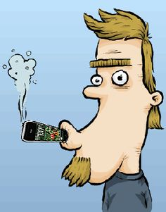
Pictures

Slide 13
Titles
What purpose do titles serve when placed alongside a passage?
Firstly, they provide readers with a brief preview or summary of the content within the passage, helping them to gauge what to expect and whether the material is relevant to their interests or needs.
Titles also act as a guide, offering context and direction for the passage, which aids in comprehension and navigation.
1. The Power of Mindfulness: Achieving Inner Peace
2. The Impact of Climate Change on Polar Bear Populations
3. Digital Revolution: How Technology Is Shaping Our Future"

Slide 14
Scanning and Skimming
What are scanning and skimming?
Skimming is the process of reading a text quickly without a clear intent to find particular information. Skimming is used for gaining a vague idea of the main concepts within a passage.
Scanning is defined as the process of quickly reading a text with a clear purpose to find particular keywords or important information.

Slide 15
Scanning and Skimming
How to do skimming?
1. Look quickly at the picture.
2. Read the title.
3. Read the first two lines of the first paragraph.
4. Read the first lines of all the paragraphs.
5. Read the first lines of the last paragraphs.

Slide 16
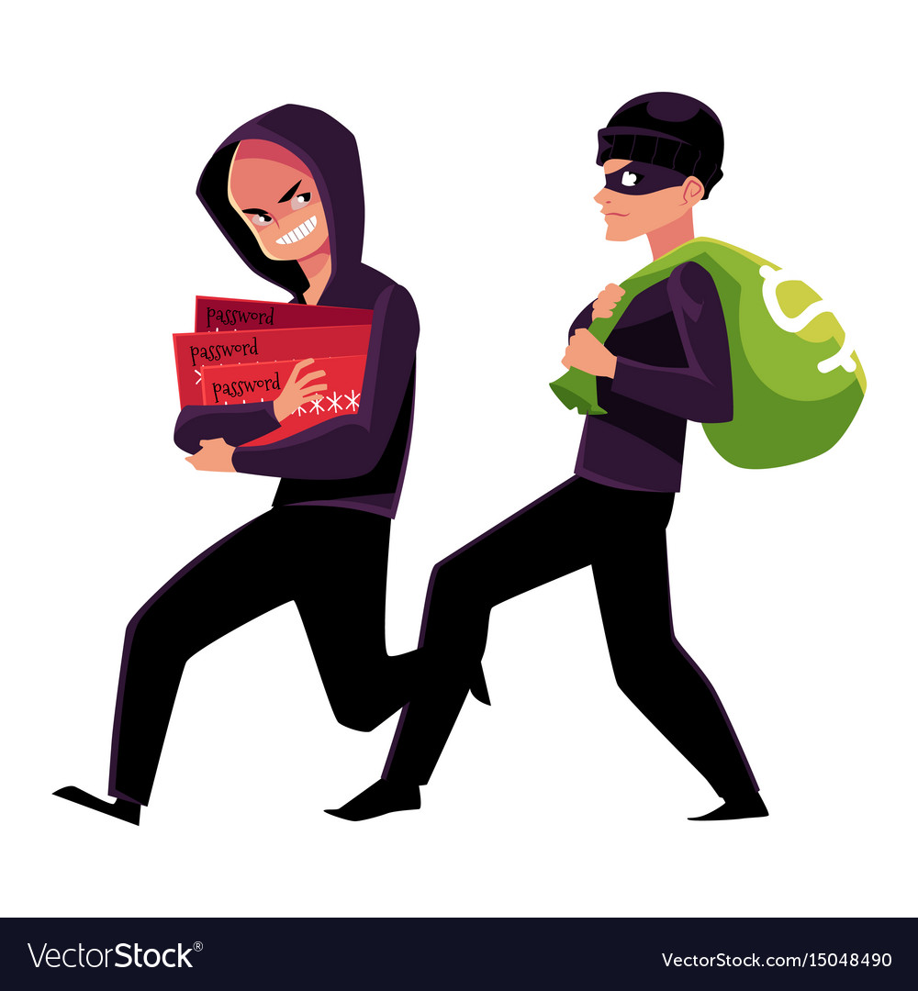
Scanning and Skimming

Slide 17
Scanning and Skimming
The same thief facing two families
Mike and Morris lived in the same village. While Morris owned the largest jewelry shop in the village, Mike was a poor farmer. Both had large families with many sons, daughters-in-law and grandchildren.
The thief stole everything they had and Morris and his family had to return to the village empty handed, having lost all their valuables that they had taken with them.

Slide 18
Scanning and Skimming
How to do Scanning?
1. You don’t read the whole passage.
2. Just read the questions and then look for the answers in the passage.
………………..

Slide 19
Scanning and Skimming
What do scientists tell about dolphin and language?

Slide 20
Scanning and Skimming
Dolphins are regarded as the friendliest creatures in the sea and stories of them helping drowning sailors have been common since Roman times. The more we learn about dolphins, the more we realize that their society is more complex than people previously imagined. They look after other dolphins when they are ill, care for pregnant mothers and protect the weakest in the community, as we do. Some scientists have suggested that dolphins have a language but it is much more probable that they communicate with each other without needing words. Could any of these mammals be more intelligent than man? Certainly the most common argument in favor of man's superiority over them that we can kill them more easily than they can kill us is the least satisfactory.

Slide 21
Summary
What is Summary?
Summarizing, or writing a summary, means giving a concise overview of a text’s main points in your own words. A summary is always much shorter than the original text.
1. Read the text.
2. Identify the key points in each section.
……………………………..
Writing a summary does not involve critiquing or evaluating the source. You should simply provide an accurate account of the most important information and ideas (without copying any text from the original).

Slide 22
Reading

Slide 23
Reading
The Shepherd and the Wild Sheep
…………..
Balancing Loyalty and Temptation
Recognizing True Priorities
A fake Friend
An Inexperienced Shepherd
……………………

Slide 24
Reading
Messages:
The narrative encourages us to prioritize existing relationships and responsibilities over fleeting allurements.
Certain individuals resist taming and prefer to remain free, cherishing their independence and autonomy.

Slide 25
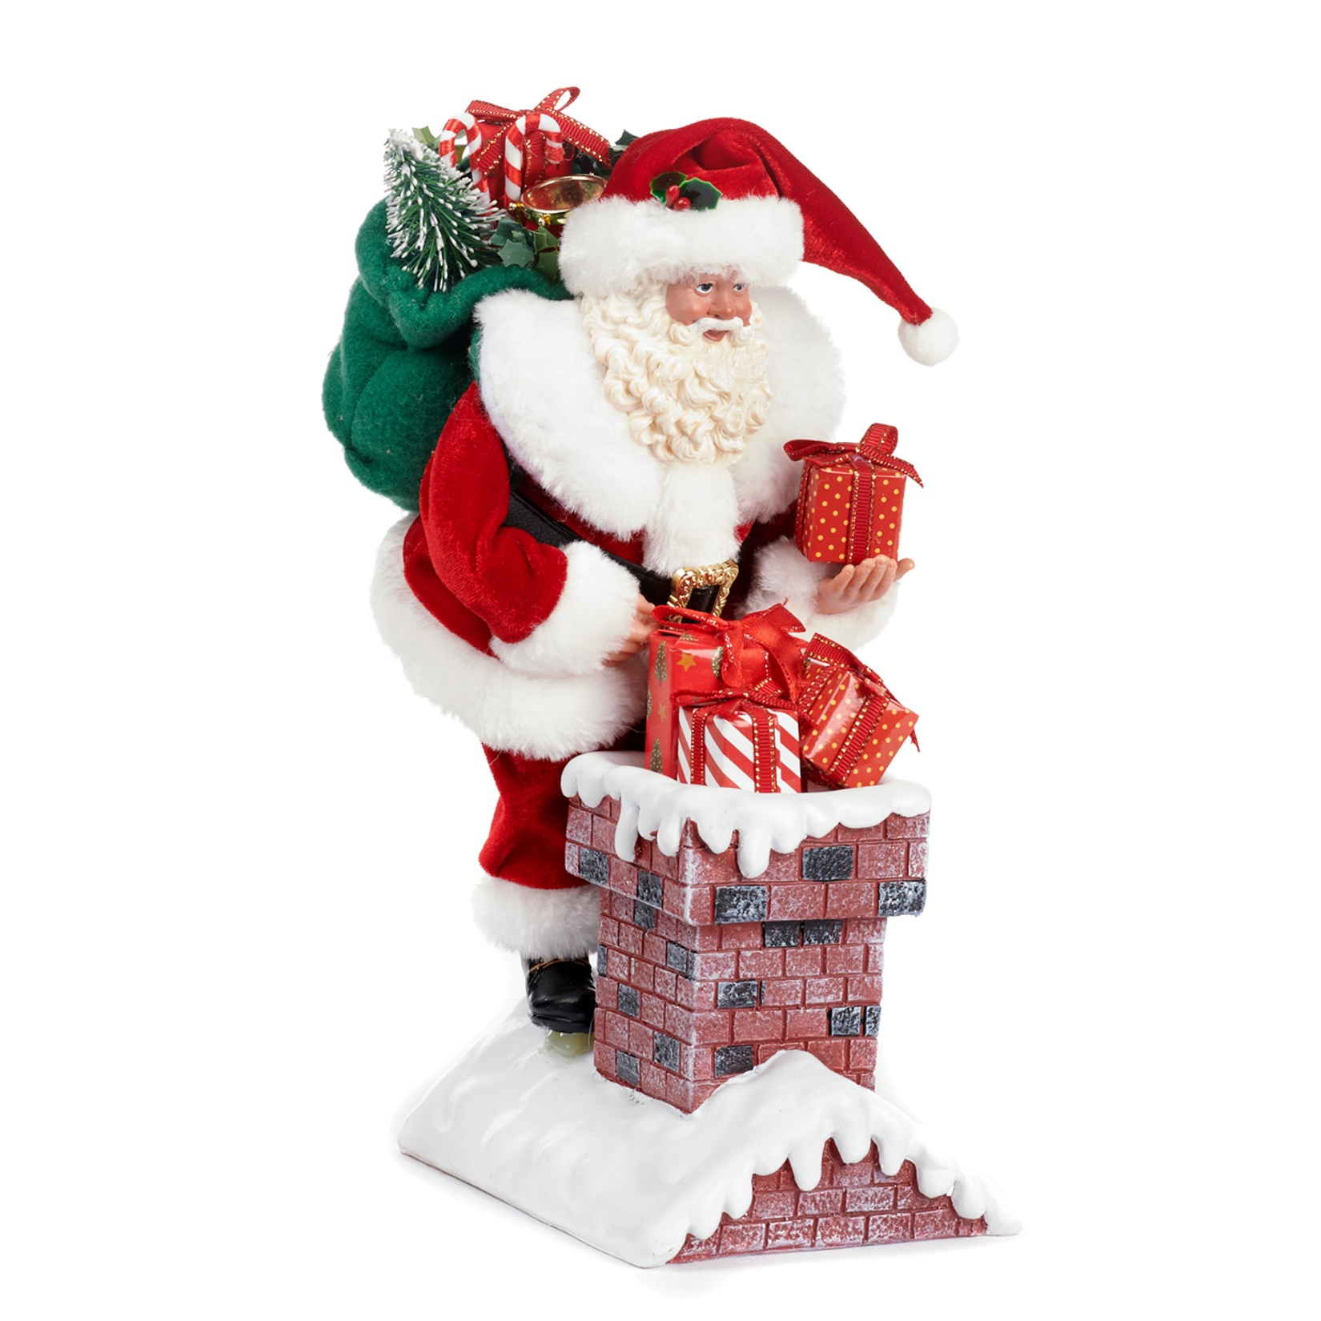
Reading

Slide 26
Reading
The Real Saint Nick

Slide 27
Reading
Titles:
The Secret Benefactor: Marcus' Miracle
Nick’s Act of Generosity: A Tale of Transformation
Saint Nick: A Story of Silent Charity
………………………………………..
Messages:
1. Acts of kindness, even when done in secret, can bring about unexpected blessings and transformations in people's lives.
2. The story of Saint Nick reminds us of the power of selfless generosity and how a single act of kindness can leave a lasting legacy of goodwill and happiness.
3. This passage also underscores the importance of secret charity.

Slide 28
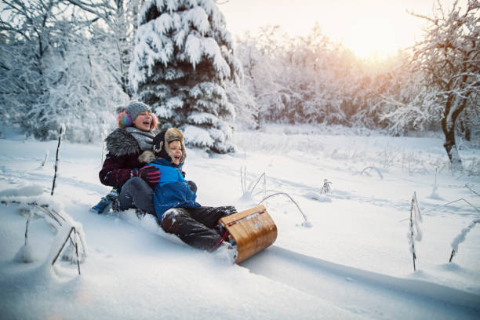
Reading

Slide 29
Reading
The boy and his Sled

Slide 30
Reading
Mike's Clever Plan: Turning a Bully into a Friend
A Sled of Friendship: Mike's Strategy to Stop the Teasing
From Bully to Buddy: How Mike Changed Joe's Ways
……………………………..

Slide 31
Reading
Messages:
Message of Friendship: This heartwarming story reminds us that even in difficult situations, kindness and creativity can transform bullies into friends.
Teaching Empathy: "Mike's Sled" illustrates the power of empathy and inventive problem-solving as a way to mend relationships and foster understanding.
Inspiration for Change: In a world filled with negativity, this tale of Mike's determination to change Joe's behavior serves as an inspiring example of how one person can make a difference through compassion and patience.

Slide 32
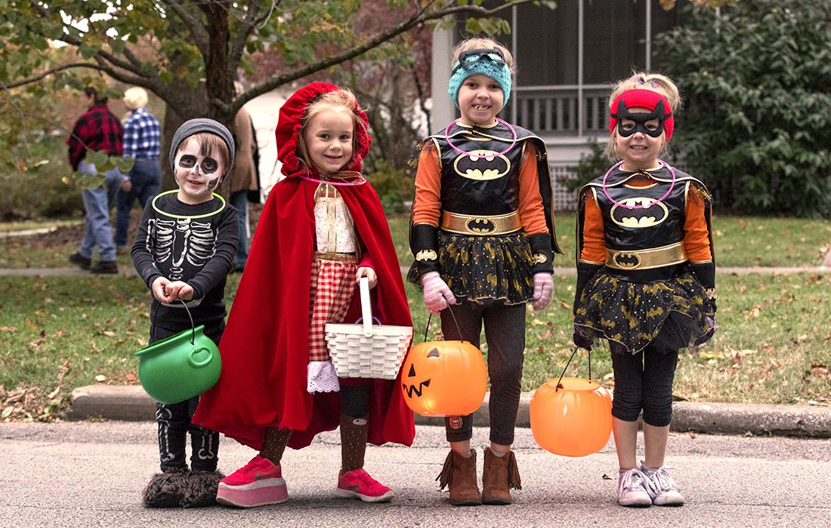
Reading

Slide 33
Reading
"From Ancestral Beliefs to Candy Galore: The Evolution of Trick-or-Treating"
""The Scary Origins and Sweet Traditions of Halloween Trick-or-Treating"
"Costumes, Candy, and Community: The Modern Celebration of Trick-or-Treat"

Slide 34
Reading
Cultural Evolution: This passage highlights the fascinating transformation of a tradition rooted in ancient beliefs into the modern, fun-filled Halloween custom we know today.
From Ancestors to Kids in Costume: Explore how the once serious practice of offering food to the dead evolved into the lighthearted and exciting activity of trick-or-treating, uniting communities in festive spirit.
The passage shows that in this world different cultures exist that may be unbelievable in your eyes.

Slide 35
Reading
1. The Unfortunate Encounter: Senator vs. Worm
2. A Bump on the Senator's Head: The Worm's Great Escape
3. Senator, Worm, and a Kitchen Drama
……………………….
1. The story demonstrates the consequences of making impulsive decisions without careful consideration. The senator's demand to kill the worm leads to an unexpected and painful outcome for him, while the worm manages to escape harm. This message may suggest that rash actions can often lead to unintended and unfavorable results, encouraging readers to think before they act.
2. The Value of Empathy: The story can be seen as a lesson in empathy. While the senator's initial reaction is to demand the worm's death, the cook questions the morality of such an action. This contrast highlights the importance of considering the well-being of all living creatures, no matter how small or seemingly insignificant, and how empathy can lead to better decisions.

Slide 36
Reading
Patsy Ann: The Deaf Dog Who Touched Hearts"
"Alaska's Beloved Greeter: The Tale of Patsy Ann"
"Patsy Ann's Legacy: The Dog Who Waited
………………………………………..
1. Loyalty Knows No Bounds: Patsy Ann's unwavering loyalty and determination to greet ships despite her disabilities serve as a powerful reminder that true loyalty transcends physical limitations. Her story inspires us to appreciate the loyalty of those around us, regardless of their differences.
2. The Power of Community: Patsy Ann's story reflects the strength of a community that rallied together to support a beloved four-legged friend. It demonstrates how collective efforts can lead to positive change and ensure that justice and compassion prevail, even for those without a voice.
3. A Timeless Tribute: Patsy Ann's enduring legacy is a testament to the impact that a single dog can have on a community. Her statue symbolizes the lasting impression she made as a loyal and cherished greeter, reminding us that acts of kindness and love can leave a lasting mark on our hearts and in our communities.

Slide 37
Reading
Outbreak, tribute, determination, anthem, thus.
During a big ….., our country had to act fast. People, determined to help, made ……. for everyone's well-being. A powerful ……. played, showing our unity and strength. ………, together, we faced challenges with resilience and ………….. The sacrifices we made became a tribute to our strong community spirit.
During a big outbreak, our country had to act fast. People, determined to help, made sacrifices for everyone's well-being. A powerful anthem played, showing our unity and strength. So, together, we faced challenges with resilience and determination. The sacrifices we made became a tribute to our strong community spirit.

Slide 38
Reading
Outbreak, tribute, determination, anthem, thus.
During a big ….., our country had to act fast. People, determined to help, made ……. for everyone's well-being. A powerful ……. played, showing our unity and strength. ………, together, we faced challenges with resilience and ………….. The sacrifices we made became a ………. to our strong community spirit.
During a big outbreak, our country had to act fast. People, determined to help, made sacrifices for everyone's well-being. A powerful anthem played, showing our unity and strength. So, together, we faced challenges with resilience and determination. The sacrifices we made became a tribute to our strong community spirit.

Slide 39
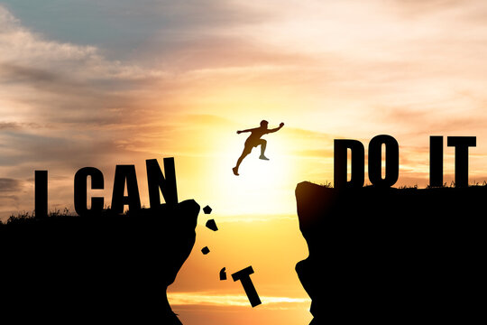
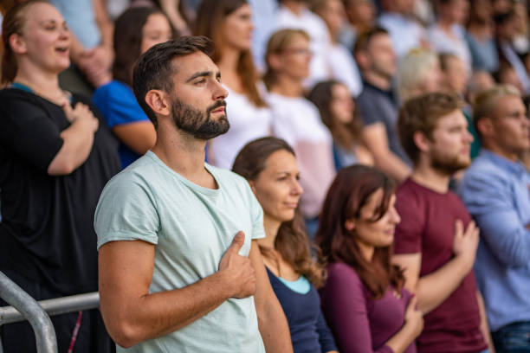
Reading
.

Slide 40
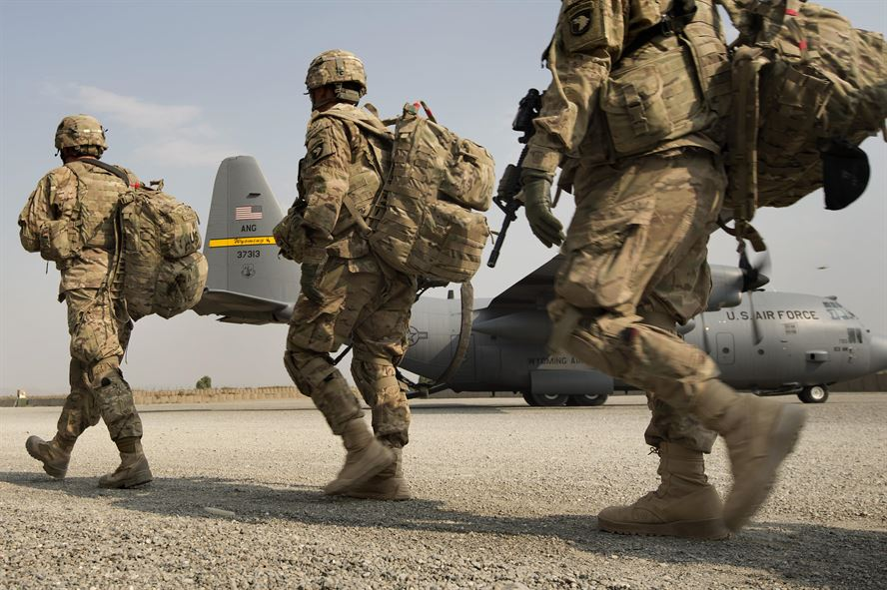
Reading
.

