Slide 1
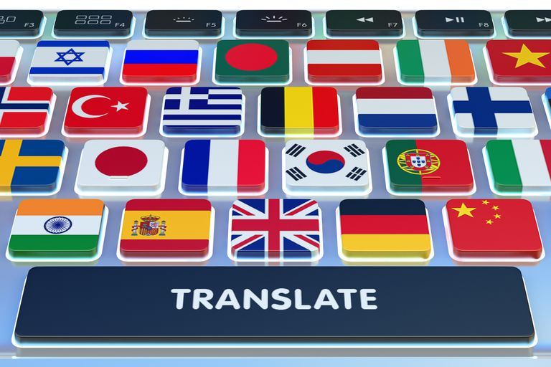
Translation
Can you translate “take” into Kurdish? -What about ‘get’? ………………………………………………
What is the most difficult questions you have ever faced as a student in English department?

Slide 2
Translation
Translation is the process of transferring meaning and form from one language, known as the source language (SL), into another language, known as the target language (TL). For example:
You are all smart. (SL)
(TL) ئێوە هەموو زیرەکن.
What is Interpreting?
Interpreting is the act of transferring the meaning of an oral message from one language into another.
What is translation?

Slide 3
Translation
What is the difference between translation and interpreting?
1. Translation needs patience and longer engagement, whereas interpreting needs swift and quick work.
2. In translation, a translator may use dictionaries, references and other translation aids, whereas an interpreter depend only on their fluency, experience, and confidence.

Slide 4
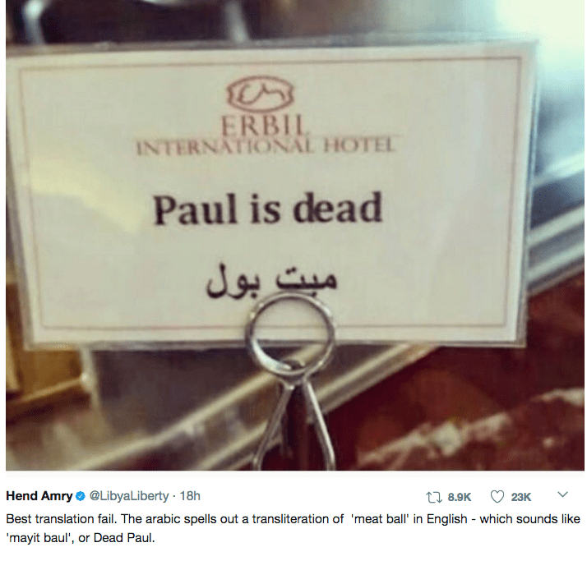
Translation
3. The interpreter may face different accents by non-native speakers or people from other regions, i.e. a Scottish person may speak in his local tongue. However, a translator may face long and convoluted paragraphs.

Slide 5
Translation
3. The interpreter may face different accents by non-native speakers or people from other regions, i.e. a Scottish person may speak in his local tongue. However, a translator may face long and convoluted paragraphs.
4. A translator must translate every single part of a text. However, an interpreter may not interpret every single word he hears. ……………………………………………………………………………………………………
What are the characteristics of good translators?
Passion.
A translator should be passionate about their translation job.
Translation Skills.
A good translator must have a specific linguistic education. They should master not only the foreign language they work with, but also the skills of translation.
Curiosity.
A translator must be curious and motivated to keep on learning new words and expression. The learning process of a translator should be never-ending.
Rich Vocabulary.
A good translator must have a wide lexicon.

Slide 6
Translation
Clarity.
Without ambiguity…
Translation Quality.
A good translator should be obsessed with quality.
Resources.
In order to achieve the aforementioned quality, a good translator should use all available resources at their disposal.
Honesty.
Translators are humans after all, therefore it is normal for them to not know some expressions or words. Nevertheless they shouldn’t just skip it, but they should conduct research and note it down for future reference.
Humble Pride.
A good translator should always deliver a translation that they can be proud of, but at the same time be humble enough to accept possible corrections from the editor/proof reader. The most important thing in the end is always the quality of the translation.

Slide 7
Translation
What are the characteristics of good interpreters?
An interpreter must have all the characteristics we have mention in translation. However, There are two other characteristics that should be found in any interpreters:
Public speaking skills
Excellent listening and memorization capacity
……………………………………………………………………………………………

Slide 8
Translation
What are the types of interpreting?
We have six major types of interpreting:
1. Consecutive Interpreting
2.Simultaneous Interpreting
3. Escort/Travel Interpreting
4. Whisper Interpreting
5. Scheduled Phone/Over-the-Phone Interpreting
6. On-Demand Phone Interpreting
………………………………………………………………………..

Slide 9
Types of Translation
Larson classifies translation into two Types:
1. Form-based translation
follow the form and structure of the SL
2. Meaning-based translation
to communicate the meaning of SL in the natural forms of TL.
.

Slide 10
Types of Translation
The prime minister yesterday visited Sweden with his brother.
سەرۆک وەزیران دوینێ سەردانی سویدی کرد لەگەڵ براکەی.
(Form-based translation)
دوێنێ بە یاوەری براکەی سەرۆک وەزیران سەردانی سویدی کرد.
(Meaning-based translation)

Slide 11
Types of Translation
Ahmad ibn Marwan Al-Kurdi, known as Nasr al-Dawla, the first son of Marwan, ascended the throne late in ١٩٩٩٩٩٩٩ in Miyafarqin.
ئەحمەد مەڕوان کوردی ناسراوە بە ناسر دەولە، یەکەم کوڕی مەروان، هاتە سەر تەخت لە ١٩٩٩٩٩٩٩ لە میافارقین.
ئەحمەد مەروان کوردی، کە کوڕی یەکەمی مەروانە و ناسراوە بە ناسر دەولە، لە میافارقین لە ساڵی ١٩٩٩٩٩٩٩ هاتە سەرتەخت/دەسەڵاتی گرتە دەست.

Slide 12
Types of Translation
………………………………………………………………………….
Newmark divides translation into two types:
1. Semantic translation:
This type of translation gives more priority to the meaning and form of the original text. (literature, religion, legal texts,)
2. Communication translation
It gives priority to the effectiveness of the message to be communicated. (advertisements, tourist brochures, manuals, etc.

Slide 13
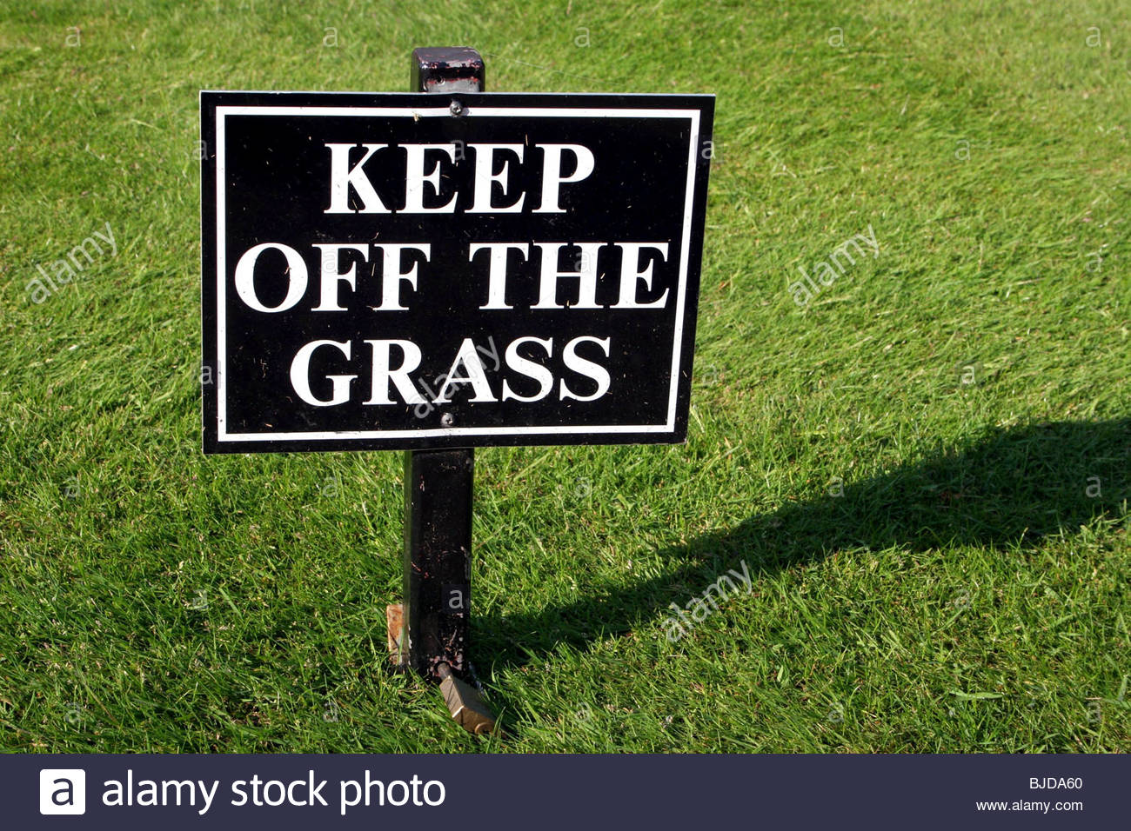
Types of Translation
Translate these signs according to both semantic and communicative translations:

Slide 14
Types of Translation
نا بۆ مەشروب
خواردنەوە ئەلکهۆلیەکان قەدەغەیە
...............................
نا بۆ چەک
بەکارهێنانی چەک قەدەغەیە
هێنانە ژوورەوەی چەک قەدەغەیە
.............................................
دوور کەوە لە گژوگیا
تکایە بەناو گژوگیا دا مەڕۆ

Slide 15
Types of Translation
Roman Jacobson classifies translation into three types:
INTERLINGUAL (or Translation proper) translation
Translating one text in SL into another text in TL
Example: They killed two students
ئەوان دوو قوتابیان کوشت
INTRALINGUAL (or rewording)
Interpreting the verbal signs in a certain language by another set of verbal signs of the same language.
Example: He needs to throw a lot of things. He has a lot of stuff to get rid of.

Slide 16
Types of Translation
Intersemiotic (transmutation) translation
An interpretation of verbal signs by means of signs on non-verbal sign system.

Slide 17
Types of Translation
Catford classifies translation in accordance with three factors: extent, level of language and rank
Translation according to extent:
Full translation: without leaving any part untranslated.
Jonh holds an M.A. degree in Physics.
جۆن هەڵگری بروانامەی ماستەرە لە فیزیا

Slide 18
Types of Translation
B) Partial translation: partially translated as some parts do not have an equivalent in TL.
My father always says that the night of al-Qadir is very important.
. باوکم هەموو کات دەڵی شەوی قەدر زۆر گرنگە
We make an attempt to apply the international ISO system at our university.
ئێمە هەوڵدەدەین سیستەمی ئایزۆ (ISO)ی نێودەوڵەتی لە زانکۆکەمان پەیڕەوبکەین

Slide 19
Types of Translation
Translation According to the notion of rank
Word-for- word translation:
(Translation of the individual words)
E.g., Clara spent all her life in a little village.
کلارا بەسەری برد هەموو ژیانی لە بچوک گوندێک
B) Literal Translation : translating all the words as they are within the framework of the TL grammar.
(identical words or phrases)

Slide 20
Types of Translation
Example:
Everyone has the right to life, liberty and the security of person.
هەموو کەسێک مافی ژیان و ئازادی و ئاسایشی .کەسی هەیە
..............................................................

Slide 21
Types of Translation
C. Free translation: reproducing the content without the form of the original.
Actions speak louder than words
کردار شەرتە
…………………………………………………………….
کردارەکان قسەدەکەن بەرزتر لە وشەکان
کردارەکان لە وشەکان بەرزتر قسە دەکەن
کردار شەرتە

Slide 22
Types of Translation
Jack defined the word "learning" to me: “learning is a process of gaining knowledge or skills. It can change our behavior.” However, he forgot the fact that learning is an ontological process.
.
.....................................................................
.

Slide 23
Types of Translation
جاک پێناسەی وشەی فێربونی بۆ کردم: فێربون پرۆسەی بەدەستهێنانی زانیاری و توانایە. فێربوون دەتوانێ رەفتارمان بگۆڕێ. بەڵام ئەو راستییەی لەبیر چوو کە فێربوون پرۆسەیەکی ئۆنتۆلۆژیە.
جاک پێناسەی وشەی "فێربوون"ی بۆ کردم بەوەی کە فێربوون بریتیە لە پرۆسەی بەدەستهێنانی توانا و زانست و زانیاریی. فێربوون لەتوانایدایە رەفترارمان بگۆرێ." وەلێ، جاک ئەو راستییەی بیر چوو کە فێربوون پرۆسەیەکی ئۆنتۆلۆژیە.

Slide 24
Types of Translation
We added the words “بریتیە و بەوەی ‘ in the text. These two words are function words and do not change the meaning of the text. Adding them is to make the text more Kurdish.
We have translated the word ‘knowledge’ as “ زانست و زانیاری” not “زانست’ or “زانیاری” alone as the translation would be incomplete.
In the English text, the word knowledge comes before skill. However, in the Kurdish text, the word skill comes first.

Slide 25
Types of Translation
3. However is translated as “وەلێ” because it is more academic and formal. بەڵام is correct but it is not so formal and academic.

Slide 26
Types of Translation
The organization acts as a main interface between officials and people.
ریکخراوەکە وەک پردی پەیوەندی نێوان بەرپرسان و خەڵکی کار دەکات.
The peshmargas were ready to fight to the bitter end.
پێشمەرگەکان ئامدەبوون تا دوا دڵۆپی خوێن بجەنگن.

Slide 27
Types of Translation
The two sides called a truce to avoid further bloodshed.
هەردوو لایەن ئاگربەستیان ڕاگەیاند تا لەوە زیاتر خوێن نەرژێ.
We need a very well-thought-out plan to be able to drive a wedge in our enemy’s unity and cohesiveness.
ئێمە پێوسیتمان بە پلانێکی پتەوە/تۆکمەیە تا دوبەرەکی/ درز بخەینە ناو یەکێتی و یەکگرتووی دوژمنەکانمانەوە.

Slide 28
Types of Translation
Gist translation:
Producing a summary of the source text by deleting unnecessary information. The deletion doesn’t affect the overall meaning.
Example: I want them to come into our country. I want them to come legally. I want them to come through a process. I want a process.
من دەمەوێ ئەوان بە پرۆسەیەک و رێگایەکی یاسایی بێنە وڵاتەکەمان.

Slide 29
Types of Translation
You know staying is terrible for our country. It is very bad for our country. We should withdraw our troops in middle east. It is good, you know, to pull out our troops.
وەک دەزانی مانەوەمان زۆر خراپە بۆ وڵاتەکەمان، وە پێویستە هیزەکانمان لە رۆژهەڵاتی ناوەڕاست. بکێشینەوە.

Slide 30
Types of Translation
Soon after the 1991 uprising, the Kurdish people evacuated the cities and crossed the borders of the neighboring countries in a mass exodus.
دەست بەجێ دوای راپەڕینەکەی ساڵی ١٩٩١، گەلی کورد شارەکانیان چۆڵ کرد و بە کۆڕەو سنوری ووڵاتانی دراوسیان بەزاند.

Slide 31
Types of Translation
A bomb-laden car struck a concrete barrier and exploded last month.
مانگی رابردوو، ئۆتۆمبێلێکی بۆمب رێژکراو خۆی کێشا بە بەربەستێکی کۆنکریتی و تەقییەوە.
.............................................................

Slide 32
Types of Translation
Angry over the U.S. withdrawal from northern Syria, residents of a Kurdish-dominated Syrian city threw potatoes at American military vehicles as they drove through on Monday.
Defense Secretary Mark Esper said U.S troops will stay in eastern Syria to protect Kurdish-held oil fields for at least the coming weeks and he was discussing options to keep them there.

Slide 33
Types of Translation
Angry over the U.S. Withdrawal from northern Syria, residents of a Kurdish-dominated Syrian city hurled potatoes at American military vehicles as they drove through on Monday.
بە هۆی توڕەبوونیان لە بڕیاری کشانەوەی هێزەکانی ئەمریکا لە باکوری سوریا، رۆژی دووشەممە، هاوڵاتیانی شارێک کە زۆرینەیان کوردن ئۆتۆمىێلە سەربازیەکانی ئەمریکایان لە کاتی تێپەڕبوونیان بەو شارە, پەتاتە باران کرد.

