Slide 1
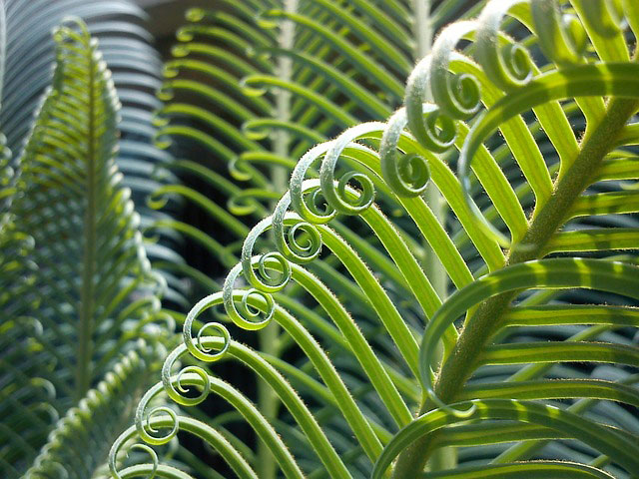
Salahaddin University College of Engineering Sciences Field crops department
Semester: Spring 2022 Class : 2nd Grade Lecture: 1
Plant Physiology
Asst. Lecture
M. Zhala M.Ameen

Slide 2
Outline…..
Definition of plant physiology.
Definition of Solution & some examples.
The components of solutions.
They are two types of solvents.
Importance of water in plant life.
What are the Solubility and Emulsions.
Classified the Solutions.
Difference between true solutions, colloids and suspensions.
Practical part.

Slide 3
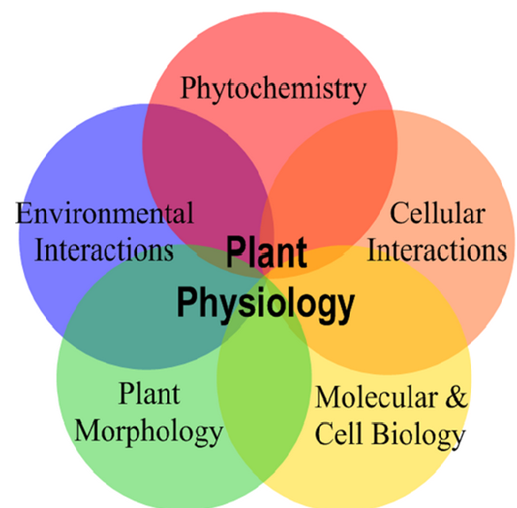
Definition of plant physiology
Is a study of the plant way of life, which include various aspects of the plant lifestyle and survival including (metabolism, water relations, mineral nutrition, development, movement, irritability, organization, growth and transport processes).
Plant physiology processes:-
1- Is a lab science.
2- Is an experimental science.
3- Relies heavily on chemistry and
physics.

Slide 4
Define the Solutions:
Are physical mixtures of two or more substances, the parts of which are not chemically combined and can be separated relatively easily.
Are formed when two or more substances are mixed on an atomic or molecular scale to form only, can be composed of (liquids, gases or solids).

Slide 5
Some examples about Solutions

Slide 6
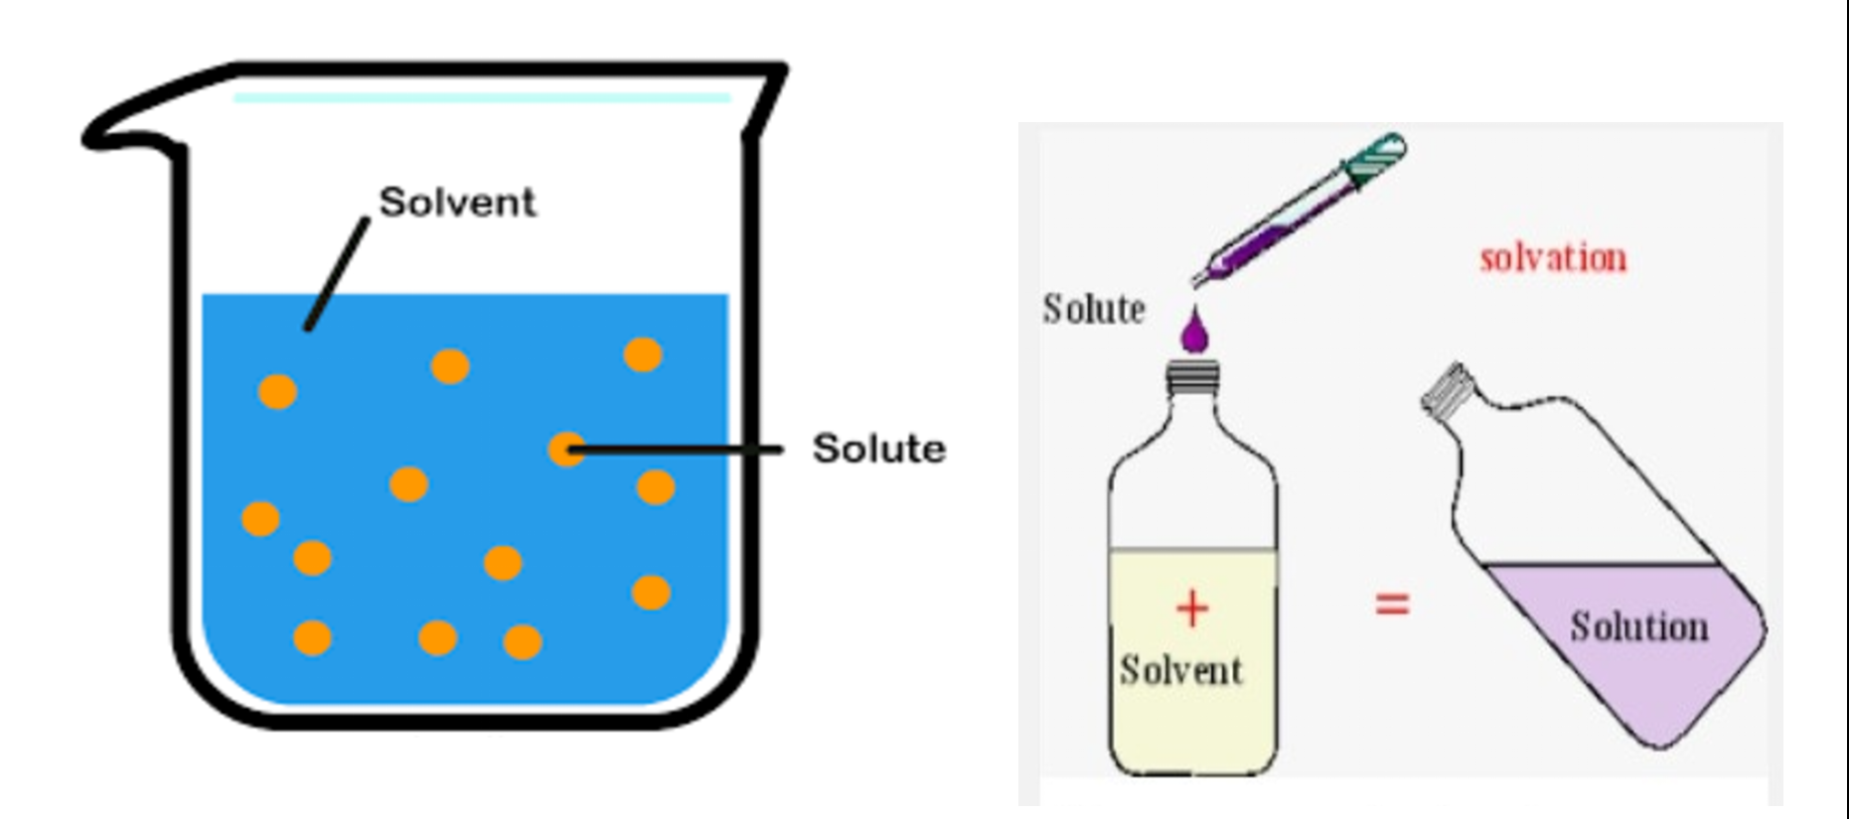
The components of solutions
Solutes: is the substance in the lesser quantity in the solution.
Solvents: is the substance in the greater quantity.
for example: in sea water there is a lot more water than salt, so the water is the solvent and the salt is the solute.

Slide 7
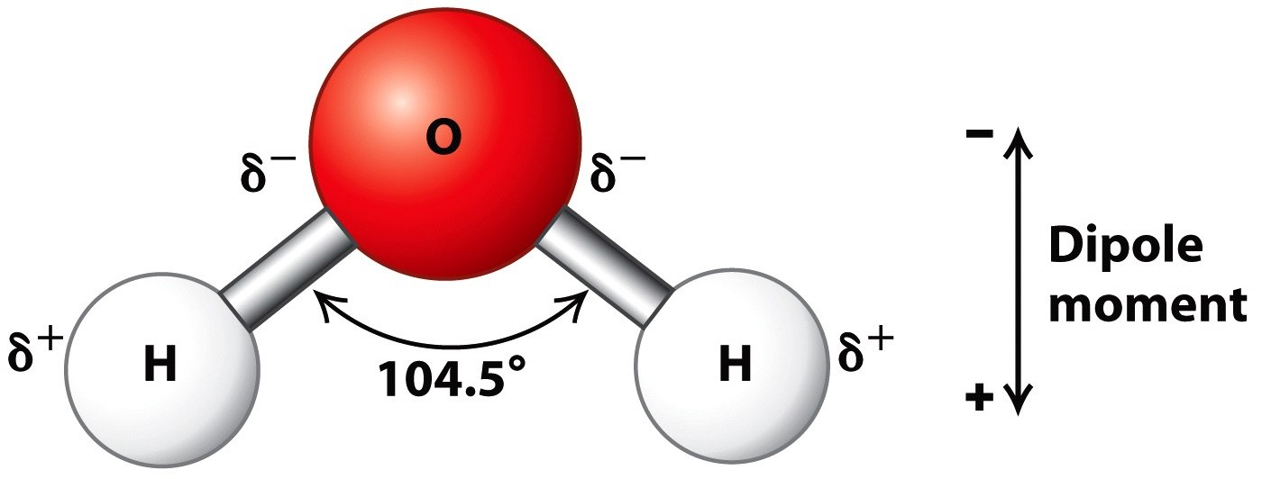
They are two types of solvents:-
Non –polar solvents. The most common non-polar solvents and solutes are the hydrocarbons.
Manly found in crude oils and tars, hydrocarbons like (Petrol and mineral turpentine, will dissolve oils, grease, wax, methane gas) and most organic molecules.
Polar solvents. Water is the
most common polar solvent
on Earth. It will dissolve (acid,
ionic salts, alcohol, ammonia,
sugars and even silicates from
rock if under high pressure and
temperature.

Slide 8
Importance of water in plant life.
Water consist the biggest part of protoplasm (80-90)%.
Water is sharing in biological process either directly or indirectly.
Water dissolves some gases like (O2 or CO2).
Water is the medium of translocation of dissolved minerals and organic nutritional materials.
Water is playing a role in keeping turgid pressure.

Slide 9
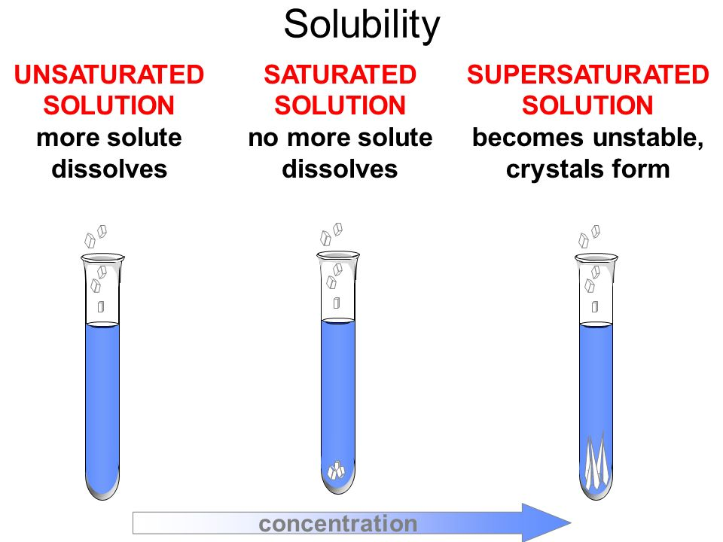
Solubility
Describes how much solute can be dissolved and held in each liter of solution.
Generally: Solid and liquid more soluble in hot solvent than cold. Gasses more soluble in cold solvent than hot.

Slide 10
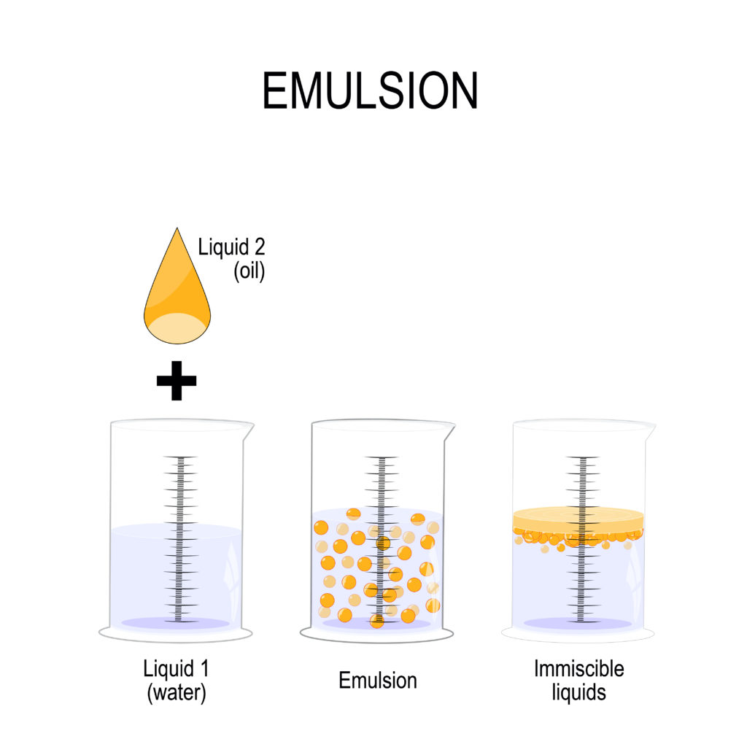
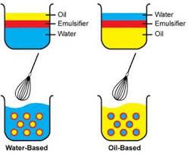
Emulsions.
Are immiscible (incapable of mixing) colloidal suspensions of one liquid in another liquid, will separate into their individual components if allowed to sit for long enough.
For example; face creams ,water and oil … etc
Emulsifying agents are to keep an emulsion stable or un separated, example (water and oil).

Slide 11
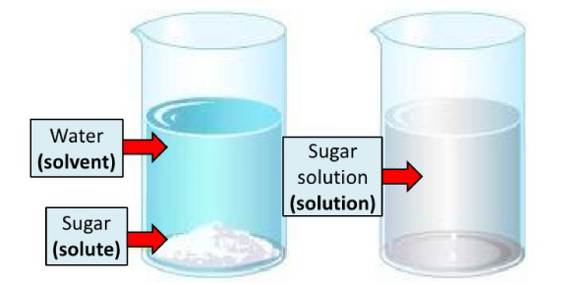
Solutions can be classified
True Solution. Is a homogeneous mixture of two or more substances in which substance solute in solvent has the particle size of less than (10-9)m or (nm), example (sugar in water).

Slide 12
2- Suspensions
Is a heterogeneous mixture in which particle size of one or more components is greater than (1000)nm, example (flue in water).

Slide 13
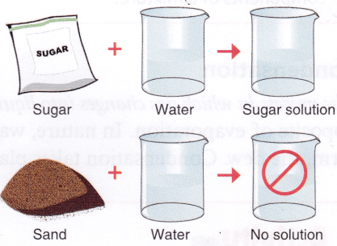
3- Colloidal Solution
Is a heterogeneous mixture in which particle size of substance is intermediate of true solution and suspension solution, between (1-1000)nm, example (sand in water).
Some important properties of colloidal solution:-
1- Adsorption & increased surface area.
2- Brownian Movement.
3- Filterability.
4- Tyndall Effect.

Slide 14
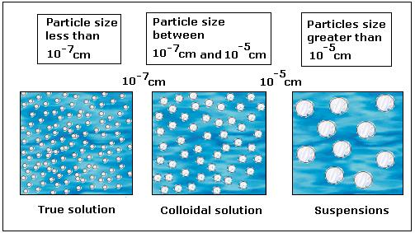
Comparative sizes of particles in solutions

Slide 15
Difference between true solutions, colloids and suspensions
Suspension | Colloidal Solutions | True Solution | Property
Greater than 1000nm | 1- 1000 nm | Less than 1 nm | Size of the particles
Heterogeneous | Heterogeneous | Homogeneous | Nature
Suspension particles do not pass through filter paper & par. paper. | Colloidal particles pass through filter paper but not through parchment p. | True particles diffuse rapidly through filter paper as well as parchment paper. | Filterability
Suspension part. Are big enough to be seen by naked eye. | Colloidal part. Are not seen to naked eye but can be studied through ultra microscope. | True part. Are not visible to naked eye. | Visibility
May or may not show Tyndall effect. | Show Tyndall effect. | Dose not show Tyndall effect. | Tyndall effect
Opaque | Translucent | Transparent | Appearance

