Slide 1
Salahaddin University College of Engineering Sciences Field crops department
Semester: Spring 2020 Class : 2nd Grade Lecture: 6
Semester: Spring 2020 Class : 2nd Grade Lecture: 1
Asst. Lecture
M. Zhala M.Ameen

Slide 2
Water potential (Ѱ): is a measure of the tendency of water to move into or within a system, the units is megapascals (Mpa) or bars. 1Mpa = 10 atmospheres of pressure
Ѱ = Ѱs + Ѱp + Ѱm
Where:
- Ѱ = is the water potential of a cell.
- Ѱs = is the osmotic potential.
+ Ѱp = is the pressure potential.
- Ѱm = is the matric potential.

Slide 3
Notes:
Plant cells usually have a negative water potential, unless they are in equilibrium with pure water = zero.
Cell with turgor pressure have a positive Ѱp.
Cells at incipient plasmolysis have a Ѱp = zero.
Water potential of tissues can be estimated rather simply by equilibrating preweighed samples of tissue in solution of known (Osmotic potential).

Slide 9
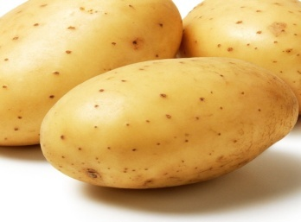
Materials
Potato (Solanum tuberosum).
Balances.
Boiling tube.

Slide 10
4- Distilled water.
5- Sucrose solutions (0.2 , 0.4 , 0.6 , 0.8 , 1.0 ) M.
6- measuring cylinder.
Notes:
,

Slide 11
Procedure
Cut 6 equal volumes of plant tissue (potato).
Dry the plant tissue with paper towel and measure the mass of each piece using an electronic balance.
Use a Measuring Cylinder to measure 10cm³ of 1.0M sugar solution and pour it into a Boiling Tube.

Slide 12
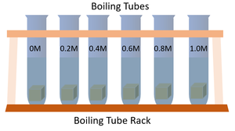
4- Place one piece of plant tissue into each of the 5 boiling tubes leaving them for 12-24 hours (ensuring it is the same time for all).
5- Remove the pieces of plant tissue, drying them with a paper towel and measure their mass.
6- Plot a graph showing the concentration of sugar solution on the x-axis and the change in mass of plant tissue on the y-axis.

