Slide 1
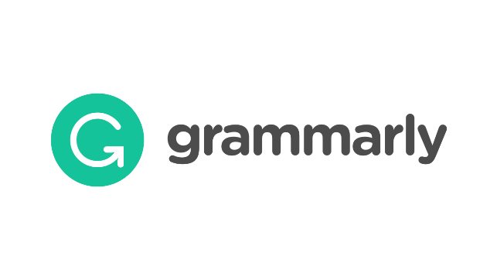
Benefits of Using Grammarly (Online Writing Assistant Software)
Asst.Lect.Zhala Abdulqader
MA in English Language and Linguistics

Slide 2
What is ‘Grammarly’?
Grammarly is a writing assistant that job seekers, writers, and other professionals can use to proofread and edit their documents.
It checks for spelling, grammar, and punctuation errors, and it enhances vocabulary usage.
Grammarly was launched in 2009 by Alex Shevchenko, Max Lytvyn, and Dmytro Lider.

Slide 3
Create an account (Free Grammarly)
For more features upgrade to Premium.
Grammarly for Education. (used by universities)
Universities buy Grammarly yearly for students and lecturers.
Students check their essays , reports and researches there.
Students enhance their writing skill.
Grammarly for Business.

Slide 4
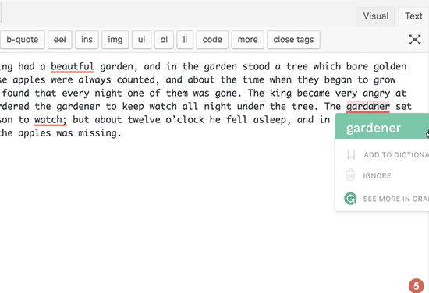
1-Grammarly Highlights Your Mistakes and Shows you How to Correct Them

Slide 5
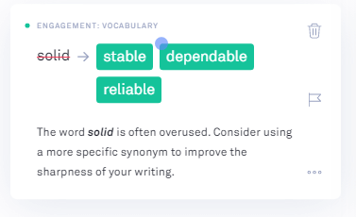
2. Grammarly Helps You Improve Your Vocabulary
My student wrote:
Which is very boring and solid lifestyle.
Here are some problems that were detected:
It is a fragment.
overuse of boring (with the great suggestion of dull)
overuse of solid (with three suggestions)

Slide 6
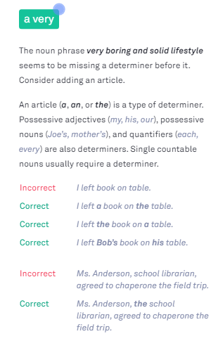
3. Grammarly Gives You Mini Grammar Lessons

Slide 7
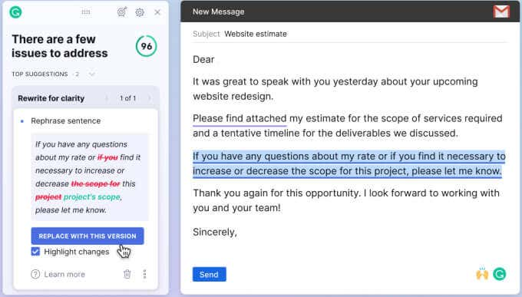
4-Grammarly can Rephrase: This feature is used by researchers.

Slide 8
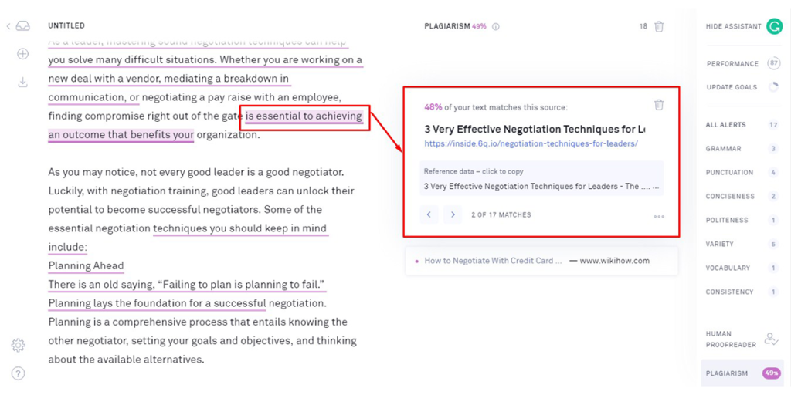
5. A handy plagiarism checker can help writers identify any inadvertently borrowed content.

Slide 9
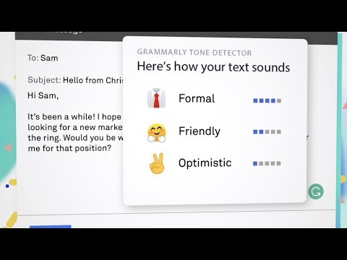
6-Tone Detector
It analyzes the words you write and determines your tone and will warn you when your tone is too informal for the situation or it could be interpreted differently than intended.

Slide 10
How to Create and Account?

Slide 11
Refrences
https://www.thebalancemoney.com/grammarly-proofreading-and-grammar-checker-review-2062231
https://www.apoven.com/grammarly-benefits/#grammar.
https://n10.in/8-benefits-of-using-grammarly-online-writing-assistant-software/
https://www.grammarly.com/edu

